Slide 1




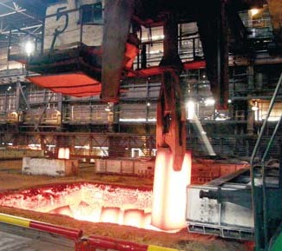

ERASMUS+
Modelling CybPhys
609557
Kryvyi Rih National University
Courses development progress (12/04/21)

Slide 2
151 – «Сyber-Physical Systems in industry, business and transport» - key milestones
Obligations of the Kryvyi Rih National University are to open (Sept 2021) and accredit by National Agency for Quality Assurance in Higher Education (Nov 2022) a new educational and professional program 151 – «Сyber-Physical Systems in industry, business and transport» (Master degree)
What we have already done
The new educational program is included in the Unified State Database on Education
The final curriculum is developed and approved by KNU management
A special document – the educational and professional program that describes the features and the competence of graduates of 151, is developed and approved by KNU management
Exam tickets have been developed for entering a new specialty

Slide 3
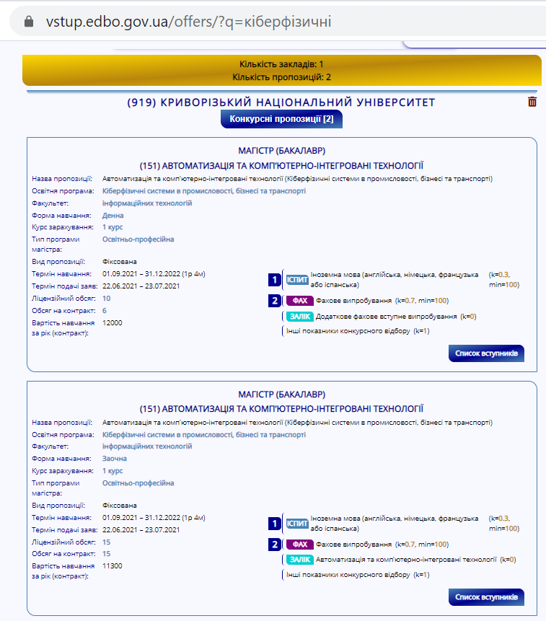
151 – «Сyber-Physical Systems in industry, business and transport»

Slide 4
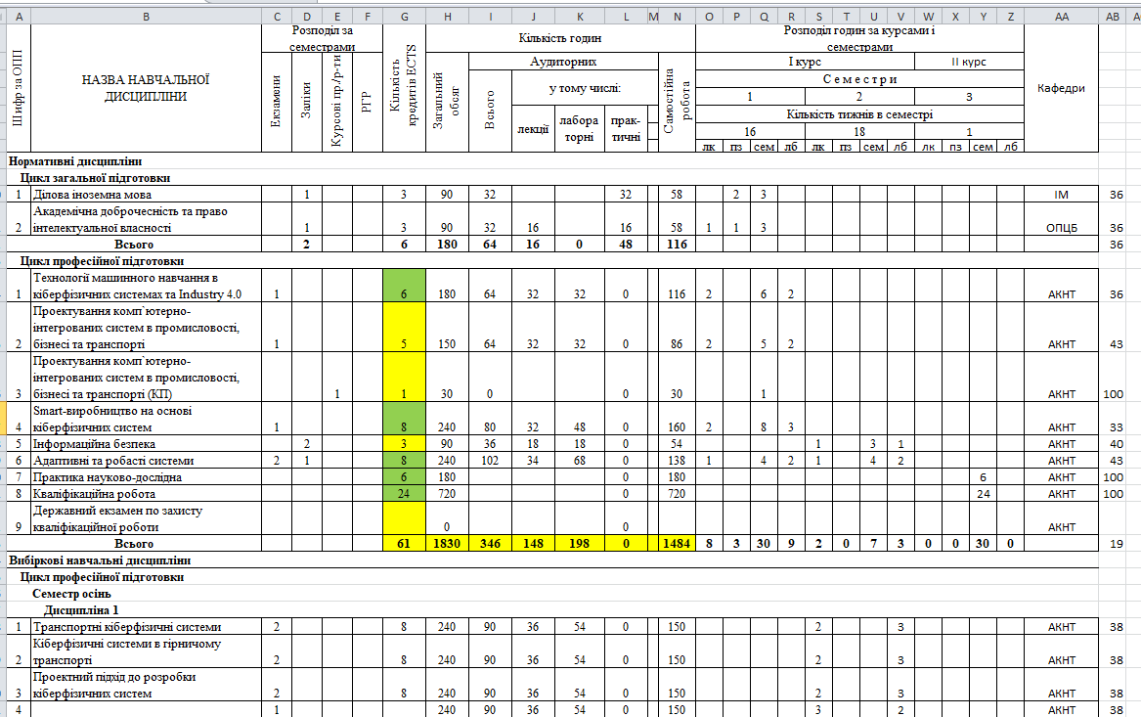
151 – «Сyber-Physical Systems in industry, business and transport»

Slide 5
Curriculum development aspects
Kriviy Rih National University declared development and implementation of 7 courses (3 new/4 updated). These courses will be included in 2 curricula – 151-Cyber-physical systems (Master Program) and 275 – Transportation technologies (Bachelor Program)
№ | COURSES | THE NAMES OF RESPONSIBLE
New courses
1. | Smart manufacturing based on cyber-physical systems | Sergii Ruban PhD, Associate prof. of the Automation, Computer Science and Technology Department
2. | Machine Learning for Cyber Physical Systems and Industry 4.0 | Vitaliy Tron PhD, Associate prof. of the Automation, Computer Science and Technology Department
3. | Transportation Cyber-Physical Systems | Volodymyr Sistuk PhD, Dean of Transport Faculty, Associate prof. of the Dep. of Automobile Transport
Updated courses
1. | Open Pit Intelligent Transportation System | Mykola Stupnik Rector of KNU, Professor, Doctor of Engineering Science Yurii Monastyrskyi Professor, Doctor of Engineering Science, Head of the Department of Automobile Transport
2. | Modern Information Technologies in Transport | Volodymyr Sistuk PhD, Dean of Transport Faculty, Associate prof. of the Dep. of Automobile Transport
3. | Adaptive and Robust Systems | Natalia Morkun Professor, Doctor of Sciences (Engineering), Head of the Automation, Computer Science and Technology Department
4. | Project Approach to the Designing of Cyber-Physical Systems | Iryna Zavsiehdashnia PhD, Associate prof. of the Automation, Computer Science and Technology Department

Slide 6
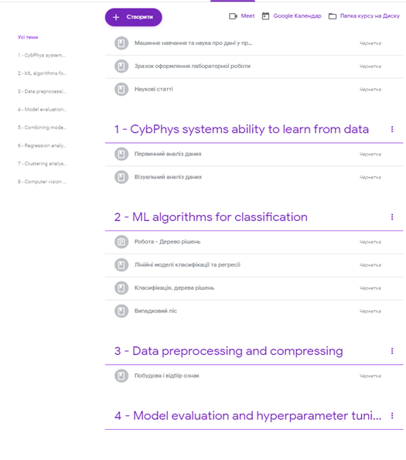
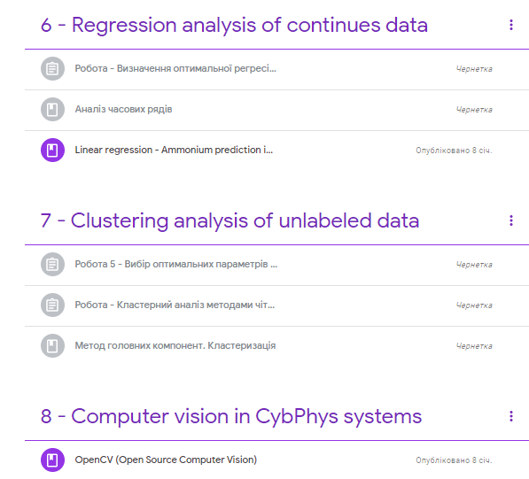
In KNU we use Google Classroom platform for studying processes
Machine Learning for Cyber Physical Systems and Industry 4.0

Slide 7
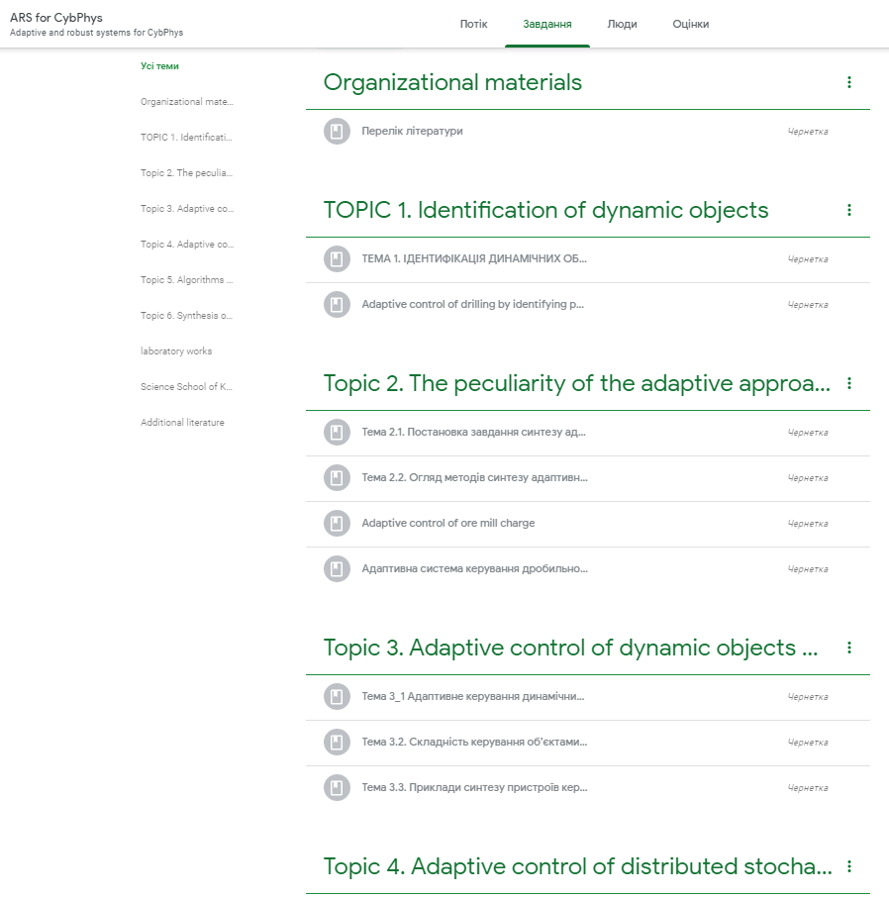
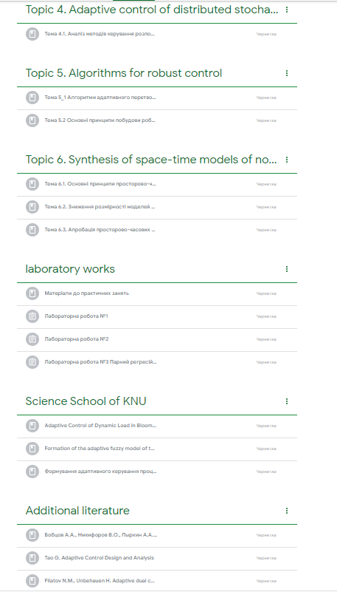
Adaptive and robust systems for CybPhys

Slide 8
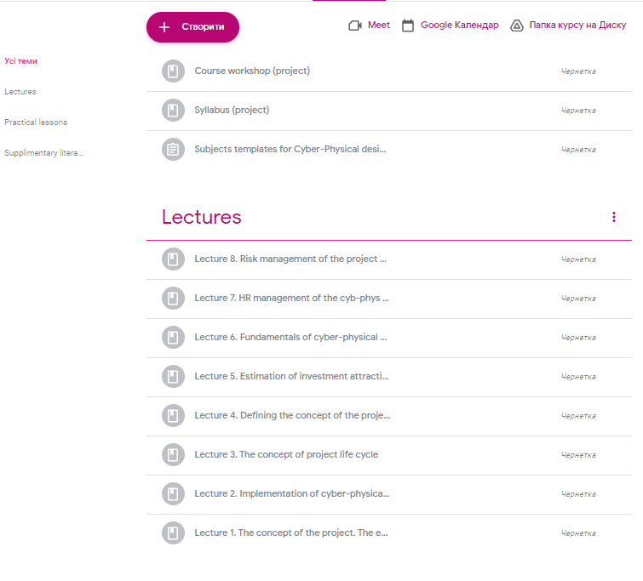
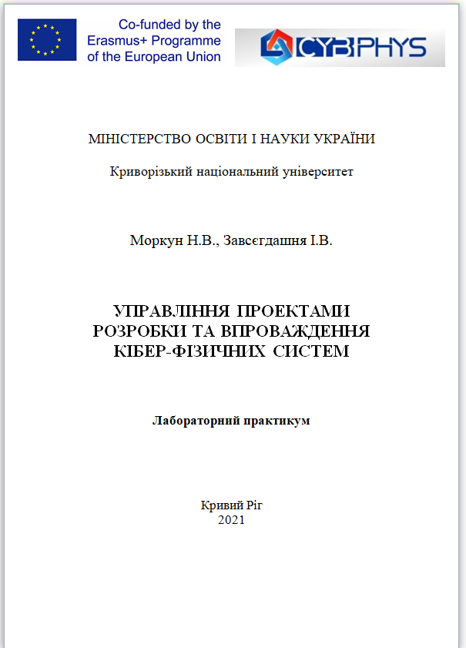
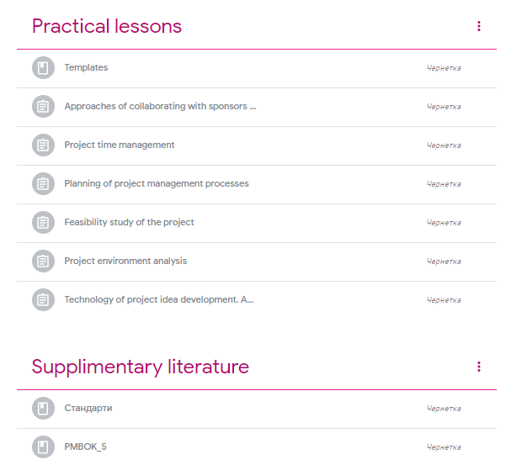
Project Approach to the Designing of Cyber-Physical Systems

Slide 9
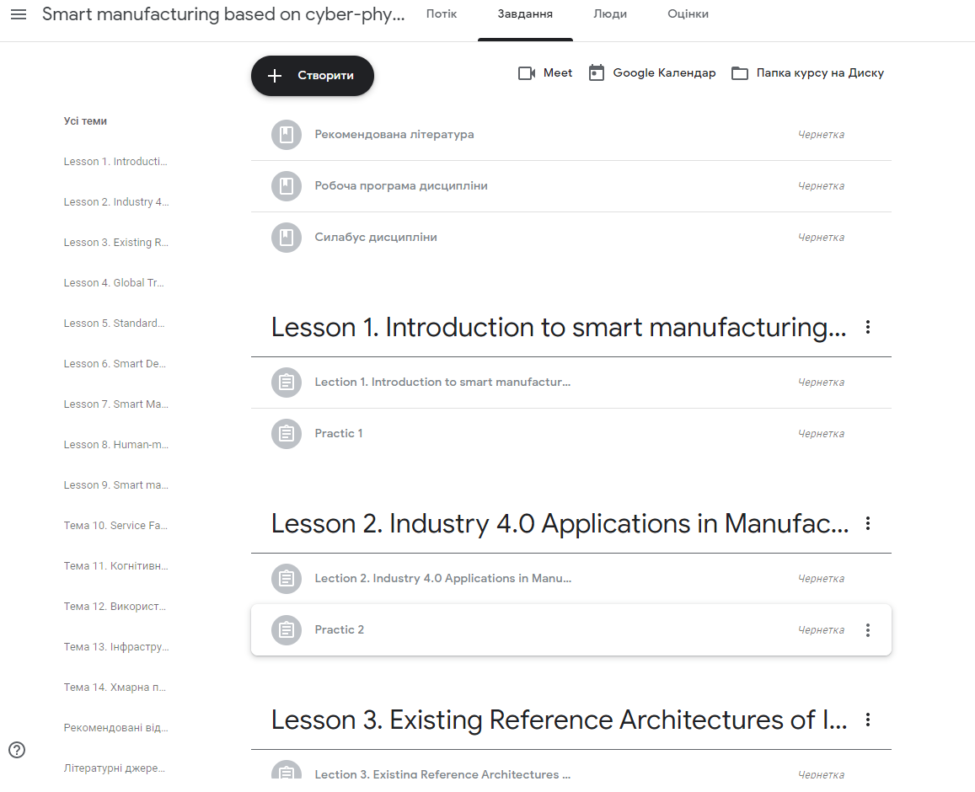

Slide 10
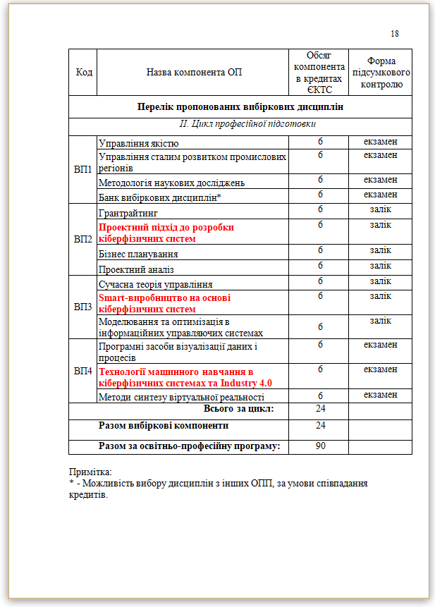
It was decided to include a number of disciplines, such as:
Smart manufacturing based on cyber-physical systems
Machine Learning for Cyber Physical Systems and Industry 4.0
Project Approach to the Designing of Cyber-Physical Systems
in the curriculum of the specialty
122-Computer Science (Master's level)

Slide 11

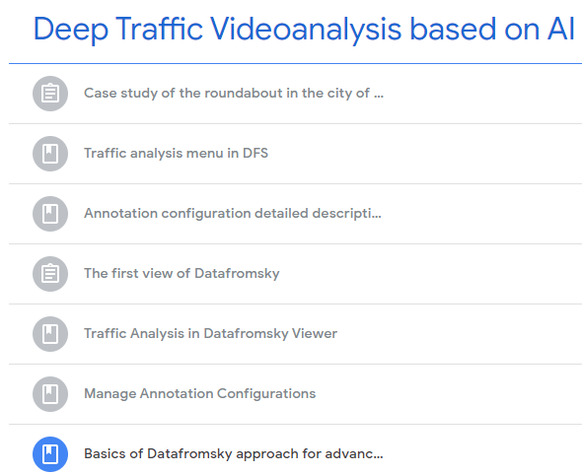
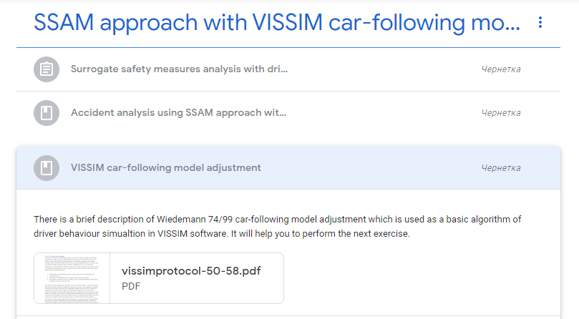
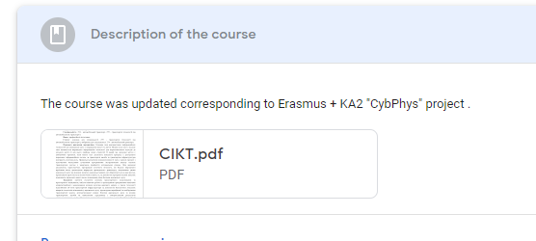

Slide 12
Course: Modern Information Technologies in Transport (MITT)
Course: Open Pit Transport Cyber-Physical Systems (OPT CPS)
Finished tasks
1. Workpackage development
Curriculums, Syllabi, Work Programs are in use
E-books chapters were prepared
Cyber-Physical Systems for Clean Transportation.
Сhapter 10. Road Traffic Cyber-Physical Systems Microsimulation (In Ukrainian and English)
Cyber-Physical Systems Modelling and Simulation.
Chapter 5: Transportation Systems (simulation,
modelling, traffic video analysis) (in English)
Сurrent tasks
2. Student training have been conducting on MITT
3. The method of road traffic survey was successfully tested
4. Learning materials for OPT CPS are tested
Future tasks
5. Instructional guidelines for labs will be developed with cooperation with key stakeholders

Slide 13
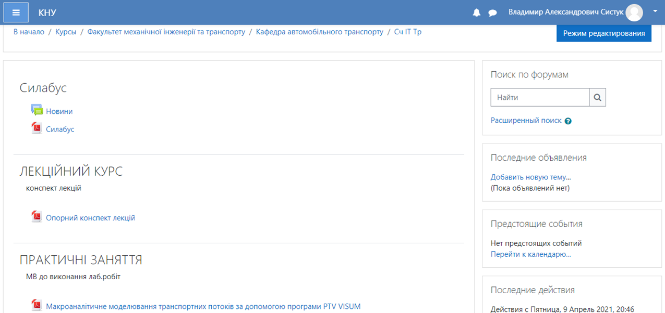
Curriculum, Syllabus, Work Program are available on Automobile Department web-site:
https://at.knu.edu.ua/
and KNU moodle platform:
http://mlib.knu.edu.ua/course/index.php?categoryid=87&browse=courses&perpage=20&page=1

Slide 14
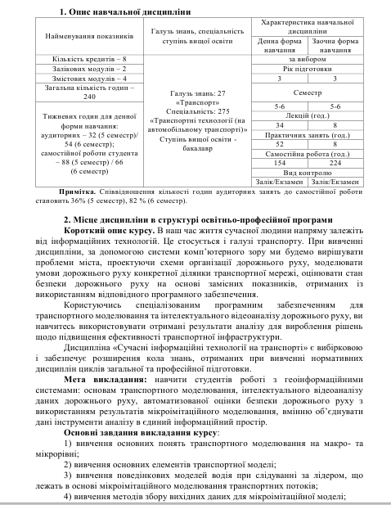
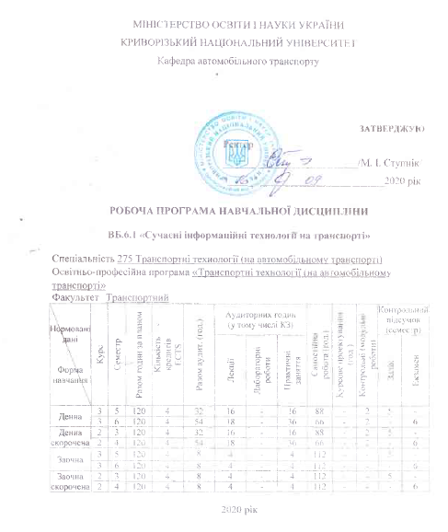
Fragments of syllabus and work program of MITT course

Slide 15
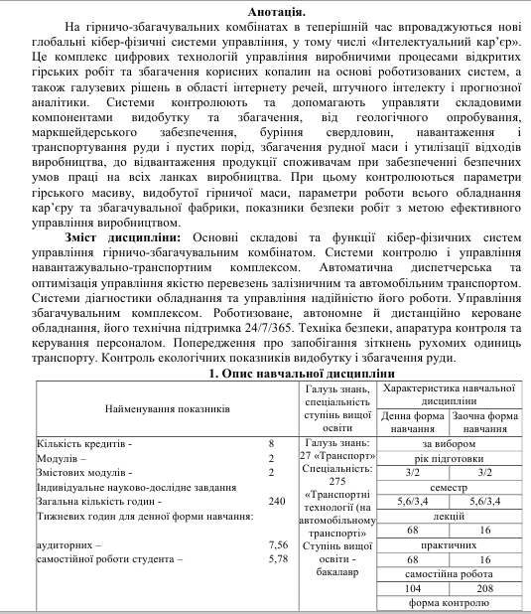
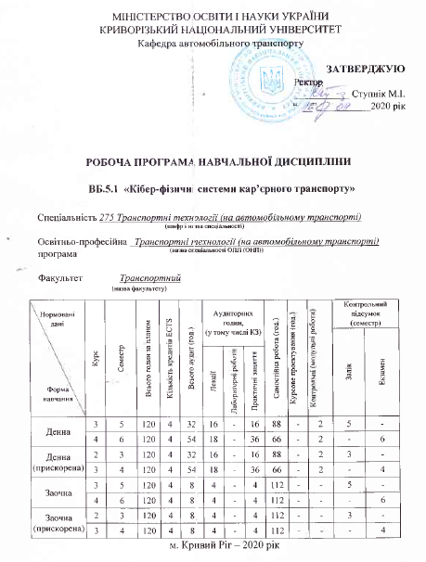
Fragments of syllabus and work program of OPT CPS course

Slide 16

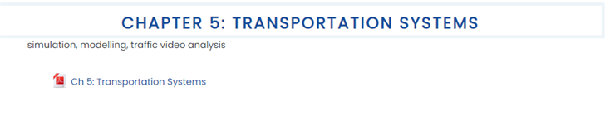

E-books chapters are uploaded to BSU platform
https://eduphys.bsu.by/course/view.php?id=104
Student training on MITT in Google Classroom

Slide 17
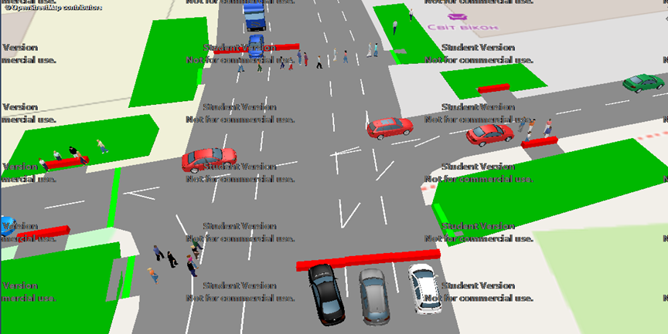
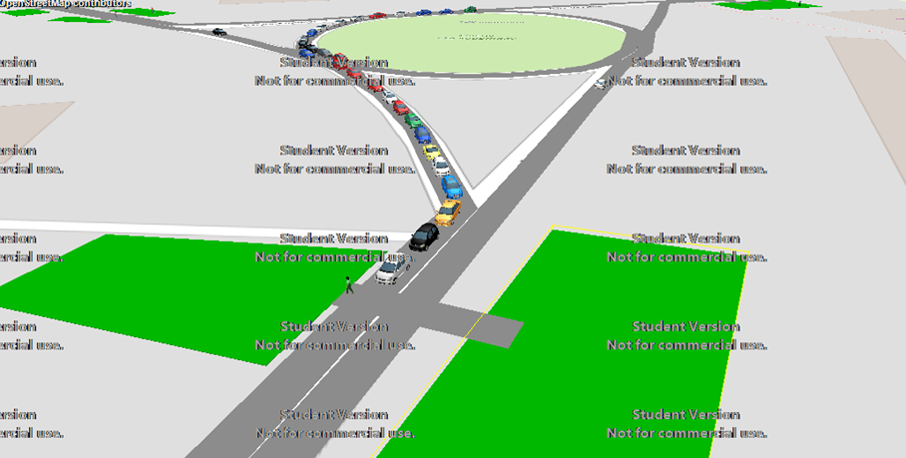

Equipment purchased with the help of the CypPhys Project is used in case study workshops (MITT course)
Developed methodology of traffic survey is tested *in filed conditions (in student practices), *in a class-room environment (remotely). Field studies are carried out via drone DJI Mavic Air 2 using. Labs are conducted using DataFromSky intelligent analysis (AI) of obtained road traffic video footages and VISSIM microsimulation software to further decision-making.

Slide 18
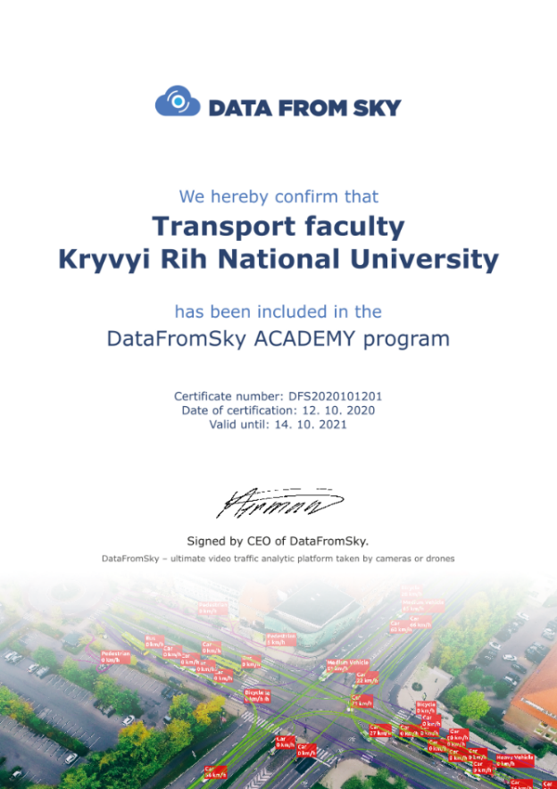
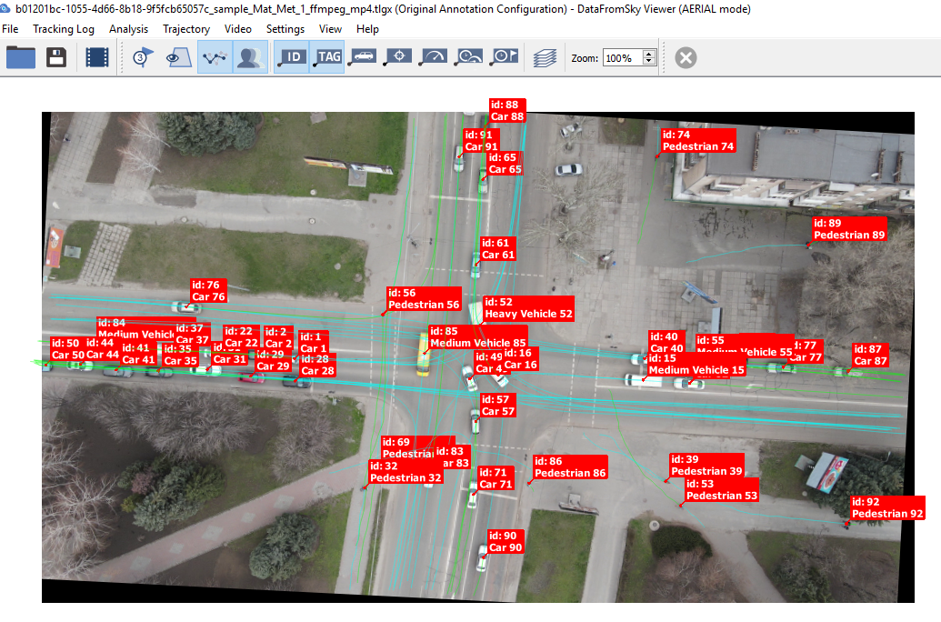
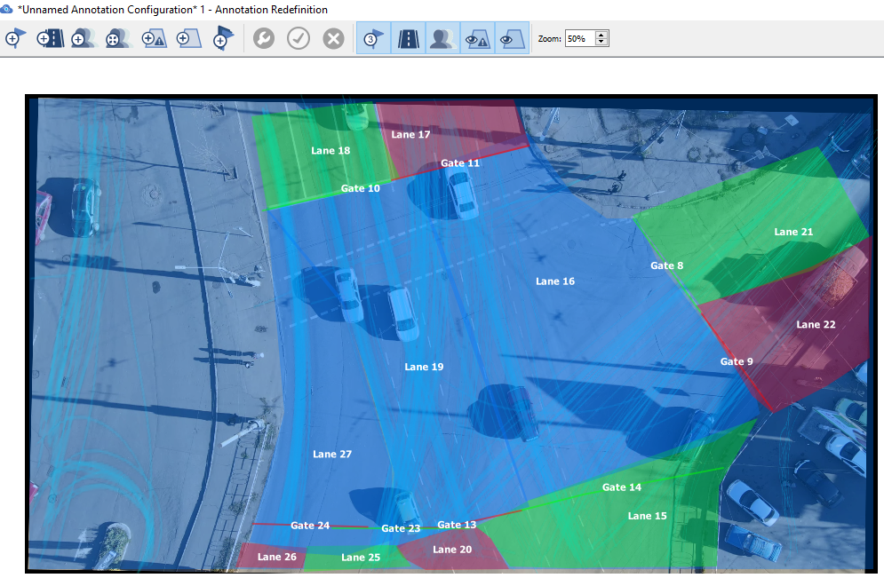
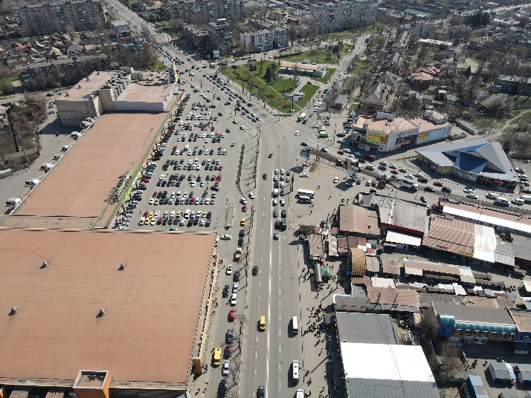

Slide 19





Learning materials development for OPT CPS course
Implementation phases of digital manufacturing
I Phase – Robotic Open Pit Trucks
Autonomous open pit trucks technology field test operations at CGOK enterprise in Kryvyi Rih
II Phase – Control Systems
Load and fuel consumption control system, single central control facility
III Phase – Control and Safety
ACS “Open Pit”, VG Drill, VG Scarex, diagnostics systems, dispatching control, road conditions monitoring
IV Phase – Robots and Analytics
Autonomous and remotely controlled mining transport complex, single central control facility

Slide 20
Publications
KNU project team participates in development of 3 E-books (6 chapters):
6. Cyber-Physical Systems modelling and simulation
6.2. Big Data and the need for Data Processing (Natalia Morkun)
6.5. Transportation Systems (including e-vehicles, simulation, modelling, traffic video analysis, impact on the grid) (Volodymyr Sistuk)
7. Cyber-Physical Systems for Clean Transportation
7.6. Specifics of applying the project approach to the development of Cyber Physical Systems for Clean Transportation
(Natalia Morkun, Iryna Zavsiehdashnia)
7.7. Intelligent information technologies and systems in transport (S. Ruban, V. Tron)
7.10. Road Traffic Cyber-Physical Systems Microsimulation (Volodymyr Sistuk, Yurii Monastyrskyi)
Bringing innovations to the market
Startup presentation. Pitch deck (Natalia Morkun, Iryna Zavsiehdashnia)
All E-books chapters are translated into English

Slide 21
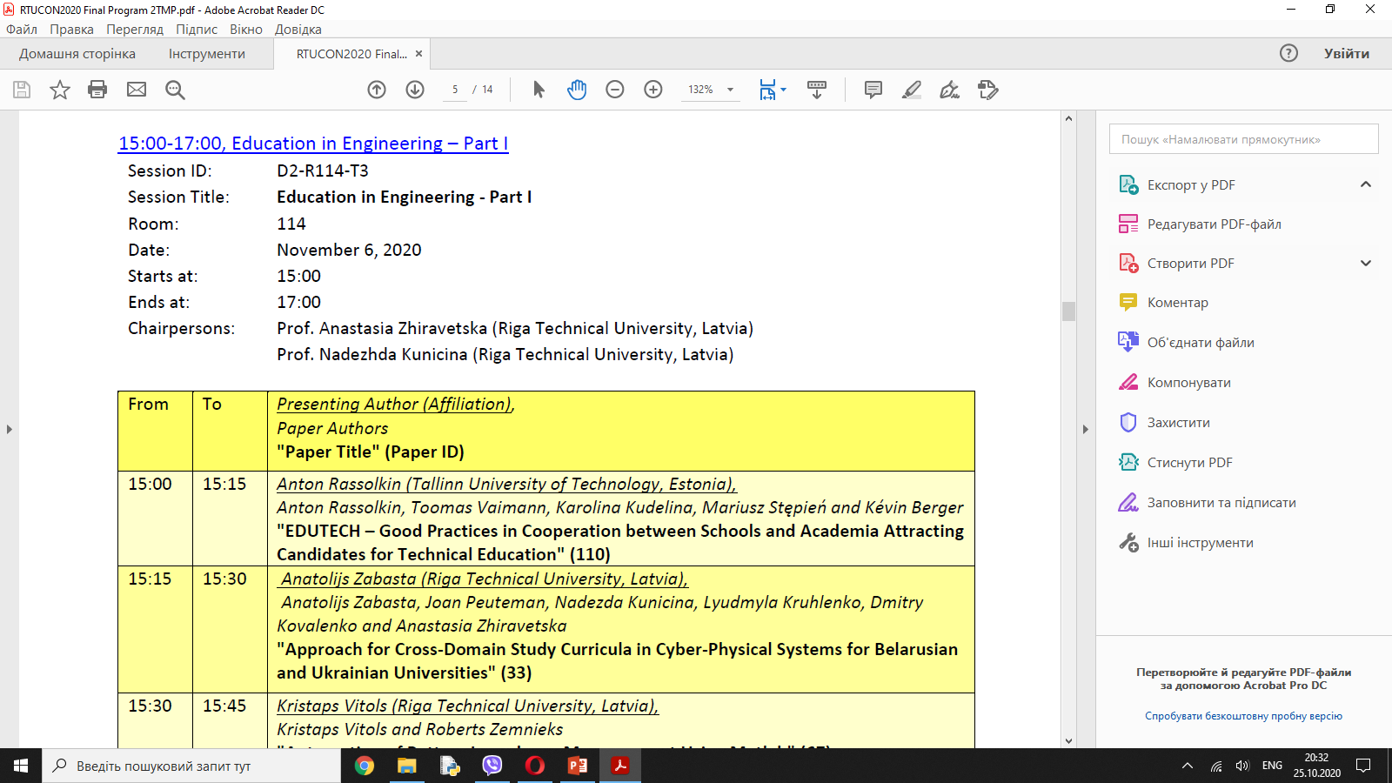
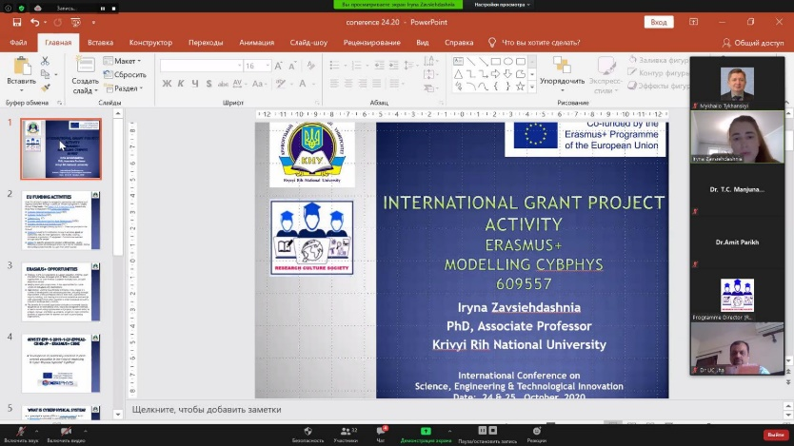
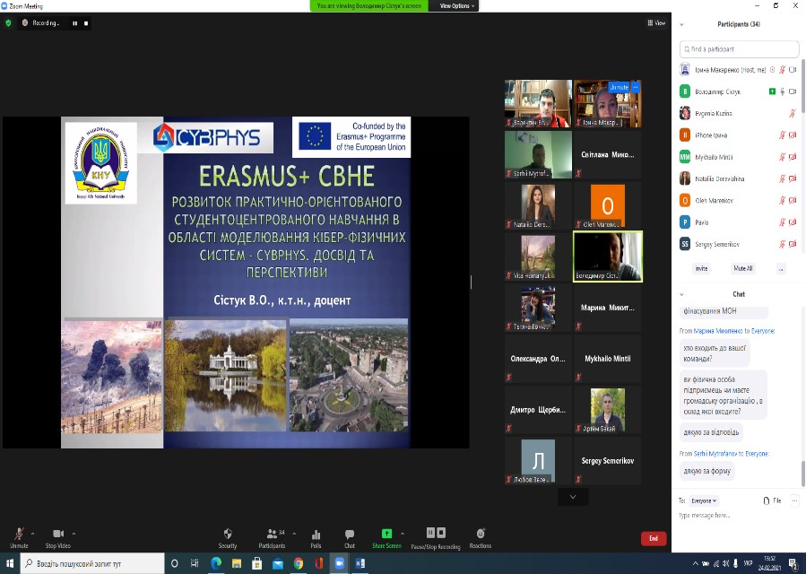
Dissemination
Together with European and Belorussian partners the scientific paper “Approach for Cross-Domain Study Curricula in Cyber-Physical Systems for Belarusian and Ukrainian Universities” was published in the frame of RTUCON2020 international conference.
International Conference on Science, Engineering & Technological Innovation ( 24 - 25 October, 2020 )
Jointly organized by Research Culture Society (India) and Kryvyi Rih National University - Automation, Computer Science and Technology Department (Ukraine)
Participation in regional scientific and practical seminar of young scientists and graduate students «International and state grants and research projects from idea to implementation: practice, experience, prospects» with a report on the СybPhys project.

Slide 22
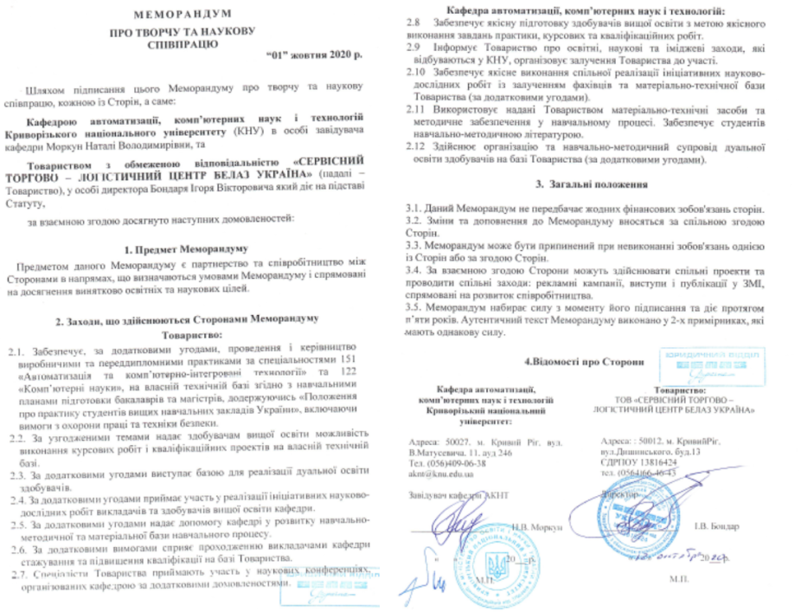
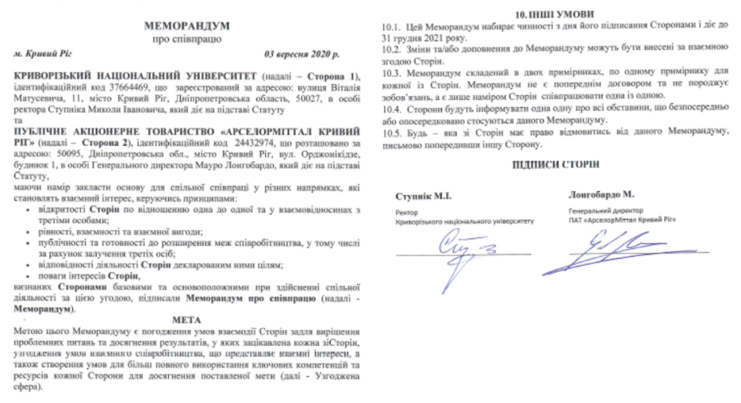
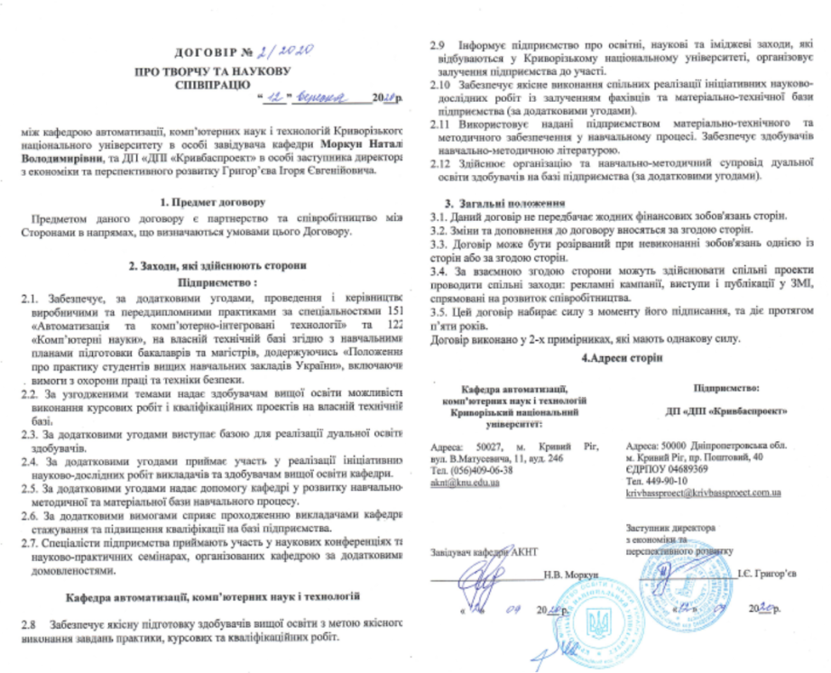
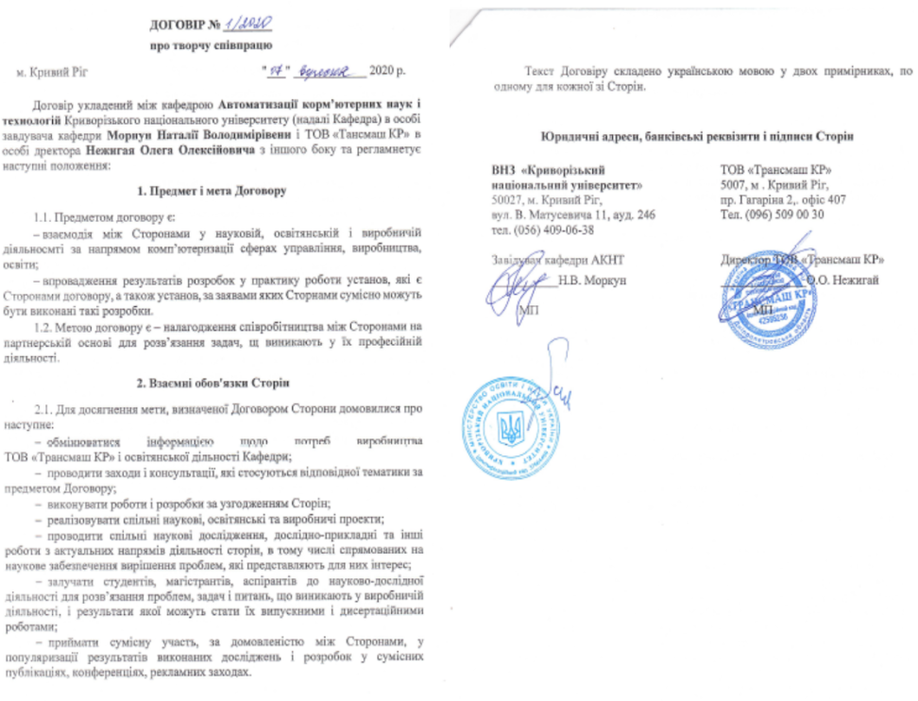
Departments and the University have signed 5 cooperation agreements with stakeholders

Slide 23
Krivyi Rih National University –
WE ARE READY FOR ERASMUS +
Modelling CybPhys
609557 СHALLENGES!

