Slide 1
Implementation of Innovative ICT based Teaching & Learning Methods (related to WP3)
Joan Peuteman
Stephane Stroobant
Bozheng Pang
Workshop and Management meeting: November 15-16th (2021).
Erasmus+: Development of practically-oriented student-centred education
in the field of modelling of Cyber-Physical Systems (CybPhys)

Slide 2
Table of content
Basic goal
ICT based tools
Virtual Learning Platforms
Practical realizations
Didactical movies
Teacher training

Slide 3
Basic goal
Teaching and preparing students:
to think and act as an academically skilled person,
to realise an academic and research oriented career,
to realise an industry oriented career.
A decent learning process, embedded in a learning environment, is needed to reach these basic goal(s).

Slide 4
Basic goal
The learning environment is often modelled as:

Slide 5
Table of content
Basic goal
ICT based tools
Virtual Learning Platforms
Practical realizations
Didactical movies
Teacher training

Slide 6
ICT based tools
The learning process and the content of the course is very important.
Paper based course materials remain important. But
digital content is easy to adapt to new circumstances,
digital content is easy to structure,
digital content provides new possibilities.
This is very important from the point of view of the teacher/professor.

Slide 7
ICT based tools
Digital content, ICT based tools are an important topic in the present Erasmus+ project CybPhys: WP3
Creation of an e-library: we all together develop e-books
Developing learning and teaching methodologies and pedagogical approaches based on the use of ICT
Use of virtual lab practices in computer classes
…
A Virtual Learning Platform is also an important tool.

Slide 8
Table of content
Basic goal
ICT based tools
Virtual Learning Platforms
Practical realizations
Didactical movies
Teacher training

Slide 9
Virtual Learning Platforms
A Virtual Learning Platforms allows teachers to
provide students with study material of different types (for example e-books),
interact with the students in real-time,
follow the evolution of the learning process,
know the performance of each student in specific tasks,
…

Slide 10
Virtual Learning Platforms
Virtual Learning Platforms can be:
Commercial software (e.g. Toledo, Blackboard)
Open source software (e.g. Moodle)
In the present Erasmus+ project CybPhys, the decision has been taken to use Moodle.

Slide 11
Table of content
Basic goal
ICT based tools
Virtual Learning Platforms
Practical realizations
Didactical movies
Teacher training

Slide 12
Practical realizations
The use of a Virtual Learning Platform has been shown
by two demo-courses on Cyber-Physical Systems.
We have a demo-course using Blackboard (Toledo)

Slide 13
Practical realizations
We have a demo-course using Blackboard (Toledo).
The course contains 14 chapters.

Slide 14
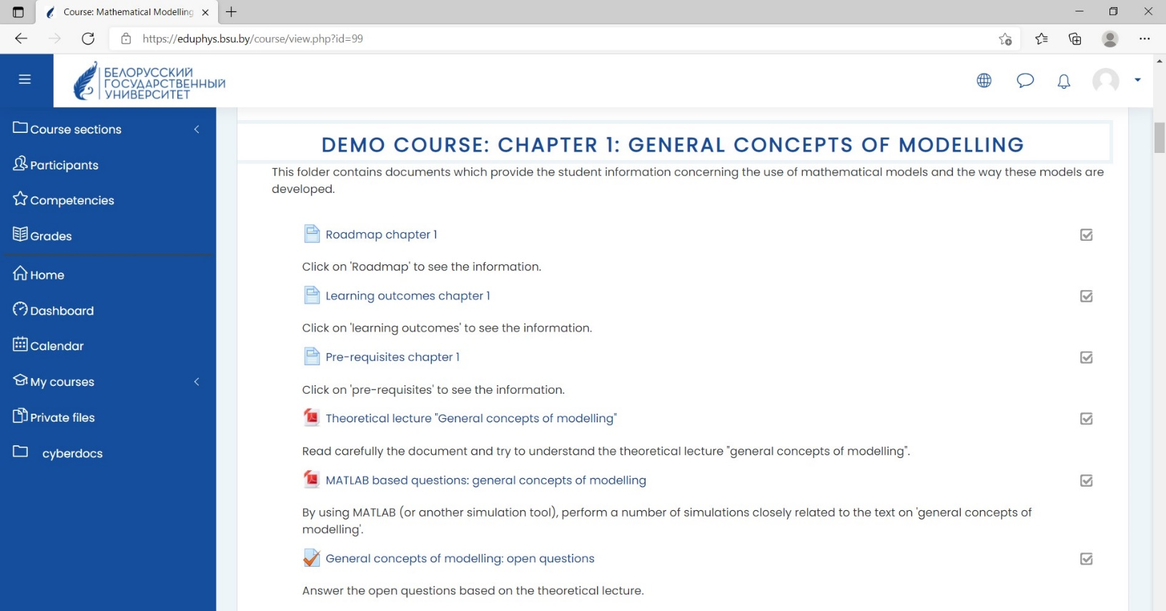
Practical realizations
We have a demo-course using Moodle.
The course contains 15 chapters.

Slide 15
Practical realizations
These demo-courses contain
texts,
PowerPoint presentations,
open-ended questions, closed questions, multiple-choice questions, simulation based questions, …
scientific papers,
links to websites,
links to Youtube movies,
self made didactical movies,
…

Slide 16
Table of content
Basic goal
ICT based tools
Virtual Learning Platforms
Practical realizations
Didactical movies
Teacher training

Slide 17
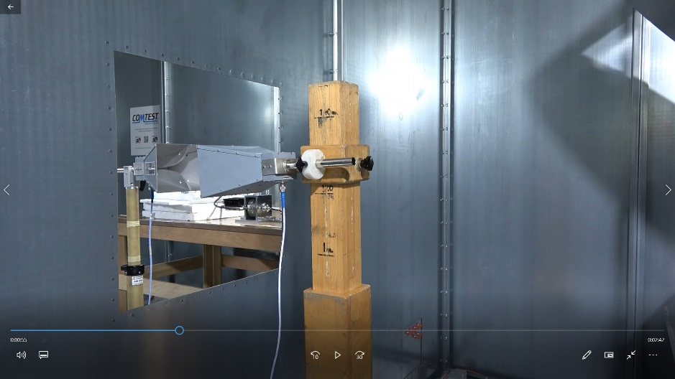
Didactical movies
A number of didactical movies have been made to be shared
using the Virtual Learning Platforms with topics like:
The use of a Faraday cage
The use of a reverberation chamber
Radiated emission measurements
The use of a double reverberation chamber
The use of a HALT chamber
Testing the resilience of a critical data communication
channel

Slide 18
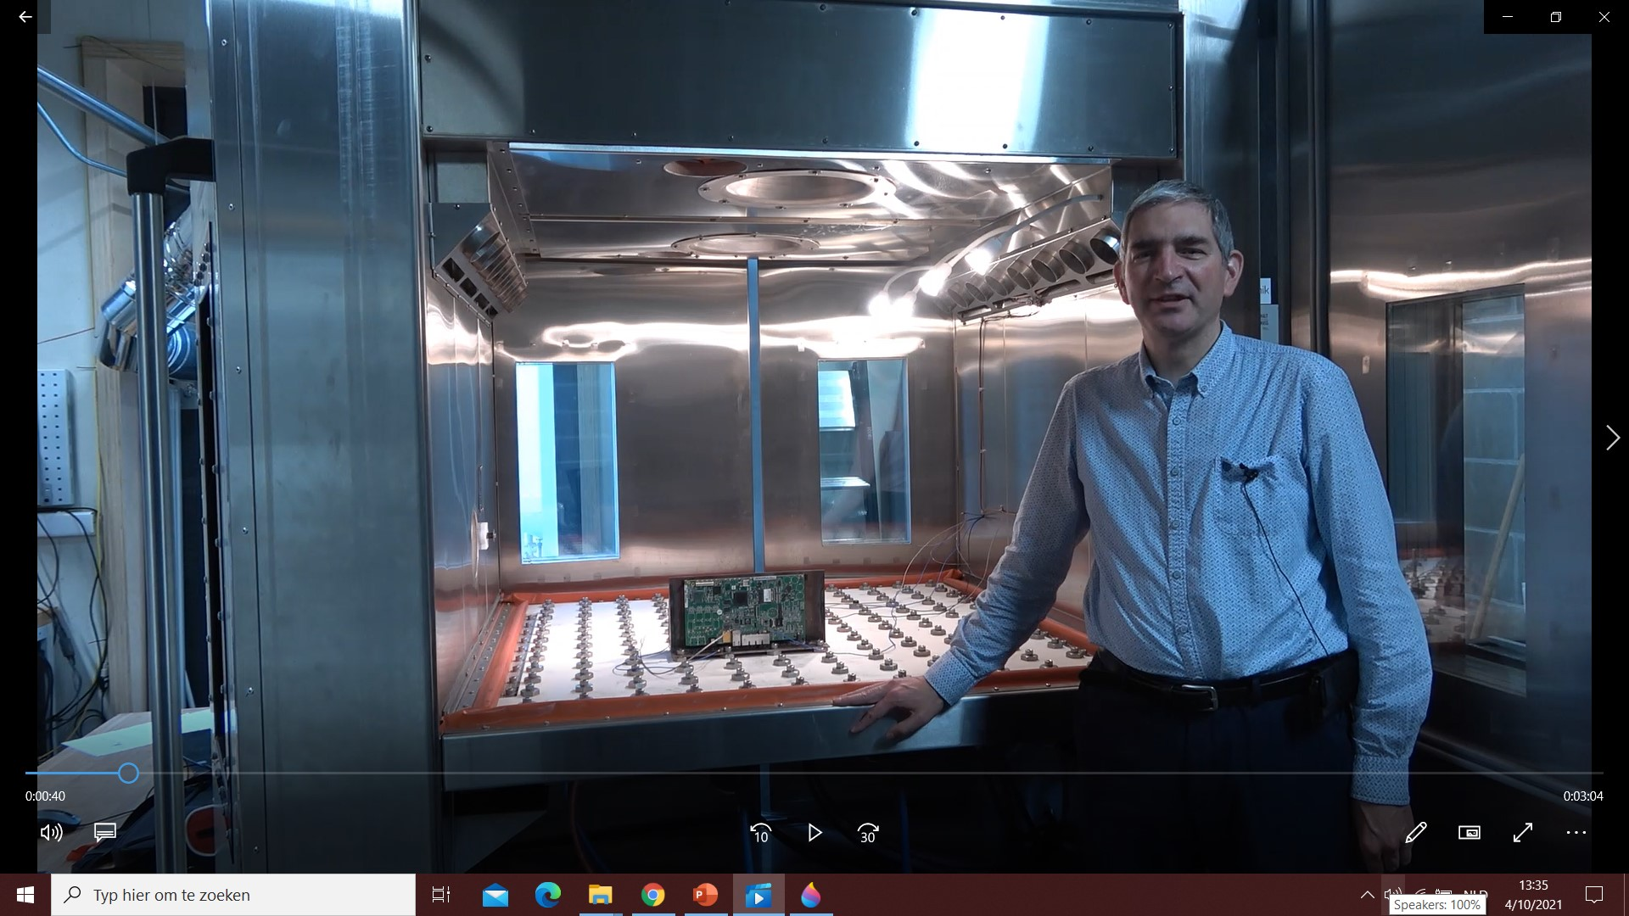
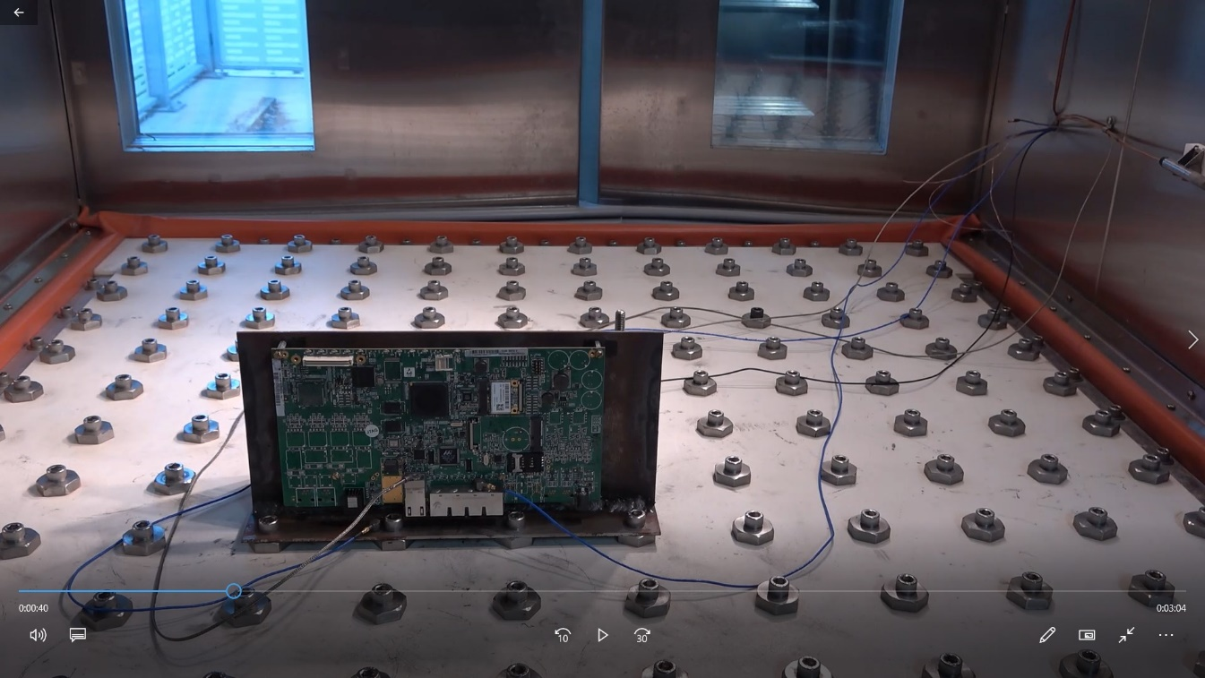
Didactical movies
HALT chamber

Slide 19
Table of content
Basic goal
ICT based tools
Virtual Learning Platforms
Practical realizations
Didactical movies
Teacher training

Slide 20
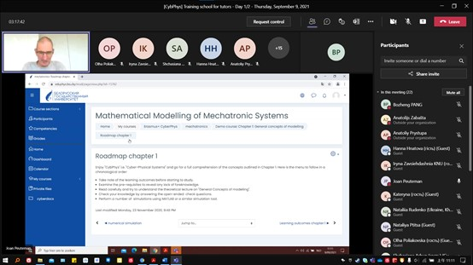
Teacher training
The demo-courses on Cyber-Physical Systems
(Blackboard and Moodle) have been used during the
teacher training in September 2021.

Slide 21
Teacher training
The teacher training dealt with quite a number of
applications of innovative teaching methods &
electronic environments.
Innovative teaching: using a digital learning platform
Academic literature
Innovative teaching in a multi-campus context:
technological solutions
Distance learning: innovative interuniversity collaboration

Slide 22
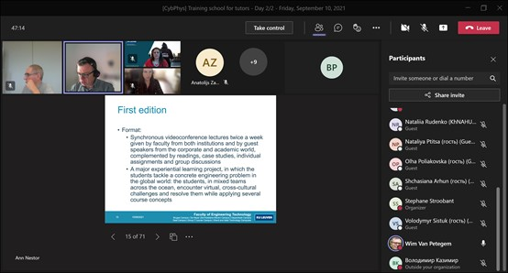
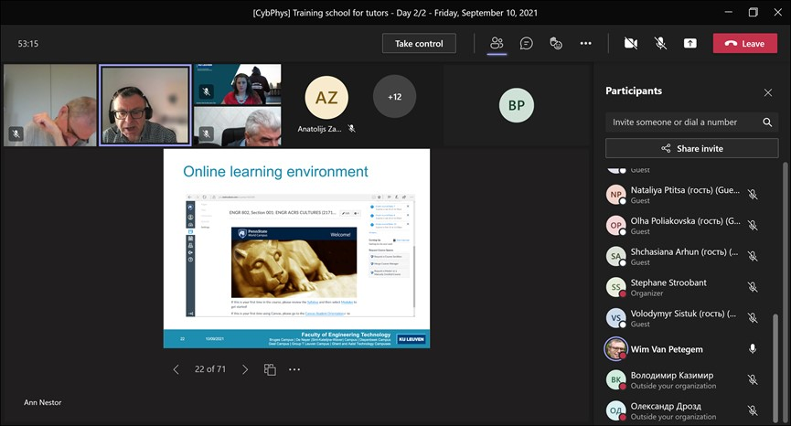
Teacher training

Slide 23
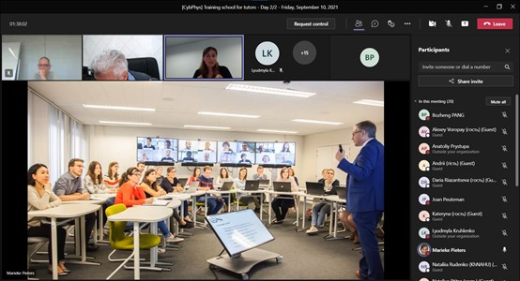
Teacher training
TECOL hybrid systems: face-to-face and online teaching

Slide 24
Table of content
Basic goal
ICT based tools
Virtual Learning Platforms
Practical realizations
Didactical movies
Teacher training

Slide 25
Thank your for your attention! Questions?

