Slide 1
Chernihiv Polytechnic National University
Erasmus+ project 609557-EPP-1-2019-1-LV-EPPKA2-CBHE-JP
“Development of practically-oriented student-centred education in the field of modelling of Cyber-Physical Systems", Acronim “CybPhys”
MC1 and WS2 on curricula development, acceptance and testing.
November 15 – 16th 2021, RTU, Riga

Slide 2
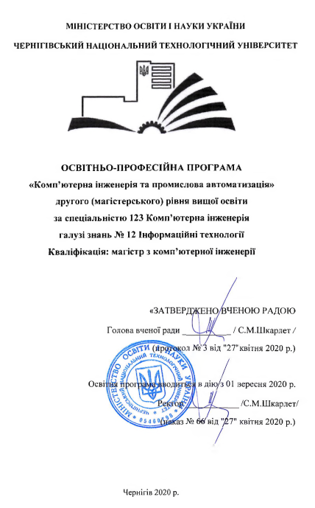
WP2: Acceptance of new study program and courses
New Master program : Computer engineering and Industrial Automation
Specialty : Computer engineering
Accreditation of the specialty "Computer engineering", master level by the Ministry of Education on Ukraine
Certificate of accreditation series ND № 2685401 from June 27, 2017. The certificate is valid until July 1, 2024
Accreditation of the new master program and curriculum
by CPNU Academic Council on April 27, 2020
Accredited according to CE standard by Academic Council of CPNU on April 26, 2021
https://op.stu.cn.ua/files/op/OPP%20123%20KIPA%20magistr_2020.pdf
https://op.stu.cn.ua/files/np/NP%20123%20%20KIPA%20magistr%202020.pdf
2

Slide 3
WP2: Arrangements for testing of new developed and modernised courses
New master degree courses in the new master program “Computer engineering and Industrial Automation”:
https://stu.cn.ua/wp-content/uploads/2021/04/new-courses20-1.pdf
credits
Model-oriented control in Digital Manufacturing 5
Programming of Automation Systems 5
Design and Simulation of Power electronics components 5
Modelling and Measurement of physical processes in Robotics. 5
Simulation of Manufacturing Environment 5
Total 25
Updated courses in bachelor program "Electronics of robotic systems and complexes“:
https://stu.cn.ua/wp-content/uploads/2021/11/updated-courses_2.pdf
Introduction to electronic systems 6
Development of electromechanical robotic systems 4
Total 10
3

Slide 4
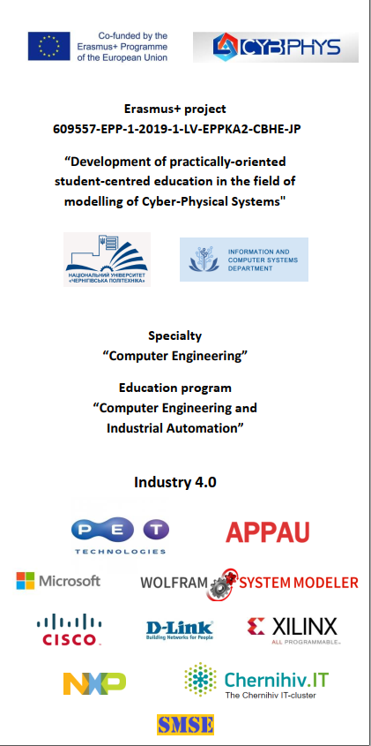
WP2: Arrangements for testing of new developed and modernised courses.
Courses support.
Developing of Moodle courses;
Developing of Youtube on-line lectures;
Creation of new laboratory “Simulation of Cyber Physical Systems”;
Quality Assurience support
4

Slide 5
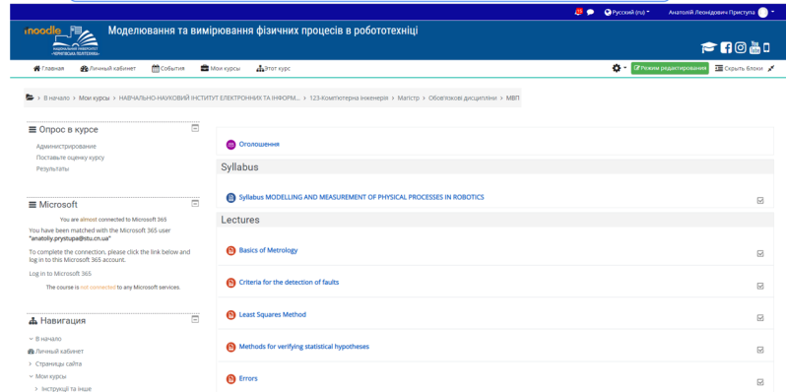
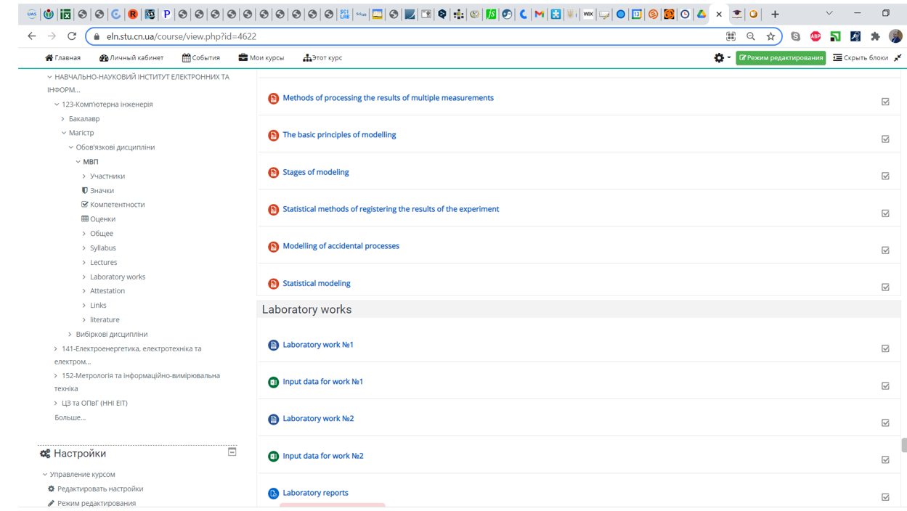
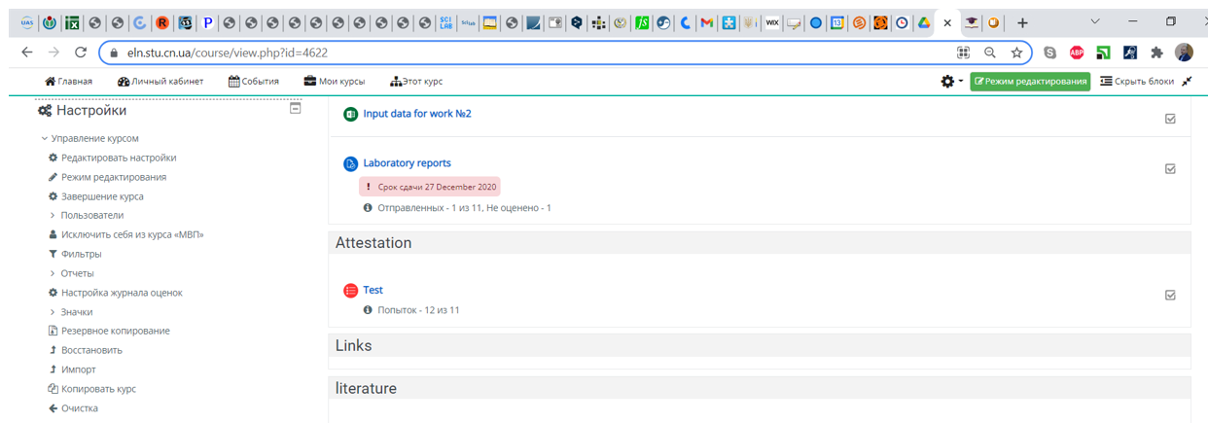
WP2: new developed courses support.
Moodle courses
https://eln.stu.cn.ua/login/index.php
5

Slide 6
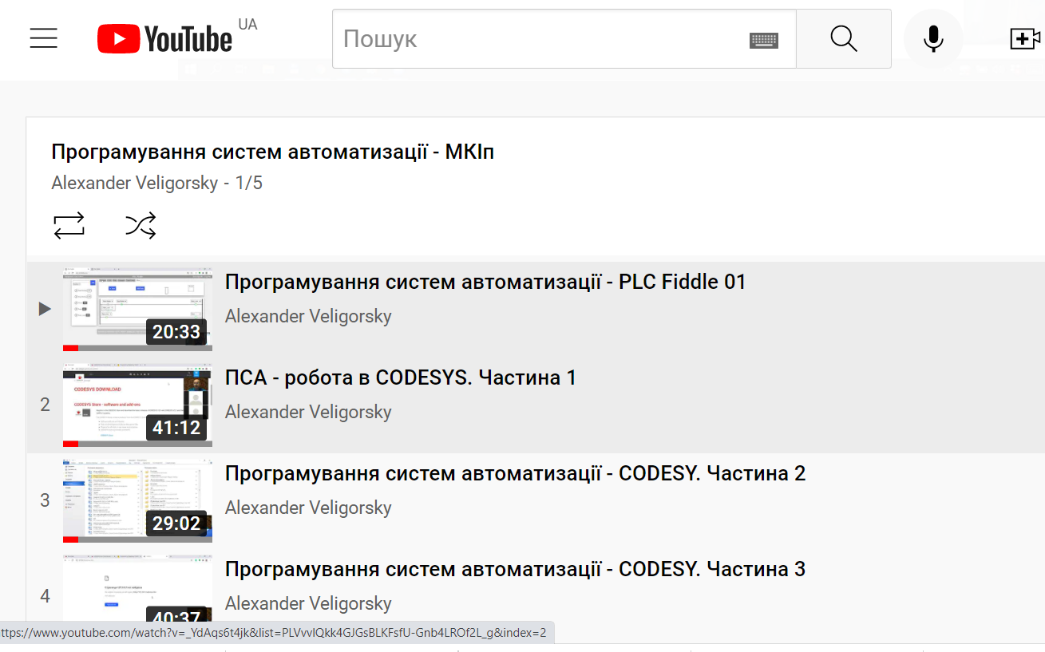
WP2: new developed courses support.
Youtube on-line lectures
https://www.youtube.com/watch?v=TP9FtEpM-Rk&list=PLVvvlQkk4GJGsBLKFsfU-Gnb4LROf2L_g&index=1&ab_channel=AlexanderVeligorsky
6

Slide 7
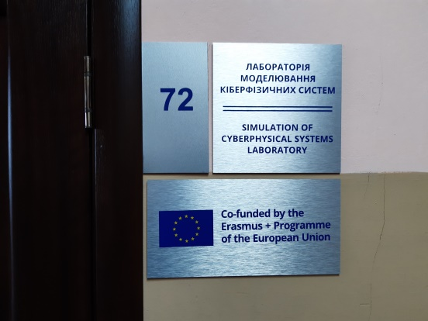
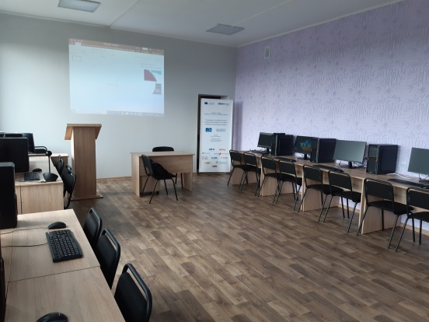
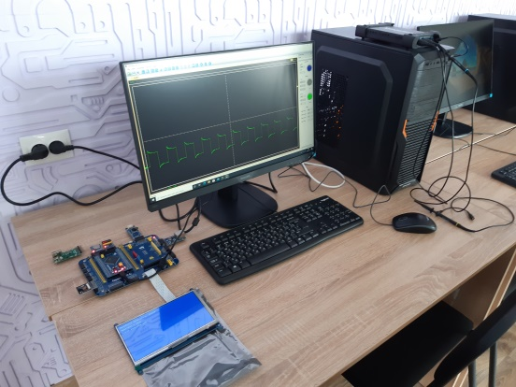
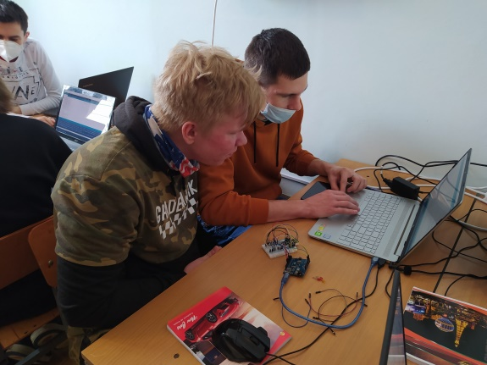
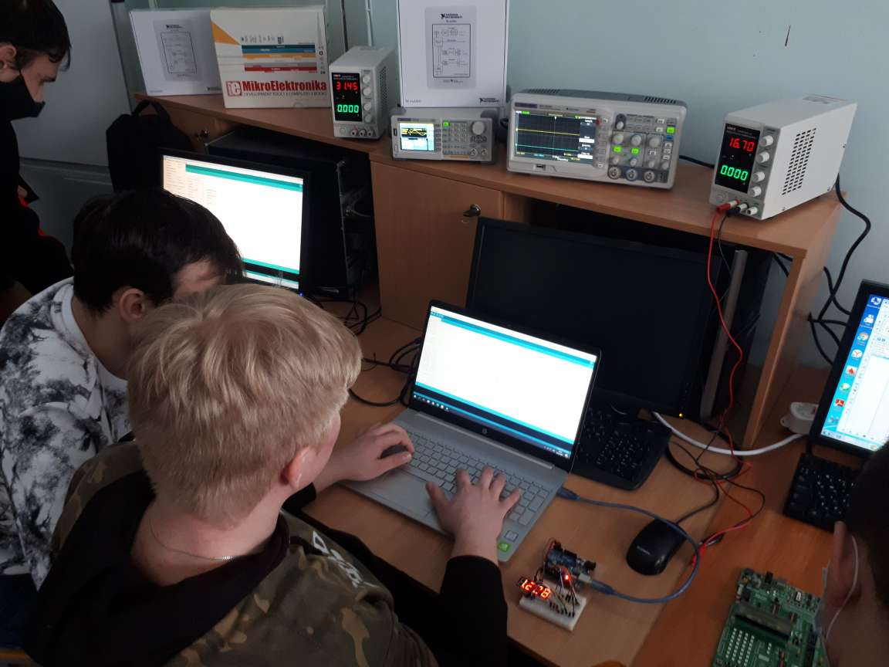
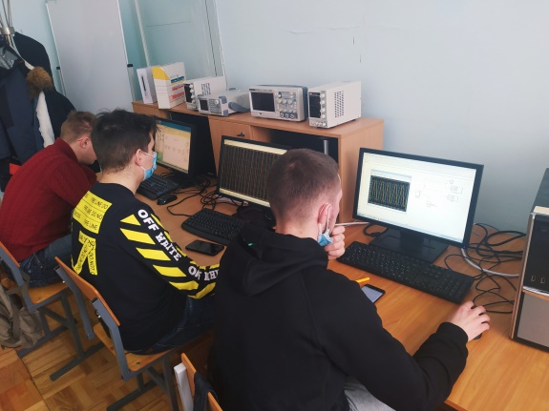
WP2: new developed courses support.
New laboratory “Simulation Cyber Physical Systems”
https://stu.cn.ua/mizhnarodna-diyalnist/mizhnarodni-programy-ta-proekty/proyekt-cybphys/nova-laboratoriya-modelyuvannya-kiberfizychnyh-system/
7

Slide 8
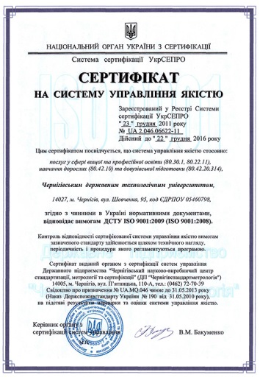
WP2: new developed courses support.
Quality Assurience
The University has the certificate on the system of quality assurance according to ISO 9001.
Courses document includes:
- curriculums (approved at the level of the vice-rector);
- lecture notes (department level);
- guidelines (department level);
- modular and individual tasks, tests, exam tickets (department level);
- packages of complex and rector's control works (rector level)
3. Internal audit (educational and methodical department level).
4. Mutual visits of teachers.
5. CybPhys project QA audit (according to QA plan).
8

Slide 9
WP2: Implementation of electronic text books (e-book 3)
Model-oriented control in Intelligent Manufacturing Systems
Content:
Intelligent Manufacturing Systems and Industry 4.0 Concept
The Principles of Model-Oriented Control
Implementation Models of Control Algorithms
Predictive Models and Dynamic Model Checking
Recovery Models and their Construction
Software and Hardware Tools for MOC
Examples of MOC Applications
Contributors: CPNU, RTU, V.M. Glushkov Institute of Cybernetics NAS of Ukraine
Status: preparation for publication in contact with RTU Publishing House:
acceptations of the track change after editors
added Annotation in Latvian and English
added Glossary of Abbreviation
https://eduphys.bsu.by/course/view.php?id=100

Slide 10
WP4: Developing the Sharing Modelling and Simulation Environment platform. Progress.
Project plan.
Activity | Term by plan | Status
Purchase of equipment (hardware and software) | October, 2021 | In progress
Installation of the software on the servers of CPNU | November, 2021 | Is done
Configuring all software including account creation | December, 2021 | In progress
Implementation of the necessary functions | February, 2022
Development of SMSE interface | March, 2021
Development of SMSE course examples | May, 2022
Testing of SMSE | June, 2022
Development of documentation | July, 2022
Delivery-acceptance of SMSE | August, 2022
SMSE proposal: https://stu.cn.ua/wp-content/uploads/2021/11/smse-proposal.pdf
SMSE equipment: https://cs.stu.cn.ua/wp-content/uploads/2021/11/ogoloshennya_2_3.pdf
SMSE acting version: https://eln.stu.cn.ua/login/index.php

Slide 11
WP4: Developing the Sharing Modelling and Simulation Environment platform. Progress.
Equipment.
Network equipment: Router Cisco 3560 Series 1
Server's equipment:
Server Dual Xeon GOLD series 2U 1
Server Single Xeon Silver series 4U 2
SSD Samsung 860 Pro series 512GB 1
HDD Western Digital 4TB 1
Notebook HP 250 G8 1
APC Smart-UPS SRT 1000VA 1
Purchase of equipment is in progress:
Plan of procurement is singed by all sides
Tender was held
Wait for permission from Ministry of Economic of Ukraine

Slide 12
SMSE architecture
Main idea and task – embedding Jupyter platform to Moodle
Account Management system
(Moodle Learning Platform )
SMSE architecture
Tools Support system
(Jupyter platform )
Content
(Interactive courses like Jupyter notebook)

Slide 13
SMSE use case diagram

Slide 14
Contact information:
Chernihiv Polytechnic National University
14035, Ukraine, Chernihiv, Shevchenko Str., 95
site: www.stu.cn.ua
CybPhys project contacts:
Volodymyr Kazymyr
tel. +38 050 344 43 77
e-mail: vvkazymyr@gmail.com

