Slide 1
Dissemination and Exploitation of CYBPHYS Project
Prepared by kryvyi rih national university

Slide 2
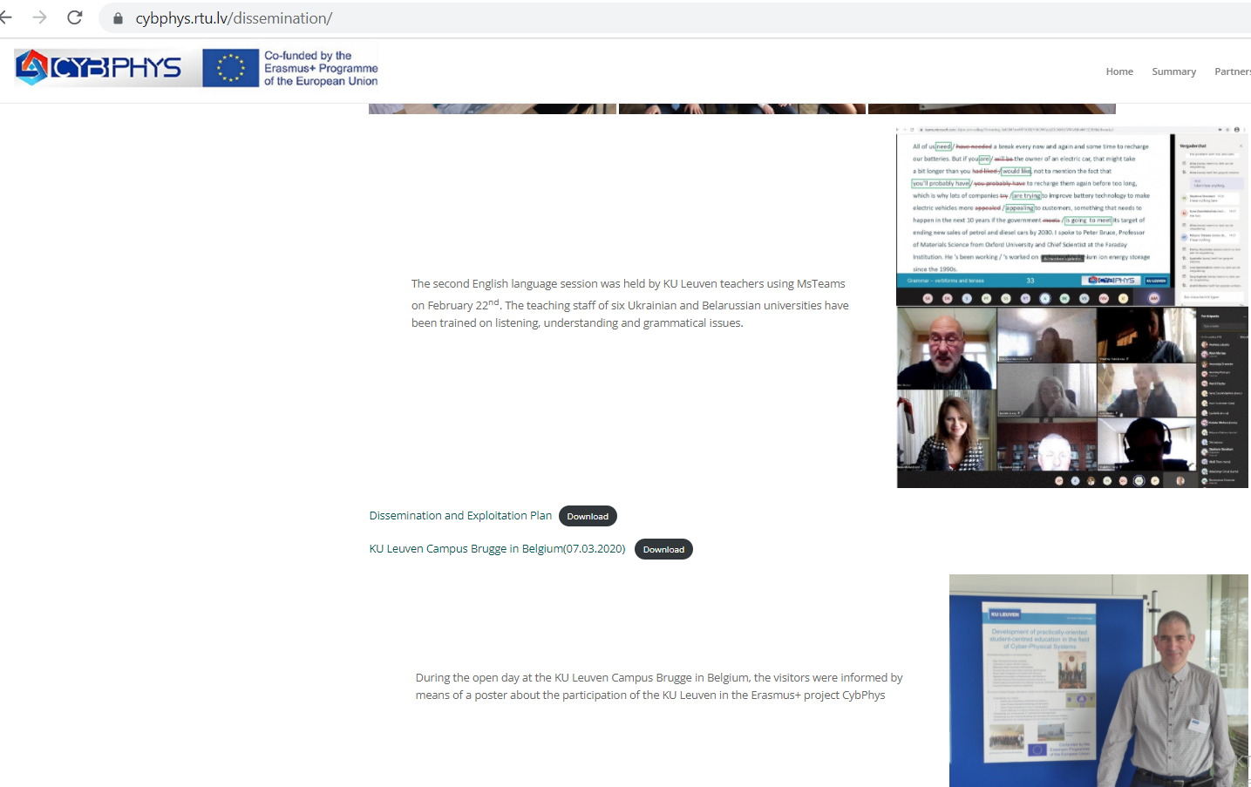
Objective/Aim of WP6
The overall objectives are:
to increase public awareness about CYBPHYS and its impact;
to motivate students and professionals to follow CYBPHYS offered courses and education programs;
to ensure sustainability of the project outcomes beyond the project.

Slide 3
The DISSEMINATION AND EXPLOITATION PLAN of the CYBPHYS project
The main priorities of the dissemination and exploitation plan of the CYBPHYS project are:
to identify and pursue opportunities to disseminate and circulate information on the evolution of the project and its adherence to the overall objectives;
to clearly identify channels, methods and messages to reach, engage and trigger engaging with stakeholders.
The target groups:
students, engineers, researchers, academic staff and students from other universities who are not involved in the project, professional associations and the companies that operate in the field of cyber-physical systems (cps), governmental agencies, national education accreditation agencies.
From targeted group we exclude Belorussian partners.

Slide 4
The DISSEMINATION AND EXPLOITATION PLAN of the CYBPHYS project
6.1-3. Information sessions and Final conference and social media.
6.4. Recommendations for new training beyond the project.
6.5. Strengthening the academia – industry network.
6.6. Hosting and maintenance of eLearning and SMSE platform beyond the project.
6.7. Signing of double-sided agreements.
Information/promotion al materials/ | Number of workshops conferences, stakeholder meetings, held.
Information sessions for target groups and the final conference. | The number of participants in information sessions.
Communication via social media | The number of informative articles, publications in media, presentations, etc.
Recommendations for new training programs for beyond the project. | The number of users of social media and the project web portal.
The academia – industry network is established | The number of double-sided partners’ agreements for the maintenance of eLearning and SMSE platform beyond the project.
Hosting and maintenance of eLearning and SMSE platform beyond the project is arranged | The number of partners’ agreements for cooperation

Slide 5
The strategy of the project dissemination
The strategy of the project dissemination and exploitation includes:
▪ the creation of a project´s identity;
▪ the creation of a project´s website;
▪ the organization of events;
▪ the publication of a project´s results on the project´s website;
▪ fostering uncover results for real-world decisions.
The dissemination and exploitation plan of the CybPhyS project includes the action plan for reaching the target audiences. The various activities in the WP6 are planned and communication strategies in order to maximize the impact of the dissemination and exploitation are defined.

Slide 6
the creation of a project´s identity
A project identity has been set up at the beginning of the project and it´s defined through the project logo.
In compliance to European Commission (EC) guidelines, all dissemination materials issued by the project include the necessary information and graphic identity of the funding entity.
These logos are to be used in all activities, channels and materials, such as the website, deliverables, technical documents, guidelines and social media.

Slide 7
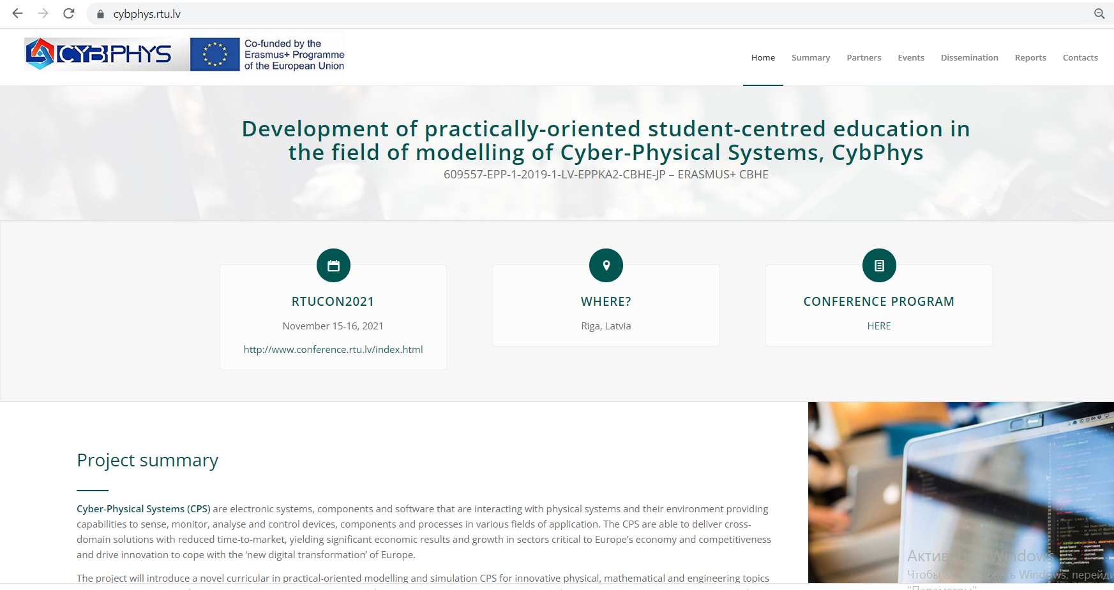
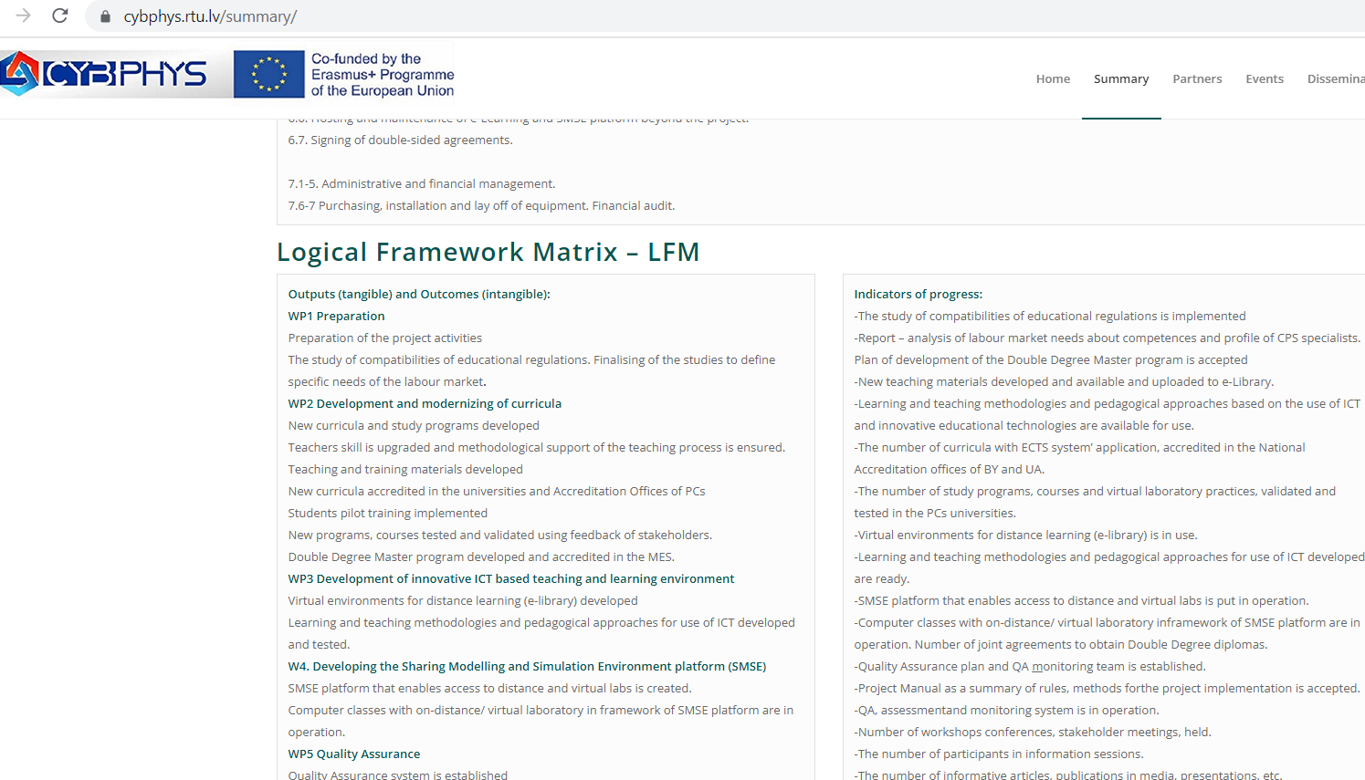
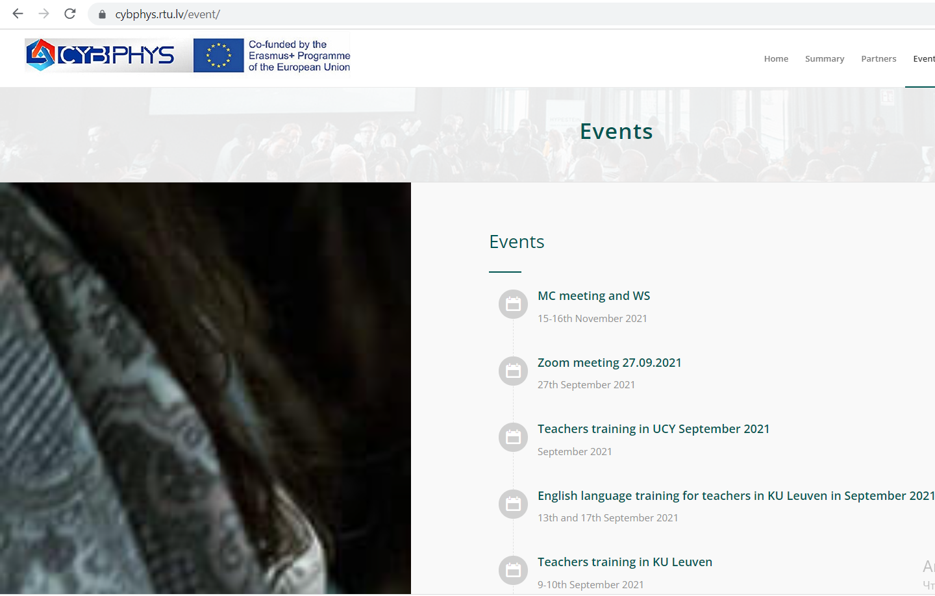
the creation of a project´s website
1. Organize and maintain the project identity and online presence of the project:
Project website: https://cybphys.rtu.lv/

Slide 8
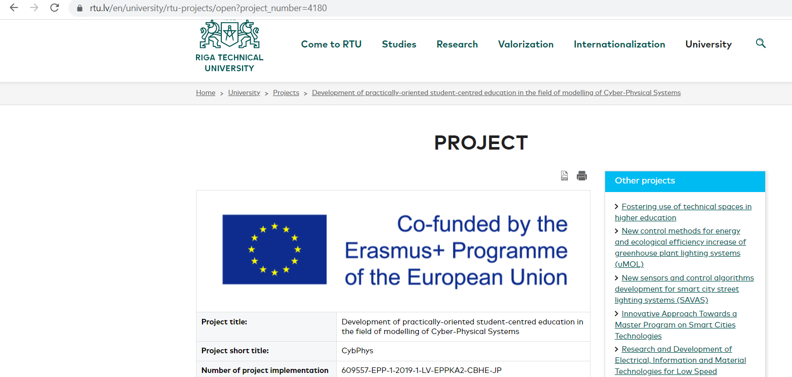
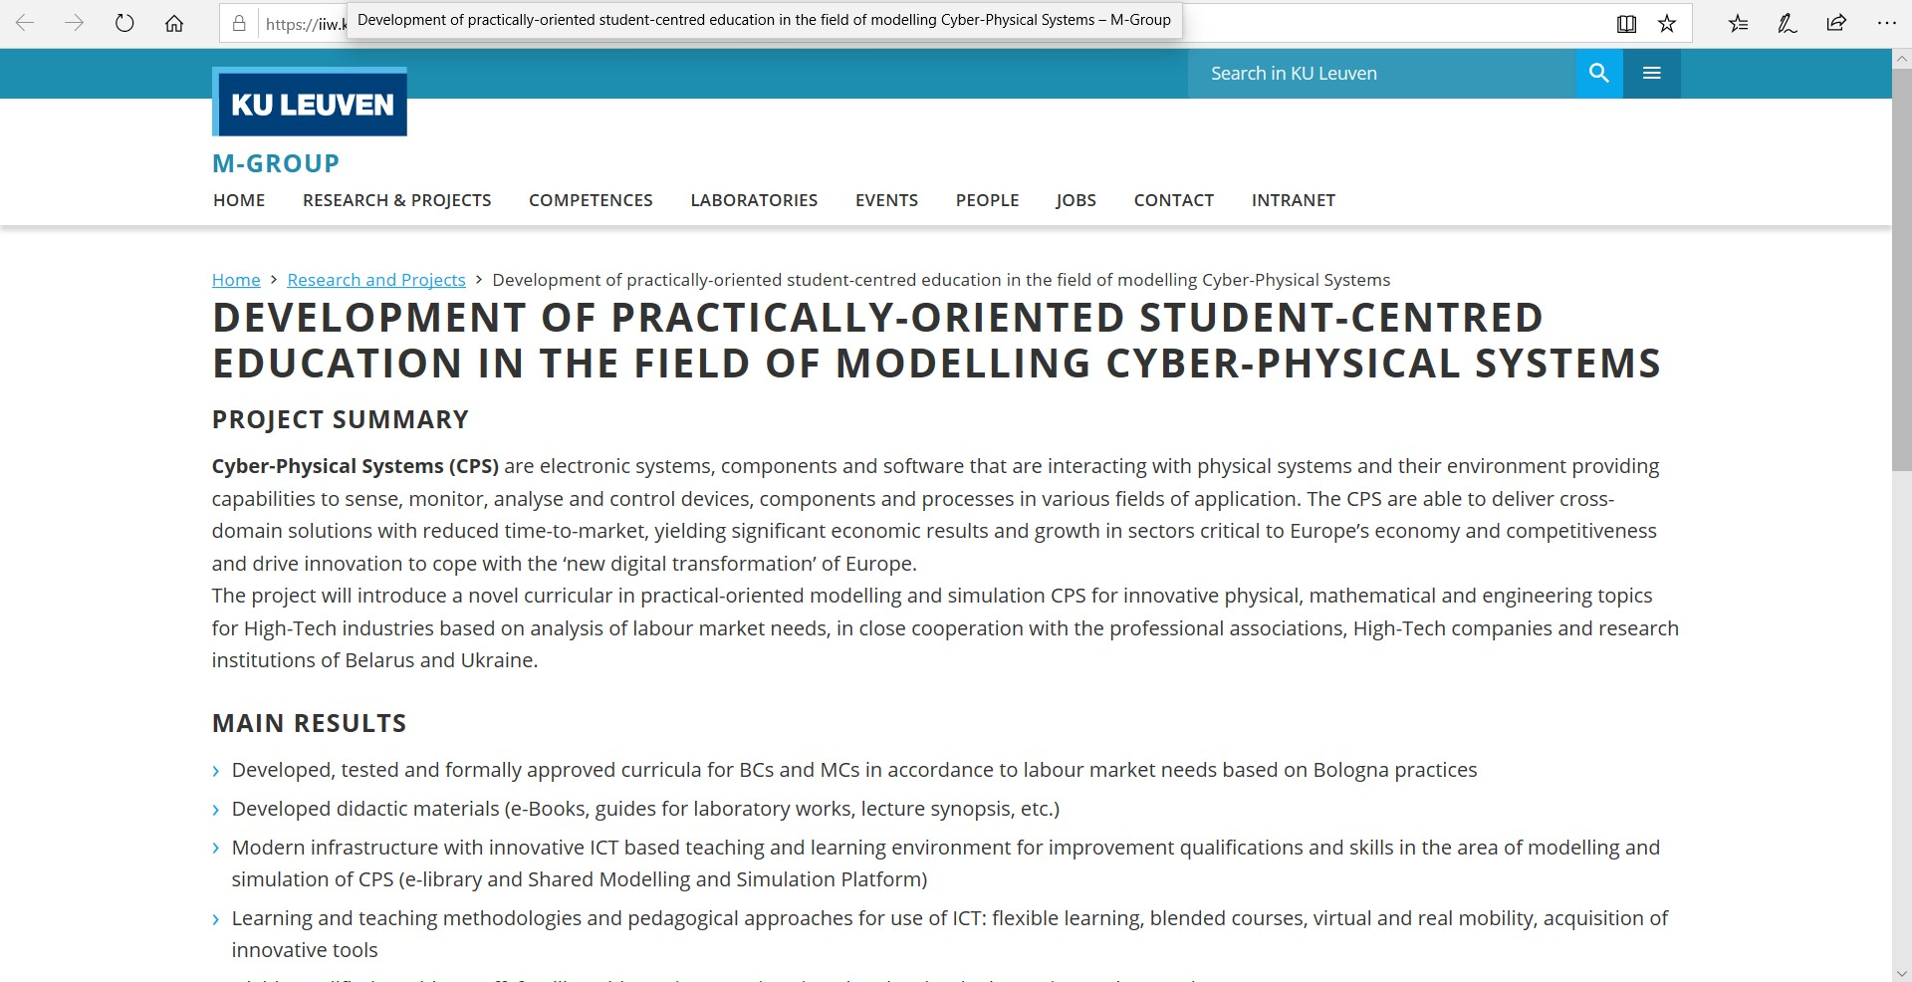
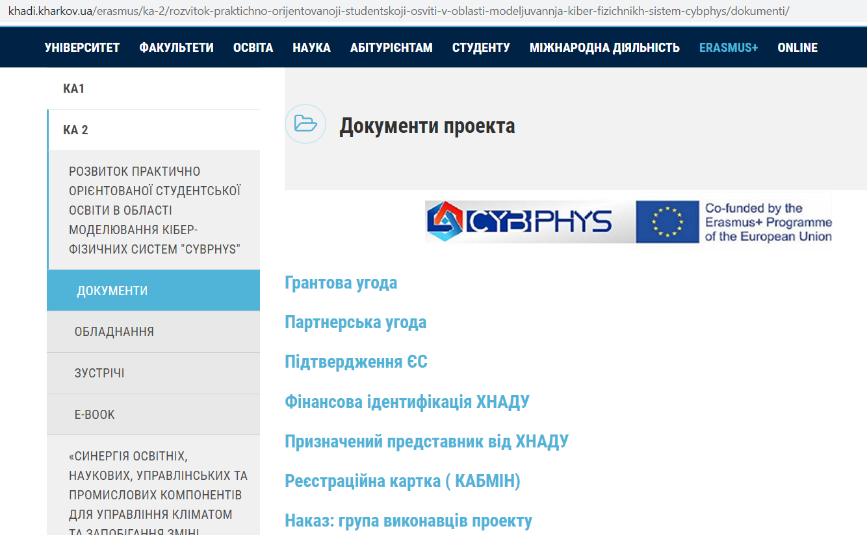
the creation of project´s websites FOR participants

Slide 9
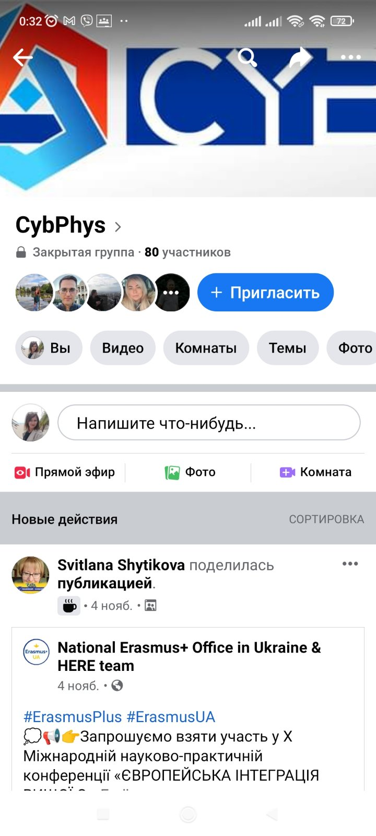
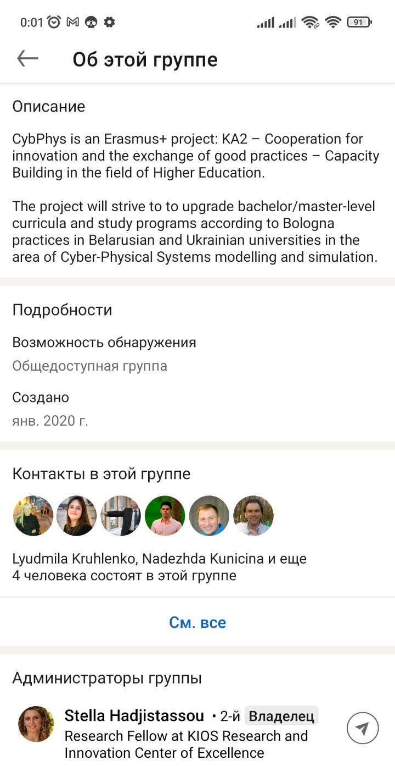
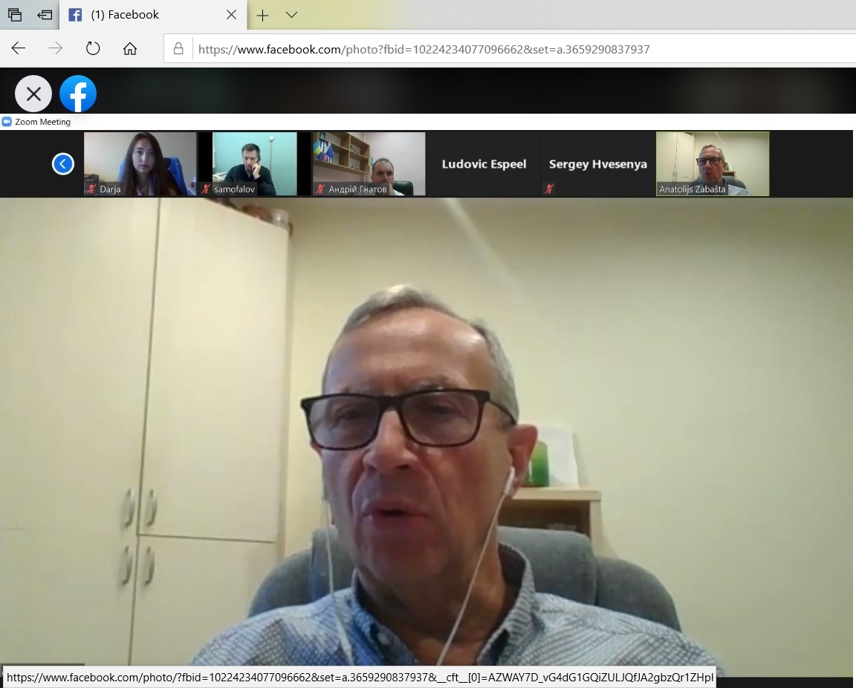
Social media
Facebook: https://www.facebook.com/groups/227194018274534/?ref=share
Linkedin: https://www.linkedin.com/groups/12355821/
Twitter
Instagram

Slide 10
The organization of events
2. Organize relevant events and the final conference at the end of the project.
Kick-off meeting in Minsk 5-6th December 2019
Meeting in Brussels 27-28th January 2020
Double Degree Master program – study visit of academic staff KhNAHU to RTU 17-18th February 2020
WS2 and MC1: Workshops in Riga for curricula development 29-30th June 2020
English language training for teachers in Bruges 2021 online session in 2021
Teachers training in RTU September 2021 7-8th September 2021
Teachers training in KU Leuven 9-10th September 2021
English language training for teachers in KU Leuven in September 2021 13th and 17th September 2021
Teachers training in UCY September 2021 September 2021

Slide 11
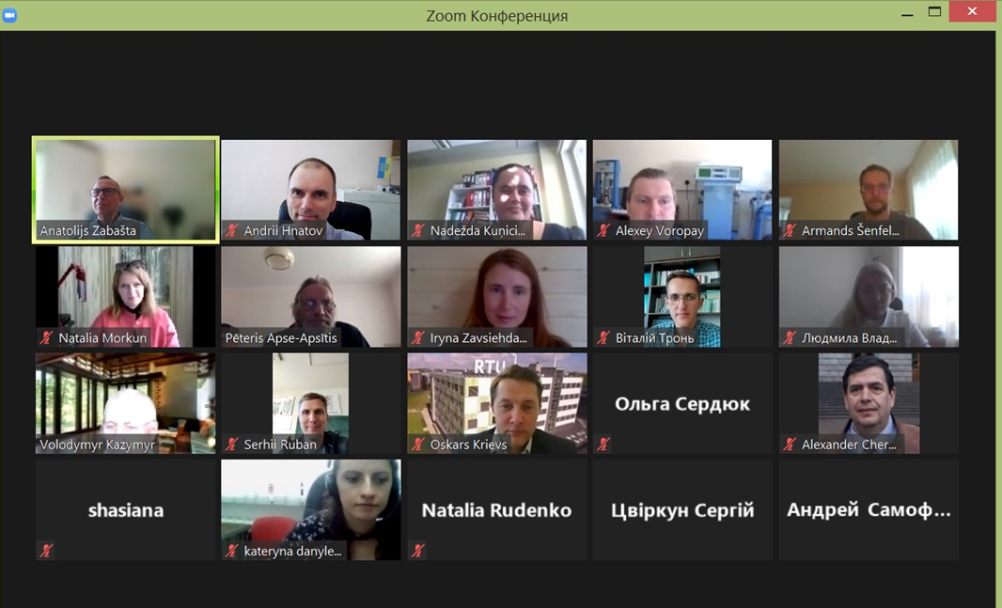
The Project EVENTS and communication
The organization of offline meetings is impacted by Covid-19 disease. Till we have any restrictions due to the Covid-19 all meetings are held as online ones. The decision of physical meetings organization will be made only after restrictions are over in all countries where the participants of the meeting come from. This decision will be made as a consensus of the CybPhys project´s partners.

Slide 12
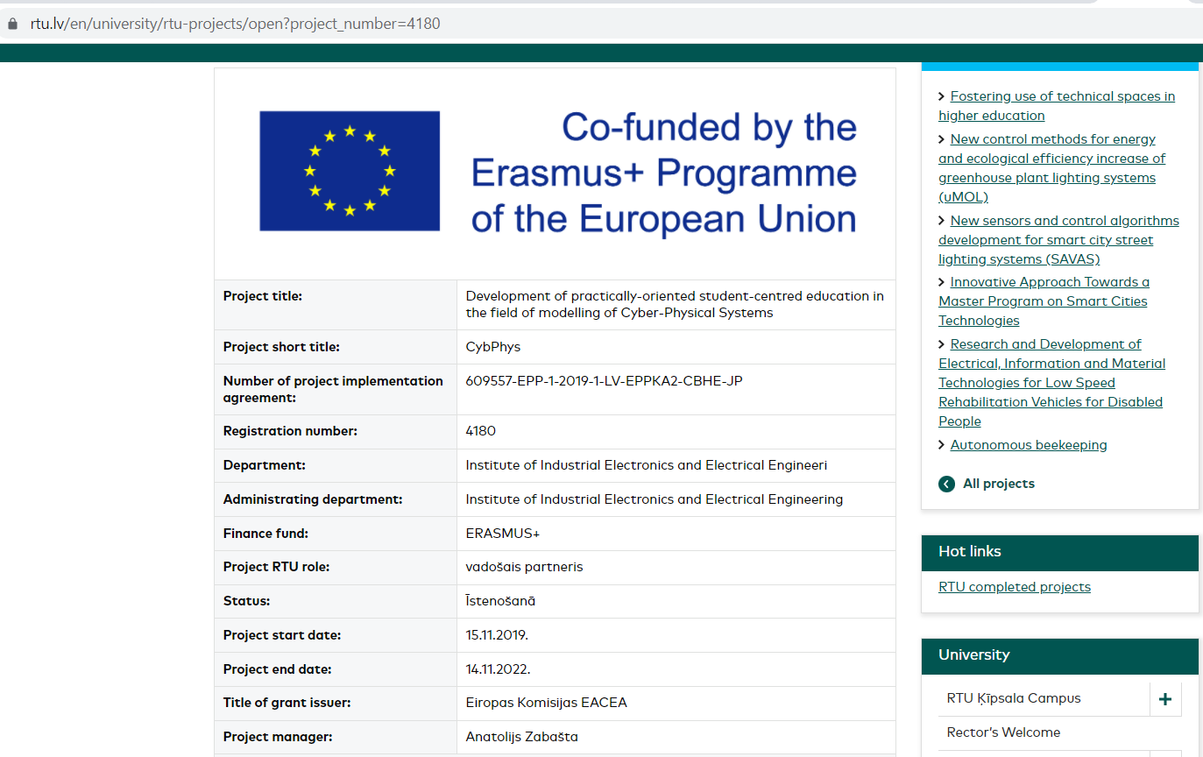
the publication of a project´s results

Slide 13
Scientific Publications:
Given the high degree of innovation involved in the framework of CybPhyS’s activities, several scientific publications are expected to be produced and published. These publications intend to reach other scientists and contribute to the body of knowledge in the field.
Zabasta, A., Peuteman, J., Kunicina, N., Kazymyr, V., Hvesenya, S., Hnatov, A., Paliyeva, T., Ribickis, L. (2020). Research on Cross-Domain Study Curricula in Cyber-Physical Systems: A Case Study of Belarusian and Ukrainian Universities. EDUCATION SCIENCES, 10 (10), Art.No. ARTN 282. doi: 10.3390/educsci10100282
Zabasta, A., Kunicina, N., Nikiforova, O., Peuteman, J., Fedotov, A.K., Fedotov, A.S., Hnatov, A. (2020). Development of industry oriented cross-domain study programs in cyber-physical systems for Belarusian and Ukrainian universities. In: Multi-paradigm modelling approaches for cyber-Physical systems, Chapt. 11, (271-292). London: Elsevier - Academic Press. ISBN: 978-0-12-819105-7.
Zabasta, A., Peuteman, J., Kunicina, N., Kruhlenko, L., Kovalenko, D., Zhiravetska, A. (2020). Approach for Cross-Domain Study Curricula in Cyber-Physical Systems for Belarusian and Ukrainian Universities. In: 2020 IEEE 61th International Scientific Conference on Power and Electrical Engineering of Riga Technical University (RTUCON). Presented at the RTUCON2020, Riga, Latvia, 05 Nov 2020-06 Nov 2020. ISBN: 978-1-7281-9510-0. doi: 10.1109/RTUCON51174.2020.9316585
Peuteman J., Maricau A., Zabasta A., Verslype S., Espeel L., Boydens J., Pissoort D. (2021). Computer-mediated communication based English language teaching to academic staff of Belarus and Ukraine in a COVID-19 environment, In: Proceedings of the International e-Engineering Education Services Conference (e-Engineering’2021), Presented at e-Engineering’2021, Jordan, 22 June – 23 June 2021, pp. 37- 42, ISBN 978-1-7281-3470-3.

Slide 14
Scientific Publications:
Given the high degree of innovation involved in the framework of CybPhyS’s activities, several scientific publications are expected to be produced and published. These publications intend to reach other scientists and contribute to the body of knowledge in the field.
Zabasta, A., Peuteman, J., Kunicina, N., Kazymyr, V., Hvesenya, S., Hnatov, A., Paliyeva, T., Ribickis, L. (2020). Research on Cross-Domain Study Curricula in Cyber-Physical Systems: A Case Study of Belarusian and Ukrainian Universities. EDUCATION SCIENCES, 10 (10), Art.No. ARTN 282. doi: 10.3390/educsci10100282
Zabasta, A., Kunicina, N., Nikiforova, O., Peuteman, J., Fedotov, A.K., Fedotov, A.S., Hnatov, A. (2020). Development of industry oriented cross-domain study programs in cyber-physical systems for Belarusian and Ukrainian universities. In: Multi-paradigm modelling approaches for cyber-Physical systems, Chapt. 11, (271-292). London: Elsevier - Academic Press. ISBN: 978-0-12-819105-7.
Zabasta, A., Peuteman, J., Kunicina, N., Kruhlenko, L., Kovalenko, D., Zhiravetska, A. (2020). Approach for Cross-Domain Study Curricula in Cyber-Physical Systems for Belarusian and Ukrainian Universities. In: 2020 IEEE 61th International Scientific Conference on Power and Electrical Engineering of Riga Technical University (RTUCON). Presented at the RTUCON2020, Riga, Latvia, 05 Nov 2020-06 Nov 2020. ISBN: 978-1-7281-9510-0. doi: 10.1109/RTUCON51174.2020.9316585
Peuteman J., Maricau A., Zabasta A., Verslype S., Espeel L., Boydens J., Pissoort D. (2021). Computer-mediated communication based English language teaching to academic staff of Belarus and Ukraine in a COVID-19 environment, In: Proceedings of the International e-Engineering Education Services Conference (e-Engineering’2021), Presented at e-Engineering’2021, Jordan, 22 June – 23 June 2021, pp. 37- 42, ISBN 978-1-7281-3470-3.

Slide 15
KPI and targets for each of the channels used for dissemination
Channel | KPI | Year 1 target | Year 2 target
Website | Number of visitors | 100
Social media | Number of posts
 | Number of followers/subscribers
Press releases | Number of press releases
Scientific publications | Number of journal papers/conference papers
Workshops/Seminars | Number of workshops/seminars organized
Events with other EU projects | Number of events co-organized with other EU projects or with the participation of CybPhyS partners
For all activities involving dissemination and communication, it is important to have tools to access the reach, success and status of each initiative. For these reasons, quantitative metrics should be used, so that the success of the initiative can be measured and, if necessary, adapted towards achieving project goals.

Slide 16
The DISSEMINATION AND EXPLOITATION PLAN of the CYBPHYS project must be revised according to the COVID conditions and with the view of Belorussian partners suspension.

