Slide 1
Development of practically-oriented student-centred education in the field of modelling of Cyber-Physical Systems – CybPhys 609557-EPP-1-2019-1-LV-EPPKA2-CBHE-JP – ERASMUS+ CBHE
MC and WS meeting
November 15 - 16th 2021
Anatolijs Zabashta, Nadezda Kunicina, Anastasija Ziravecka
Project coordinator
Riga Technical University

Slide 2
Day 1: Monday November 15th
Agenda | Time | Contributor
Adoption of the agenda. Project progress. | 10.00 | A. Zabašta, RTU
WP2: Acceptance of new study programs and courses by the Ministry of Education on Ukraine and by Partner’ universities. | 10.15 | WP2 leader A. Hnatov, CPNU, KNU.
WP2: Arrangements for testing of new developed and modernised courses. | 10.45 | A. Hnatov, L. Kruhlenko, V. Kazymyr
WP2: Preparation for Report on Testing of developed courses and study programs in the universities. | 11.15 | N. Kuņicina, A. Žiravecka
Coffee break | 11.45
WP2: Implementation of electronic text books: 1. Bringing innovations to the market – RTU, GSU 2. Mathematical Modelling of Mechatronic Systems – KU Leuven 3. Model-oriented control in Intelligent Manufacturing Systems – CNUT 4. Modern Mathematical Physics: Fundamentals and Application – BSU 5. High-Performance Scientific Computing and Data Analysis – BSU 6. Cyber-Physical Systems modelling and simulation – UCY 7. Cyber-Physical Systems for Clean Transportation – KNAHU 8. Control methods for critical infrastructure and Internet of Things (IoT) systems interdependencies analysis – RTU 9. Computer modelling of physical processes (handbook for students and PhD students) | 12.00 | The leaders of the books: N. Kuņicina, J. Peuteman, V. Kazymyr, I. Ciornei, S. Hadjistassou A. Hnatov About issuing in RTU Publishing House: A. Galkina, N. Kuņicina About Belarusian books (4, 5 and 9): A. Zabašta
WP5: Quality Assurance. QAP. Progress. | 12.45 | WP5 leader, S. Hadjistassou, I. Ciornei
Lunch | 13.15
WP6: Dissemination of results. Dissemination and Exploitation plan. Progress. | 14.15 | WP6 leader L. Kruhlenko
WP3: Application of innovative teaching methods & electronic environments. Progress. | 14.45 | WP3 leader J. Peuteman
WP4: Developing the Sharing Modelling and Simulation Environment platform. Progress. | 15.00 | WP4 leader V. Kazymyr
Planning of students training at RTU in January - February 2022 | 15.15 | RTU: N. Kunicina, A. Zhiravecka, A. Zabašta
Planning of students training at KU Leuven in January - February 2022 | 15.30 | KU Leuven: J. Peuteman
Coffee break | 15.45
Planning of students training UCY in January - February 2022 | 16.00 | UCY: I. Ciornei, S. Hadjistassou
Other issues and conclusion of the day 1 | 16.15 | All participants
The end of the day | 16.45

Slide 3
Project progress
Teachers training courses:
English courses: on-site in Bruges: 12 trainees
CybPhys Training School for Academics in Partner Countries: 40 trainees at Ukrainian and 5 at Belarusian universities
We will try to prepare certificates by the end of November
Extraordinary Financial report was submitted on November 4th
EACEA still have not confirmed neither budget, neither responsibilities of the partners, neither schedule of the travels

Slide 4
WP2: Acceptance of new study programs and courses by the Ministry of Education on Ukraine and by Partner’ universities

Slide 5
 | Level of study | credits | Number of students in the first year | Number of students in the second year | Number of teaching staff to be trained
 | CNTU
31 | Model-oriented control in Digital Manufacturing | 5 | 25 |  | 2
32 | Programming of Automation Systems | 5 | 25 |  | 2
33 | Design and Simulation of Power electronics components | 5 | 25 |  | 2
34 | Modelling and Measurement of physical processes in Robotics | 5 | 25 |  | 2
35 | Simulation of Manufacturing Environment | 5 | 25 |  | 2
36 | Simulation of electronic circuits | 5 | 25 |  | 2
37 | Development of electromechanical robotic systems | 5 | 25 |  | 2
 | KhNTHU
38 | Energy-saving technologies in transport 2 | 8.5 | 10 |  | 1
39 | The structure of hybrid and electric vehicles | 4 | 10 |  | 1
40 | Electric systems of environmentally friendly vehicles | 4 | 10 |  | 1
41 | Methods of planning scientific research on vehicles | 5.5 | 10 |  | 1
42 | Mathematical modelling and methods of optimization | 3 | 10 |  | 1
43 | Intelligent information technologies and systems in transport | 8.5 | 10 |  | 1
 | KNU
44 | Smart manufacturing based on cyber-physical systems | 8 | 25 |  | 2
45 | Machine Learning for Cyber Physical Systems and Industry 4.0 | 6 | 25 |  | 2
46 | Transportation Cyber-Physical Systems | 8 | 25 |  | 2
47 | Designing Computer-Integrated Systems | 8 | 25 |  | 2
48 | Adaptive and Robust Systems | 8 | 25 |  | 2
49 | Computer modelling of physical processes and systems | 8 | 25 |  | 2
50 | Modern Information Technologies in Transport | 8 | 25 |  | 2
 |  | 122.5 | 410 | 0 | 34
 | Our promisses at the project Application | 240 | 420 |  | 102

Slide 6
Method of new curricula testing with feedback from teaching staff, students, students organizations and entrepreneurs (professional associations, enterprises, etc.) involved in student teaching and curricula enhancement
(covered 2.8 and D5.5 of the QAP)

Slide 7
The goal of the courses testing
According to Log Frame Matrix (LFM) Partners reports with lists of the students studying in the modernized study programs
Partners reports with a feedback from:
students by courses
academic/teacher staff involved in teaching of students by courses
students organizations
The measurement of indicators according to the LFM are:
the number of validated / tested during one-year master-level courses
The number of students toughed
Testing to be held twice: related an Autumn of 2021 and Spring 2022 semesters
Partners reports on curricular testing with feedback from teaching staff, students and experts from professional associations, enterprises and scientific research institutions involved in teaching of students, curricular modernization and reviewing.
Testing reports: January 15th, June 15th

Slide 8
Training Evaluation Sheet for Students
No | Criterion | Strongly disagree, % | Partially disagree, % | Neutral assessment, % | Partially agree, % | Strongly agree, %
1 | All study program themes required to achieve the defined learning outcomes were covered
2 | The course was well-structured and the themes were explained in a comprehensible manner
3 | The logical structure of the lecture was maintained
4 | Audio-visual materials were efficiently used during the lecture
5 | Creative thinking was efficiently promoted
6 | Practical application of theory was efficiently promoted
7 | During the class the amount of theoretical material and practical tasks was balanced
8 | Recommended literature sources were accessible and helped in acquiring the course materials
9 | The lecturer/professor’s attitude to the students was positive and helpful
10 | The time for the completing of the practical tasks was enough
11 | The information about the classes organisation was clear and easy available

Slide 9
What did you like in the course?
Чем Вам понравился этот курс?
Outline 3 points you would like to take with you/have learnt in this class
Выделите наиболее значимые с Вашей точки зрения знания, которые Вы приобрели на этих занятиях
Do you have any suggestions for further improvement of the course? (If so, please give details and if you would like to be contacted about this idea please include your email address)
Есть ли у вас какие-либо предложения по дальнейшему совершенствованию курса? (Если да, то просьба уточнить, и если вы хотите, чтобы с Вами связались по этому вопросу, пожалуйста, укажите адрес своей электронной почты)
-------------------------------------------------------------------------------------------------
If you do not mind, please could you give us some additional more information about yourself
Gender: Male/Female/Prefer not to specify
Age: 16-21 22-30 31-40 41-50 51-60 61+
Status: Home Student EU Student International Student

Slide 10
Consolidated for students
Report
on the Spring semester testing of courses and laboratory practices
in the framework of the project «PHYSICS» program ERASMUS+ EU
Date of testing: 18.04-25.06.2018
How many questionnaire forms have been proceeded: 31
How many questionnaire forms were found valid: 31
Course title | Degree of course (bachelor, master) | Testing results
 |  | Strongly disagree % | Partially disagree % | Neutral assessment % | Partially agree % | Strongly agree %
Nonlinear Optics | 4-year course | 1.6 | 0.4 | 9.1 | 22.7 | 66.1
Semiconducting devices (lab. practice) | 4-year course | 0 | 6.5 | 11.7 | 39 | 41.6
Integrated Environment for Engineering Computing (lab. practice) | 4-year course | 4.2 | 8.3 | 13.4 | 29.1 | 44.5
Statistics on the answers given on the course (in percentage).
Comments and conclusions for BSU students questioning about testing results by 1st and 2nd items with free answers in Annex 1 (feed-back testing sheets):
Question 1. Most master students noted that the lectures were interesting and relevant. Modern teaching methods were used: presentations, video. Some of them admitted friendly atmosphere during the lecture courses.
Question 2. We received a large amount of information on the subjects studied and mastered the skills to work with modern software for physical processes simulation as well. We also learned about nanomaterials and nanotechnologies.
Question 3. Most mater students noted the necessity for getting more audio and video materials to increase the efficiency of self-study.

Slide 11
Training Evaluation Sheet for teachers
Questionnaire for staff
Title of training course: _________________________________________
Level of training course (Bachelor, Master, Course year)):_______________________________
Date: ___________________
Name of Trainer(s): ____________________________________________
Room: _________________

Slide 12
Full number of students registered for the course
Evaluation of average attendance of the lectures (%)
Evaluation of average attendance of the classes, (%) | Lect |  | Pract - |  |  | Lab -
The number of students with intermediate control assessment on laboratory and practical exercises | High (9-10) | Average (6-8) |  | Low (4-5) |  |  | Failed (< 4)
The number of students who have ultimate control assessment (the exam) | High (9-10) | Average (6-8) |  | Low (4-5) |  |  | Failed (< 4)
The proportion of tasks (in %) of all included in the course, aimed at:
pure application of knowledge | development of critical thinking, causal-investigatory analysis, development of practical experience and skills |  |  |  | development of new computertence, independent thinking, the ability to non-standard approaches in solving problems and making decisions
The proportion of students who have completed these tasks with the highest rating (in %)
pure application of knowledge | development of critical thinking, causal-investigatory analysis, development of practical experience and skills |  |  |  | development of new computertence, independent thinking, the ability to non-standard approaches in solving problems and making decisions

Slide 13
What is, how do you think, the importance of this course?
Point out a few basic things that you consider most important in mastering this course?
Do you have any suggestions for further improvement of the course? (If so, please give details and if you would like to be contacted about this idea please include your email address)
-------------------------------------------------------------------------------------------------
If you do not mind, please could you give us some additional information about yourself?
Status: assistant/ lecturer/ assistant professor/ professor
Teaching experience: just started/ 3-7years/ 7-15years/ 15-20years/ >20years/
________________________ Signature

Slide 14
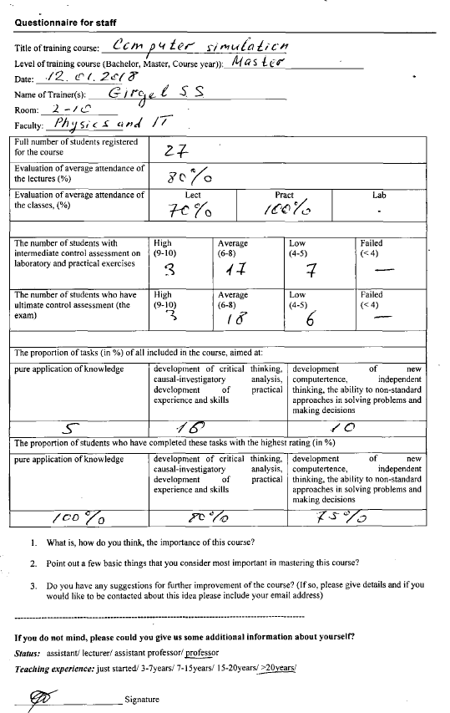

Slide 15
Testing of students organization representatives
The same questionnaire as for students
The similar consolidation reporting form

Slide 16
Report on new curricular testing
with feedback from stakeholders
(Report 1 of KhNAHU of 2020 education year)
Deliverable No 2.8

Slide 17
Schedule for curricular evaluation
Two reports!
(D2.8) | Partner’ Reports on new curricula testing with feedback from teaching staff, students, student’ organisations and entrepreneurs (professional associations, enterprises, etc.) involved in student teaching and curricula enhancement (covered also by D5.5) | 15.01.22 14.06.22.

Slide 18
WP2: Implementation of electronic text books:
1. Bringing innovations to the market – RTU, GSU
2. Mathematical Modelling of Mechatronic Systems – KU Leuven
3. Model-oriented control in Intelligent Manufacturing Systems – CNUT
4. Modern Mathematical Physics: Fundamentals and Application – BSU
5. High-Performance Scientific Computing and Data Analysis – BSU
6. Cyber-Physical Systems modelling and simulation – UCY
7. Cyber-Physical Systems for Clean Transportation – KNAHU
8. Control methods for critical infrastructure and Internet of Things (IoT) systems interdependencies analysis – RTU
9. Computer modelling of physical processes (handbook for students and PhD students)

Slide 19
WP5: Quality Assurance. QAP. ProgressWP5: Quality Assurance. QAP. Progress.

Slide 20
WP6: Dissemination of results. Dissemination and Exploitation plan. Progress

Slide 21
WP3: Application of innovative teaching methods & electronic environments. Progress

Slide 22
WP4: Developing the Sharing Modelling and Simulation Environment platform. Progress.

Slide 23
Planning of students training at RTU, KU Leuven and UCY
The partners just have confirmed the dates of the student training school:
RTU 17.01 – 28.01.2022
KU Leuven 07.02 – 18.02.2022
UCY 28.02 – 11.03.2022
Requirements and recommendations for participants:
Vaccinated
Motivated
EN language knowledge
Laptops are recommended
Preparation:
List of the students by December 15th

Slide 24
Students training at RTU
The course runs for 2 weeks from Monday 17th to Friday 28th of January.
A week before the start (for example, on the January 11th), we will organize a Zoom, where we will discuss the order and Prof Kuņicina will give a homework to the students.
Classes are mainly held in the morning from 9:00 to 12:00. After lunch, mostly (but not each day) from 13:00 to 16:00, independent work either in the laboratory or in the classroom.
One excursion to Recycling Plant of Riga city in Getlini is planned. It depends on Covid-19 situation.
On Wednesday and Thursday 26-27th, Ukrainian partners will be invited to give a couple of lectures on the topics related to new courses before a lunchtime.
On Friday 28th before lunch - defence of prototypes and closing of the school.
On Thursday 27th and Friday 28th (both days after lunch) we plan to hold a Management meeting and a WS with the all partners.
Since our Ukrainian partners are willing to have a meeting in Riga and due to two colleagues from KU Leuven have bought tickets to Riga (for Nov 15-16th), it looks reasonable to arrange a face-to face meeting.

Slide 25
Day 2: Tuesday November 16th
Feedback from the previous day discussions | 10.00 | All partners
Preparation to monitoring and evaluation of the QA by external expert | 10.15 | A. Zabašta
Project financial aspects and results of additional Financial report. | 10.30 | A. Zabašta, all partners.
Feedback from EACEA on Midterm Technical report (remaining issues, which have not been discussed in the previous topics of the agenda) | 11.00 | A. Zabašta, N. Kuņicina, J. Peuteman, I. Ciornei, L. Kruhlenko, V. Kazymyr, A. Hnatov,
Continuing of discussion about project progress: WP2, WP3, WP4, WP5 and WP6 | 11.30 | All partners
Coffee break | 12.00
Other issues | 12.15 | All participants
Conclusions, next steps. | 12.45 | RTU: A. Zabašta, all partners
The end of the day 2 | 13.00

Slide 26
Day 2: November 16th Preparation to monitoring and evaluation of the QA by external expert

Slide 27
External evaluation and monitoring of the project
What is expected by this project:
Intended learning outcomes are developed and published in the new syllabi.
Industry (professional associations, etc.) representatives and students participate in syllabi design.
The curriculum and program design and content is reviewed and evaluated by involved parties and stakeholders; suggestions are offered and follow‐up procedures are determined.
Specific needs of different modes of delivery (e.g. lecturing, lab work, e‐learning) and target groups are taken into account.
Learning resources are available to the teachers and students
Formal program approval procedures by the university authorities are initiated and completed timely.
Monitoring of the progress and achievements of students is in place

Slide 28
External evaluation and monitoring of the project
Primary data for Evaluation and Monitoring should be gathered by:
Questionnaires
Interviews with Universities and Industry representatives
Study program curriculum, syllabus analysis
Feedback reports from Workshops, Seminars, Conferences etc.
Discussions with stakeholders’ and target groups’ meetings

Slide 29
External evaluation and monitoring of the project
Monitoring Outcome
Feed back to Project Management Committee
Evaluation Outcome
Intermediary Report 2022 Spring
Final Report 2022 June - July

Slide 30
Project financial aspects and results of additional Financial report

Slide 31
Financial results – Financial report on 30.10 21
The consolidated report was sent before a deadline
All partners sent their Financial statements – Excel file
Partners have to deliver bookkeeping documents about the cost of salary and travel (excepted KhNAHU)
UCY – In Financial statements WPs, Activities - description does not conform between columns.

Slide 32
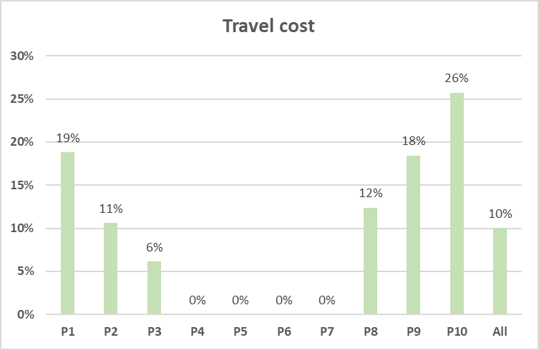
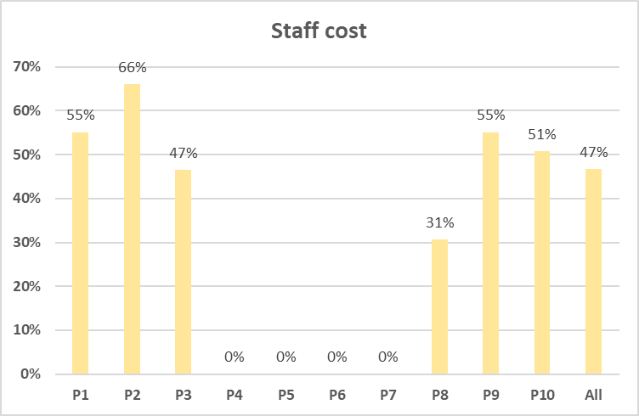
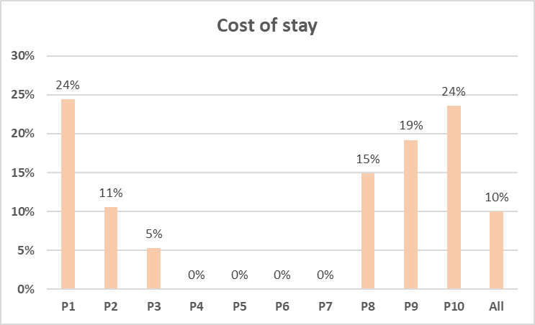
Project financial aspects and results of additional Financial report

Slide 33
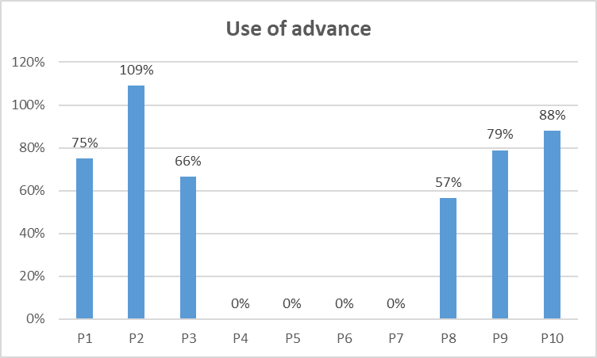
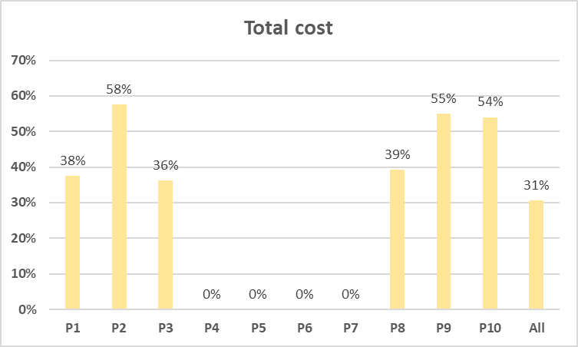
Project financial aspects and results of additional Financial report
Note: CPNU – 18 040 EUR – tender for additional equipment
Suggestion: New advance payment to the partners in November
KU - Leuven 10 000
UCY - No
NCPU - 5 000
KhNAHU - 5000
KNU - 5000
1st advance no Brussels | 415 830
1st advance used (all partners): | 61.2%
1st advance used EU and UA partners: | 78.3%
Remains on RTU account on 3.11.21 | 90 830

Slide 34
Feedback from EACEA on Midterm Technical report (remaining issues, which have not been discussed in the previous topics of the agenda)

Slide 35
Feedback from EACEA
“There is sometimes confusion about where the information should be reported, and we had to look throughout the report to find the answers to our questions.
In the final report, we would recommend that the partners re-read the e-Reports Explanatory Note in the EACEA Beneficiaries’ Space to make sure the information is displayed in the right places”.
Coordinator will send a Final Report template and The e-Reports Explanatory Note. Next Midterm report om March 15th
Note: restricted number of characters in the report form (3600)

Slide 36
Feedback from EACEA: equipment
“The equipment should be registered in the inventory of the corresponding university.
Coordinator should keep proof of this in his files, together with all documentation regarding the tendering process (publication of specs, offers received, etc.).
The purchase of services and equipment in Partner Countries is exempt from VAT.”
All partners have sent documents and proofs about equipment, however, please keep all proofs, because we will receive questions from EACEA.

Slide 37
Feedback from EACEA
“The European Commission is currently reflecting on a way to deal with the situation”.
We have not got answers to two RTU letters about adjustments in the consortium.
As regards the Staff costs Excel sheet, the "Short description of tasks" should be more explicit. The Agency must be able to assess whether the requested amount of unit costs is consistent with the deliverables produced. To this end, we would like to ask you to be more precise in the description of tasks.
I have not got explanation from PO about “Short description of tasks”
Description of tasks in JD has to conform description in TS. EACEA will request proofs for tasks description declared in JD.

Slide 38
Feedback from EACEA: dissemination
“A dissemination and exploitation plan. We consider this plan is a good basis for improvement. The various dissemination activities are listed, but the plan should be more detailed”.
Dissemination plan by December 15th
https://eduphys.bsu.by/mod/folder/view.php?id=2265
Dissemination and Exploitation Plan (July 2021)
Closest tasks for dissemination and exploitation (March 2021)
Communication report (June 2021)
https://eduphys.bsu.by/course/view.php?id=84#section-4 (Communication reports of the partners)
The project website provides general information about the project. However, the website should also be updated regularly.”
WP6 leader will prepare dissemination information for publishing at least once per month
Although, the universities have included information about the project on their websites, it is difficult to find the project’s webpage without the direct weblink. In order to increase dissemination, EU projects should be easier to spot on the university websites.

Slide 39
Feedback from EACEA: sustainability
“Please make sure you keep proof of the accreditation as supporting document. If modules do not require accreditation under national law, please mention it in the final report.
Guidelines were produced on how to develop new PhD Programs in the Cyber-Physical Modelling field”. ???
“The consortium is invited to develop a concrete sustainability strategy, with measurable quantitative/qualitative indicators to (i) increase the interest of students for the newly developed courses; (ii) identify and secure funding sources to ensure the sustainability of these courses in the future”.
QAP WP6 (D6.4): A report with recommendations for new master-level program: introduction in PCs universities beyond the project.
Interviews with the stakeholders: industry representatives should be arranged in order to get a feedback and recommendations about new programs and courses;
Recommendations based on feedback from new courses testing;
recommendations obtained in the meetings and workshops with associated partners and other stakeholders
Sustainability of SMSE platform

Slide 40
Feedback from EACEA: sustainability of the projects
“The Agency is placing a special emphasis on the sustainability of the projects and the dissemination and exploitation of the results. For this purpose, we are conducting regularly ex-post impact monitoring visits”.
To upload the project results on the Project Results Platform at the project end: https://ec.europa.eu/programmes/erasmus-plus/projects/
We consider valid project results:
They are the overall and tangible outputs of your project activities (rather than the actual activities themselves),
such as curricula (or at least curricula compendia),
reports, operating guidelines of the teaching centers, etc.
Agreements with stakeholders, etc.
internal project documents (such as a quality assurance plans, dissemination plans etc.) or promotion material (leaflets, posters, etc.) are not considered as a project results

Slide 41
Other questions

Slide 42
Next meeting schedules
The meeting will be held on line:
On December Fr. 17th 15.00 - 16.30
Agenda:
Methods of the feedback on courses testing and reporting
Dissemination and exploitation plan

Slide 43
Thank you for contribution and participation!

