Slide 1

Erasmus+ KA2
Capacity Building in Higher Education
«Development of practically-oriented student-centred education in Cyber-Physical Systems modelling» «CybPhys»
Official number: 609557-EPP-1-2019-1-LV-EPPKA2-CBHE-JP
WP 2 «Development and modernizing of curricula»
Leader: Kharkiv National Automobile and Highway University
Presented by:
Professor Andrii Hnatov
Zoom meeting 15-16.11.2021

Slide 2

2
Kharkiv National Automobile and Highway University
KA2: «CybPhys»
WP2 Tasks:
2.1. Development curricula and study programs for education. Teaching materials for the bachelor- and master-students study programs and courses. (Due date 14.08.2021)
2.2. Teaching staff training on curricula topics. Students training on curricula topics. (Due date 14.11.2021.)
2.3. Teachers training on professional English languages skill. (Due date 14.11.2020.)
2.4. Workshops for curricula and study programs development: WS2 – WS9. (14.08.2022)
2.5. Curricula accreditation in the universities and Accreditation offices of PCs. (30.06.2021.)
2.6. Testing and validation of the developed education programs, courses and lab practices. (Due date 14.06.2022)
2.7. Tuning of curricula and study programs in PCs universities. (Due date 14.11.2022)
2.8. Measuring of a feedback of stakeholders. (Due date 14.08.2022)
2.9. Double Degree Master program development and accreditation. (Due date 14.08.2022)

Slide 3

3
Kharkiv National Automobile and Highway University
KA2: «CybPhys»
Acceptance of new study programs and courses
CPNU: 5 new and 2 modernized courses
New: master degree courses in the new master program “Industrial Automation”. The program will be accredited by the Education and Science of Ukraine.
Model-oriented control in Digital Manufacturing
Programming of Automation Systems
Design and Simulation of Power electronics components
Modelling and Measurement of physical processes in Robotics.
Simulation of Manufacturing Environment
Updated courses in the existing Bachelor program “Computer systems of automation”
Introduction to electronic systems
Development of electromechanical robotic systems.

Slide 4
4
Kharkiv National Automobile and Highway University
KA2: «CybPhys»
Acceptance of new study programs and courses
CPNU: 5 new and 2 modernized courses
University | Course/Lab title | Updated or totally new | Level (Bachelor, Master) | ECTS credit points | The teaching/training methodologies developed/adopted e.g. e-learning/ training modalities, practical placements in enterprises, etc. | The link to the university‘ webpage | Date of accreditation | The status / document of accreditation
CPNU | Model-oriented control in Digital Manufacturing | New | Master | 5 | training methodologies developed , | https://stu.cn.ua/wp-content/uploads/2021/04/new-courses20-1.pdf | April 27,/2020 | Accreditation of the specialty "Computer engineering", master level. Certificate of accreditation series ND № 2685401 from June 27, 2017. The certificate is valid until July 1, 2024
CPNU | Programming of Automation Systems | New | Master | 5 | teaching | -“- | -“- | -“-
CPNU | Design and Simulation of Power electronics components | New | Master | 5 | training methodologies developed | -“- | -“- | -“-
CPNU | Modelling and Measurement of physical processes in Robotics | New | Master | 5 | teaching | -“- | -“- | -“-
CPNU | Simulation of Manufacturing Environment | New | Master | 5 | training methodologies developed | -“- | -“- | -“-
CPNU | Introduction to electronic systems | Updated | Bachelor | 6 | adopted | -“- | Marth 25,/2019 | Accreditation of the specialty "Electronics", bachelor level. Certificate of accreditation series ND № 2687200 from July 31, 2017. The certificate is valid until July 1, 2024
CPNU | Development of electromechanical robotic systems | Updated | Bachelor | 4 | adopted | -“- | -“- | -“-

Slide 5

5
Kharkiv National Automobile and Highway University
KA2: «CybPhys»
Acceptance of new study programs and courses
KhNAHU: 2 new and 4 modernized courses
To develop 2 new training courses for master’s students program “Electric Vehicles and Energy-Saving Technologies”. The program will be accredited by the Education and Science of Ukraine.
Energy-saving technologies in transport;
The structure of hybrid and electric vehicles;
4 training courses will be upgraded and renewed for Master’s students in “Electric Vehicles and Energy-Saving Technologies”:
Electric systems of environmentally friendly vehicles;
Methods of planning scientific research on vehicles;
Mathematical modelling and methods of optimization;
Intelligent information technologies and systems in transport.

Slide 6
6
Kharkiv National Automobile and Highway University
KA2: «CybPhys»
Acceptance of new study programs and courses
KhNAHU: 2 new and 4 modernized courses
University | Course/Lab title | Updated or totally new | Level (Bachelor, Master) | ECTS credit points | The teaching/training methodologies developed/adopted | The link to the university‘ webpage | Date of accreditation | The status / document of accreditation
KhNAHU | Energy-saving technologies in transport | New | Master | 8,5 | Lecture, practicals, lab practicals | http://dl.khadi.kharkov.ua/course/view.php?id=1331 | autumn 2022 | Completed, autumn 2022
KhNAHU | The structure of hybrid and electric vehicles | New | Master | 4 | Lecture, lab practicals | https://dl.khadi.kharkov.ua/course/view.php?id=1630 | autumn 2022 | Completed, autumn 2022
KhNAHU | Electric systems of environmentally friendly vehicles | Updated | Master | 4 | Lecture, lab practicals | http://dl.khadi.kharkov.ua/course/view.php?id=1356 | autumn 2022 | Completed, autumn 2022
KhNAHU | Methods of planning scientific research on vehicles | Updated | Master | 5,5 | Lecture, practicals, lab practicals | https://dl.khadi.kharkov.ua/course/view.php?id=1363 | autumn 2022 | Completed, autumn 2022
KhNAHU | Mathematical modelling and methods of optimization | Updated | Master | 3 | Lecture, lab practicals | https://dl.khadi.kharkov.ua/course/view.php?id=1733 | autumn 2022 | Completed, autumn 2022
KhNAHU | Intelligent information technologies and systems in transport | Updated | Master | 8,5 | Lecture, practicals, lab practicals | http://dl.khadi.kharkov.ua/course/view.php?id=1357 | autumn 2022 | Completed, autumn 2022

Slide 7

7
Kharkiv National Automobile and Highway University
KA2: «CybPhys»
Acceptance of new study programs and courses
KNU: 3 new and 4 modernized courses
New: master degree
Smart manufacturing based on cyber-physical systems
Machine Learning for Cyber Physical Systems and Industry
Transportation Cyber-Physical Systems
Updated master degree: Training courses will be upgraded and renewed for Master’s students in “Сyber-physical systems” and “Automobiles and Fleet”.
Project approach to the designing of cyber-physical systems
Adaptive and Robust Systems
Open-Pit Transport Сyber-Physical Systems
Modern Information Technologies in Transport

Slide 8
8
Kharkiv National Automobile and Highway University
KA2: «CybPhys»
Acceptance of new study programs and courses
KNU: 3 new and 4 modernized courses
University | Course/Lab title | Updated or totally new | Level (Bachelor, Master) | ECTS credit points | The teaching/training methodologies developed/adopted | The link to the university‘ webpage | Date of accreditation | The status / document of accreditation
KNU | Smart manufacturing based on cyber-physical systems | new | Master (mandatory) | 8 | Discipline teaching plan, syllabus, lectures, distant learning materials | https://classroom.google.com/c/MjU0NjIyMzc2NjU5?cjc=i4jbi5l | Autumn 2022 | Approval protocols: - №8 from 09.02.21 – Department of Automatiom, Computer Scienses and Technologies - №7 from 22.02.21 – Faculty of international Technologies - №7 from 23.02.21 Academic Council of KNU. Order №109 from 24.02.21 on the implementation of the Stydy Programm and teaching plans
KNU | Machine Learning for Cyber Physical Systems and Industry | new | Master (mandatory) | 6 | Discipline teaching plan, syllabus, lectures, distant learning materials | https://classroom.google.com/c/NDAwNjE0Mzg4MTYw?cjc=s2lfpam | Autumn 2022 | Approval protocols: - №8 from 09.02.21 – Department of Automatiom, Computer Scienses and Technologies - №7 from 22.02.21 – Faculty of international Technologies - №7 from 23.02.21 Academic Council of KNU. Order №109 from 24.02.21 on the implementation of the Stydy Programm and teaching plans
KNU | Transportation Cyber-Physical Systems | new | Master (variable) | 8 | Discipline teaching plan, syllabus, lectures, distant learning materials | https://classroom.google.com/c/NDI2MjU0MDAxMTkx?cjc=chhhhvg | Autumn 2022 | Approved by ACST dep. #1 from 25.08.21
KNU | Open Pit Intelligent Transportation System | updated | Master (variable) Bachelor (variable) for specialty 275 – Transportation technologies (on road transport) | 8 | discipline curriculum, syllabus, lectures | https://classroom.google.com/c/NDI2MjM5ODI0MzI3?cjc=swvawpr | Autumn 2022 | Approved by ACST dep. #1 from 25.08.21 Approved by KNU authorities prot #7 from 14.05.2020

Slide 9
9
Kharkiv National Automobile and Highway University
KA2: «CybPhys»
Acceptance of new study programs and courses
KNU: 3 new and 4 modernized courses
University | Course/Lab title | Updated or totally new | Level (Bachelor, Master 5-year course) | ECTS credit points | The teaching/training methodologies developed/adopted | The link to the university‘ webpage | Date of accreditation | The status / document of accreditation
KNU | Modern Information Technologies in Transport | updated | Master (variable) Bachelor (variable) for specialty 275 – Transportation technologies (on road transport) | 8 | discipline curriculum, syllabus, lectures | https://classroom.google.com/c/NDAyNzc1ODk0MzM1?cjc=2sbxy6v | Autumn 2022 | Approved by ACST dep. #1 from 25.08.21 Approved by KNU authorities prot #7 from 14.05.2020
KNU | Adaptive and Robust Systems | updated | Master (mandatory) | 8 | Discipline teaching plan, syllabus, lectures, distant learning materials | https://classroom.google.com/u/1/c/MjI0NDQ4MjU3MTg3 | Autumn 2022 | Approval protocols: - №8 from 09.02.21 – Department of Automatiom, Computer Scienses and Technologies - №7 from 22.02.21 – Faculty of international Technologies - №7 from 23.02.21 Academic Council of KNU. Order №109 from 24.02.21 on the implementation of the Stydy Programm and teaching plans
KNU | Project Approach to the Designing of Cyber-Physical Systems | updated | Master (variable) | 8 | Discipline teaching plan, syllabus, lectures, distant learning materials | https://classroom.google.com/u/1/w/MjI0MTE5Mjg1MTg3/t/all | Autumn 2022 | Approval protocols: - №8 from 09.02.21 – Department of Automatiom, Computer Scienses and Technologies - №7 from 22.02.21 – Faculty of international Technologies - №7 from 23.02.21 Academic Council of KNU. Order №109 from 24.02.21 on the implementation of the Stydy Programm and teaching plans

Slide 10



10
Kharkiv National Automobile and Highway University
KA2: «CybPhys»
Double Diploma Master Program
between
Riga Technical University
and
Kharkiv National Automobile and Highway University
An agreement was signed between Riga Technical University and Kharkiv National Automobile and Highway University on the introduction of a double degree diploma in the educational process of the master's degree program "Electric Vehicles and Energy-Saving Technologies" (within 141 specialties "Electric Power, Electrical Engineering and Electromechanics").

Slide 11
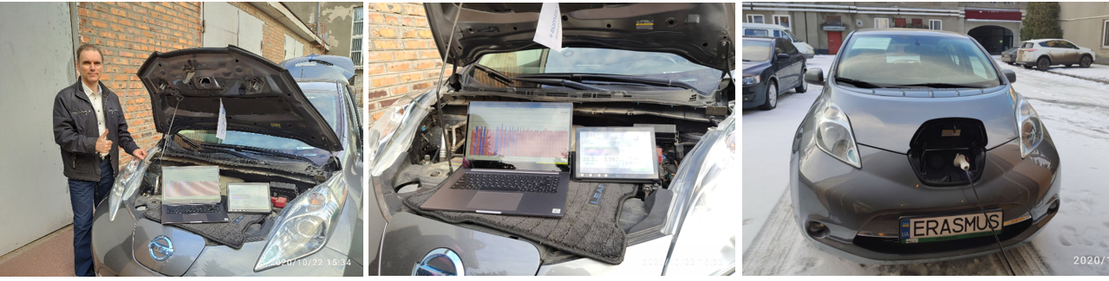
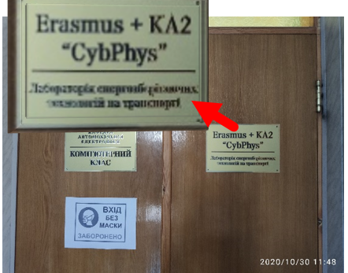
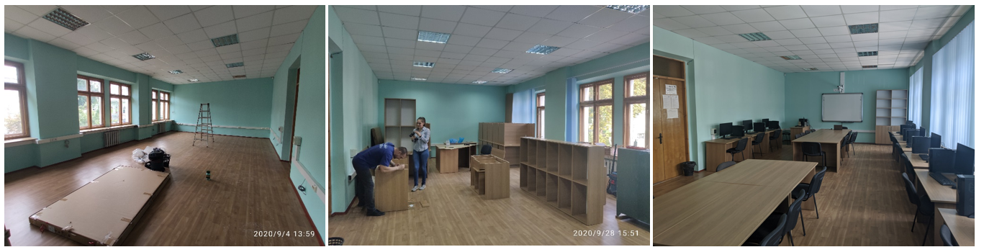
11
Kharkiv National Automobile and Highway University
KA2: «CybPhys»
Laboratory of Energy-saving
technologies in transport
The lab "Laboratory of Energy-saving technologies in transport" was created.

Slide 12
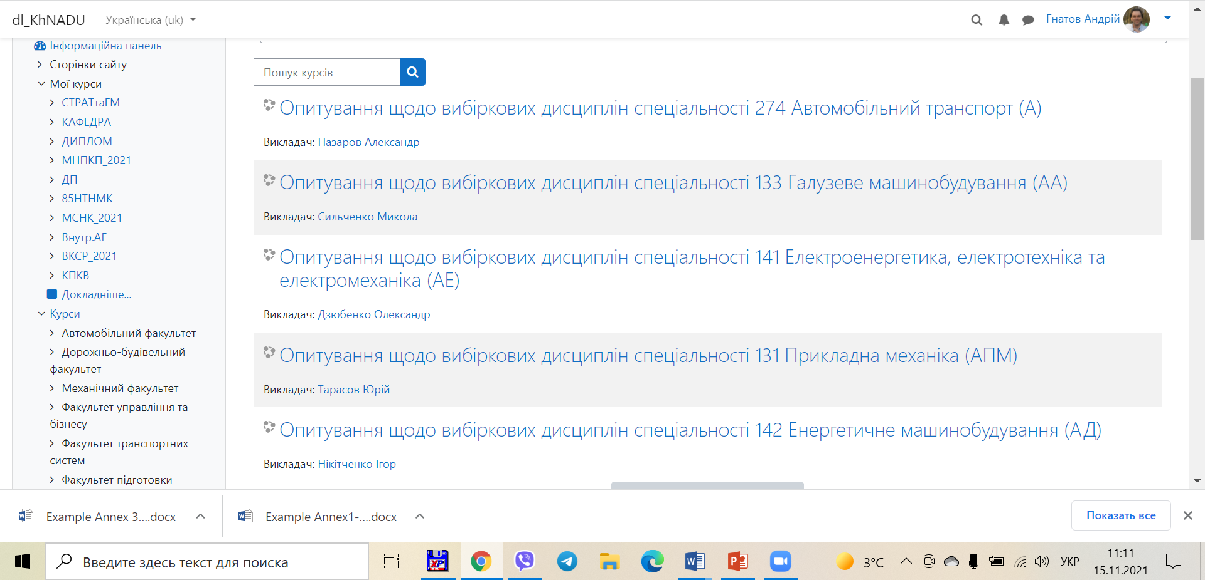
12
Arrangements for testing of new developed and modernized courses

Slide 13
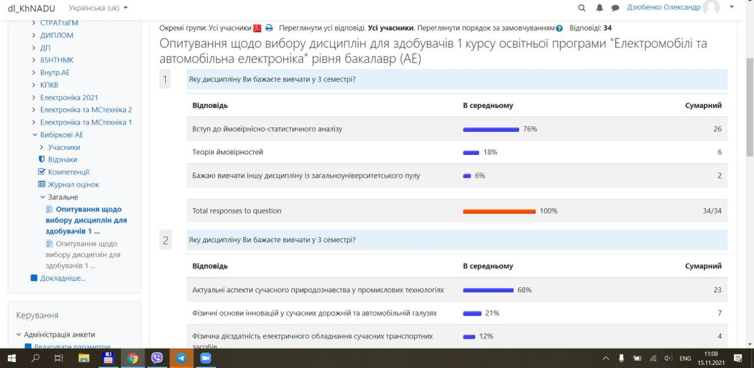
13
Arrangements for testing of new developed and modernized courses

Slide 14
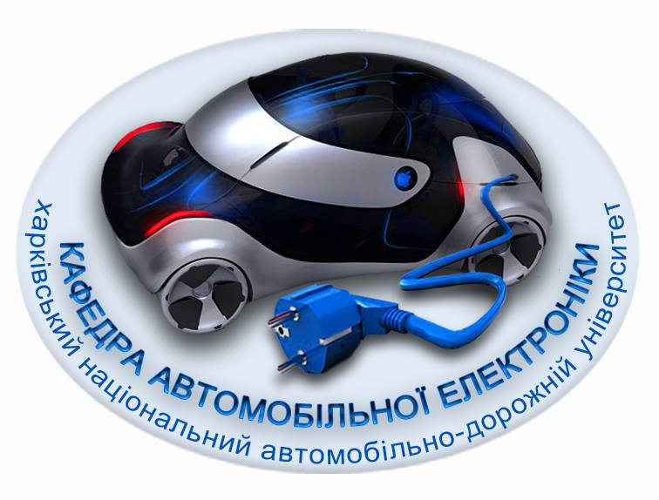
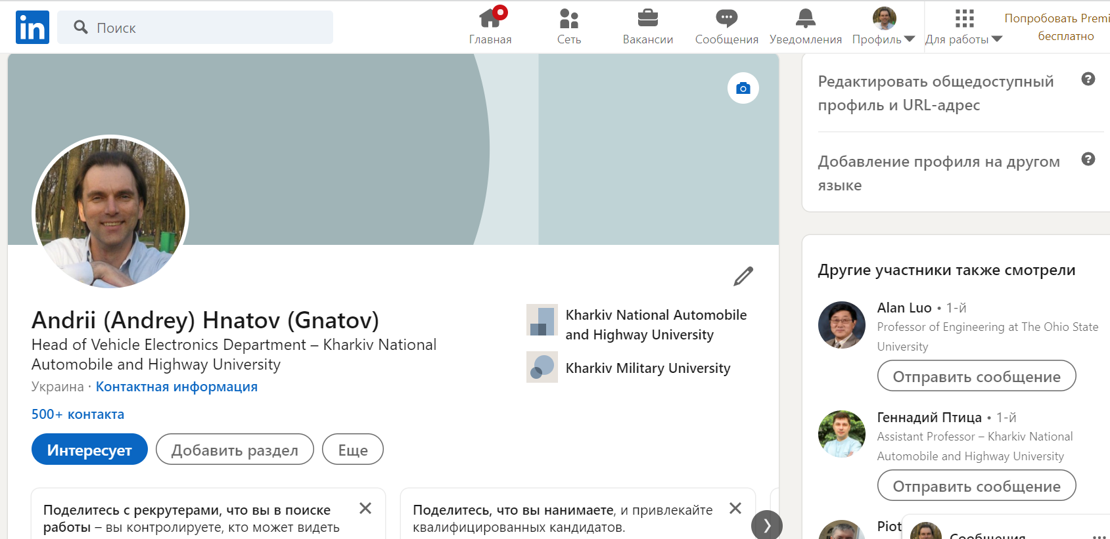
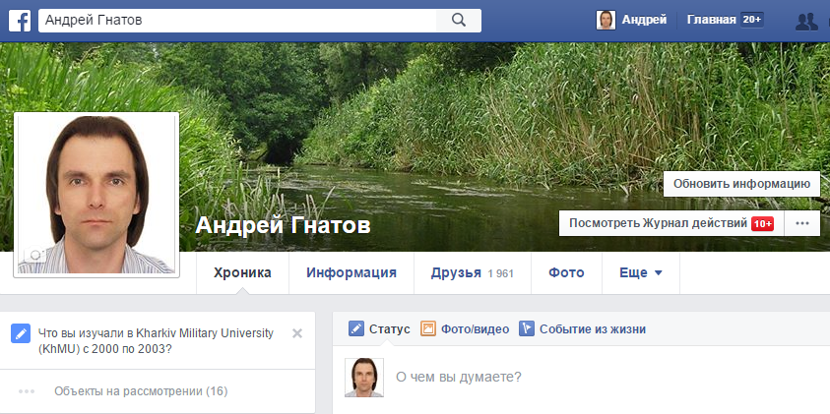
Contacts
14
Address: 61002, Ukraine, Kharkiv, Yaroslava Mudrogo St., 25
Kharkiv National Automobile and Highway University
Phone: +38(057) 700-38-52
Mobile: +38(066) 743-08-87
Е-mail: kalifus76@gmail.com
Linkedin: Andrii Hnatov
Linkedin
Facebook

