Slide 1
Chernihiv Polytechnic National University
Erasmus+ project 609557-EPP-1-2019-1-LV-EPPKA2-CBHE-JP
“Development of practically-oriented student-centred education in the field of modelling of Cyber-Physical Systems", Acronim “CybPhys”
Online meeting 11, May 2022

Slide 2
SMSE progress
1. SMSE development
2. SMSE manual development

Slide 3
SMSE architecture
Main idea and task – embedding Jupyter platform to Moodle
Account Management system
(Moodle Learning Platform )
SMSE architecture
Tools Support system
(Jupyter platform )
Content
(Interactive courses like Jupyter notebook)

Slide 4
SMSE data flow diagram
Jupyter Lab documents
Moodle
Jupyter platform
Course topic documents
Intermediate storage
……
Users
Jupyter Lab documents

Slide 5
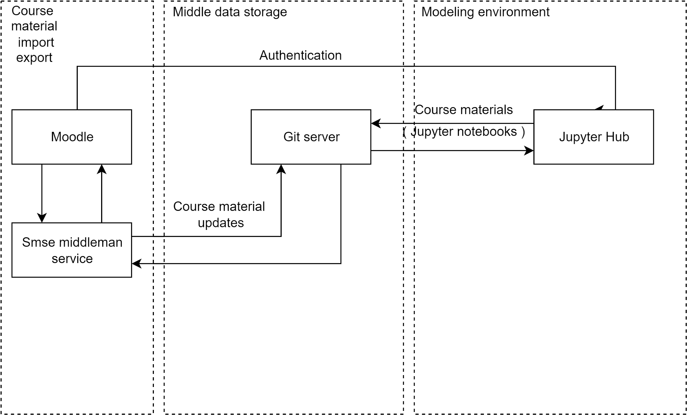
SMSE deployment diagram
5

Slide 6
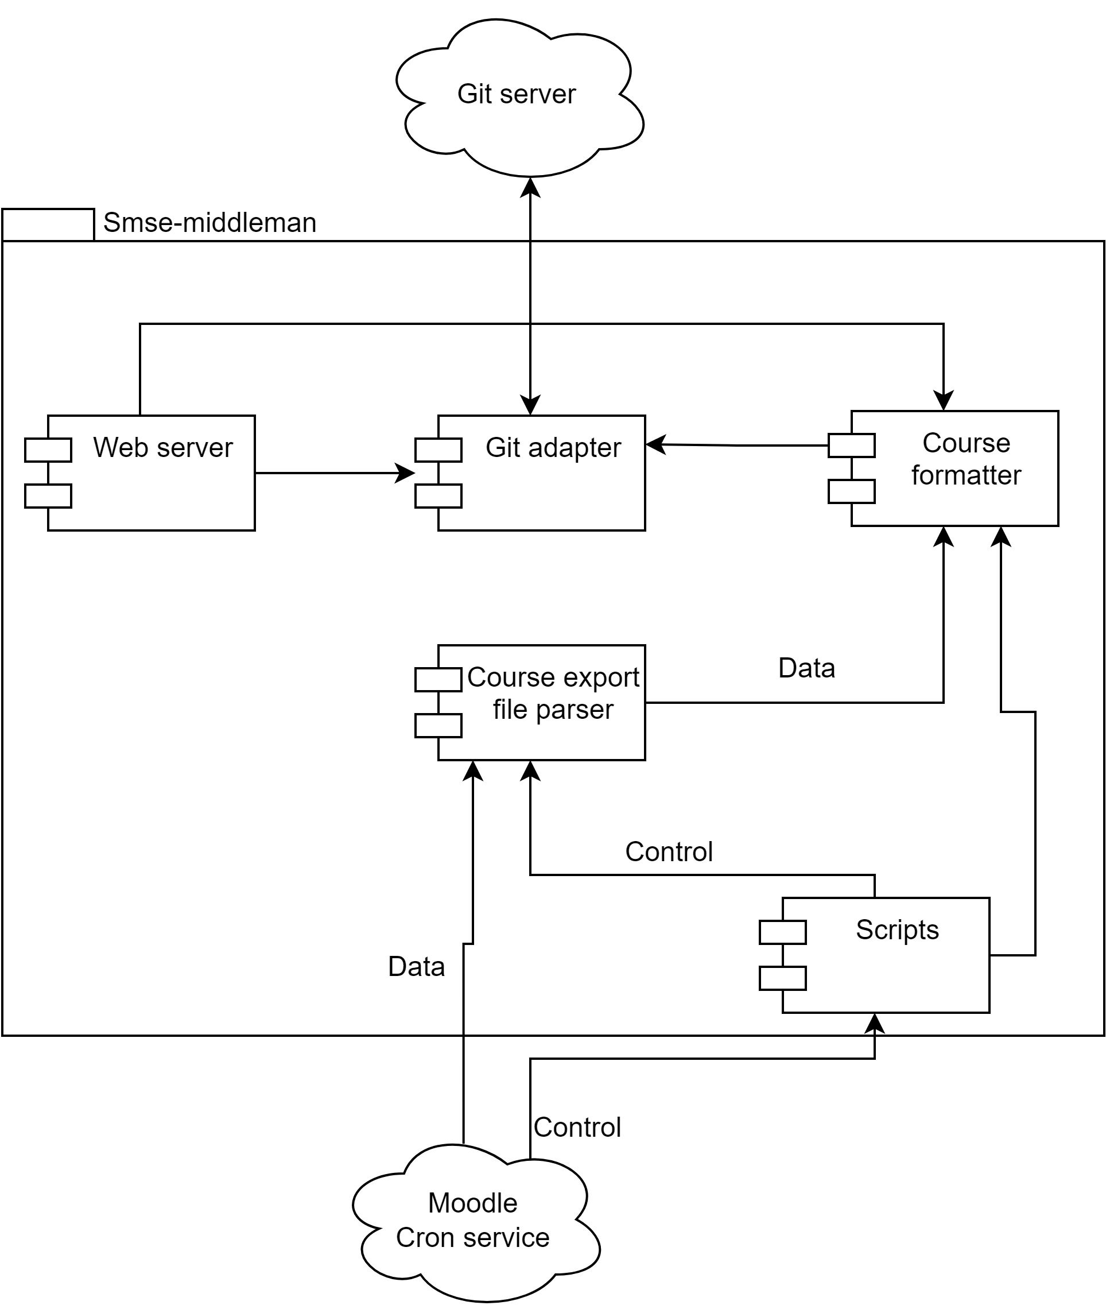
SMSE middleman diagram

Slide 7
SMSE manual
1. SMSE overview
2. Jupyter Notebook manual
3. SMSE using

Slide 8
Contact information:
Chernihiv National University of Technology 14035, Ukraine, Chernihiv, Shevchenko Str., 95
site: www.stu.cn.ua
CybPhys project contacts:
Volodymyr Kazymyr
tel. +38 050 344 43 77
e-mail: vvkazymyr@gmail.com

