Slide 1
ERASMUS+ Modelling CybPhys 609557
Kryvyi Rih National University
Monitoring meeting, RTU
November 25th , 2022

Slide 2
WP2-Development and modernizing of curricula
2.1. Workshops for curricula and study programs development
2.2. Testing and validation of the developed education programs, courses and
lab practices.
2.3. Tuning of curricula and study programs
2.4. Measuring of a feedback of stakeholders.
2.5. Bachelors program 274- Transport technologies (in automotive transport) Accreditation in NAQA (spring 2021)
Double Degree Master program “151-Cyber-physical systems in industry, business and transport” Accreditation in NAQA (autumn 2022)
2

Slide 3
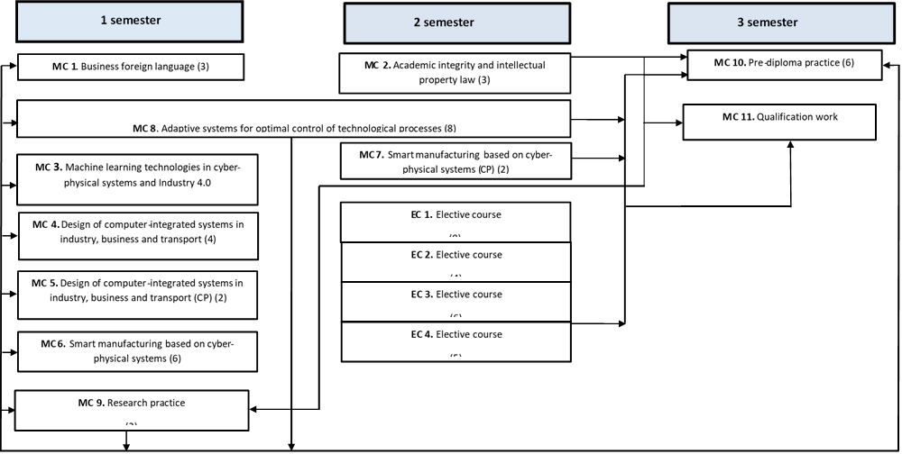
Architecture of Double Degree Master program “151-Cyber-physical systems in industry, business and transport”
MC – Mandatory Course, EC – Elective Course, CP – Course Project
2

Slide 4
Double Degree Master program “151-Cyber-physical systems in industry, business and transport”
Year | Number of students
2022- 2023 | 33
2021-2022 | 7
Results of the first stage of Accreditation of
Double Degree Master program “151-Cyber-physical systems in industry, business and transport” from NAQA
Criterion 1. Design and goals of the educational program A
Criterion 2. Structure and content of the educational program B
Criterion 3. Access to the educational program and recognition of learning outcomes B
Criterion 4. Studying and teaching according to the educational program B
Criterion 5. Control measures, evaluation of applicants for higher and academic education virtue B
Criterion 6. Human resources B
Criterion 7. Educational environment and material resources A
Criterion 8. Internal quality assurance of the educational program B
Criterion 9. Transparency and publicity B
All materials on the web-page http://www.knu.edu.ua/akredytaciya
2

Slide 5
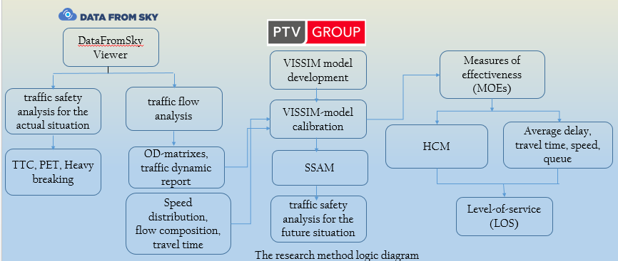
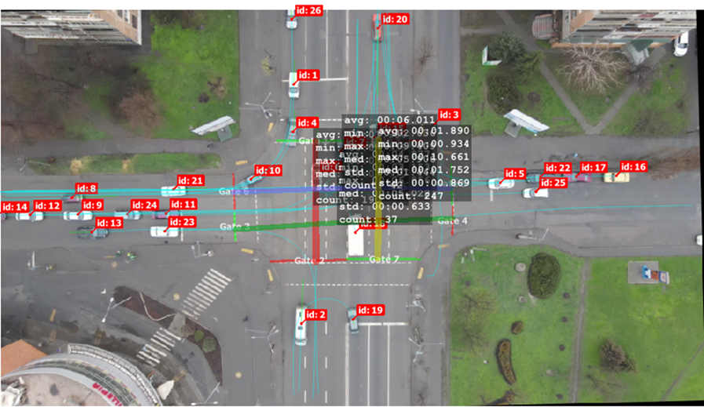
The research elements implementation in the courses
Modern Information Technologies in Transport
Using equipment: UAV DJI Mavic Air2
2

Slide 6
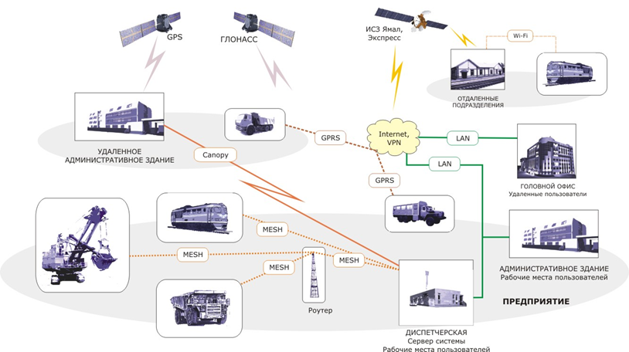
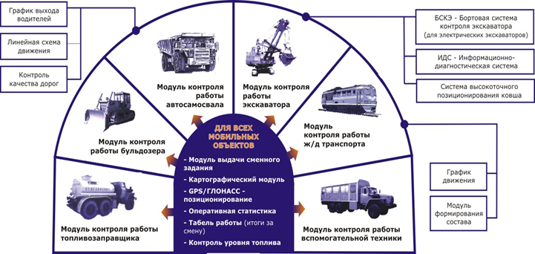
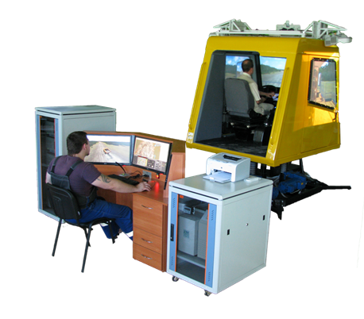
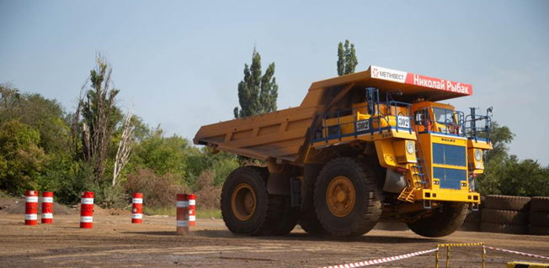
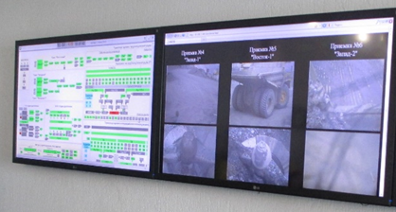
The research elements implementation in the courses
Open Pit Transport Cyber-Physical Systems
2

Slide 7
WP5: Quality assurance
Feedback from students – 14 persons involved
Feedback from stakeholders on newly developed courses – at least 5 persons involved
Area of professional activity | Name of organization/enterprise | The name of the course evaluated
Industrial enterprise | Nadra invest Ukraine | Project approach to the development of cyber-physical systems
 | PJSC ArcelorMittal Kryvyi Rih Mining department Office | Modern Information Technologies in Transport, Open Pit Cyber-Physical Systems
R&D | Krivbassproekt | Project approach to the development of cyber-physical systems, Adaptive and robust systems
IT-services | GIGA UA | Smart manufacturing based on cyber-physical systems, Adaptive and robust systems, Machine Learning Technologies in Cyber-Physical Systems and Industry 4.0
HEI | KNU | Smart manufacturing based on cyber-physical systems, Adaptive and robust systems, Machine Learning Technologies in Cyber-Physical Systems and Industry 4.0
Municipality | Transport and Communications Department of the Executive Committee of the Kryvyi Rih City Council | Modern Information Technologies in Transport, Open Pit Cyber-Physical Systems
2

Slide 8
WP6 – Dissemination
6.1. Development of information and promotional materials
6.2. Information sessions for target groups
6.3. Project Web Portal and social media
6.4. Recommendations for new training programs for the targeted stakeholders beyond the project
6.5. Strengthening the academia – industry network
6.6. Maintenance of e-Learning and SMSE platform beyond the project.
6.7. Strengthening cooperation beyond the project to sustain the outcomes.
2

Slide 9
1. Methodology of the dissemination
The tasks for the last period of the project:
Develop Dissemination and Exploitation Plan
Stimulate media interest and coverage
Design and display posters and leaflets at Ukrainian universities
Participate in conferences and publish papers in high impact journals
Plan and Conduct seminars for main stakeholders
Plan and arrange information sessions to attract students and to inform stakeholders, authorities and other HEIs
Disseminate and exploit the project activities and results using virtual forums and other social networking sites
Develop, create and maintain an accessible project website as key valorisation tool
Organize a final conference to disseminate the project results and organize their evaluation by stakeholders, education authorities and the industry representatives
3

Slide 10
Quantitate assessment of implemented activities in the framework of WP6
Item | Activity | Implemented
 | Identify Key Stakeholders in the field for targeted dissemination of project goals, objectives and outcomes | KhNAHU (16), KNU (10), CPNU (11)
WP6.1 | Stimulate media interest and coverage | Press releases: RTU (3), KHNAHU (4), KNU (1), CPNU (2), UCY (2)
WP6.2 | Plan and arrange information sessions to attract students and to inform stakeholders, authorities and other HEIs | RTU (4), KU Leuven (3), KNU (1), KHNAHU (2), CPNU (3)
WP6.3 | Participate in conferences and publish papers in high impact journals | UCY (2), KULeuven (5), RTU (4), CPNU (2), KHNAHU (3), KNU (4)
4

Slide 11
Item | Activity | Implemented
WP6.2 | Plan and Conduct seminars for main stakeholders | -
WP6.2 | Organize a final conference | Hybrid format
WP6.3 | Disseminate and exploit the project activities and results using virtual forums and other social networking sites | YCU (29), RTU (perm), KULeuven (16), KhNAHU (perm), KNU (perm), CPNU (perm)
WP6.3 | Maintain an accessible project website | RTU
WP6.5 | Strengthening the academia – industry network | CPNU (11), KHNANU (16), KNU (8)
WP6.6 | Maintenance of e-Learning and SMSE platform beyond the project. | CPNU (5)
WP6.7 | Strengthening cooperation beyond the project to sustain the outcomes | -
5

Slide 12
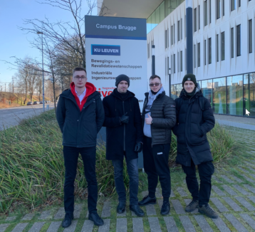
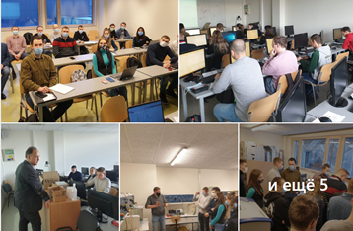
Dissemination activities KNU (Jan-Sept 2022)
Students of the Department of Automation, Computer Sciences and Technologies of KNU completed internship at RTU in the period January 17-28, 2022.
Students of KNU completed an internship at the KU Leuven in the period February 07-19, 2022
7

Slide 13
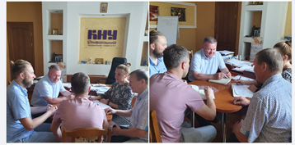
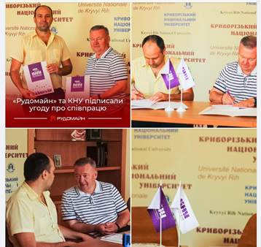
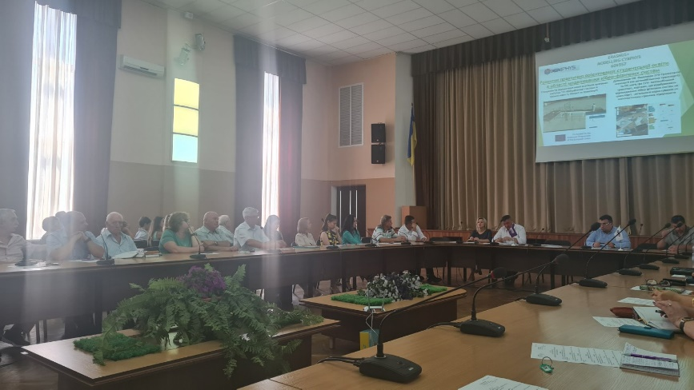
Dissemination activities KNU (Jan-Sept 2022)
Strengthening the academia – industry network
Strengthening internal communications
Memorandums and agreements were signed between the Department of Automation, Computer Science and Technology KNU and Kryvyi Rih industrial enterprises "Belaz SMTC", "Krivbasproekt", "Transmash KR
KNU CybPhys internal team meetings
KNU signed a partnership agreement with “Rudomine” company
Team leader presented the project at KNU staff meeting
8

Slide 14
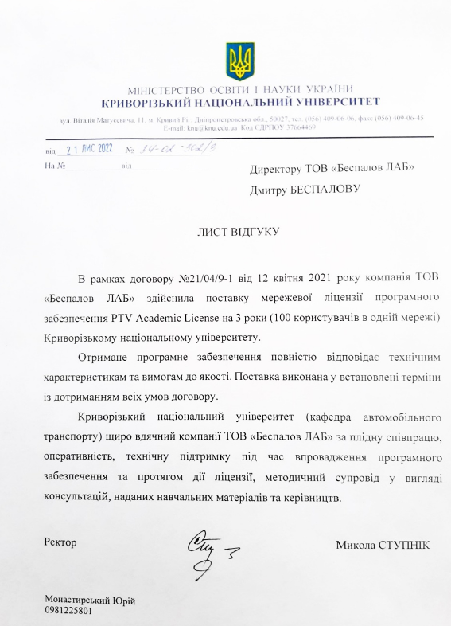
Feedback from/to the stakeholders, PTV group distributor
8

Slide 15
THANK YOU FOR YOUR ATTENTION!

