Slide 1
Development of practically-oriented student-centred education in the field of modelling of Cyber-Physical Systems – CybPhys 609557-EPP-1-2019-1-LV-EPPKA2-CBHE-JP – ERASMUS+ CBHE
WS meeting on QA with external expert
January 23rd 2023
Anatolijs Zabashta,
Project coordinator
Riga Technical University

Slide 2
Agenda for September 19th
Quality assurance issues of CybPhys project – Irina Kulitane, expert of Konso Ltd.
Discussion on QA issues – all partners
Next steps on QA by the end of the project
Other issues
Student’s school in Nicosia

Slide 3
Project progress
On-line WS on SMSE acquisition was held on January 12th
On-line workshop will be arranged by CPNU in February – March.
The date of WS will be confirmed by CPNU with the project partners by the end of January.
CPNU and partners will make preparation to WS in Bruges on “Acquisition of SMSE – eLearning platform”.
Since each Ukrainian (EU partners are welcomed!) should develop at least one laboratory work on SMSE, participants of the workshop should fulfil a homework before WS in Bruges.
CPNU will prepare in advance home task and recommendations before WS.
Purchase of laptops
Confirmation from the Ministry of Economy
Adjustments of PA
RTU will transfer advance

Slide 4
WP 5 Quality Assurance
Irina Kulitane, Konso Ltd

Slide 5
Further tasks and the next steps

Slide 6
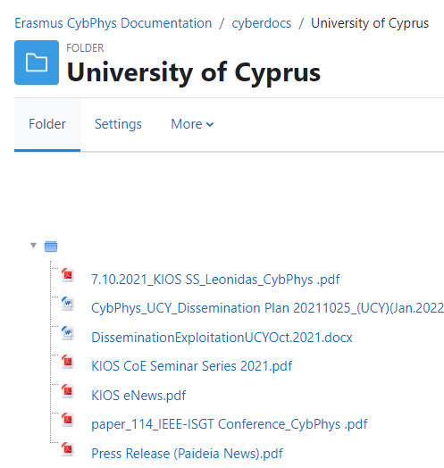
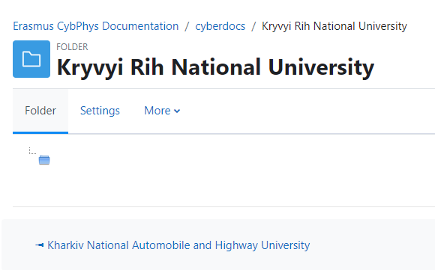
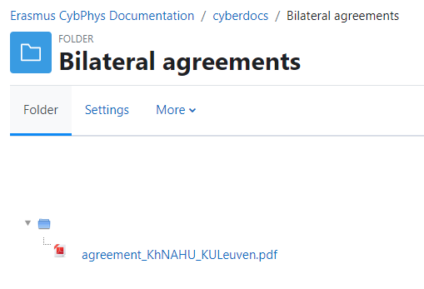

Slide 7
Further tasks and the next steps
Students training in UCY, Nicosia, Jan. 30- Feb. 10th, 2023 (at site and online)
Meeting on March 16-18th in Riga!
Purchase of laptops
CPNU will arrange a seminar on SMSE in February-March.
Preparation to the WS in Bruges on April 12-14th.
Ukrainian partners will publish all documents, which proof accreditation of courses and study programs in the e-Library of CybPhys.
Accreditation of study programs and courses by the end of April 2023.
Preparation to the Final conference in Riga on April 27-28th
- Sustainability plan beyond the project

Slide 8
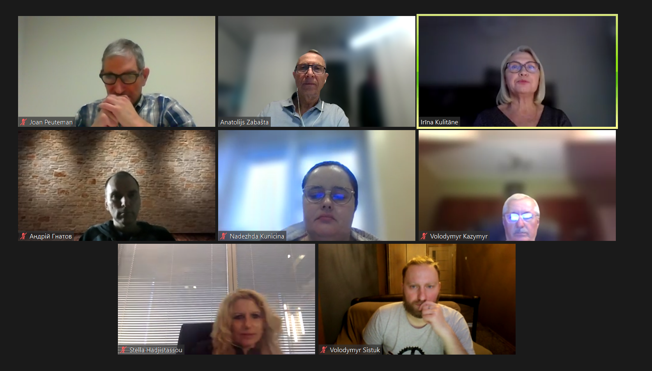

Slide 9
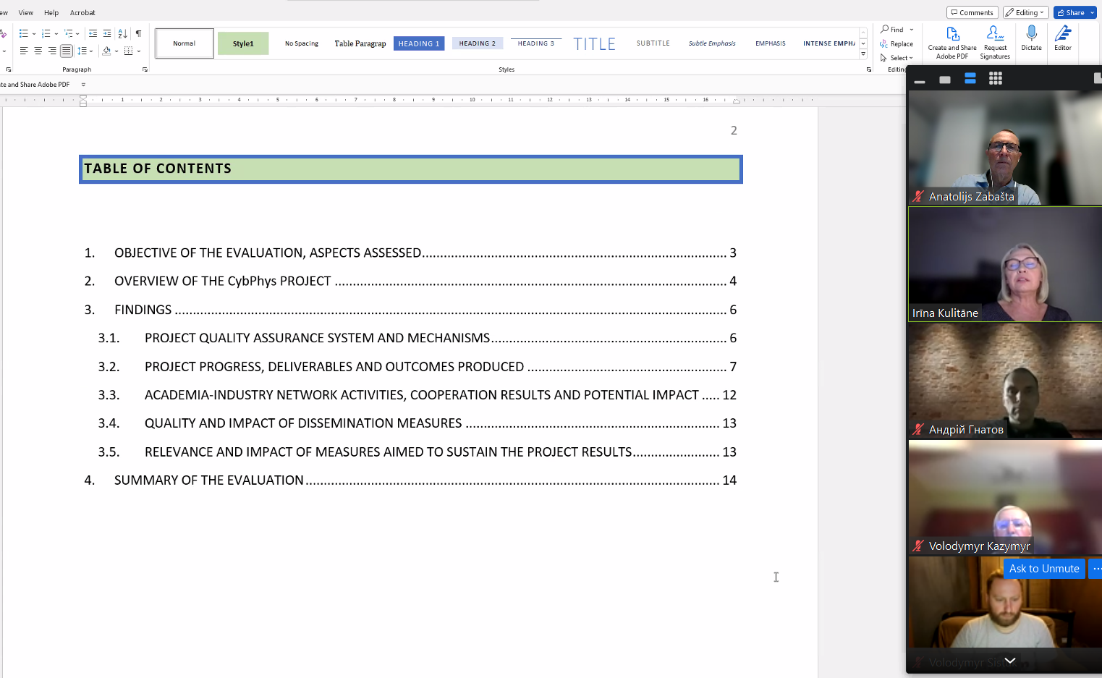

Slide 10
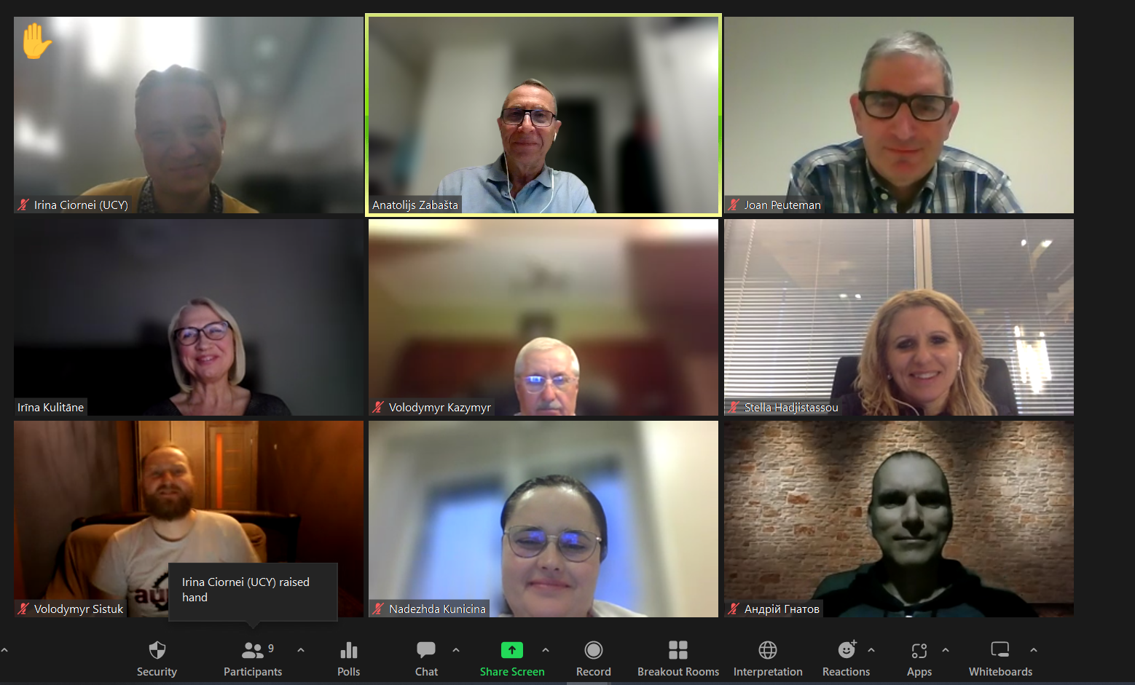

Slide 11
Thank you for the questions!

