Slide 1
Cyber-Physical Systems: modelling – linear and non-linear systems part 1
Joan Peuteman
Workshop: March 16-18 (2023).
Erasmus+: Development of practically-oriented student-centred education
in the field of modelling of Cyber-Physical Systems (CybPhys)

Slide 2
Table of content
Modelling
Different types of models 1
Different types of models 2
Stages of mathematical modelling
Solving the equations
Solving the equations: example

Slide 3
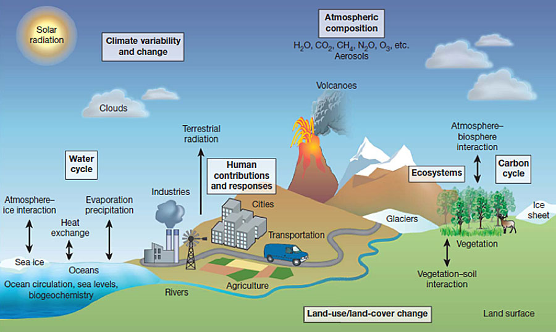
Modelling
Models are used to describe the way systems behave.
The behaviour of systems can be very complicated and hard to study.
Example: Our environment, our climate is a system. It is really hard to understand its behaviour. It is really hard to predict its behaviour.

Slide 4
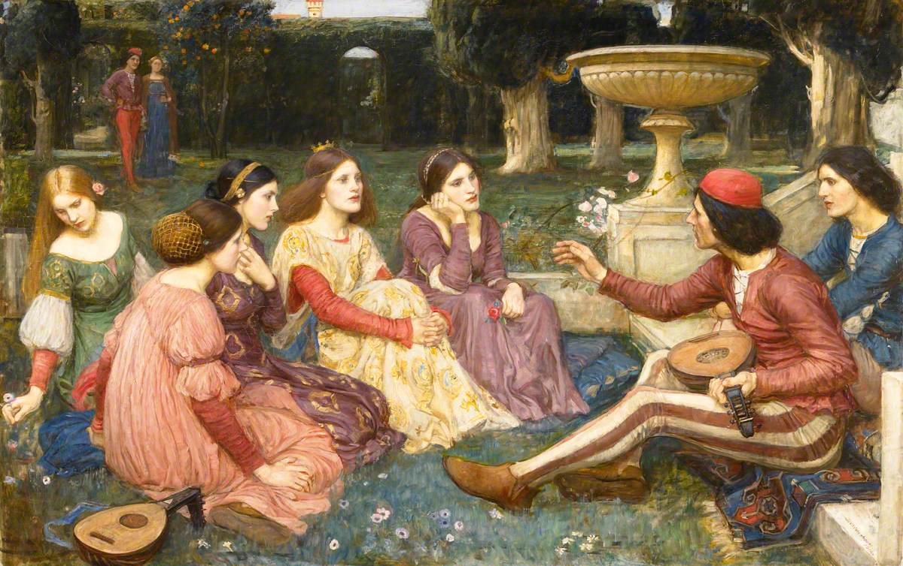
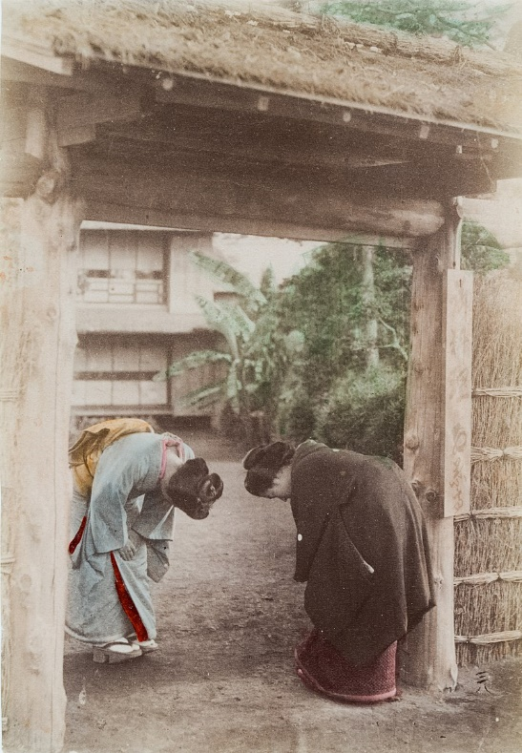
Modelling
Example: Each human being is a system. It is really hard to understand the human behaviour: behaviour of an individual person – behaviour of a group of people.
The Decameron: 14th century.
Japanese women: 19th century.

Slide 5
Modelling
Example: A learning process of an individual person or an entire classroom. It is hard to model, understand and control its behaviour.

Slide 6
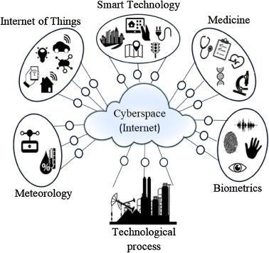
Modelling
Example: Cyber-Physical Systems are everywhere in our modern society. They have an increasing impact on our daily life.
Cyber-Physical Systems
A self-driving car contains a huge range of
Cyber-Physical Systems.

Slide 7
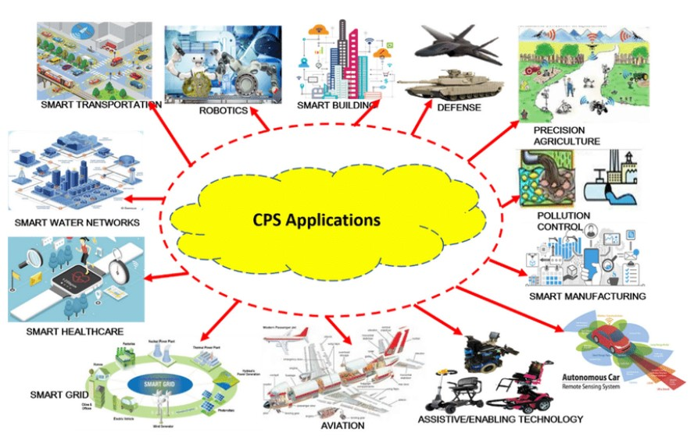
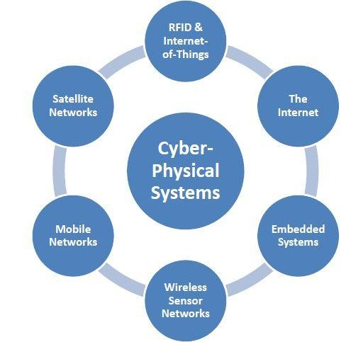
Modelling
The performance but also the complexity of Cyber-Physical Systems is increasing steadily. Appropriate models to understand its behaviour are really needed.

Slide 8
Modelling
Models are used in almost every professional discipline:
social sciences,
political sciences,
economics,
natural sciences,
engineering: mechanical systems
engineering: electronic systems,
engineering: mechatronic systems
engineering: Cyber-Physical Systems,
…
By modelling systems, mathematical tools allow a much better understanding of the behaviour of these systems.

Slide 9
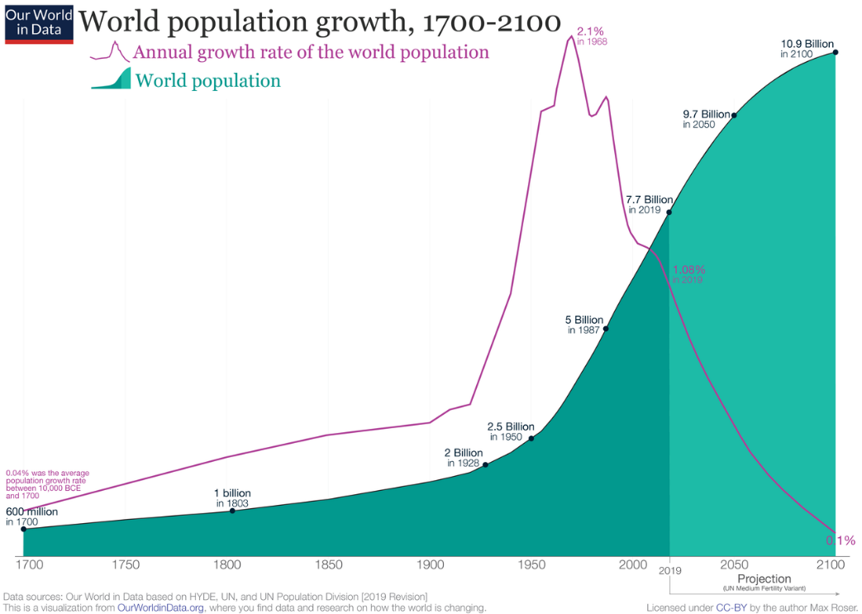
Modelling
Mathematical modelling to describe the behaviour of a system, can have a large range of goals:
A scientific point of view: understanding in a qualitative and/or quantitative way phenomena occuring in society, natural sciences, engineering… Based on the present situation, predictions about the future are possible.
Based on models, the worldwide
population growth can be predicted.
Predictions can be correct, predictions
can be wrong or inaccurate.

Slide 10
Modelling
Mathematical modelling to describe the behaviour of a system, can have a large range of goals:
Having a decent mathematical model, it is possible to study the impact of input variables.
Focusing on engineering, a system can be modelled during the design process before building and testing the real-world system. This approach reduces the risks (and costs) when testing the real-world behaviour.
But anyhow, mathematical tools are useful.

Slide 11
Table of content
Modelling
Different types of models 1
Different types of models 2
Stages of mathematical modelling
Solving the equations
Solving the equations: example

Slide 12
Different types of models 1
A distinction can be made between deterministic models and stochastic models.
Deterministic models always predict the same output when starting from the same initial conditions in combination with the same input.
Let’s consider an example.
Consider a society with $p\left(t\right)$ people at a time instant $t$. In absence of limiting factors (e.g. no lack of food), the population growth is proportional with the number of people. The evolution of the population can be described by a differential equation ($a$ is a parameter depending on the net birth rate)
$$\frac{d p\left(t\right)}{d t}=a.p\left(t\right)$$

Slide 13
Different types of models 1
The differential equation
$$\frac{d p\left(t\right)}{d t}=a.p\left(t\right)$$
has a solution
$$p\left(t\right)=p\left(0\right) e^{a t}.$$
Here, $p\left(0\right)$ represents the population at $t=0$.
In case $a>0$, an exponential growth of the population is obtained.
In case $a<0$, a decrease of the population occurs i.e. the number of deaths is larger than the number of births.

Slide 14
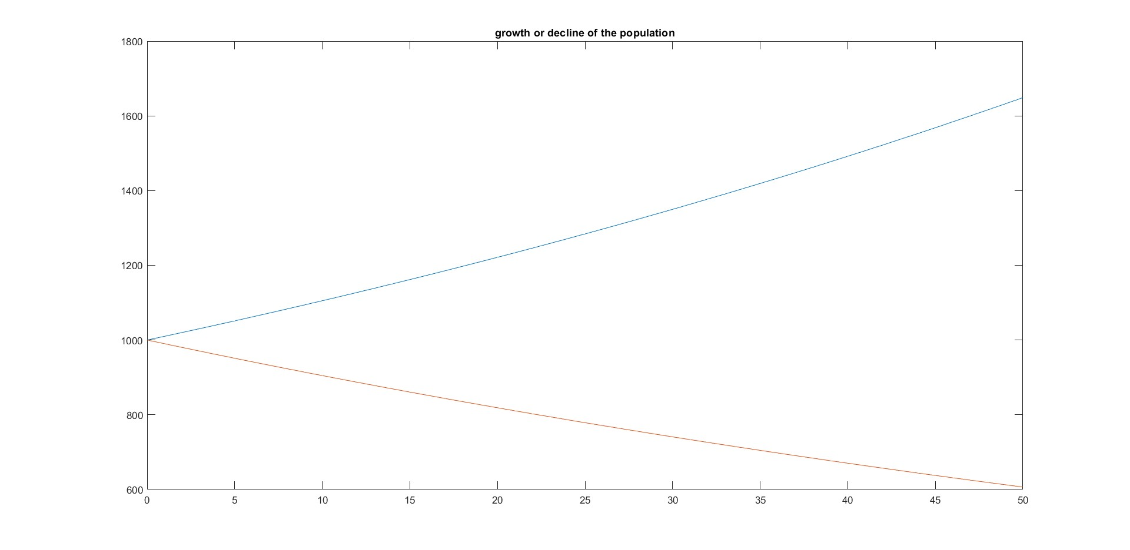
Different types of models 1
In case $a=0.1>0$, a growth of the population is obtained.
In case $a=−0.1<0$, a decrease of the population is obtained.
population
deterministic model
$$a=0.1$$
$$a=−0.1$$
time

Slide 15
Different types of models 1
The evolution of a population can also be described using a difference equation. No continuous time is used but a descrite time $n$ which counts the discrete generations. The difference equation equals
$$p\left(n+1\right)=b.p\left(n\right)$$
where $p\left(n\right)$ is the number of people of the $n$-th generation. The parameter $b$ depends on the net birth rate. The solution of the difference equation equals
$$p\left(n\right)=b^{n}.p\left(0\right).$$
The differential equation and the difference equation correspond with each other in case $b=e^{a T}$ when $T$ is the duration of a single generation.

Slide 16
Different types of models 1
Both the differential equation and the difference equation provide a deterministic model. Such a deterministic model is valid in case the population is sufficiently large.

Slide 17
Different types of models 1
When considering small populations, a larger stochastic variability is encountered. This forces to consider the births and the deaths separately.
Between times $t$ and $t+Δt$, three different events can happen.
With a probability $p_{b}\left(t\right)$ a birth occurs. With a probability $p_{d}\left(t\right)$, a death
occurs.

Slide 18
Different types of models 1
Based on the probabilities a birth and/or a death occurs, it is possible to simulate the evolution of the population.
Choose a sufficiently small time step $Δt$.
Choose a random number $x∈\left[0,1\right]$.
Assume a birth occurs in case $x∈[0,p_{b}\left(t\right)[$.
Assume a death occurs in case $x∈[p_{b}\left(t\right),p_{b}\left(t\right)+p_{d}\left(t\right)[$.
Assume no birth nor death occurs in case $x∈\left[p_{b}\left(t\right)+p_{d}\left(t\right),1\right]$.
This implies the expected value of
$$p\left(t+∆t\right)−p\left(t\right)=p_{b}\left(t\right){−p}_{d}\left(t\right)$$
breeding program of panda bears

Slide 19
Different types of models 1
The expected value of
$$p\left(t+∆t\right)−p\left(t\right)=p_{b}\left(t\right){−p}_{d}\left(t\right)$$
implying
$$E\left(\frac{p\left(t+∆t\right)−p\left(t\right)}{∆t}\right)=\frac{p_{b}\left(t\right){−p}_{d}\left(t\right)}{∆t}.$$

Slide 20
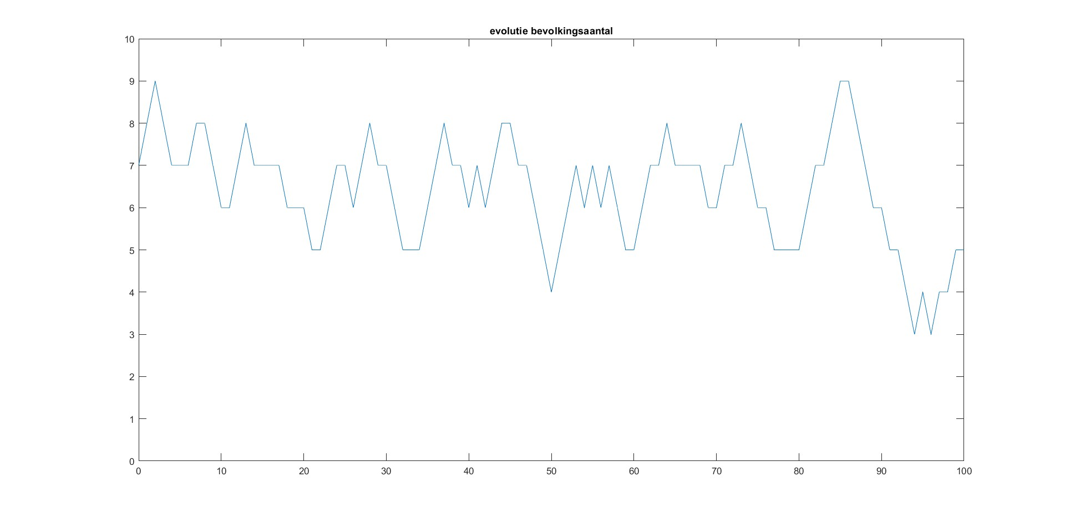
Different types of models 1
MATLAB simulation of the evolution of the population with initially a small population of $7$. We assume $p_{b}=p_{d}=0.3$.
Stochastic nature, every new simulation provides a different result.
population
evolution of the population
time

Slide 21
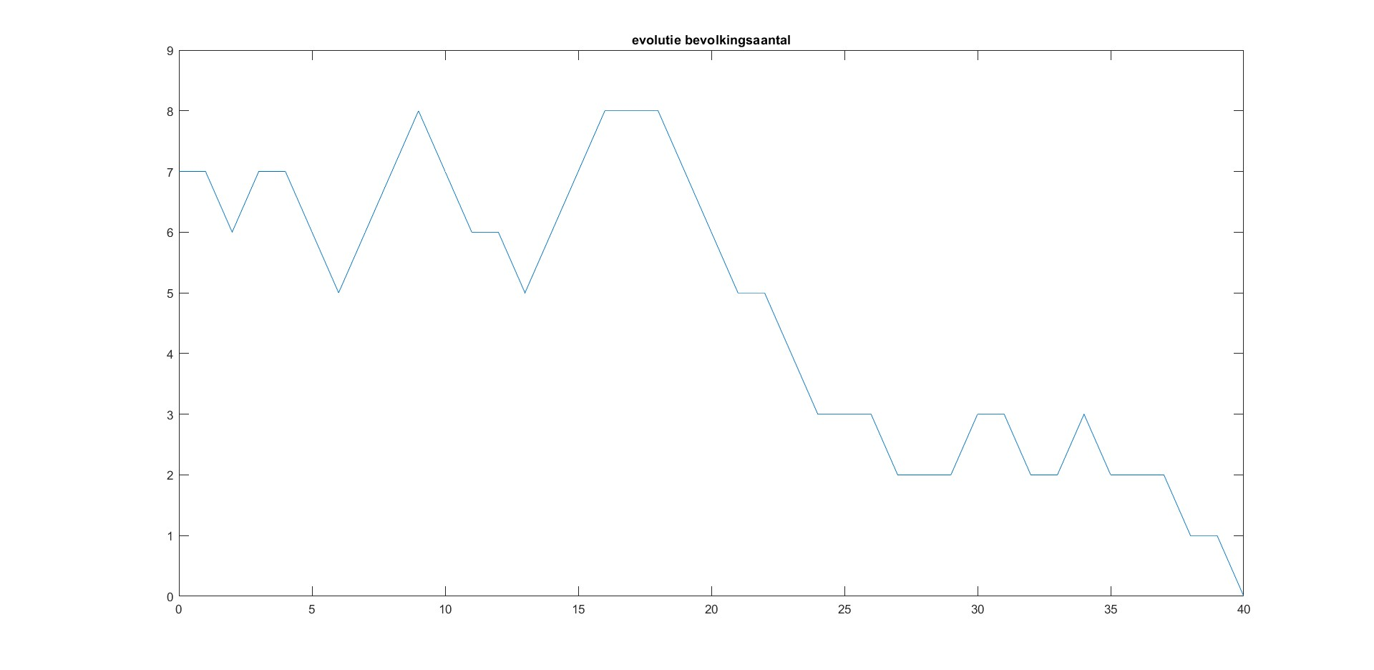
Different types of models 1
Sometimes, the small population extincts although $p_{b}=p_{d}=0.3$.
population
evolution of the population
extinction
time

Slide 22
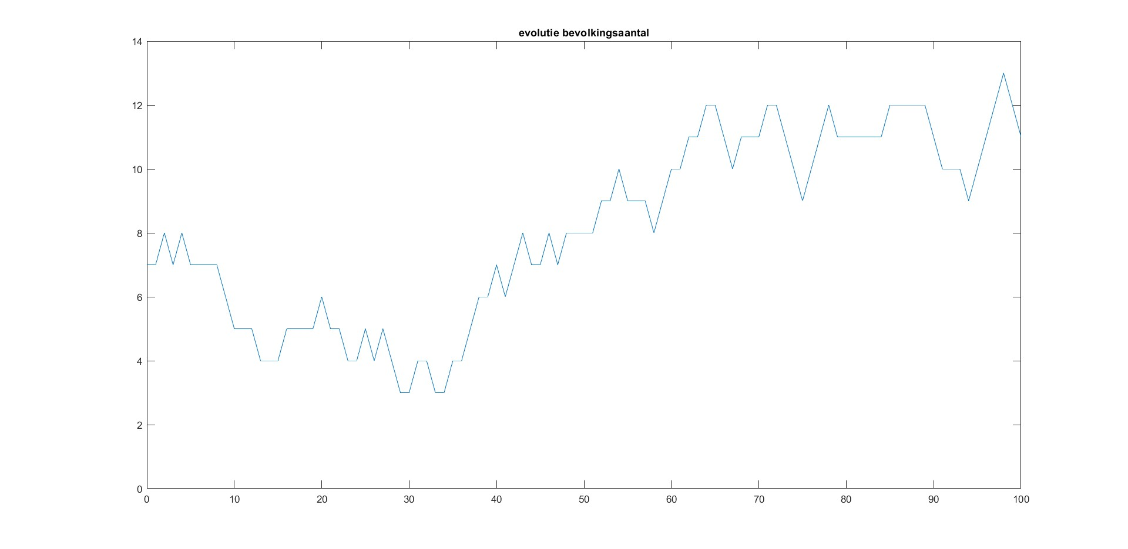
Different types of models 1
Although $p_{b}=p_{d}=0.3$, also an increase of the population can occur.
population
evolution of the population
time

Slide 23
Table of content
Modelling
Different types of models 1
Different types of models 2
Stages of mathematical modelling
Solving the equations
Solving the equations: example

Slide 24
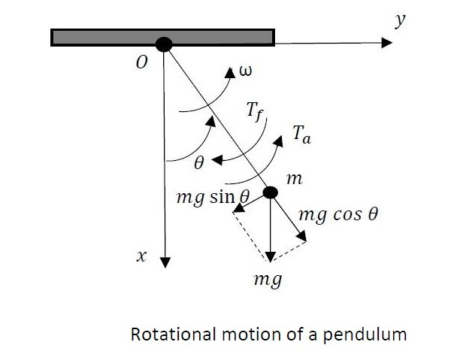
Different types of models 2
A distinction can also be made between mechanistic models and empirical models.
Mechanistic models are used when a large amount of theoretical information is available to describe the behaviour.
Example:
Consider a pendulum containing a mass $m$ suspended by a string (massless) with length $l$.
The position of the mass is determined
by the angle $θ$.

Slide 25
Different types of models 2
A torque $T_{a}\left(t\right)$ can be applied. Due to the rotational motion, friction accounts for a torque $T_{f}\left(t\right)=B.ω\left(t\right)$.
The gravitational force $m.g$ is applied to the mass in a vertical downwards direction. The gravitational force can be split up in two orthogonal components $mg cos\left(θ\left(t\right)\right)$ and $mg sin\left(θ\left(t\right)\right)$.
Only the second component accounts for a torque $mgl sin\left(θ\left(t\right)\right)$.
The second law of Newton can be applied.

Slide 26
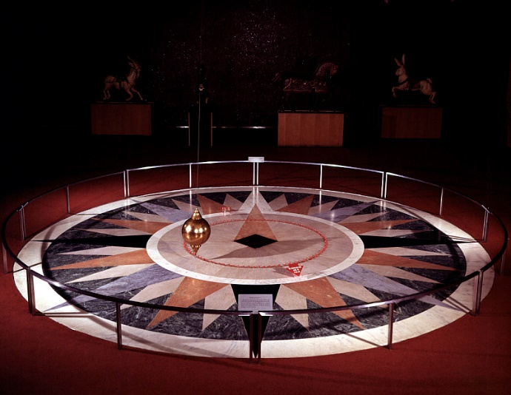
Different types of models 2
By applying the second law of Newton:
$J=m l^{2}$ is the moment of inertia of the mass about point $O$.
Notice a second order differential equation is obtained.
Foucault pendulum

Slide 27
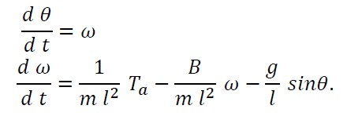
Different types of models 2
The second order differential equation
with $J=m l^{2}$ can be converted into two first order differential
equations.
The pendulum based example is not only mechanistic, it is also
deterministic.

Slide 28
Different types of models 2
Foucault pendulum (Panthéon, Paris, France)

Slide 29
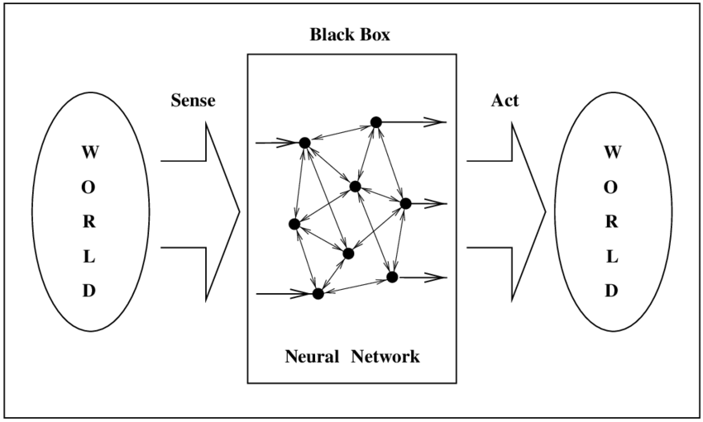
Different types of models 2
Mathematical models are sometimes classified as white box models or black box models.
A white box model is obtained when a lot of information is available concerning the working principle of the system. When the information is correct, the model will behave correctly.
A black box model is obtained when no or almost no information is available concerning the working principle of the system. By considering the relationship between the inputs and the outputs, the behaviour of the system will be translated into the black box model.
Example: neural networks.
(in real life, a lot of models are situated
between an entire white box model and
an entire black box model)

Slide 30
Table of content
Modelling
Different types of models 1
Different types of models 2
Stages of mathematical modelling
Solving the equations
Solving the equations: example

Slide 31
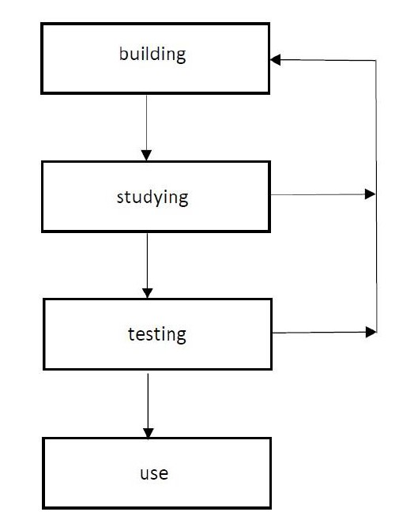
Stages of mathematical modelling
When modelling a system, often a distinction can be made between four categories of activity:
building the model,
studying the model,
testing the model,
using the model.

Slide 32
Stages of mathematical modelling
Once the model has been built, the model will be studied and tested.
Defects in the model will be corrected.
Also the corrected model will be studied and tested implying additional
corrections.
After a number of iterations, the model is
ready to be used.

Slide 33
Stages of mathematical modelling
When building a model, it important
to know what system or process will be modelled,
to know the final goal of the model.
That final goal
allows to decide how much details are needed inside the model,
determines how much accuracy is needed,
indicates the required user friendliness.
Often, trade-offs are needed. When a large accuracy is needed, often the complexity is large. When using a simpler model, often the accuracy decreases.

Slide 34
Stages of mathematical modelling
When formulating a model, a number of assumptions must be made.
As an example, consider Newtonian mechanics assuming that
$$m \frac{d^{2} x\left(t\right)}{d t^{2}}=F\left(t\right).$$
Consider the relativity theory of Einstein. Especially when the speed approaches the speed of light, mass is not assumed to be a constant.
When using the model and considering the results, do not forget the assumptions which have been made.

Slide 35
Table of content
Modelling
Different types of models 1
Different types of models 2
Stages of mathematical modelling
Solving the equations
Solving the equations: example

Slide 36
Solving the equations
When solving mathematical equations, analytical or numerical methods can be used.
When it is realistic (e.g. not too difficult) to find an analytical solution (of e.g. a differential equation), this is often considered to be advantageous.
But obtaining an analytical solution is often too complicated. Numerical approaches are often used to obtain a solution (or an approximation of the solution).

Slide 37
Solving the equations
Numerical approaches with a higer precision generally require more computing power. One needs decent software and hardware. Computers with sufficiently fast processors and a sufficiently large memory are needed.
When performing numerical calculations, numbers with finite precision are used. Round-off errors occur (by using a larger number of bits, the round-off errors are smaller).
When solving a difference equation, smaller discrete time-steps lead to reduced errors. But, more computing power is needed.

Slide 38
Table of content
Modelling
Different types of models 1
Different types of models 2
Stages of mathematical modelling
Solving the equations
Solving the equations: example

Slide 39
Solving the equations: example
Consider the second order differential equation
having $x\left(t\right)=A. cos\left(t+φ\right)$ as possible solutions. Based on the initial conditions, a unique solution is obtained.
In case $x\left(0\right)=1$ and $d x\left(t\right)/dt=0$ at $t=0$,
$$x\left(t\right)=cos\left(t\right).$$
In this simple example, an analytical solution has been obtained.

Slide 40
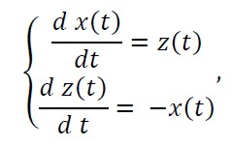
Solving the equations: example
The second order differential equation
can be rewritten as two first order differential equations by using the states $x\left(t\right)$ and $z\left(t\right)$
leading to the same analytical solution. More precisely
$$x\left(t\right)=cos\left(t\right), z\left(t\right)=−sin\left(t\right).$$

Slide 41
Solving the equations: example
By approximating the differential equations to difference equations, a numerical solution can be obtained.
The approximating difference equation (when using discrete times $n$) equals
or equivalently
with a sufficiently small time step $Δt$.

Slide 42
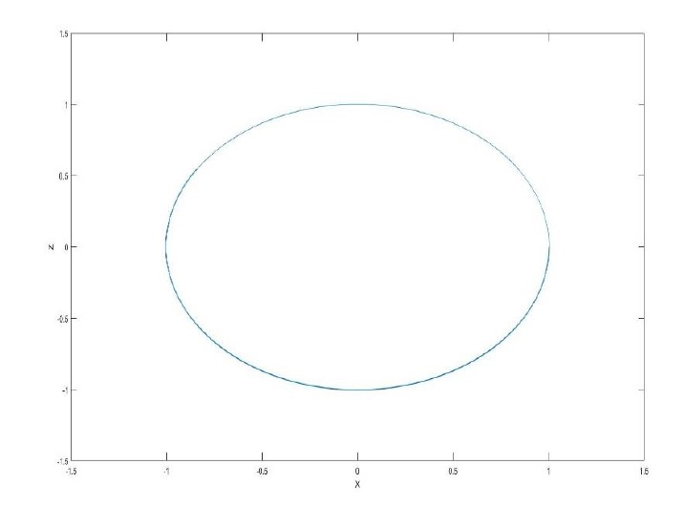
Solving the equations: example
Starting with initial conditions $x\left(0\right)=1$ and $z\left(0\right)=0$, the solution of
can be calculated and visualised.
$$z$$
$$x$$

Slide 43
Thank your for your attention! Questions?

