Slide 1
Cyber-Physical Systems: modelling – linear and non-linear systems part 2
Joan Peuteman
Workshop: March 16-18 (2023).
Erasmus+: Development of practically-oriented student-centred education
in the field of modelling of Cyber-Physical Systems (CybPhys)

Slide 2
Table of content
Spring-mass-damper system
Second order system
Two rolling vehicles
State variable model
State variable model: Laplace
Two rolling vehicles: example

Slide 3
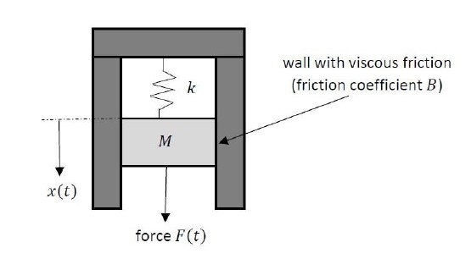
Spring-mass-damper system
A spring-mass-damper system is a very typical example of a system which can be described by a second order linear differential equation.
A force $F\left(t\right)$ is applied to
the mass $M$ implying a
displacement $x\left(t\right)$.
A spring has a spring constant
$k$ and notice the viscous friction
coefficient $B$.
Based on the second law of Newton

Slide 4
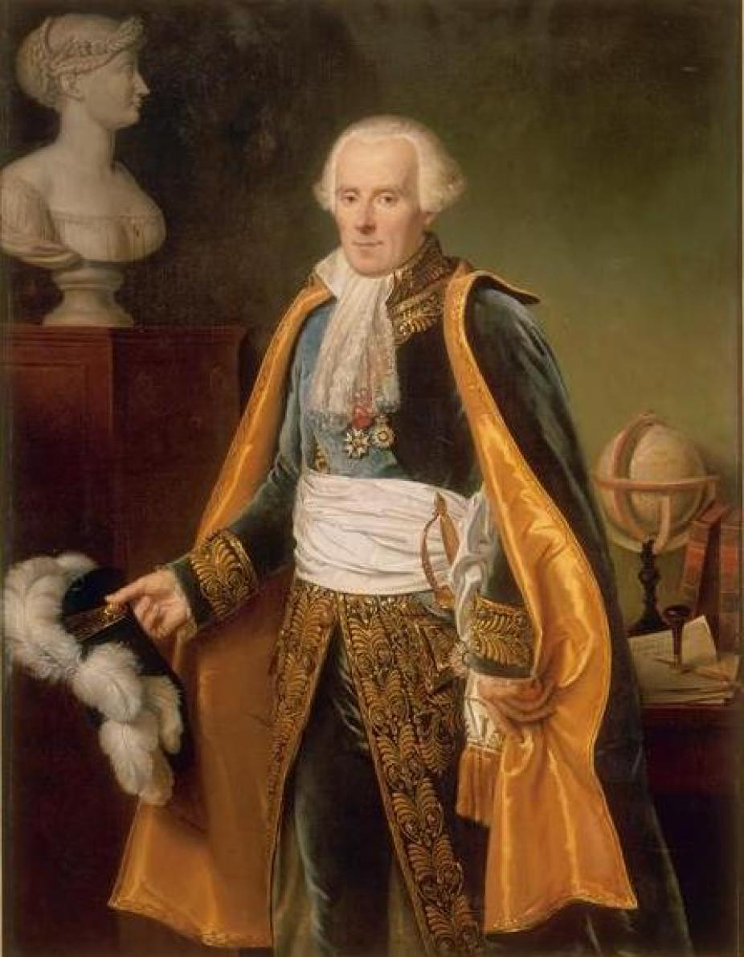
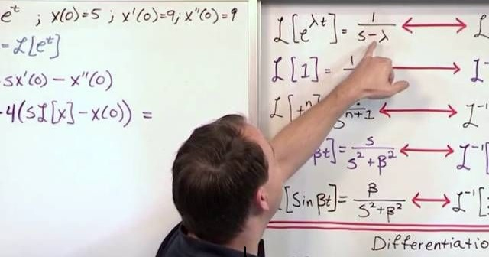
Spring-mass-damper system
By using a Laplace transform, a linear differential equation can be replaced by an algebraic equation. Solving such an algebraic equation is much easier. By taking the inverse Laplace transform, the solution of the original differential equation is obtained.
Pierre Simon de Laplace

Slide 5
Spring-mass-damper system
Solving time-invariant differential equations using Laplace transforms.
Laplace transform
original
differential equation
reformulation of the problem
algebraic equation
the longer way around
using Laplace transforms
is often much easier
difficult
solution in the Laplace
domain $X\left(s\right)$
solution $x\left(t\right)$
inverse
Laplace transform

Slide 6
Spring-mass-damper system
The Laplace transform can be written as
and the corresponding inverse Laplace transform can be written as

Slide 7
Spring-mass-damper system
Let’s use Laplace transforms to solve the differential equation
describing the behaviour of the spring-mass-damper system. By taking the Laplace transform, an algebraic equation is obtained:
Assume no external force $F\left(t\right)$ is applied. Moreover, the initial condition $x\left(0^{−}\right)=x_{0}$ and
The solution in the Laplace domain

Slide 8
Spring-mass-damper system
The solution in the Laplace domain
describes the spring-mass-damper system with an initial condition $x_{0}$ and no input force $F\left(t\right)$.
By taking the inverse Laplace transform
the behaviour of the spring-mass-damper system in the time-domain is obtained.

Slide 9
Table of content
Spring-mass-damper system
Second order system
Two rolling vehicles
State variable model
State variable model: Laplace
Two rolling vehicles: example

Slide 10
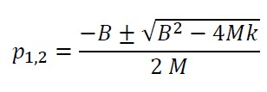
Second order system
When considering a second order system, a distinction can be made between
an overdamped system,
a critically damped system,
an underdamped system.
The spring-mass-damper system is an example of such a second order system.
Important are the roots of the denominator
i.e. the poles:

Slide 11
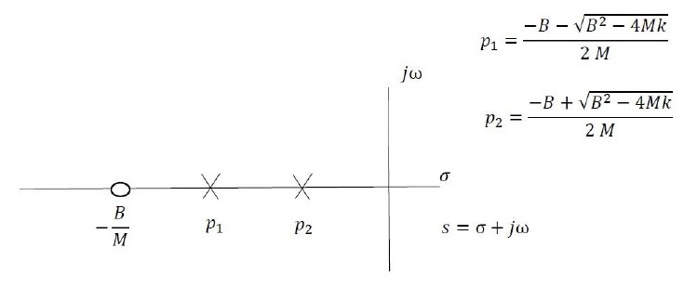
Second order system
An overdamped system is obtained in case $B^{2}>4Mk$ i.e. the viscous damping coefficient is high.
In such a situation, both poles $p_{1}$ and $p_{2}$ are real valued and stricly negative.
s-plane
A zero: root of the numerator
The poles: the roots of the denominator.

Slide 12
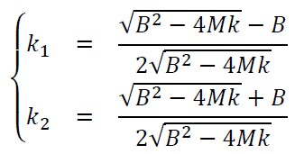
Second order system
We omit the calculations but by taking the inverse Laplace transform of
one obtains that
(overdamped system)

Slide 13
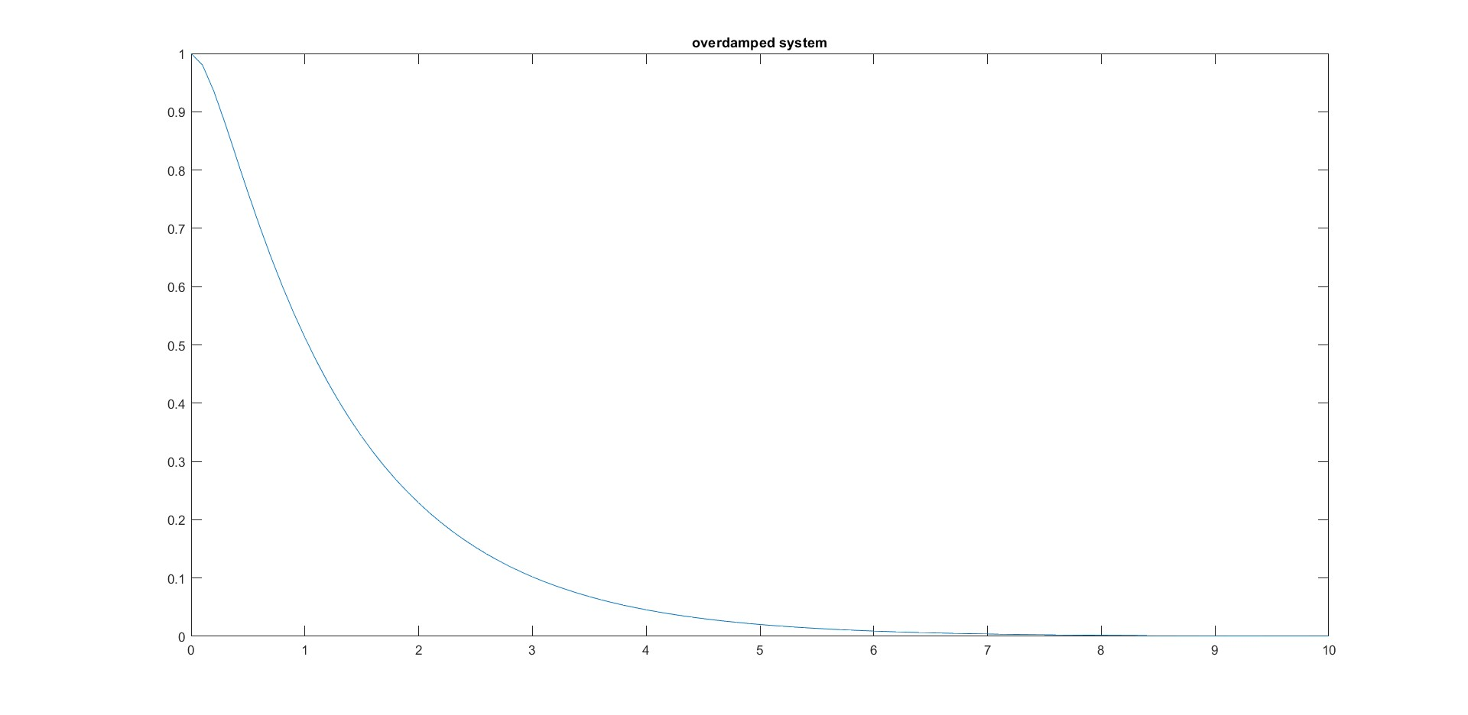
Second order system
An overdamped system with e.g. $M=0.1$, $k=0.5$ and $B=0.7$ implies an evolution of $x\left(t\right)$ (with $x_{0}=1$)
$$x\left(t\right)$$
Due to friction $x\left(t\right)→0$ without oscillations.
Quite slow evolution of $x\left(t\right)$ to zero.
time $t$

Slide 14
Second order system
A critically damped system is obtained in case $B^{2}=4Mk$.
In such a situation, both poles $p_{1}$ and $p_{2}$ are real valued and stricly negative. Notice that
$$p_{1}=p_{2}=−\sqrt{\frac{k}{M}}$$
We omit the calculations, but by taking the inverse Laplace transform of
one obtains that
$$x\left(t\right)=\left(1+\sqrt{\frac{k}{M}}t\right).e^{−\sqrt{\frac{k}{M}} t}.x_{0}$$

Slide 15
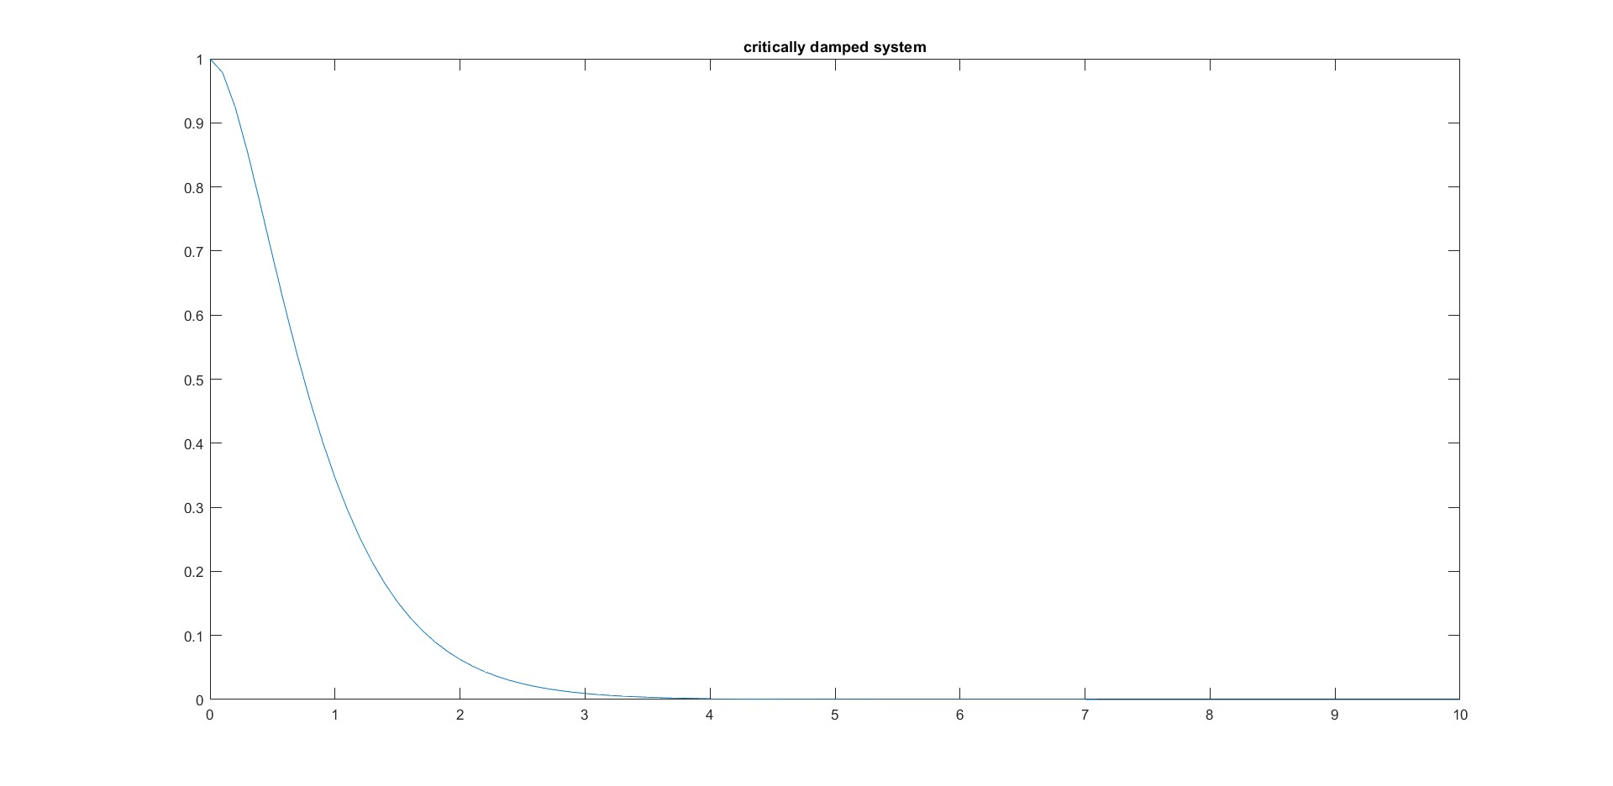
Second order system
An critically damped system with e.g. $M=0.1$, $k=0.5$ and $B=2.\sqrt{M.k}$ implies an evolution of $x\left(t\right)$ (with $x_{0}=1$)
$$x\left(t\right)$$
Due to friction $x\left(t\right)→0$.
$x\left(t\right)$ goes to zero, this evolution is faster
compared to the overdamped system.
time $t$

Slide 16
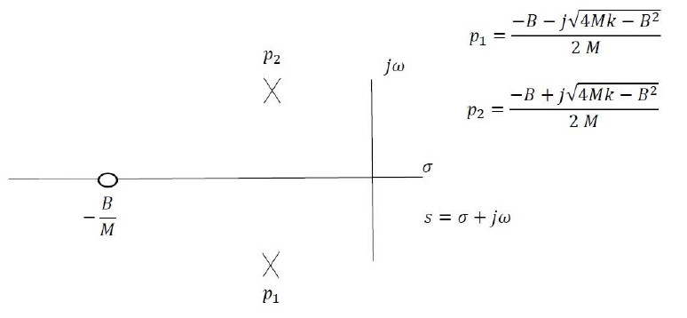
Second order system
An underdamped system is obtained in case $B^{2}<4Mk$ i.e. the viscous damping coefficient is low.
In such a situation, both poles $p_{1}$ and $p_{2}$ are complex with a stricly negative real part.
s-plane
A zero: root of the numerator
The poles:
the roots of the denominator.

Slide 17
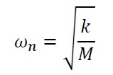
Second order system
We omit the calculations but by taking the inverse Laplace transform of
with
(underdamped system)
The poles can be written as

Slide 18
Second order system
We omit the calculations but by taking the inverse Laplace transform of
one obtains that
(underdamped system)

Slide 19
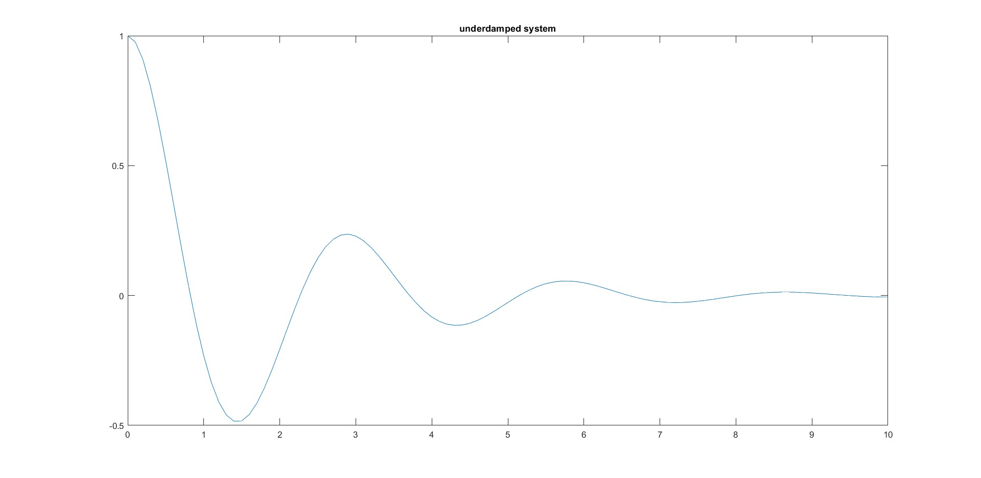
Second order system
An underdamped system with e.g. $M=0.1$, $k=0.5$ and $B=0.1$ implies an evolution of $x\left(t\right)$ (with $x_{0}=1$)
$$x\left(t\right)$$
Due to friction $x\left(t\right)→0.$
Oscillations due to the underdamped behaviour.
time $t$

Slide 20
Table of content
Spring-mass-damper system
Second order system
Two rolling vehicles
State variable model
State variable model: Laplace
Two rolling vehicles: example

Slide 21
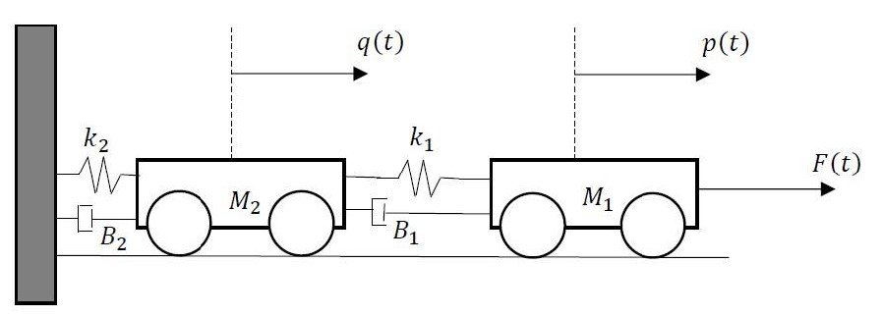
Two rolling vehicles
Consider two rolling vehicles.
Vehicle $1$ has a mass $M_{1}$ and position $p\left(t\right)$. Vehicle $2$ has a mass $M_{2}$ and position $q\left(t\right)$.
An external force $F\left(t\right)$ is applied to vehicle $1$.

Slide 22
Two rolling vehicles
Notice the connection between both vehicles with spring constant $k_{1}$ and viscous damping coefficient $B_{1}$.
Notice the connection between vehicle $2$ and a fixed wall with spring constant $k_{2}$ and viscous damping coefficient $B_{2}$.

Slide 23
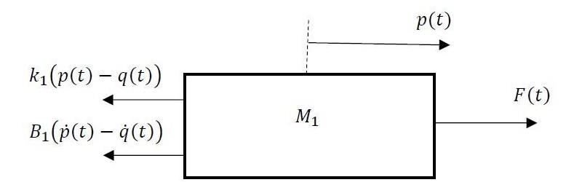
Two rolling vehicles
The behaviour of vehicle $1$ needs consideration of all forces acting on this vehicle.
due to the spring
due to the damper
Based on the second law of Newton

Slide 24
Two rolling vehicles
The behaviour of vehicle $2$ needs consideration of all forces acting on this vehicle.
due to the spring
due to the spring
due to the damper
due to the damper
Based on the second law of Newton

Slide 25
Table of content
Spring-mass-damper system
Second order system
Two rolling vehicles
State variable model
State variable model: Laplace
Two rolling vehicles: example

Slide 26
State variable model
As an example, consider again the system with two rolling vehicles.
Instead of using the two second order differential equations obtained in the previous paragraph, it is possible to use four first order differential equations.

Slide 27
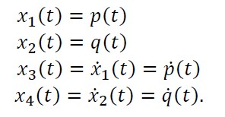
State variable model
Defining four states $x_{1}$, $x_{2}$, $x_{3}$ and $x_{4}$ as
This allows to use four first order differential equations instead of two second order differential equations.

Slide 28
State variable model
The second order differential equation
can be replaced by
The second order differential equation
can be replaced by

Slide 29
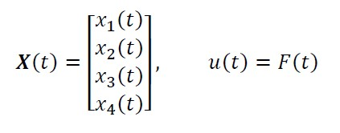
State variable model
When using the state variable model (of linear time-invariant systems), generally the differential equations are written in the form
with appropriate matrices $A$ and $B$. When $X\left(t\right)$ contains $n$ states then $A$ is an $nxn$ matrix and $B$ is an $nx1$ matrix.
When considering the two rolling vehicles, $n=4$ and

Slide 30
State variable model
When considering the two rolling vehicles, the general expression
equals

Slide 31
Table of content
Spring-mass-damper system
Second order system
Two rolling vehicles
State variable model
State variable model: Laplace
Two rolling vehicles: example

Slide 32
State variable model: Laplace
When taking the Laplace transform of
one obtains that
By solving this set of algebraic equations, the solution in the Laplace domain equals
By taking the inverse Laplace transform, the solution in the time-domain equals

Slide 33
State variable model: Laplace
As already stated, starting from
one obtains that
The matrix exponential function can be calculated as

Slide 34
Table of content
Spring-mass-damper system
Second order system
Two rolling vehicles
State variable model
State variable model: Laplace
Two rolling vehicles: example

Slide 35
Two rolling vehicles: example
Consider the system with two rolling vehicles.
MATLAB can be used to calculate the behaviour of the two
rolling vehicles.
In the present example, no external force $F\left(t\right)$ has been applied.
The behaviour due to an initial condition has been calculated.

Slide 36
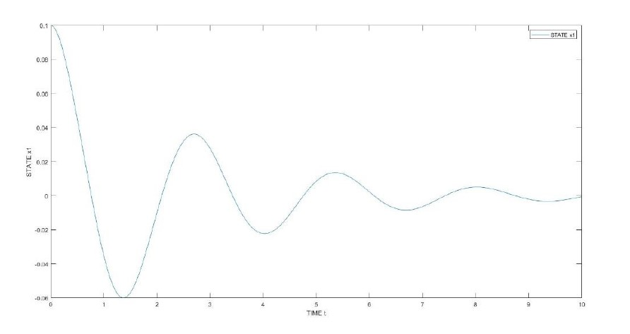
Two rolling vehicles: example
The position of vehicle 1:
position
$p\left(t\right)=x_{1}\left(t\right)$ goes to zero as $t→∞$.
time

Slide 37
Two rolling vehicles: example
The position of vehicle 1:
Initially, energy has been stored in
spring 1 with spring constant $k_{1}$ due
to initial condition $p\left(0\right)=x_{1}\left(0\right)=0.1$.
Losses occur due to the dampers with damping coefficients $B_{1}$ and $B_{2}$.
This leads to a damped oscillatory motion.
$p\left(t\right)=x_{1}\left(t\right)$ goes to zero as $t→∞$.

Slide 38
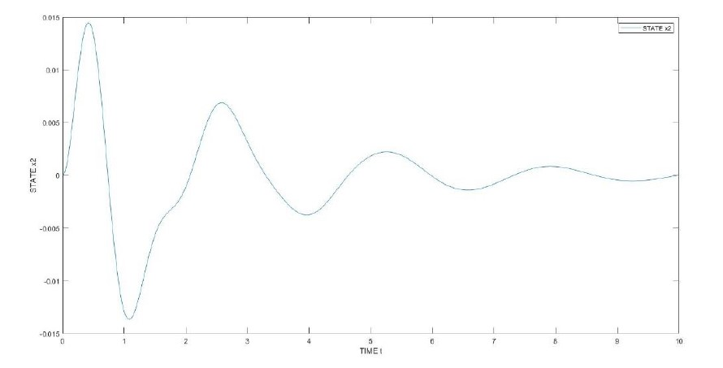
Two rolling vehicles: example
The position of vehicle 2:
position
q$\left(t\right)=x_{2}\left(t\right)$ goes to zero as $t→∞$.
time

Slide 39
Two rolling vehicles: example
The position of vehicle 1:
Initially, energy has been stored in
spring 1 with spring constant $k_{1}$ due
to initial condition $p\left(0\right)=x_{1}\left(0\right)=0.1$.
Losses occur due to the dampers with damping coefficients $B_{1}$ and $B_{2}$.
This leads to a damped oscillatory motion.
q$\left(t\right)=x_{2}\left(t\right)$ goes to zero as $t→∞$.
Initial condition
$$q\left(0\right)=x_{2}\left(0\right)=0.$$

Slide 40
Thank your for your attention! Questions?

