Slide 1
Cyber-Physical Systems: modelling – linear and non-linear systems part 3
Joan Peuteman
Workshop: March 16-18 (2023).
Erasmus+: Development of practically-oriented student-centred education
in the field of modelling of Cyber-Physical Systems (CybPhys)

Slide 2
Table of content
Introduction
Energy harvesting
Spring-mass-damper system
The natural pulsation
MEMS

Slide 3
Introduction
An increasing number of physical systems communicate and interact with each other using the Internet of Things.
There is an interplay between
physical systems
mobile networks
wireless communication
computing resources,
Articial Intelligence,
…
Such an approach facilitates a broad range of applications.

Slide 4
Introduction
A broad range of new applications arise.
Smart Driving
Intelligent Transport Systems
Smart Governance

Slide 5
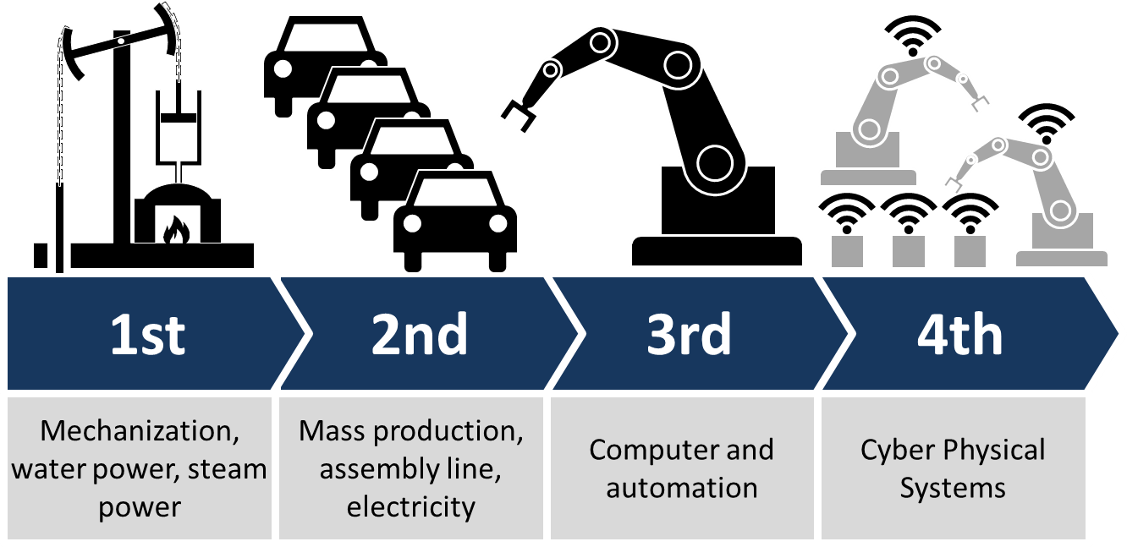
Introduction
A broad range of new applications arise.
Industry 4.0:
the Fourth Industrial Revolution

Slide 6
Introduction
A broad range of new applications arise.
Smart Cities
Smart Homes

Slide 7
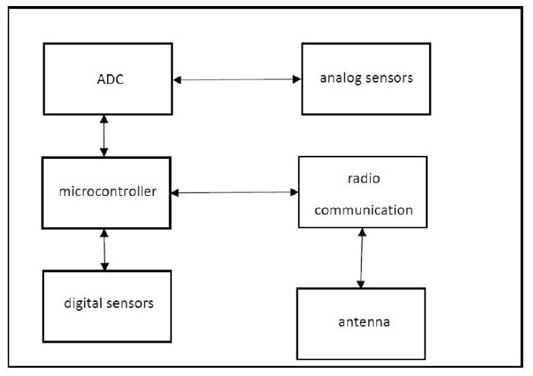
Introduction
In order to realise all these smart applications, wireless sensor networks are needed which connect a large number of sensor nodes.
Using an antenna, the sensor node is able
to communicate with other devices.
The sensor node contains (analog and
digital) sensors.
The microcontroller is able to store and
process the measurement data.
Notice the wireless sensor node needs a power supply.

Slide 8
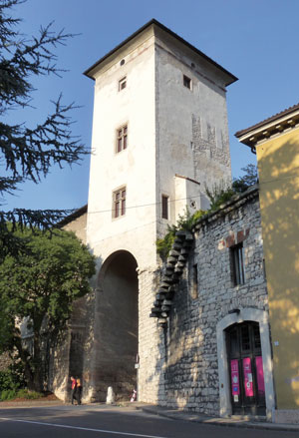
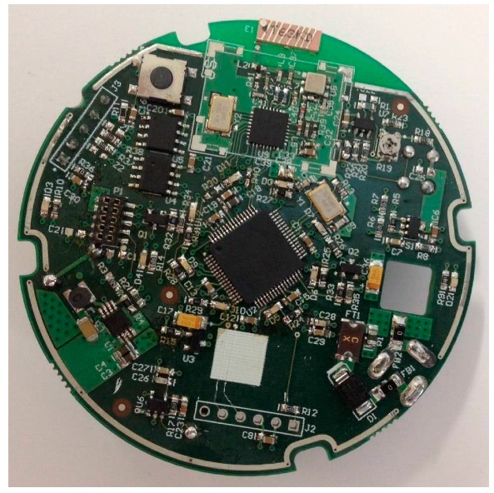
Introduction
The wireless sensor node needs a power supply. When the node has
been mounted at a remote location,
providing power by the public electrical grid is difficult,
replacing batteries is difficult, dangerous and expensive.
Possible solution:
reduce the energy consumption as much as possible,
use energy harvesters to provide the required energy.
Trent (Italy)
wireless sensor node

Slide 9
Table of content
Introduction
Energy harvesting
Spring-mass-damper system
The natural pulsation
MEMS

Slide 10
Energy harvesting
Energy harvesting allows to convert ambient energy from the environment into electrical energy. The ambient energy can be very diverse
light energy (use photovoltaic panels),
flow of liquids and gases (e.g. using a small wind turbine generator),
kinetic energy (e.g. due to vibrations)
thermal energy,
electric or magnetic fields or radio waves,
…
Here, we will focus on harvesting energy from vibrations.

Slide 11
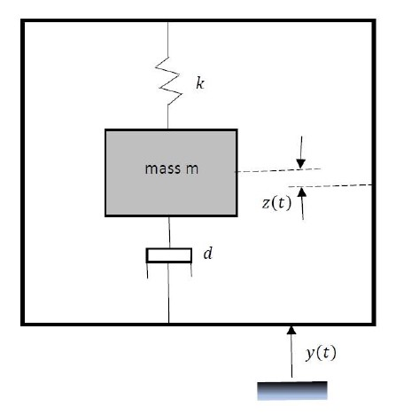
Energy harvesting
When harvesting energy from vibrations, often a two steps approach will be used.
First step: a mechanical to mechanical conversion.
Second step: a mechanical to electrical conversion (using piezoelectric materials, using an inductive system, using a capacitive system, …)
The mechanical to mechanical conversion is based on a spring-mass-damper system.

Slide 12
Table of content
Introduction
Energy harvesting
Spring-mass-damper system
The natural pulsation
MEMS

Slide 13
Spring-mass-damper system
When considering an energy harvester, in general the ambient vibrations have a low amplitude. A spring-mass-damper system is needed to amplify the relative movement of a mass compared to the original movement.
Mechanical resonance is used to have a sufficiently large relative movement allowing to realise the mechanical to electrical conversion.
The mass $m$ is connected with a spring having
a spring constant $k$.
The movement of the spring is damped i.e. notice
the viscous damping coefficient $d$.

Slide 14
Spring-mass-damper system
Assume the original vibration noise $y\left(t\right)$ is not affected by the movement $z\left(t\right)$ of the mass $m$.
The behaviour of the mass $m$ can be modelled by the differential equation
$y\left(t\right)$ is the movement of the vibration which
provides all energy. The housing of the harvester
vibrates with displacement $y\left(t\right)$.
The relative motion of the mass $m$ w.r.t. the
housing equals $z\left(t\right)$.

Slide 15
Spring-mass-damper system
The differential equation
which equals $m\left(\ddot{y}\left(t\right)+\ddot{z}\left(t\right)\right)=−d.\dot{z}\left(t\right)−k.z\left(t\right)$ is obtained by using the second law of Newton.
The upwards relative motion of the mass $m$ w.r.t.
the housing equals $z\left(t\right)$. The absolute upwards
acceleration equals $\ddot{y}\left(t\right)+\ddot{z}\left(t\right)$.
Notice the force $k.z\left(t\right)$ due to the spring. Notice
the force $d.\dot{z}\left(t\right)$ due to the damper.
$$k.z\left(t\right)$$
$$z\left(t\right)$$
$$d.\dot{z}\left(t\right)$$

Slide 16
Spring-mass-damper system
The displacement $y\left(t\right)$ can be irregular. Using Fourier analysis, $y\left(t\right)$ can be considered to be a composition of a number of cosine functions having different pulsations $ω$.
Here, we consider a sinusoidal excitational vibration $y\left(t\right)=Y.cos\left(ω t\right)$ which implies
$$\ddot{y}\left(t\right)=−ω^{2} Y cos\left(ω t\right)$$
The differential equation reduces to

Slide 17
Table of content
Introduction
Energy harvesting
Spring-mass-damper system
The natural pulsation
MEMS

Slide 18
The natural pulsation
When studying the behaviour of a spring-mass-damper system, a second order differential equation appears. We already studied its behaviour with respect to an initial condition i.e. a transient behaviour has been studied.
Here, we are interested in a steady-state behaviour due to the impact of an external input i.e.
$$\ddot{y}\left(t\right)=−ω^{2} Y cos\left(ω t\right).$$
The differential equation equals

Slide 19
The natural pulsation
The solution of the differential equation
equals
with

Slide 20
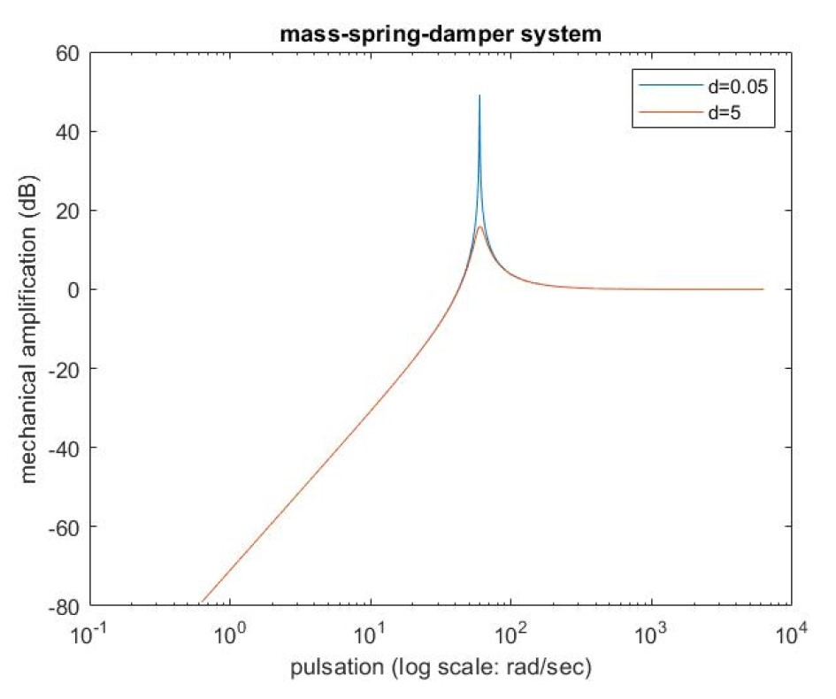
The natural pulsation
Especially the ratio between $Z$ and $Y$ (the mechanical amplification) is important.
The mechanical amplification
depends on the pulsation $ω$.
More precisely
$$\frac{Z}{Y}=\frac{m ω^{2}}{\sqrt{{\left(k−mω^{2}\right)}^{2}+d^{2}ω^{2}}}.$$

Slide 21
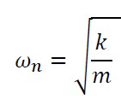
The natural pulsation
The mechanical amplification is maximized at the natural pulsation
logarithmic scale: $20.\log_{10}\left(\frac{Z}{Y}\right)$
At $ω=ω_{n}$
$$\frac{Z}{Y}=\frac{m ω^{2}}{\sqrt{{\left(k−mω^{2}\right)}^{2}+d^{2}ω^{2}}}$$
implies
$$\frac{Z}{Y}=\frac{m.ω}{d}$$
The amplification increases as the
damping coefficient $d$ decreases.

Slide 22
The natural pulsation
Close to the natural pulsation, an amplification is obtained. The lower the damping, the larger the amplification.
For pulsations lower than the natural pulsation, even an attenuation is obtained.
For pulsations larger than the natural pulsation, the amplitudes of $y\left(t\right)$ and $z\left(t\right)$ are approximately the same.

Slide 23
The natural pulsation
In case the spectrum of the excitational vibration $y\left(t\right)$ contains a large number of pulsations, only the pulsation(s) close to the natural pulsation will be amplified.
A sufficiently large motion of mass $m$ is needed (with pulsation $ω_{n}$) which facilitates the mechanical to electrical energy conversion.

Slide 24
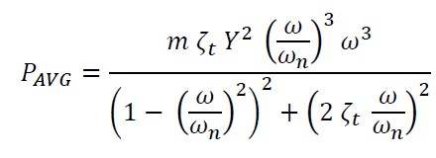
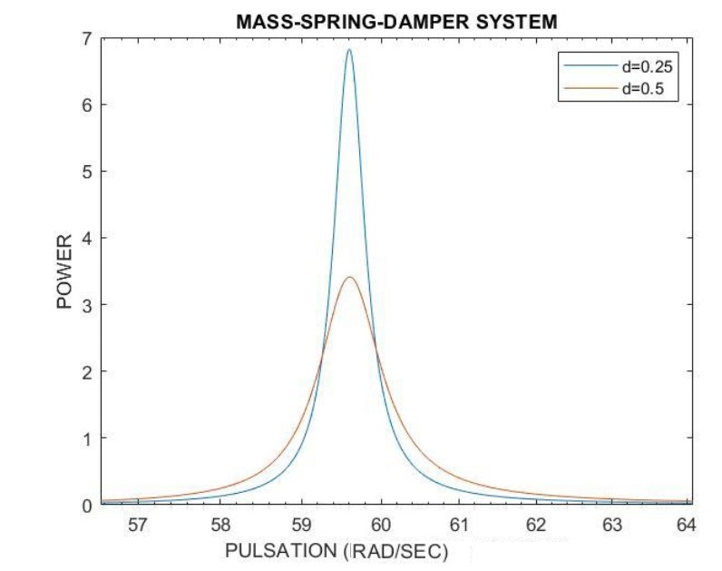
The natural pulsation
A sufficiently large motion of mass $m$ is needed (with pulsation $ω_{n}$) which facilitates the mechanical to electrical energy conversion.
A larger motion implies a larger power is available to be converted into electrical power.
We omit the calculations here, but
with

Slide 25
The natural pulsation
With
one obtains at $ω=ω_{n}$ that
Less damping, more power.

Slide 26
Table of content
Introduction
Energy harvesting
Spring-mass-damper system
The natural pulsation
MEMS

Slide 27
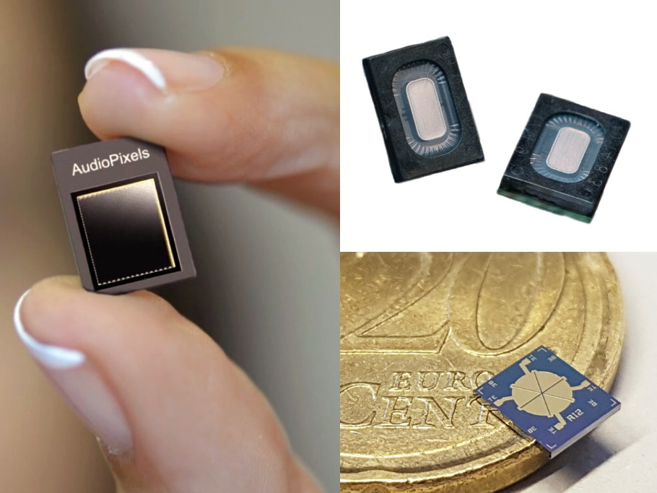
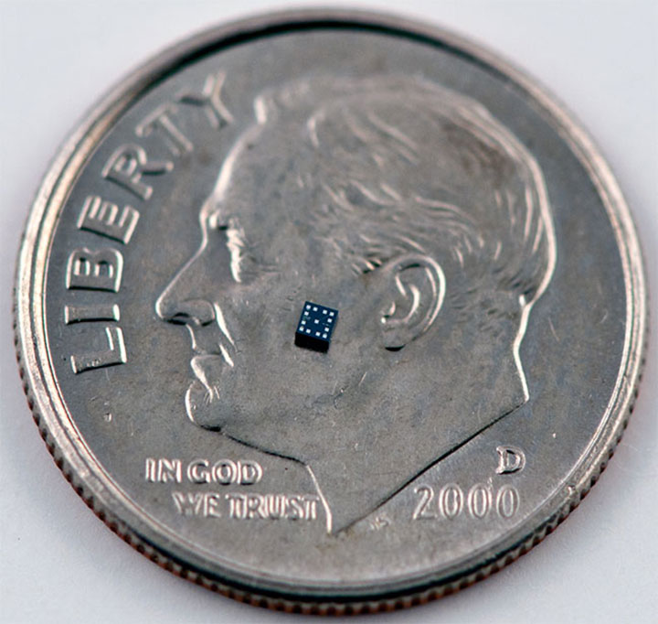
MEMS
MEMS are micro-electro-mechanical systems.
(A.S. Gillis)
MEMS gyroscope

Slide 28
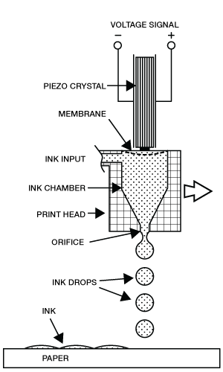
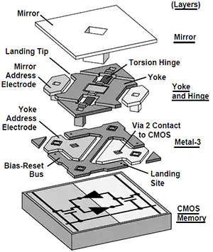
MEMS
MEMS have a broad range of applications:
Sensor driven heating and cooling systems for a building management system.
Micro-mirror arrays for high definition projection systems.
Micronozzles to control the flow of ink in inkjet printers.
Tiny gyroscopes, barometers, accelerometers and microphones to support mobile applications.
Disposable pressure sensors for use in healthcare.
…

Slide 29
MEMS
The spring-mass-damper system, we considered before, has a large mass $m$. To have a larger natural pulsation, a much smaller mass $m$ is needed.
The so-called energy MEMS also contain energy harvesters based on a spring-mass-damper system. A number of design rules can be taken into consideration.

Slide 30
MEMS
When designing an energy harvesters based on a spring-mass-damper system. Some design rules can be taken into consideration:
A sufficiently large mass $m$ is needed within the available volume ($P_{AVG}$ is proportional with $m^{2}$ for a given $ω_{n}$ and $d$).
The allowed amplitude of the movement of the mass $m$ must be as large as possible.
The spring should be designed to obtain a resonance pulsation which matches the pulsation (or a pulsation) of $y\left(t\right)$.
The transducer damping factor $ζ_{t}$ must be sufficiently small to allow the mass $m$ to move to the limits of its range.

Slide 31
Thank your for your attention! Questions?

