Slide 1
Cyber-Physical Systems: modelling – linear and non-linear systems part 4
Joan Peuteman
Workshop: March 16-18 (2023).
Erasmus+: Development of practically-oriented student-centred education
in the field of modelling of Cyber-Physical Systems (CybPhys)

Slide 2
Table of content
Linear time-invariant systems
Non-linear systems
Evolution of a population
Numerical solution
Conclusion

Slide 3
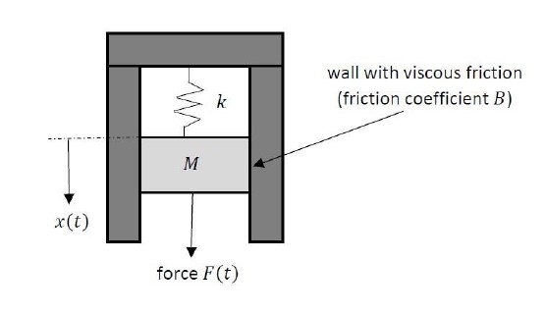
Linear time-invariant systems
A spring-mass-damper system is an example of a linear time-invariant system (LTI system).
A force $F\left(t\right)$ is applied to
the mass $M$ implying a
displacement $x\left(t\right)$.
A spring has a spring constant
$k$ and notice the viscous friction
coefficient $B$.
Based on the second law of Newton

Slide 4
Linear time-invariant systems
Laplace transforms can be used to solve the differential equation
The Laplace transform approach can only be used for linear time-invariant systems. In case the system is time-variant, no Laplace transform approach can be used.
In the present spring-mass-damper example:
If the mass $M$, the viscous friction coefficient $B$ or the spring constant $k$ are time-variant, no Laplace transform approach can be used.

Slide 5
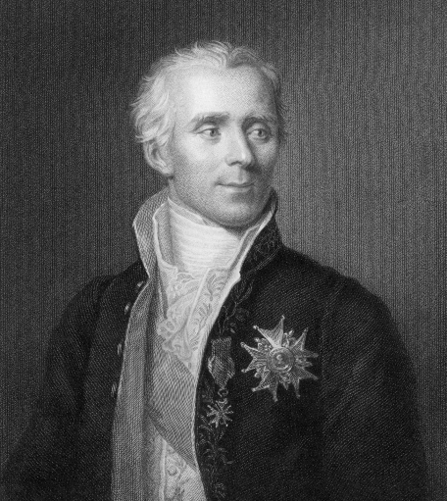
Linear time-invariant systems
The differential equations
$$M\left(t\right)\frac{d^{2} x\left(t\right)}{d t^{2}}+B \frac{d x\left(t\right)}{d t}+k x\left(t\right)=F\left(t\right)$$
$$M\frac{d^{2} x\left(t\right)}{d t^{2}}+B\left(t\right) \frac{d x\left(t\right)}{d t}+k x\left(t\right)=F\left(t\right)$$
$$M\frac{d^{2} x\left(t\right)}{d t^{2}}+B \frac{d x\left(t\right)}{d t}+k\left(t\right) x\left(t\right)=F\left(t\right)$$
$$M\left(t\right)\frac{d^{2} x\left(t\right)}{d t^{2}}+B\left(t\right) \frac{d x\left(t\right)}{d t}+k\left(t\right) x\left(t\right)=F\left(t\right)$$
can‘t be solved using the Laplace transform approach.
Pierre-Simon,
marquis de
Laplace

Slide 6
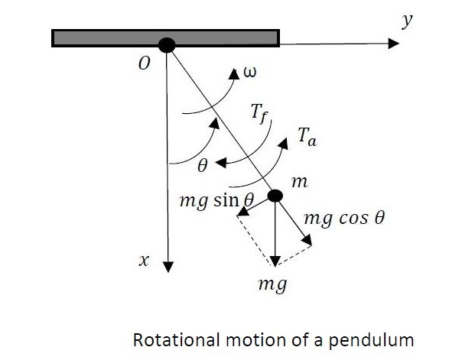
Linear time-invariant systems
Also in case a differential equation is not linear (although it is time-invariant), the Laplace transform approach can’t be used to solve the differential equation.
Consider a pendulum containing a mass $m$ suspended by a string (massless) with length $l$.
The position of the mass
is determined by the angle $θ$.
A torque $T_{a}\left(t\right)$ has been
applied. Friction accounts
for a torque $T_{f}\left(t\right)=B.ω\left(t\right)$.

Slide 7
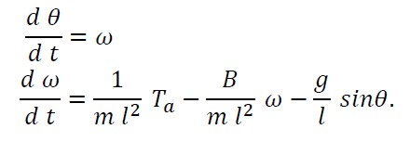
Linear time-invariant systems
The behaviour of the pendulum is described by the second order differential equation
with $J=m l^{2}$.
The behaviour of the pendulum can also be described by two first order differential equations (state-space approach)
Accounts for the
non-linear behaviour.

Slide 8
Linear time-invariant systems
Since
and
are non-linear, no Laplace transform approach can be used.
Accounts for the
non-linear behaviour.

Slide 9
Linear time-invariant systems
In case the angle $θ$ is sufficiently small, $sinθ≅θ$. In such a situation the differential equation
can be approximated (linearization) by
$$J \frac{d^{2} θ}{d t^{2}}=T_{a}\left(t\right)−B \frac{d θ}{d t} −mgl θ$$
or equivalently
$$J \frac{d^{2} θ}{d t^{2}}+B \frac{d θ}{d t}+mgl θ=T_{a}\left(t\right)$$
A linear time-invariant system is obtained,
the Laplace transform approach can be used.

Slide 10
Table of content
Linear time-invariant systems
Non-linear systems
Evolution of a population
Numerical solution
Conclusion

Slide 11
Non-linear systems
Especially the study of non-linear time-variant systems can be hard.
Also when resticting to non-linear time-invariant systems, finding an analytical solution can be hard. We will consider a few “easy” examples where analytical solutions exist.

Slide 12
Non-linear systems
Consider the differential equation
$\frac{d x}{d t}=F\left(x\right)$ or equivalently $\frac{1}{F\left(x\right)}.\frac{d x}{d t}=1$.
By integrating both sides,
$$\int{\frac{1}{F\left(x\right)}.\frac{d x}{d t}.dt}=\int{1.dt}$$
one obtains
$$\int{\frac{d x}{F\left(x\right)}=t+k}$$
which is an implicit equation. This implicit equation leads to the explicit expression
$x\left(t\right)=H\left(t+k\right).$

Slide 13
Non-linear systems
Example:
Consider the time-invariant initial value problem (with $x\left(t_{0}\right)=x_{0}$)
$$\frac{d x\left(t\right)}{d t}={x\left(t\right)}^{2}$$
By rewriting the differential equation as
$$\frac{d x}{x^{2}}=d t$$
By integrating both sides,
$$−\frac{1}{x}=\int{\frac{d x}{x^{2}}=t+k →x\left(t\right)=−\frac{1}{t+k}}$$
An appropriate value for $k$ is needed.

Slide 14
Non-linear systems
With
$$x\left(t\right)=−\frac{1}{t+k}$$
and $x\left(t_{0}\right)=x_{0}$, it is clear that $k=−\frac{1}{x_{0}}−t_{0}$. This leads to the analytical solution
$$x\left(t\right)=\frac{x_{0}}{1−x_{0}\left(t−t_{0}\right)}.$$
Consider $t>t_{0}$ with $x_{0}<0$. As $t$ increases, a monotone decrease of $\left|x\left(t\right)\right|$ is obtained. Finally, as $t→+∞$ it is clear $x\left(t\right)→0$.
Consider $t>t_{0}$ with $x_{0}>0$. As $t$ increases, a monotone increase of $\left|x\left(t\right)\right|=x\left(t\right)$ is obtained. Finally, $x\left(t\right)→+∞$. The larger $x_{0}$, the faster the denominator becomes zero i.e. at
$$t−t_{0}=\frac{1}{x_{0}} .$$

Slide 15
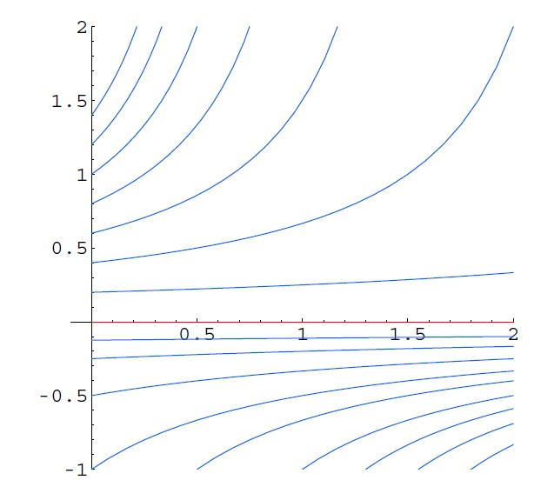
Non-linear systems
With
$$x\left(t\right)=\frac{x_{0}}{1−x_{0}\left(t−t_{0}\right)}.$$
Consider $t>t_{0}$ with $x_{0}<0$. As $t$ increases, a monotone decrease of $\left|x\left(t\right)\right|$ is obtained. Finally, as $t→+∞$ it is clear $x\left(t\right)→0$. Consider $t>t_{0}$ with $x_{0}>0$. As $t$ increases, a monotone increase of $\left|x\left(t\right)\right|=x\left(t\right)$ is obtained. Finally, $x\left(t\right)→+∞$.
$$x$$
$$t−t_{0}$$
Source: Nonlinear Ordinary Differential
Equations, Peter J. Olver

Slide 16
Table of content
Linear time-invariant systems
Non-linear systems
Evolution of a population
Numerical solution
Conclusion

Slide 17
Evolution of a population
We already considered a society with $p\left(t\right)$ people at a time instant $t$. In abscence of limiting factors (e.g. no lack of food), the population growth is proportional with the number of people.
The evolution of the population can be descibed by a linear differential equation ($a$ is a parameter depending on the net birth rate i.e. the number of births minus the number of deaths).
More precisely,
$$\frac{d p\left(t\right)}{d t}=a.p\left(t\right)$$
leading to the solution
$$p\left(t\right)=p\left(0\right).e^{a t}.$$
Here, $p\left(0\right)$ is the population at $t=0$.

Slide 18
Evolution of a population
In a more realistic scenario, the net birth rate will depend on the size of the population and external factors. E.g. when the amount of food is limited, a small population is able to grow. But a large population will have a lack of food implying a decrease of the population.
This situation can be modelled by the nonlinear differential equation
$$\frac{d p}{d t}=a\left(p\right).p$$
Let $P^{∗}$ be the carrying capacity of the environment for the population. This implies $a\left(p\right)>0$ when $p<P^{∗}$. This implies $a\left(p\right)<0$ when $p>P^{∗}$.
Several expressions for $a\left(p\right)$ can be used but $a\left(p\right)=μ\left(P^{∗}−p\right)$ is a quite simple example. Here, $μ>0$ is a positive constant.

Slide 19
Evolution of a population
The nonlinear differential equation
$$\frac{d p}{d t}=μ\left(P^{∗}−p\right).p$$
will be studied. To analyse the solutions of this differential equation, define a new variable
$$x\left(t\right)=\frac{p\left(t\right)}{P^{∗}}$$
leading to the nonlinear differential equation
$$\frac{d x}{d t}=μ.P^{∗}\left(1−x\right).x$$

Slide 20
Evolution of a population
The nonlinear differential equation
$$\frac{d x}{d t}=μ.P^{∗}\left(1−x\right).x$$
can be rewritten as
$$\frac{d x}{\left(1−x\right).x}=μ.P^{∗} dt.$$
Integrating both sides
$$\int{\frac{d x}{\left(1−x\right).x}=}μ.P^{∗}\int{dt}=\left(μ.P^{∗}\right).t+k$$

Slide 21
Evolution of a population
The integral
$$\int{\frac{d x}{\left(1−x\right).x}}=\int{\left(\frac{1}{x}+\frac{1}{1−x}\right)dx=ln\left|x\right|−ln\left|1−x\right|=ln\left|\frac{x}{1−x}\right|.}$$
This implies the nonlinear differential equation
$$\frac{d x}{d t}=μ.P^{∗}\left(1−x\right).x$$
leads to
$$ln\left|\frac{x}{1−x}\right|=\left(μ.P^{∗}\right).t+k$$
or equivalently with $c=e^{k}$
$$\frac{x}{1−x}={c.e}^{μ.P^{∗}t}$$

Slide 22
Evolution of a population
Since
$$\frac{x\left(t\right)}{1−x\left(t\right)}={c.e}^{μ.P^{∗}t}$$
it is clear that
$$x\left(t\right)=\frac{{c.e}^{μ.P^{∗}t}}{1+{c.e}^{μ.P^{∗}t}} .$$
At $t=0$, $x\left(0\right)=x_{0}=\frac{p\left(0\right)}{P^{∗}}$ implying
$$c=\frac{x_{0}}{1−x_{0}}$$
and
$$x\left(t\right)=\frac{{x_{0}.e}^{μ.P^{∗}t}}{1−x_{0}+{x_{0}.e}^{μ.P^{∗}t}} .$$

Slide 23
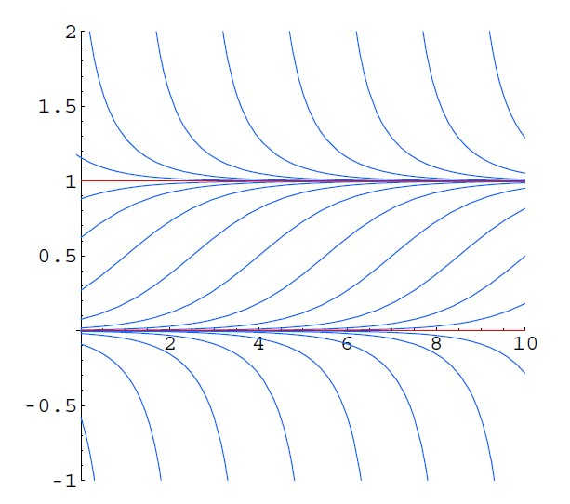
Evolution of a population
When considering
$$x\left(t\right)=\frac{{x_{0}.e}^{μ.P^{∗}t}}{1−x_{0}+{x_{0}.e}^{μ.P^{∗}t}} ,$$
it is clear that
at $t=0$, $x\left(0\right)=x_{0},$
as $t→+∞$, $x\left(t\right)→1$,
the derivative of $x\left(t\right)$ with respect to $t$ is negative when $x_{0}>1$,
the derivative of $x\left(t\right)$ with respect to $t$ is positive when $x_{0}<1$.
$$x\left(t\right)$$
time $t$

Slide 24
Evolution of a population
$$x\left(t\right)=\frac{{x_{0}.e}^{μ.P^{∗}t}}{1−x_{0}+{x_{0}.e}^{μ.P^{∗}t}} ,$$
$$x\left(t\right)$$
time $t$
Source: Nonlinear Ordinary
Differential Equations,
Peter J. Olver

Slide 25
Evolution of a population
When the (initial) population is smaller than the carrying capacity of the environment, the population will grow and finally (almost) reach this carrying capacity (but not exceed it).
When the (initial) population is larger than the carrying capacity of the environment, the population will decrease and finally (almost) reach this carrying capacity.
$$x\left(t\right)$$
(assuming the net birth rate is
positive in abscence of limiting
factors)
time $t$

Slide 26
Table of content
Linear time-invariant systems
Non-linear systems
Evolution of a population
Numerical solution
Conclusion

Slide 27
Numerical solution
In general, finding the solution of a non-linear differential equation in an analytical way is hard or even impossible.
Approximating the non-linear differential equation by a difference equation and calculating the solutions in a numerical way is often the only (or the best) option.
We already calculated the solutions for the non-linear differential equation
$$\frac{d x}{d t}=μ.P^{∗}\left(1−x\right).x$$
in an analytical way. By considering discrete times $n$, one obtains the difference equation (time step $Δt$)
$\frac{x\left[n+1\right]−x\left[n\right]}{Δt}=μ.P^{∗}\left(1−x\left[n\right]\right).x\left[n\right]$

Slide 28
Numerical solution
The difference equation
$\frac{x\left[n+1\right]−x\left[n\right]}{Δt}=μ.P^{∗}\left(1−x\left[n\right]\right).x\left[n\right]$
can be rewritten as
$$x\left[n+1\right]=x\left[n\right]+μ.P^{∗}\left(1−x\left[n\right]\right).x\left[n\right].Δt$$
Using e.g. MATLAB, with a number of initial conditions $x\left[0\right]=x\left(0\right)=x_{0}$ the evolution of $x\left[n\right]$ can be calculated and visualised.

Slide 29
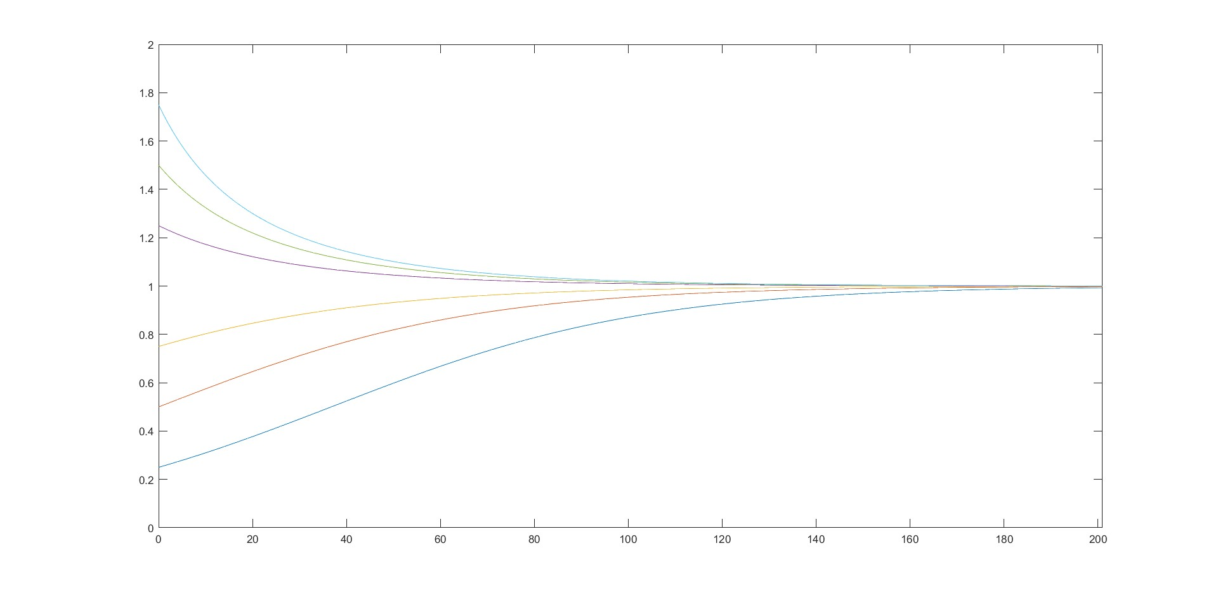
Numerical solution
The numerical solution (of course) corresponds with the result obtained by the analytical calculations.
$$x\left[n\right]$$
Relative value of the carrying capacity.
time

Slide 30
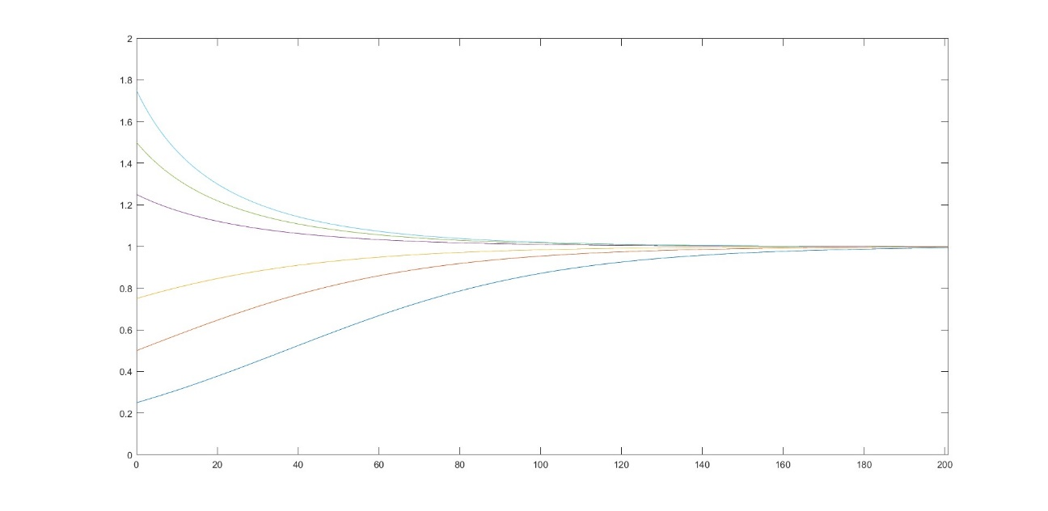
Numerical solution
When the (initial) population is smaller than the carrying capacity of the environment, the population will grow and finally (almost) reach this carrying capacity (but not exceed it).
When the (initial) population is larger than the carrying capacity of the environment, the population will decrease and finally (almost) reach this carrying capacity.
(assuming the net birth rate
is positive in abscence of
limiting factors)
$$x\left[n\right]$$
time

Slide 31
Table of content
Linear time-invariant systems
Non-linear systems
Evolution of a population
Numerical solution
Conclusion

Slide 32
Conclusion
Inspired by the e-books developed during the realisation of our Erasmus+ project “Development of practically-oriented student-centred education in the field of modelling of Cyber-Physical Systems”, we considered:
the importance of mathematical modelling and different types of models,
the importance of ordinary differential equations and difference equations,
methods to solve linear time-invariant differential equations in an analytical way,

Slide 33
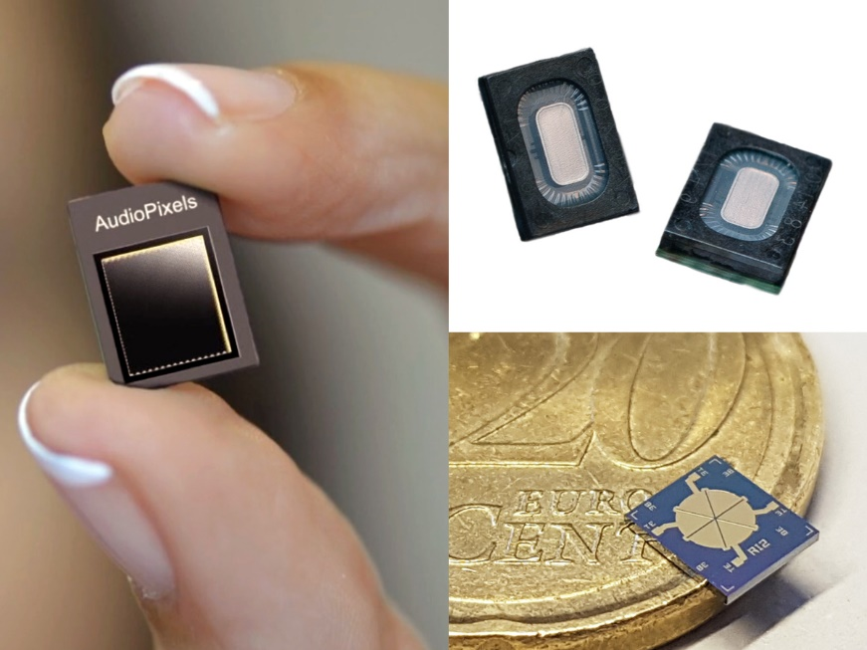
Conclusion
Inspired by the e-books developed during the realisation of our Erasmus+ project “Development of practically-oriented student-centred education in the field of modelling of Cyber-Physical Systems”, we considered:
the use of Laplace transforms,
the use of state-space modelling,
several practical applications, including Cyber-Physical Systems, MEMS, energy harvesting, second order systems, spring-mass-damper systems,…

Slide 34
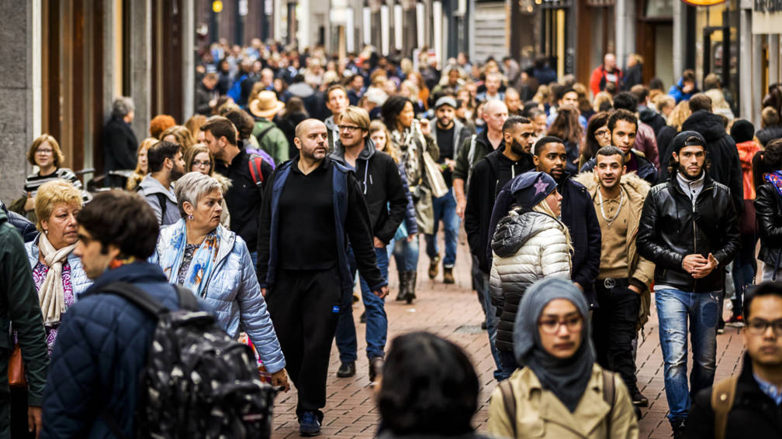
Conclusion
Inspired by the e-books developed during the realisation of our Erasmus+ project “Development of practically-oriented student-centred education in the field of modelling of Cyber-Physical Systems”, we considered:
non-linear differential equations describing the behaviour of non-linear systems,
solving non-linear differential equations in an analytical way,
solving non-linear differential equations by approximating them by difference equations and obtaining a numerical solution (including the use of e.g. MATLAB).

Slide 35
Thank your for your attention! Questions?

