Slide 1
Cyber Physical Systems Modelling and Simulations – book no6 overview
Presenter: Irina Ciornei (ciornei.irina@ucy.ac.cy)
Contributors: Stella Hadjistassou, Nikolas Flerentzou
KIOS Research and Innovation Center of Excellence
University of Cyprus
http://www.kios.ucy.ac.cy
CybPhys Meeting, Riga March 16-17, 2023

Slide 2
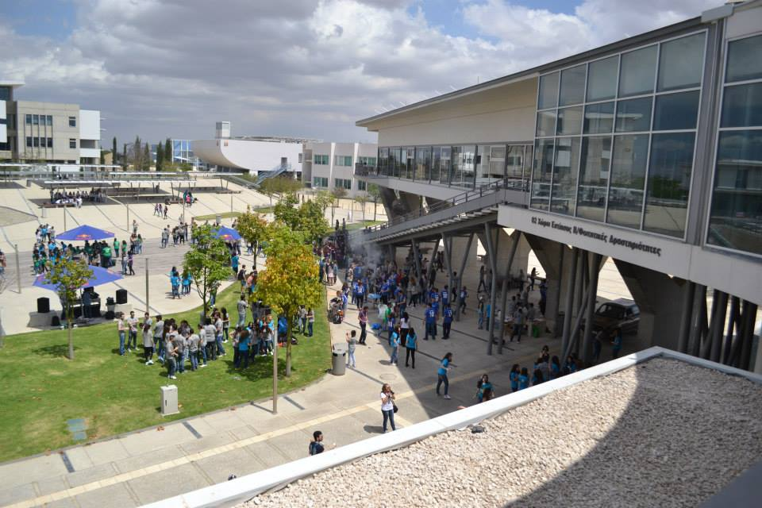
KIOS CoE at a glance
KIOS was established as a research unit in 2008 and upgraded to a Center of Excellence (CoE) in 2017 – Collaborates strategically with Imperial College, London
Operates within the University of Cyprus (at the level of Faculty)
Over 180 people at KIOS CoE
Develops research infrastructures (Testbeds) to test technologies under realistic operating conditions
Creates synergies with national and international industrial and governmental organizations
Number of KIOS Alumni: 248
The team of KIOS CoE
UCY building where KIOS CoE is located
Notes:
Greek mythology: “Kios” from the Greek Κοῖος (Kee-os), was the Titan of inquisitive mind and the questioning intelligence
Mission & Vision:
To conduct multidisciplinary research and innovation in the area of Information and Communication Technologies (ICT) with emphasis on the Monitoring, Control, Security and Management of Critical Infrastructures
To provide an inspiring environment for conducting excellent, cutting-edge research at a global scale, producing new knowledge that can be applied to solve timely and real-life problems in the considered Critical Infrastructure Systems (CIS)

Slide 3
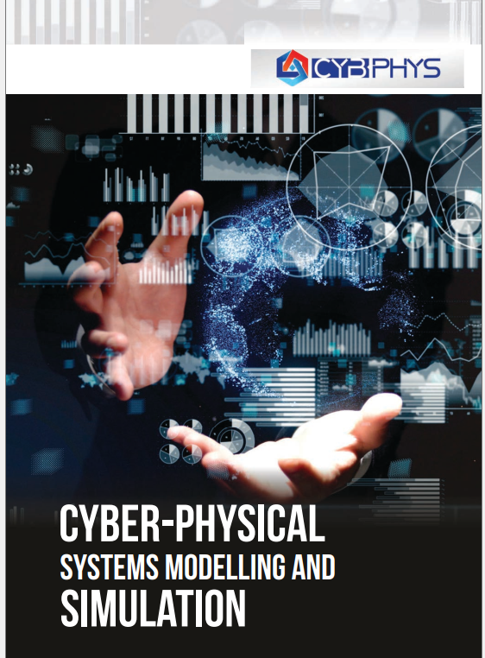
Outline
Introduction
CPS background & thematic areas
The communication and data layer in CPS
Cybersecurity for CPS
Application domains. Examples from Smart Grids
https://ebooks.rtu.lv/wp-content/uploads/sites/32/2022/11/9789934226755_Cyber-Modeling-and-Simulation.pdf

Slide 4
Introduction
Sensors everywhere
Why this book?
Timely topic for all fields of engineering due to:
Digitalization & sensors everywhere
Integration of ICT (e.g., wireless communication, IoT, etc)
Enhanced monitoring and control
Part of the core objectives of the CybPhys project to develop quality
educational content for modeling, simulation and analysis of CPS to enhance
the offered curricula for engineering students
To whom it is addressed?
Academics & educators in high-tech domains
Students registered in all engineering fields
Professional engineers
19/09/2022

Slide 5
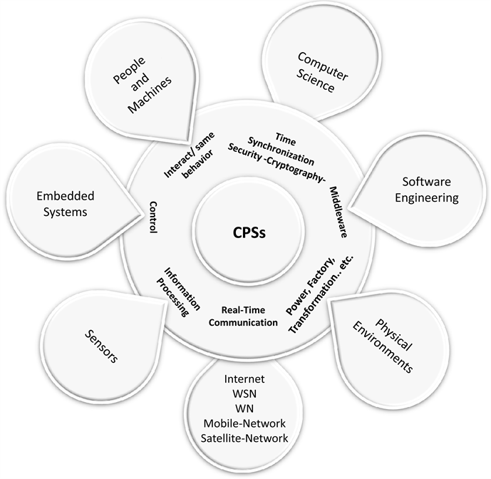
Introduction
What is the book about?
19/09/2022

Slide 6
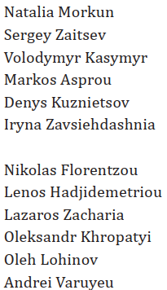
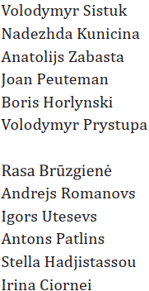
Introduction
A closer look….in numbers!
3 Editors
24 Authors
9 Chapters
Nikolas Flourentzou
Stella Hadjistassou
Irina Ciornei
240 pages
>170 references
https://ebooks.rtu.lv/wp-content/uploads/sites/32/2022/11/9789934226755_Cyber-Modeling-and-Simulation.pdf
19/09/2022

Slide 7
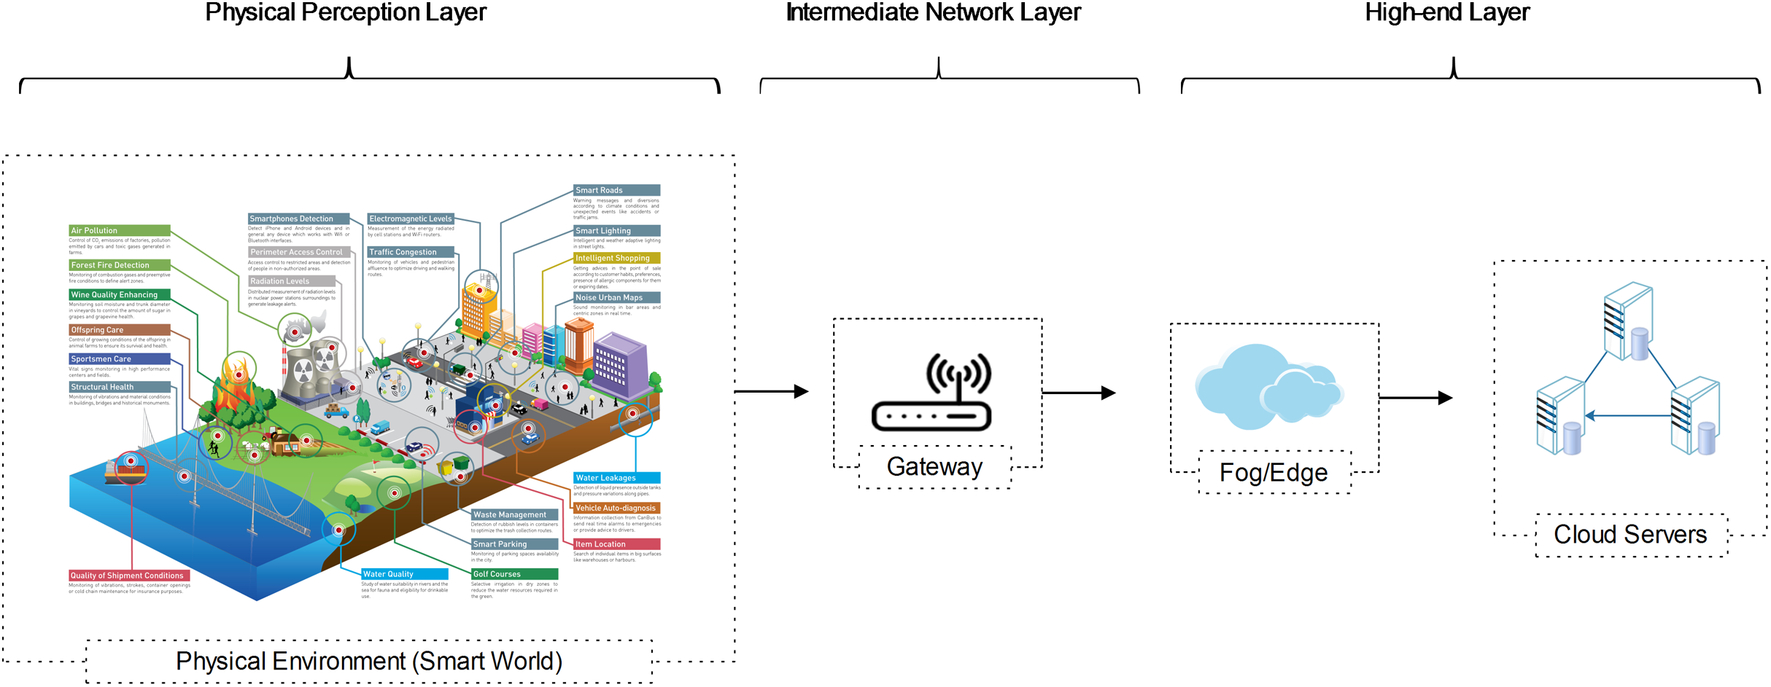
CPS background
Cyber-Physical Systems (CPSs) are interconnected real-time systems that combine discrete computation with continuous physical processes in a controllable way.
19/09/2022

Slide 8
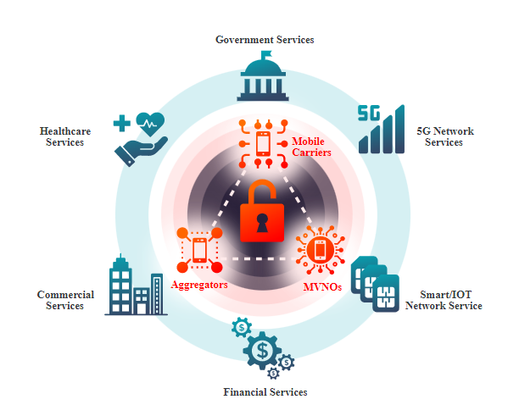
CPS background
Cyber-Physical Systems (CPSs)
Essential blocks for building resilient critical infrastructures (CI)
Assets (such as facilities, systems, sites, and networks) necessary for delivering the important services upon which daily life depends
They might also be prone on risk of attacks (cyber/physical/hybrid) which conceptually can become threat for the CI
Preparedness and protection of CPSs are important but not enough to keep them secure.
Further analysis of CPSs is required to design robust and secure systems
https://www.adaptivemobile.com/sectors/national-critical-infrastructure
19/09/2022

Slide 9
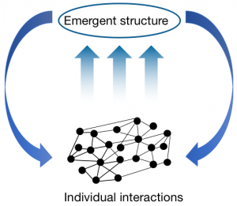
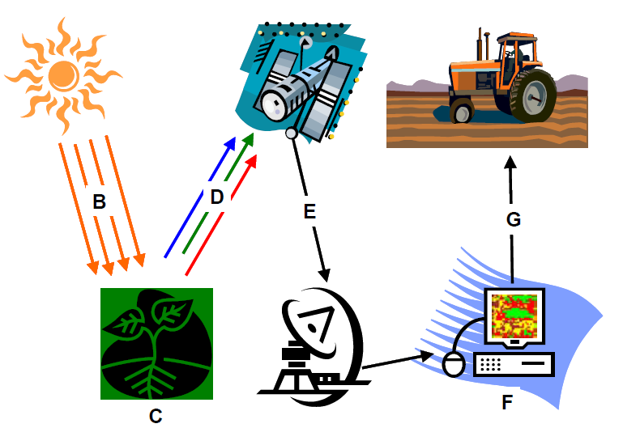
CPS background
Cyber-Physical Systems (CPSs)
An emerging new category of interconnected real-time complex but controllable technical systems that incorporate both discrete symbolic computation and continuous physical processes in a sophisticated manner [1].
It adopts a combination of cyber (ICT environment) and hardware infrastructure embedded with natural elements to sense, control, and actuate physical world behaviour, as well as human decision interaction.
 | [1] R. Poovendran, K. Sampigethaya, S. K. S. Gupta, I. Lee, K. V. Prasad, D. Corman, J. L. Paunicka, “Special Issue on Cyber– Physical Systems” in Proceedings of the IEEE, vol. 100, no. 1, pp 6-12, 2012.
19/09/2022

Slide 10
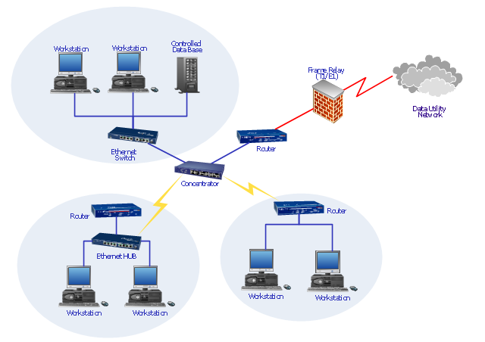
CPS background
Cyber-Physical Systems (CPSs) Novel technologies significantly contribute to the way people interact with engineering systems.
These interactions reflect the cyber-physical dimension of modern system analysis [2].
ICT networks and computer systems are supporting the management and supervision of multitude of physical assets composing CIs.
[2] E. Kyriakides, M. Polycarpou (Eds.), Intelligent Monitoring, Control, and Security of Critical Infrastructure Systems Studies in Computational Intelligence, Springer, Berlin Heidelberg, 2015, pp. 201–316, doi:10. 1007/978- 3- 662- 44160- 2_11
19/09/2022

Slide 11
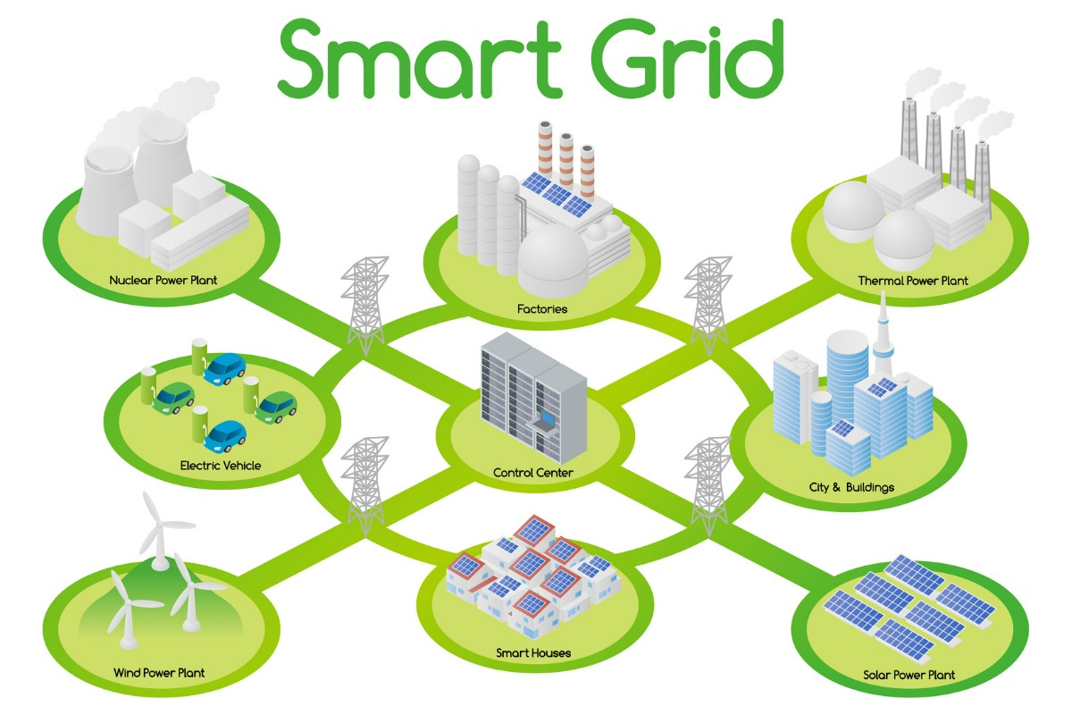
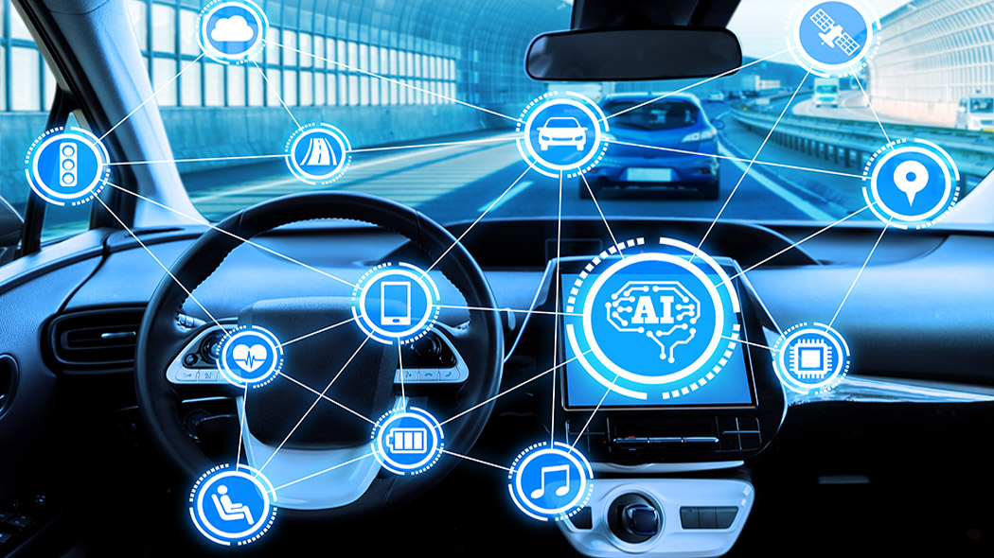
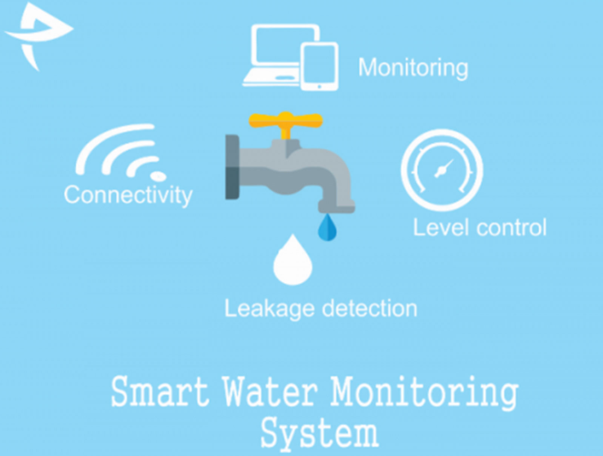
Thematic areas
Information and Communication Systems
Communication Systems are essential which offers the capabilities to transfer signals for monitoring and control of any physical system (e.g., remote locations).
Added challenge due to possible vulnerabilities to cyber threats
Communication and data layer is recognized as an essential architectural component of any CPS.
Smart Grids
Intelligent Transportation Systems
Industry 4.0
Smart Water Networks
[2] E. Kyriakides, M. Polycarpou (Eds.), Intelligent Monitoring, Control, and Security of Critical Infrastructure Systems Studies in Computational Intelligence, Springer, Berlin Heidelberg, 2015, pp. 201–316, doi:10. 1007/978- 3- 662- 44160- 2_11
19/09/2022

Slide 12
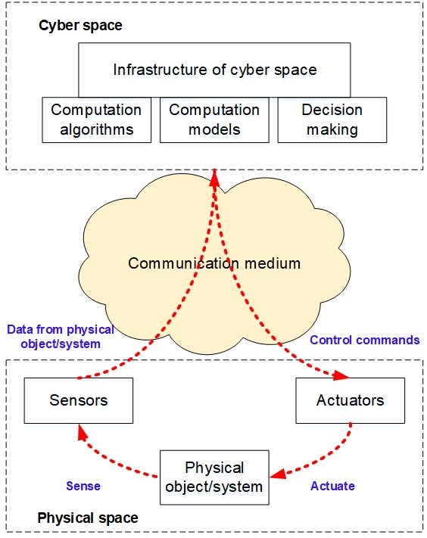
The communication and data layer in CPS
In cyber-physical systems, the components related to physical and cyber layers are convoluted in such a way that each could operate at different spatial and temporal scales, demonstrating various and different behaviours.
The reliability of interaction between physical and cyber components is directly dependent on the communication technologies and protocols used at different levels of the CPS architecture.
Connection (receive external information form field sensors)
Conversion (data to information, data processing and analysis)
Computation (collect and analyze information from all nodes of the CPS)
Cognition (decision making analysis)
Configuration (control and adjustment of CPS components)
Interaction between cyber and physical spaces in cyber-physical systems

Slide 13
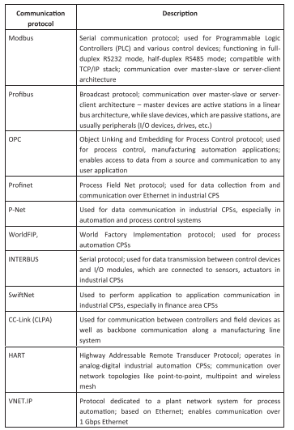
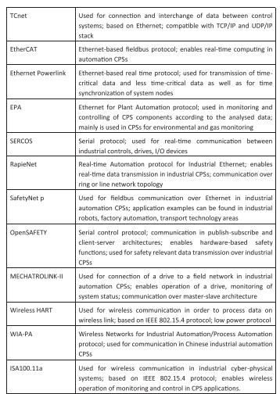
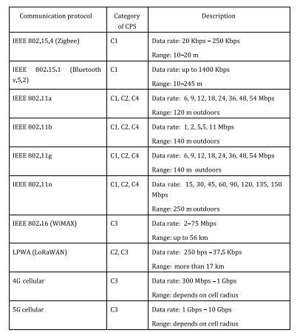
The communication and data layer in CPS
Communication Protocols in CPS
Wireless Networks
Communication Protocols for Industrial CPSs

Slide 14
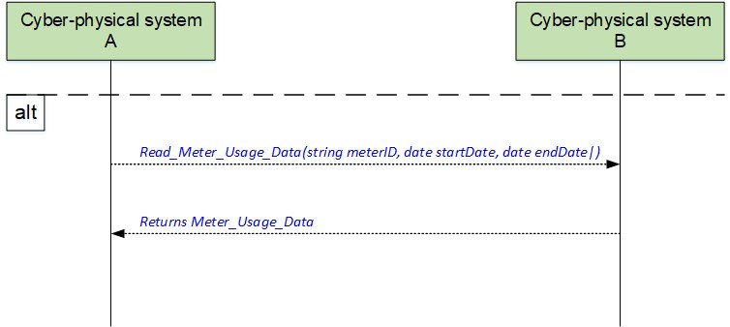
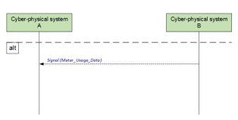
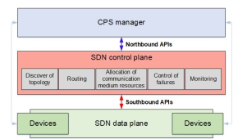
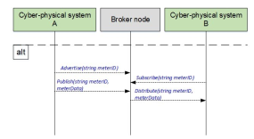
The communication and data layer in CPS
Data transmission methods over several CPSs
Data exchange in service-oriented API
Data exchange in signal-oriented API
Software-defined communication in cyber-physical systems
Publish/subscribe model for data exchange
SDN in cyber-physical system

Slide 15
The communication and data layer in CPS
Chapters 6, 7, 8, 9

Slide 16
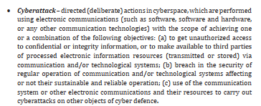
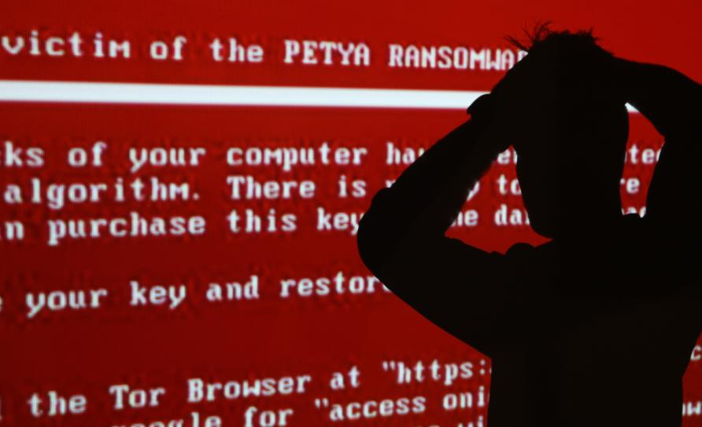
Cybersecurity for CPS
Basic glossary for cybersecurity

Slide 17
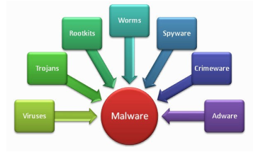
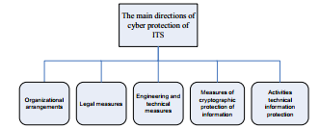
Cybersecurity for CPS
The most common types of malware
The main directions of cybersecurity of ITS
Chapter 3 and Chapter 9

Slide 18
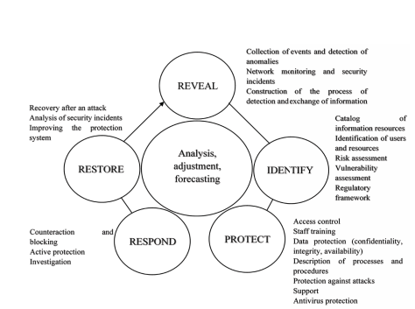
Cybersecurity for CPS
Modern digital cybersecurity tools
Chapter 3 and Chapter 9
Active cycle of cyber defence

Slide 19
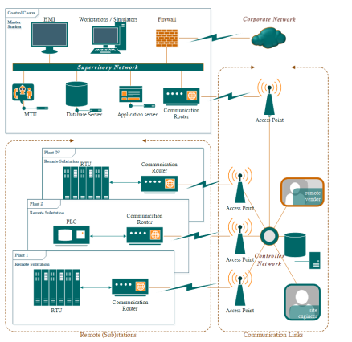
Application domains & examples
Supervisory Control And Data Acquisition (SCADA)
for industry process monitoring and control
Supervisory system
provides the control logic of the SCADA system by gathering data on the process and sending commands to the process
contains distributed software applications, multiple servers usually distributed in several locations to enable recovery in case of disasters
Remote terminal units
receive measurement signals from and send control signals to the intelligent electronic devices.
Programmable logic controller
used for gathering data from sensors and actuators; it includes a microprocessor that can provide control logic.
SCADA system architecture

Slide 20
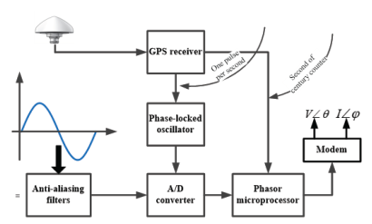
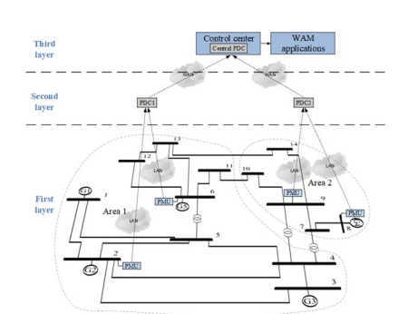
Application domains & examples
Smart grids. Example for Wide Area Monitoring and Control
Generic PMU configuration
Associated Delay of Different Communication Link
Communication infrastructure:
plays a crucial role in the implementation of a WAM system
Fiber optics is mostly used for deployment and connection of PMUs with central SCADA
5G is recently applied in field trials (Smart5Grid EU project): www.smart5grid.eu
Measurements system comprising both PMUs and PDCs

Slide 21
Application domains & examples
Smart grids. Example for Wide Area Monitoring and Control
WAMC applications make use of measurements provided by PMUs in order to provide a quasi-real-time visualisation of the power system operating condition.
State estimation: provides in real-time the state of the system (state vector)
Assumption: power system should be fully observable by the acquired measurements
The state vector contains the states of the system (i.e., bus voltage magnitude and bus voltage angle), and its determination leads to calculation of real and reactive power flows for each transmission line, net real and reactive power injected to the buses, as well as to monitoring the voltage magnitude of the power system buses to be within their operational limits.
Frequency stability assessment: aims to identify whether the power system is stable or is going to instability. The late detection of frequency instability could lead to a total blackout.
Voltage stability assessment: monitor the voltages of the grid buses in real-time by providing an indication of whether a region is critical to become voltage unstable
WAC: exploitation of the synchronised measurements to provide feedback control and coordination to the system, with the aim of compensating all the inter-area oscillations

Slide 22
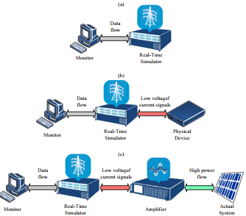
Testing and validation environments for CPS
SIL: The first one is the software-in-the-loop (SIL) simulation, where the proposed method is integrated and tested into a real-time model of the system
HIL: The second option is the hardware-in-the-loop (HIL) simulation, which provides the capability of connecting physical devices to the real-time simulation model. This kind of simulation is used for the development and testing of highly complex control, protection, and monitoring systems
PHIL: The advancement of the HIL option is the power hardware in-the-loop (PHIL). HIL is considered when low-voltage and low-current physical devices are connected to the real-time model, while PHIL provides the actual power flow required by higher power devices.
Illustration of the three real-time simulation options: (a) – SIL; (b)– HIL; and (c) – PHIL

Slide 23
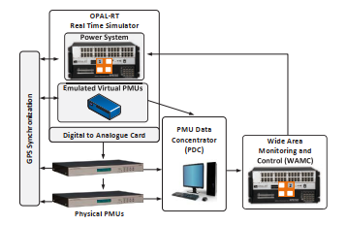
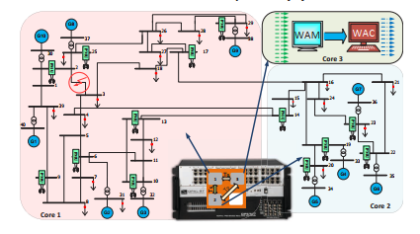
Modelling and simulation tools for advanced testing and validation of CPS
Integration of WAMC in real-time grid operation conditions
Schematic diagram of the laboratory setup for testing the proposed WAMC scheme in actual conditions, which consists of the real-time simulator, actual and virtual PMUs, GPS antennas, and a PDC
IEEE 39-bus test system illustrating the separation of the system into 3-cores for real-time simulation and the optimal PMU placement in the system

Slide 24
Smart Grids
Chapter 4

Slide 25
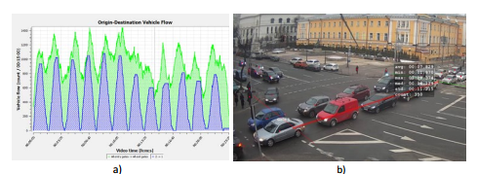
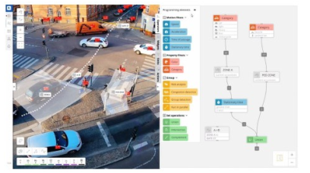
Application domains & examples
Intelligent Transportation Systems
Visualization of the congested directions: a) – on the chart; b) – on the scene view
Visualization of the traffic statistics in the FLOW Insights

Slide 26
Intelligent Transportation Networks
Chapter 5

Slide 27
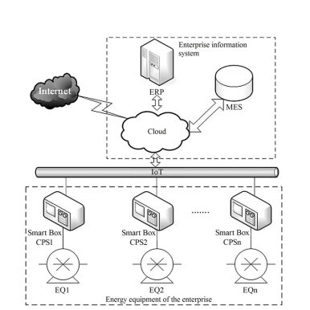
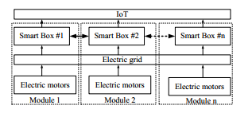
Intelligent Industry Processes analytics and big data (Industry 4.0)
CPS for preventive diagnostics of mining and metallurgical industry
The module network of diagnostic Smart Boxes
A logic-functional circuit of an enterprise with Smart Box diagnosing devices

Slide 28
Industry 4.0 and big data analytics
Chapter 2

Slide 29
Thanks for your attention
Questions & Discussion

