Slide 1



Development of practically-oriented student-centred education in the field of modelling of Cyber-Physical Systems, CybPhys: 609557
MC and WS meeting
March 16 – 18th, 2023, Riga Technical University, Latvia
Overview on new insights to the development of the secure cyber-physical systems
A curricula of a new KTU study subject with emphasis on teaching/ training material presented in e-book “Control Methods for Critical Infrastructure and Internet of Things (IoT)”
Assoc. prof. Rasa BRUZGIENE
Department of Computer Sciences
Kaunas University of Technology
Lithuania
rasa.bruzgiene@ktu.lt

Slide 2
Details of a new study subject in KTU
Syllabus with focus to CybPhys e-book
Learning methods
Assessment methods
Some statistics and feedback from the students
Outline:

Slide 3
Study subject
T120B125
“Cyber Physical Systems and it Security”
Created on: 01-09-2022
Started on: 01-09-2023
Accredited until: 01-09-2024
Level of study subject: Bachelor
Study programme: Informatics Engineering
Prerequisites for the students’:
Fundamentals of programming,
basics of digital logic,
computer architecture,
digital signals,
basics of cyber security

Slide 4
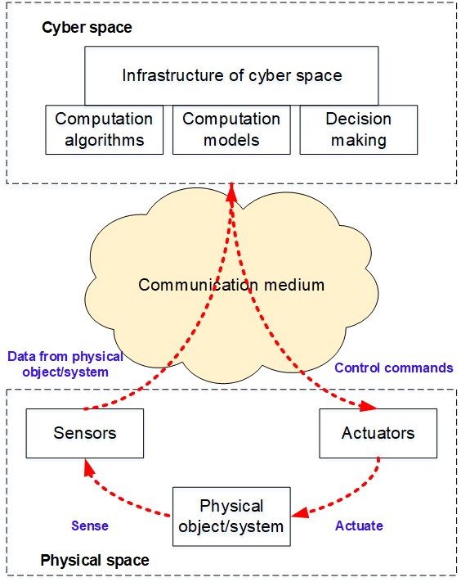
Study subject
T120B125
“Cyber Physical Systems and it Security”
Main aim:
To provide knowledge in the fields of development, operation, application of cyber physical systems and to develop abilities to apply the principles and methods of data processing and transmission, computer networks, communications and cyber security, that are required to ensure the secure operation of cyber physical systems in cyber and physical spaces.
Notes:
Smart systems, in which physical and computing components interact using communication networks, technologies, methods and tools.
[NIST SP 1500-201]

Slide 5
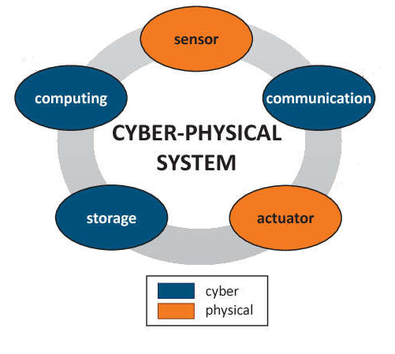
Study subject
T120B125
“Cyber Physical Systems and it Security”
Insights to the security of CPS
CPS security threats can be classified as:
cyber threats;
physical threats.

Slide 6
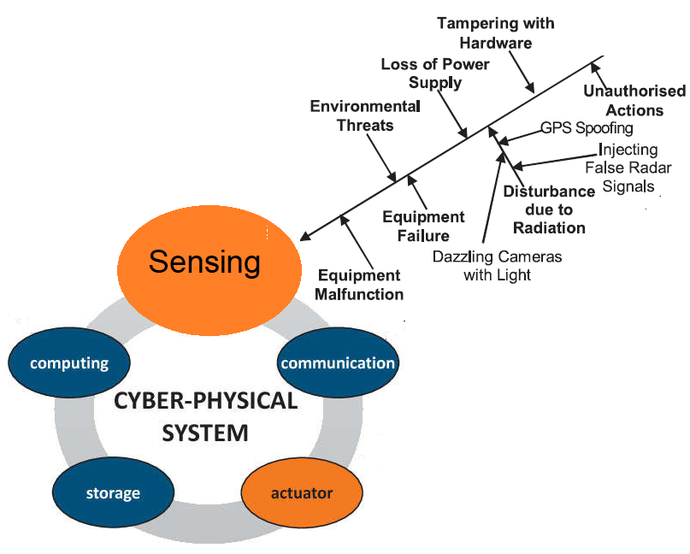
Study subject
T120B125
“Cyber Physical Systems and it Security”
Threats to physical space

Slide 7
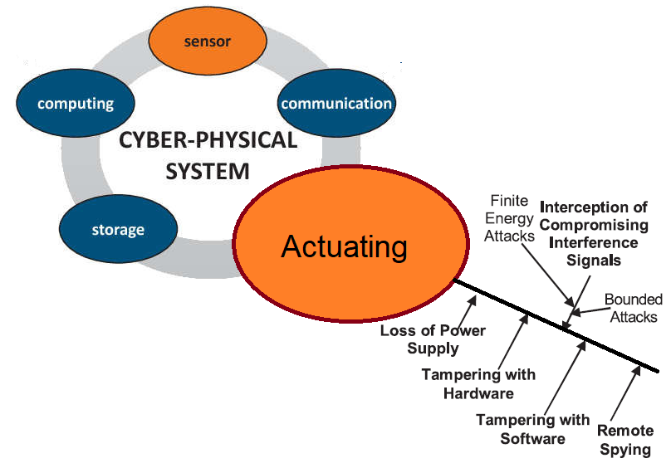
Study subject
T120B125
“Cyber Physical Systems and it Security”
Threats to physical space

Slide 8
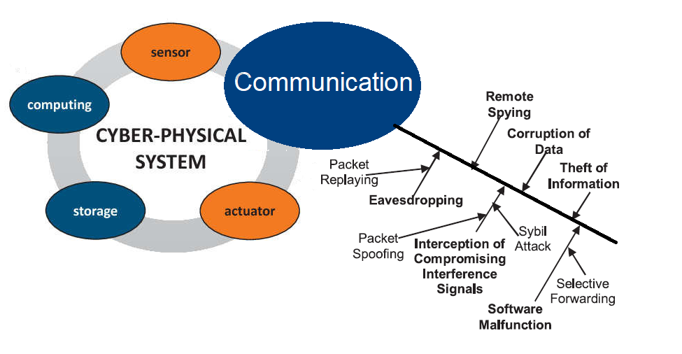
Study subject
T120B125
“Cyber Physical Systems and it Security”
Threats to communication part

Slide 9
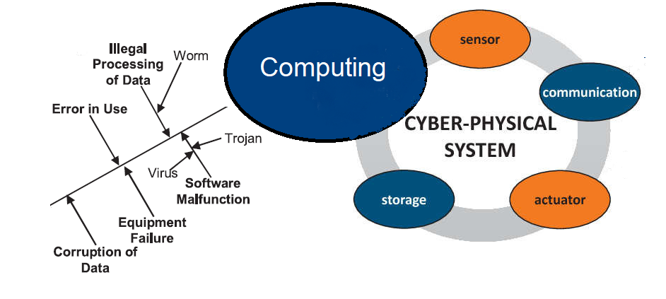
Study subject
T120B125
“Cyber Physical Systems and it Security”
Threats to computing part

Slide 10
Syllabus
4 general sections:
FUNDAMENTALS OF CYBER PHYSICAL SYSTEMS
DEVELOPMENT AND MANAGEMENT OF CYBER PHYSICAL SYSTEMS
COMMUNICATION IN CYBER PHYSICAL SYSTEMS
SECURITY OF CYBER PHYSICAL SYSTEMS

Slide 11
CybPhys e-book
”Control methods for critical infrastructure and Internet of Things (IoT)”
The book describes the operational principles of the Internet of Things and the current computer control of critical infrastructure.
It delves into the challenges that arise while modelling a continuous urban environment process in order to achieve a high quality in management of automated infrastructure.
Main chapters:
Structure of network and legacy networks
Control of complex distributed systems
Critical infrastructures control fundamentals
Embedded Operating Systems for IoT
Industrial Safety
Data Encryption and Key Management
Design of Adaptive Systems
Electromagnetic compatibility for CIS
Syllabus
4 general sections:
FUNDAMENTALS OF CYBER PHYSICAL SYSTEMS
DEVELOPMENT AND MANAGEMENT OF CYBER PHYSICAL SYSTEMS
COMMUNICATION IN CYBER PHYSICAL SYSTEMS
SECURITY OF CYBER PHYSICAL SYSTEMS

Slide 12
Syllabus
Topics included:
Definition, structure and essential components, functional/architectural elements, characteristics
Process of cyber physical system development, criteria for system operation and security
Classification of cyber physical systems, types of architectures, principles of realization the relations
Application areas of cyber physical systems, analysis of case studies
4 general sections:
FUNDAMENTALS OF CYBER PHYSICAL SYSTEMS
DEVELOPMENT AND MANAGEMENT OF CYBER PHYSICAL SYSTEMS
COMMUNICATION IN CYBER PHYSICAL SYSTEMS
SECURITY OF CYBER PHYSICAL SYSTEMS

Slide 13
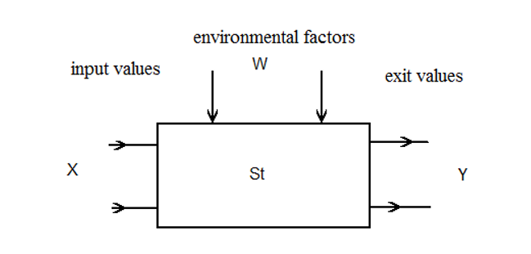
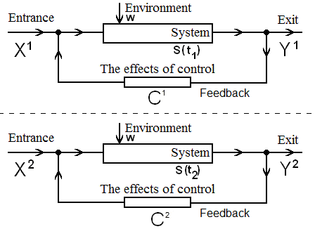
CybPhys e-book
”Control methods for critical infrastructure and Internet of Things (IoT)”
Chapter:
Control of complex distributed systems
Topics included:
Definition, structure and essential components, functional/architectural elements, characteristics
Process of cyber physical system development, criteria for system operation and security
Classification of cyber physical systems, types of architectures, principles of realization the relations
Application areas of cyber physical systems, analysis of case studies

Slide 14
Syllabus
Topics included:
Peripherals, their structural elements and integration into cyber physical systems
Access network and roaming devices, their interconnection and functions
Data collection and processing in cyber physical systems
Management of adaptive and real-time cyber physical systems, control of security parameters
4 general sections:
FUNDAMENTALS OF CYBER PHYSICAL SYSTEMS
DEVELOPMENT AND MANAGEMENT OF CYBER PHYSICAL SYSTEMS
COMMUNICATION IN CYBER PHYSICAL SYSTEMS
SECURITY OF CYBER PHYSICAL SYSTEMS

Slide 15
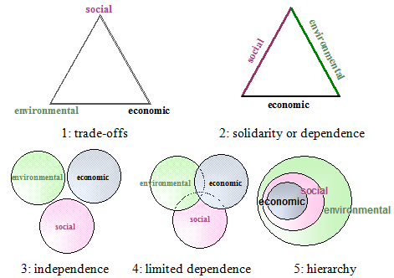
CybPhys e-book
”Control methods for critical infrastructure and Internet of Things (IoT)”
Chapter:
Control of complex distributed systems
Topics included:
Peripherals, their structural elements and integration into cyber physical systems
Access network and roaming devices, their interconnection and functions
Data collection and processing in cyber physical systems
Management of adaptive and real-time cyber physical systems, control of security parameters
Notes:
The main dimensions of sustainability

Slide 16
Syllabus
Topics included:
Fundamentals of communication in cyber physical systems
Communication protocols of cyber physical systems, principles of their operation and application
Mobile communication networks and technologies in cyber physical systems
Software defined radio, wireless and cloud computing technologies in cyber physical systems
4 general sections:
FUNDAMENTALS OF CYBER PHYSICAL SYSTEMS
DEVELOPMENT AND MANAGEMENT OF CYBER PHYSICAL SYSTEMS
COMMUNICATION IN CYBER PHYSICAL SYSTEMS
SECURITY OF CYBER PHYSICAL SYSTEMS

Slide 17
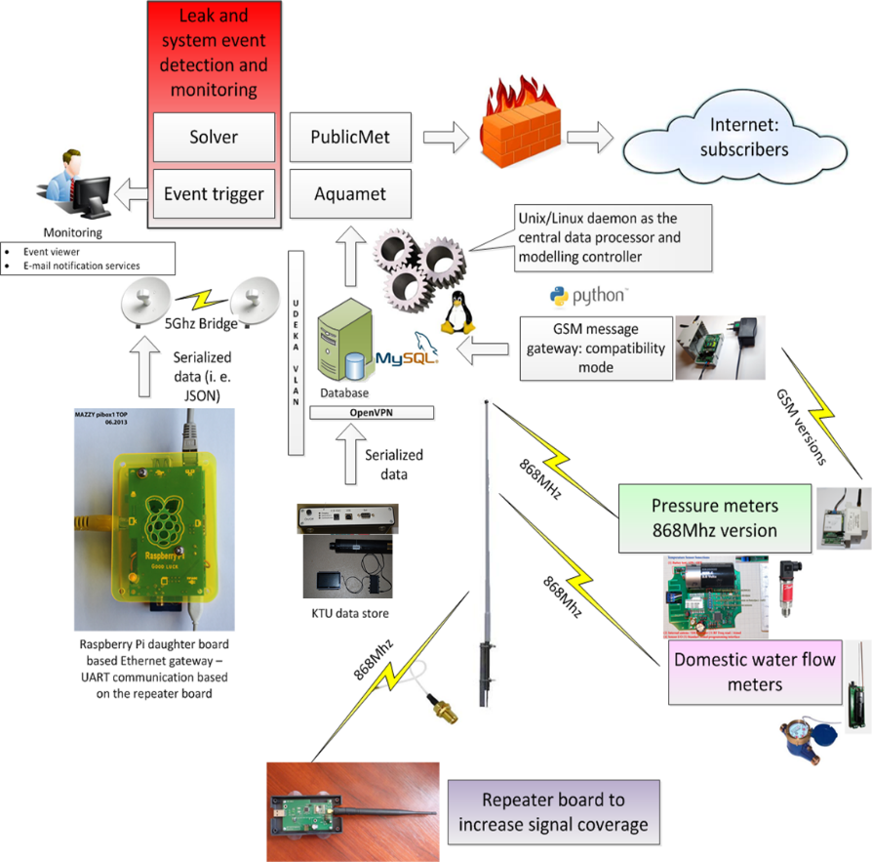
CybPhys e-book
”Control methods for critical infrastructure and Internet of Things (IoT)”
Chapter:
Critical Infrastructures Control Methods
Topics included:
Fundamentals of communication in cyber physical systems
Communication protocols of cyber physical systems, principles of their operation and application
Mobile communication networks and technologies in cyber physical systems
Software defined radio, wireless and cloud computing technologies in cyber physical systems
Notes:
Smart metering system

Slide 18
Syllabus
Topics included:
Threats and risks to the security of cyber physical systems during their development and operation phases
Cyber-attacks and their vectors, analysis of case studies
Security protocols at different levels of cyber physical systems
Methods for security assurance in cyber physical systems, their models and application
4 general sections:
FUNDAMENTALS OF CYBER PHYSICAL SYSTEMS
DEVELOPMENT AND MANAGEMENT OF CYBER PHYSICAL SYSTEMS
COMMUNICATION IN CYBER PHYSICAL SYSTEMS
SECURITY OF CYBER PHYSICAL SYSTEMS

Slide 19
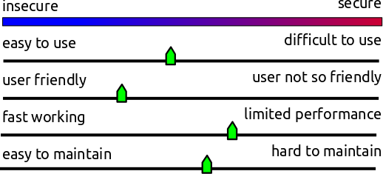
CybPhys e-book
”Control methods for critical infrastructure and Internet of Things (IoT)”
Chapter:
Industrial Safety
Topics included:
Threats and risks to the security of cyber physical systems during their development and operation phases
Cyber-attacks and their vectors, analysis of case studies
Security protocols at different levels of cyber physical systems
Methods for security assurance in cyber physical systems, their models and application
Notes:
Smart metering system

Slide 20
Study subject
T120B125
“Cyber Physical Systems and it Security”
Teaching/learning
methods:
Inquiry-based learning
Lab works
Practical workshops
Theory lecture

Slide 21
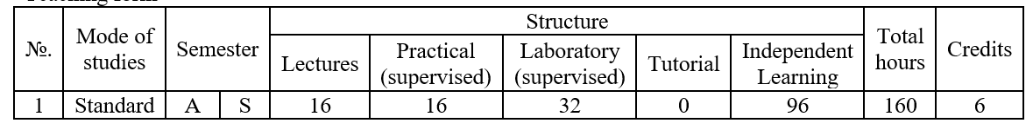
Teaching form
Inquiry-based learning activities
Theory lectures every two weeks per semester
Lab workshops every week per semester
Practical workshops under the engineering project every two weeks per semester

Slide 22
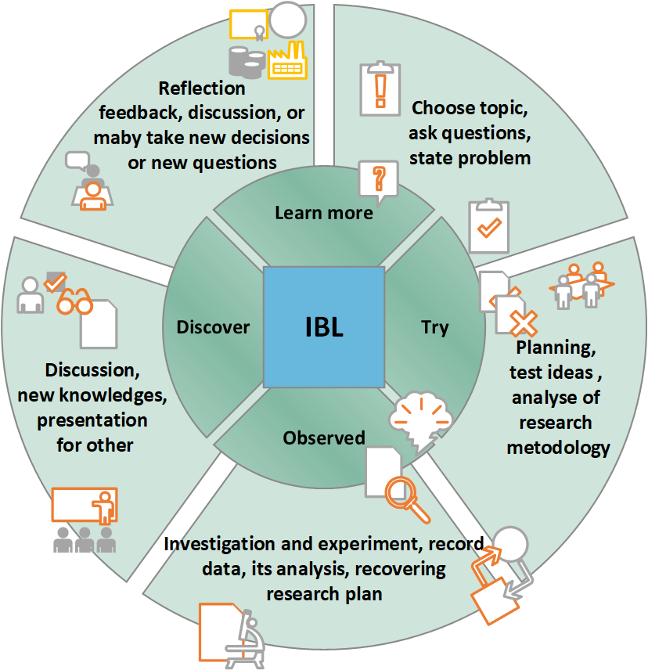
Study subject
T120B125
“Cyber Physical Systems and it Security”
Inquiry-based learning is an educational strategy, in which learners follow methods and practices in order to build knowledge as similar as professional scientists are doing.

Slide 23
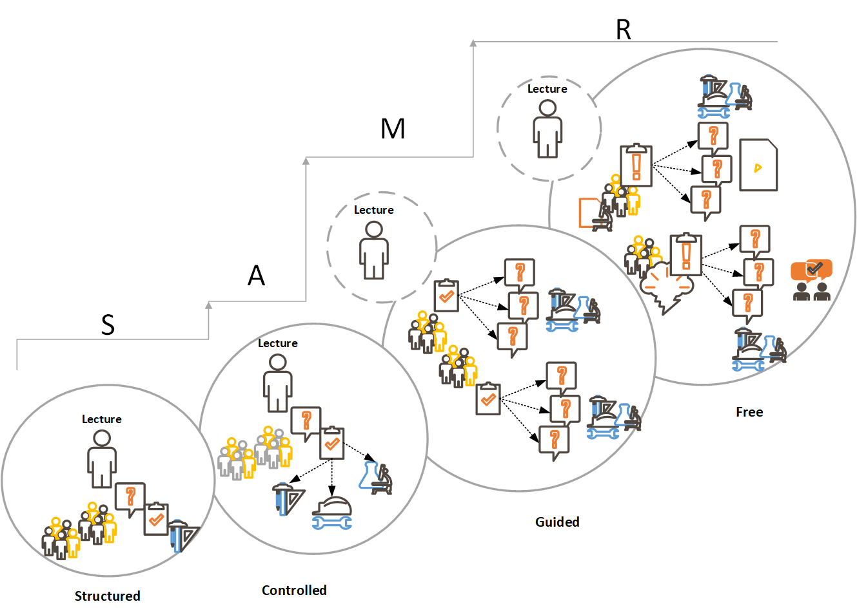
structured inquiry – when problems and questions are raised by teachers, also material and methods are searched and structured;
guided inquiry – when students search for ways to solve the teacher’s raised problem, to find answers to the questions based on the material formed;
Study subject
T120B125
“Cyber Physical Systems and it Security”
free inquiry – when students make research questions/statements and decide which of searched methods will be chosen to prove it; the facts are formed and it substantiation or refutation is sought.
According to SAMR (Substitution, Augmentation, Modification, and Redefinition) model, the meaning of last two levels actually alters to the learning process and potentially to the learning outcomes.

Slide 24
Examples of CPS ideas for case analysis

Slide 25
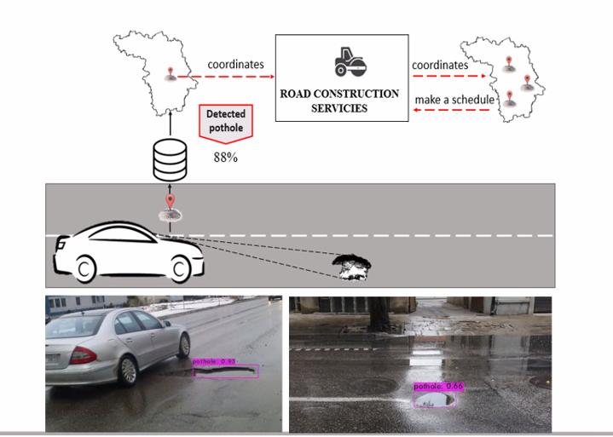
Smart management of construction of the road

Slide 26
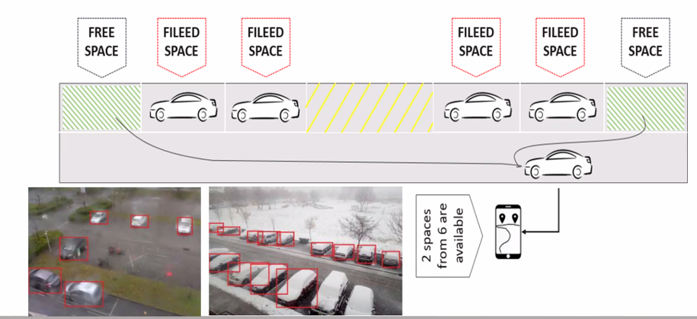
Smart management of free parking spaces in a city

Slide 27
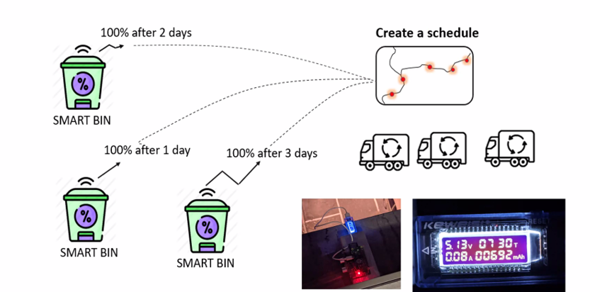
Smart management of household waste
Notes:
monitoring the filling of waste containers
Forecasting when the containers will be full
Creating the optimal schedule for the removal of the waste in containers
Creating the optimal travel route for the waste company‘s trucks to take the waste from citizens
...

Slide 28
Flexible Assessment Pathways

Slide 30
Example of the criteria for the assessment of the engineering project
Impact to the final grade

Slide 31
Some statistics and feedback

Slide 32
Study subject
T120B125
“Cyber Physical Systems and it Security”
Number of students: 38
Number of passed students: 37
Average grade of passed students: 7.54
87% of students replied, that the module uses advanced teaching/learning methods
89% of students agreed, that the module materials and learning resources are engaging and contributed to the achievement of the module's objectives, outcomes and competences.

Slide 33
Thank you for your attention.

