Slide 1

Erasmus+ KA2
Capacity Building in Higher Education
«Development of practically-oriented student-centred education in Cyber-Physical Systems modelling» «CybPhys»
Official number: 609557-EPP-1-2019-1-LV-EPPKA2-CBHE-JP
Progress on preparation to DD between RTU and KhNAHU
Presented by:
Professor Andrii Hnatov
2023, March 16-18th

Slide 2




2
Kharkiv National Automobile and Highway University
KA2: «CybPhys»
Double Diploma Master Program
between Riga Technical University and
Kharkiv National Automobile and Highway University
WP2 Tasks:
2.9. Double Degree Master program development and accreditation. In-progress (RTU and KhNAHU start preparation for the student admission)
An agreement was signed between Riga Technical University and Kharkiv National Automobile and Highway University on the introduction of a Double Degree diploma in the educational process of the master's degree program "Electric Vehicles and Energy-Saving Technologies" (within 141 specialties "Electric Power, Electrical Engineering and Electromechanics").

Slide 3
3
Kharkiv National Automobile and Highway University
KA2: «CybPhys»
Double Degree Master Program
Electric Vehicles and Energy-Saving Technologies
KhNAHU: 2 new and 4 modernized courses
2 new training courses developed for DDMP “Electric Vehicles and Energy-Saving Technologies”.
Energy-saving technologies in transport;
The structure of hybrid and electric vehicles;
4 training courses upgraded for DDMP “Electric Vehicles and Energy-Saving Technologies”:
Electric systems of environmentally friendly vehicles;
Methods of planning scientific research on vehicles;
Mathematical modelling and methods of optimization;
Intelligent information technologies and systems in transport.

Slide 4
4
Kharkiv National Automobile and Highway University
KA2: «CybPhys»
Acceptance of new study programs and courses
KhNAHU: 2 new and 4 modernized courses
University | Course/Lab title | Updated or totally new | Level (Bachelor, Master) | ECTS credit points | The teaching/training methodologies developed/adopted | The link to the university‘ webpage | Date of accreditation | The status / document of accreditation
KhNAHU | Energy-saving technologies in transport | New | Master | 8,5 | Lecture, practicals, lab practicals | http://dl.khadi.kharkov.ua/course/view.php?id=1331 | winter 2022 | Completed, winter 2022
KhNAHU | The structure of hybrid and electric vehicles | New | Master | 4 | Lecture, lab practicals | https://dl.khadi.kharkov.ua/course/view.php?id=1630 | winter 2022 | Completed, winter 2022
KhNAHU | Electric systems of environmentally friendly vehicles | Updated | Master | 4 | Lecture, lab practicals | http://dl.khadi.kharkov.ua/course/view.php?id=1356 | winter 2022 | Completed, winter 2022
KhNAHU | Methods of planning scientific research on vehicles | Updated | Master | 5,5 | Lecture, practicals, lab practicals | https://dl.khadi.kharkov.ua/course/view.php?id=1363 | winter 2022 | Completed, winter 2022
KhNAHU | Mathematical modelling and methods of optimization | Updated | Master | 3 | Lecture, lab practicals | https://dl.khadi.kharkov.ua/course/view.php?id=1733 | winter 2022 | Completed, winter 2022
KhNAHU | Intelligent information technologies and systems in transport | Updated | Master | 8,5 | Lecture, practicals, lab practicals | http://dl.khadi.kharkov.ua/course/view.php?id=1357 | winter 2022 | Completed, winter 2022

Slide 5

5
Kharkiv National Automobile and Highway University
KA2: «CybPhys»
Accreditation of the DDMP
Electric Vehicles and Energy Saving Technologies

Slide 6
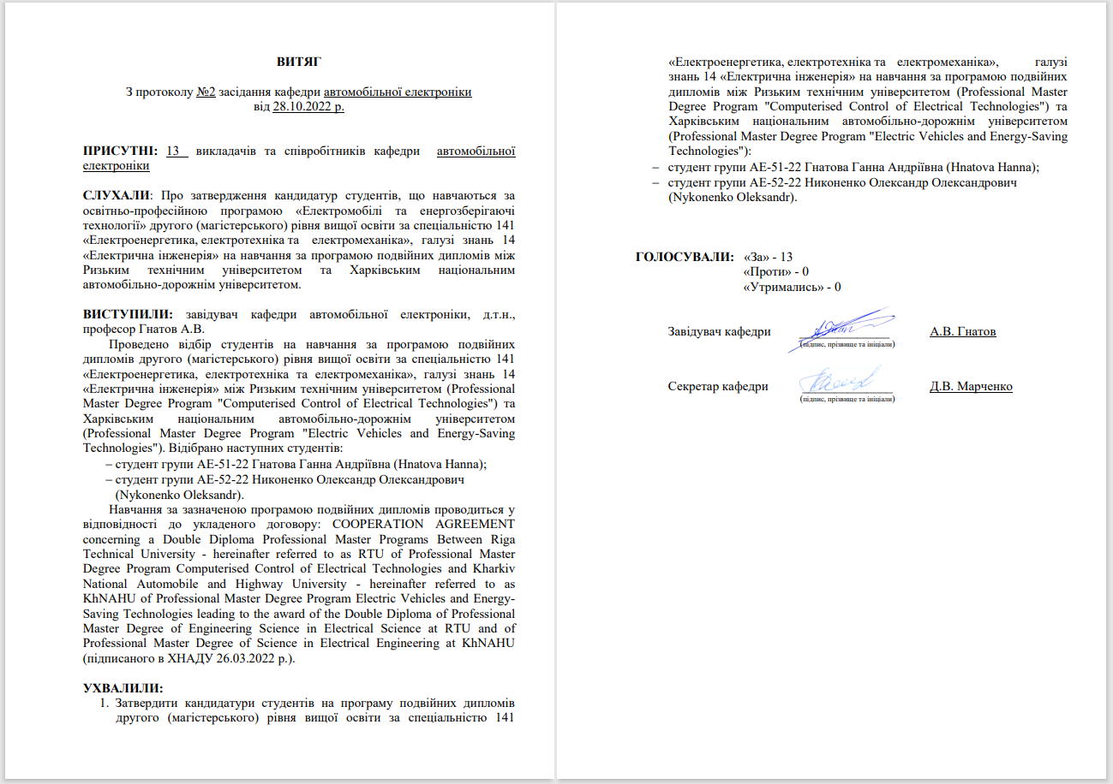
6
Kharkiv National Automobile and Highway University
KA2: «CybPhys»
Minutes of the meeting of the Vehicle Electronics Department
Protocol for approving the candidacies of students studying under the educational and professional program "Electric vehicles and energy-saving technologies" of the second (master's) level of higher education in the specialty 141 "Electric power engineering, electrical engineering and electromechanics", field of knowledge 14 "Electrical engineering" to study under the Double Diploma program between Riga Technical University and Kharkiv National Automobile and Highway University.
Studies at RTU will begin in September 2023.

Slide 7
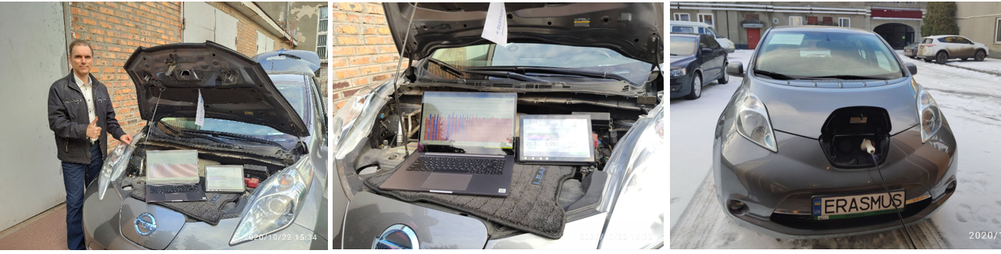
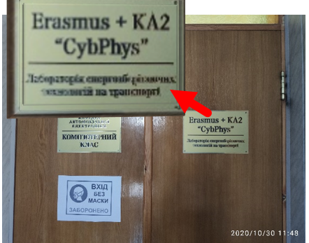
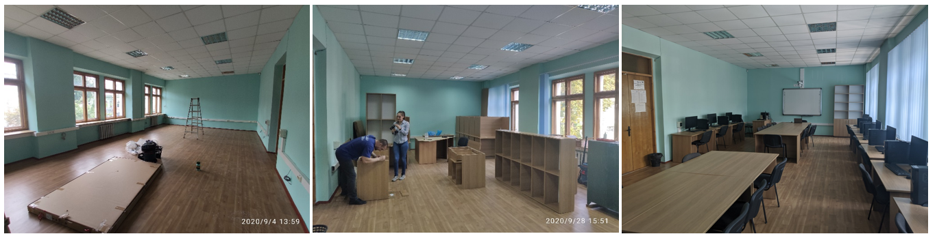
7
Kharkiv National Automobile and Highway University
KA2: «CybPhys»
Laboratory of Energy-saving
technologies in transport
The lab "Laboratory of Energy-saving technologies in transport" was created.

Slide 8


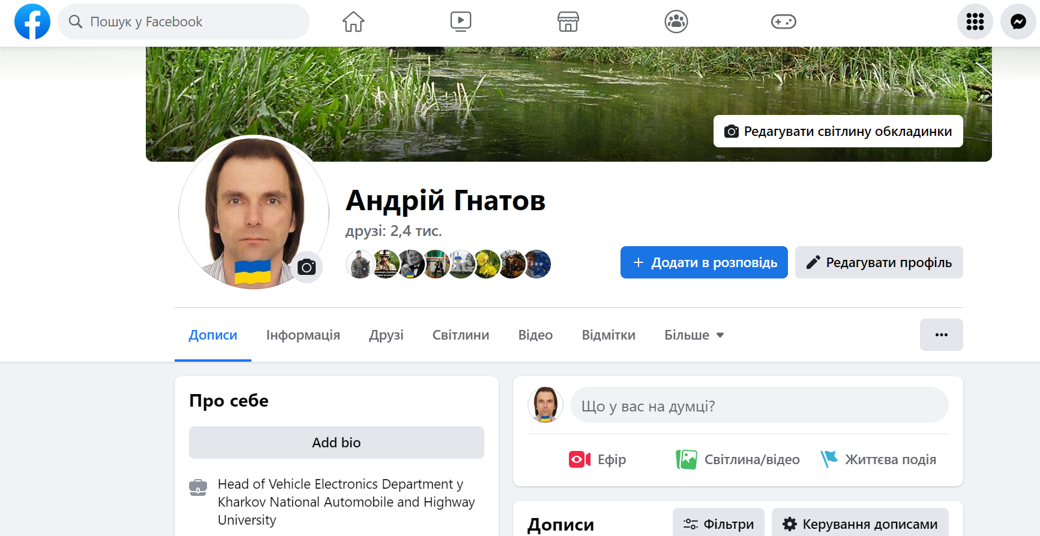
Contacts
8
Address: 61002, Ukraine, Kharkiv, Yaroslava Mudrogo St., 25
Kharkiv National Automobile and Highway University
Phone: +38(057) 700-38-52
Mobile: +38(066) 743-08-87
Е-mail: kalifus76@gmail.com
Linkedin: Andrii Hnatov
Linkedin
Facebook

