Slide 1
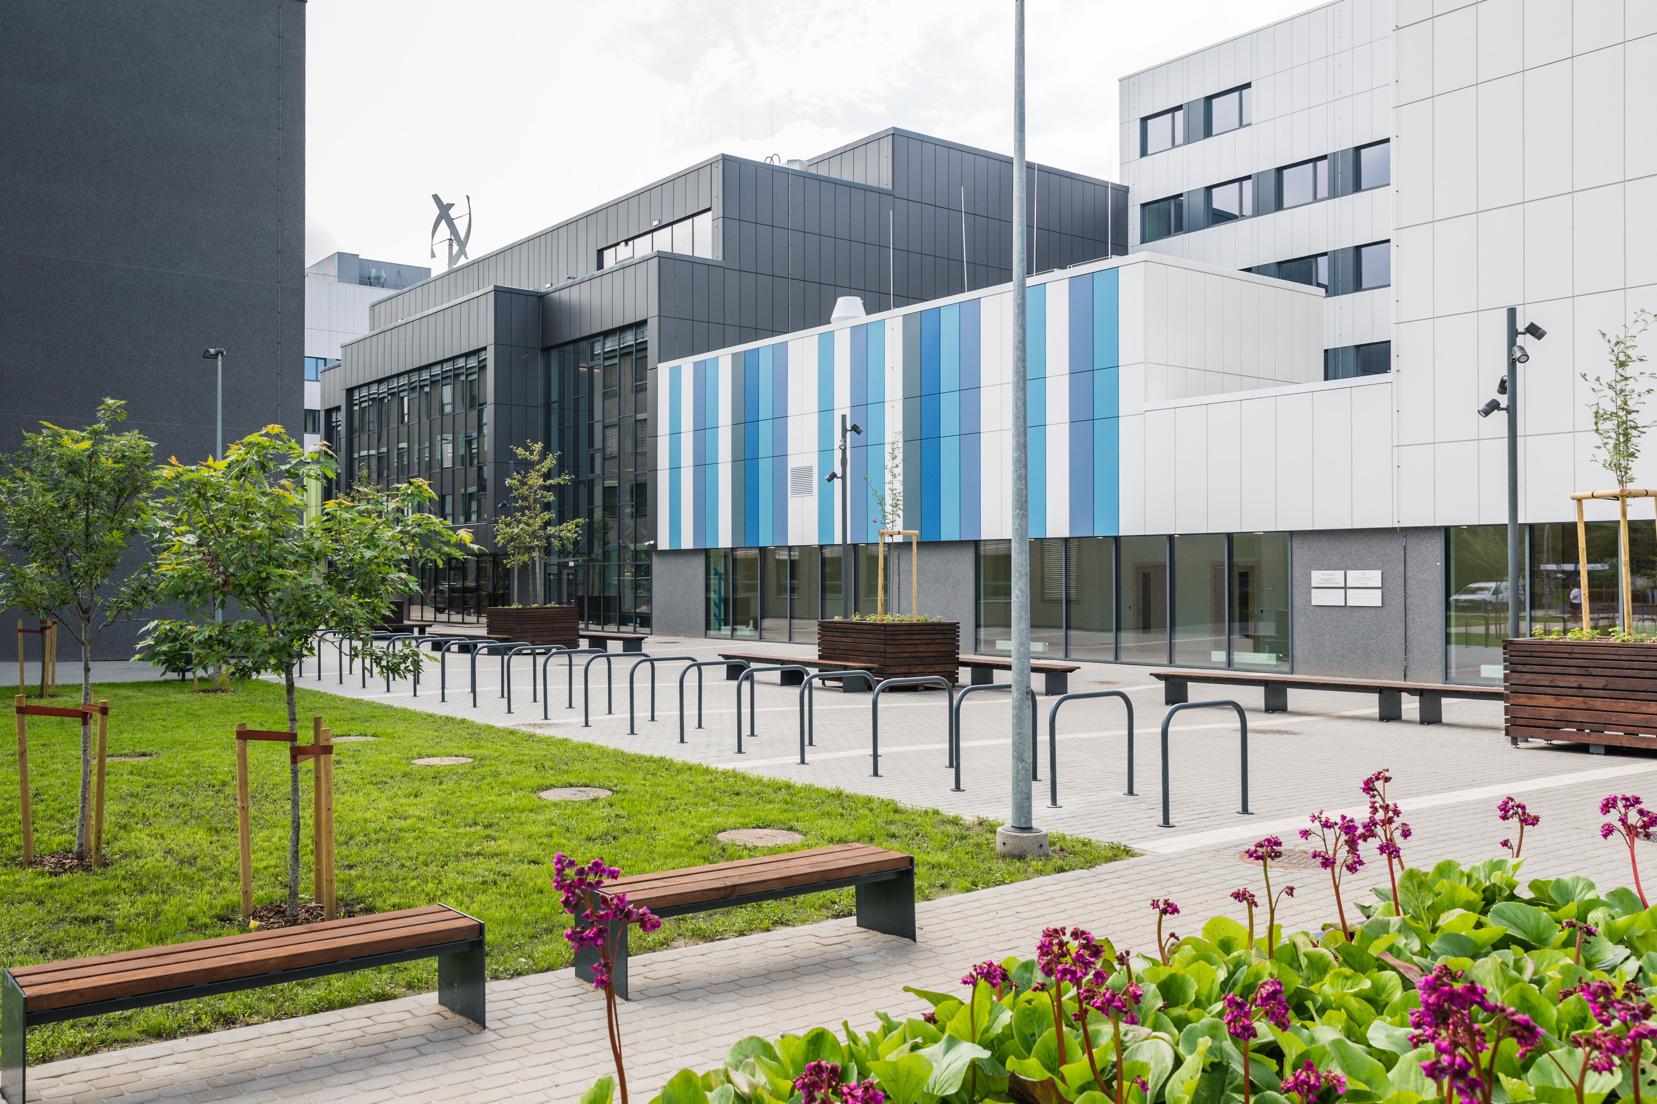
RIGA
TECHNICAL
UNIVERSITY
(Latvia)
Exchange studies

Slide 2
Facts & Figures
STUDY PROGRAMS
14 000 Students
STUDY PROGRAMS
COMPLETELY TAUGHT IN ENGLISH
30 % International students
4
AFFILIATIONS: CESIS, LIEPAJA, VENTSPILS, DAUGAVPILS
140 000 More than Alumni
RTU Engineering High School
1031 Academic staff & researchers
Latvian Maritime Academy

Slide 3
Faculties
Architecture
Civil engineering
Computer science & information technology
E-Learning technologies & humanities
Engineering economics & management
Electronics & telecommunications
Power & electrical engineering
Material science & applied chemistry
Mechanical engineering, transport & aeronautics

Slide 4
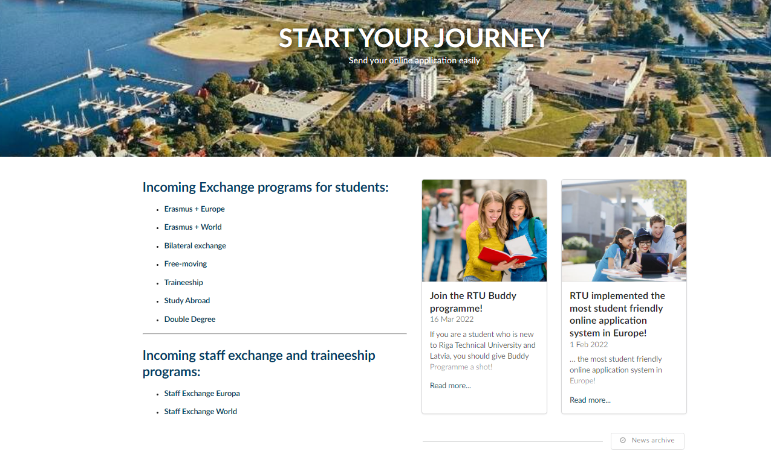
Online application
Incomingexchange.rtu.lv

Slide 5
Documents to be uploaded
Proof of nomination from home university
Transcript of marks from home university
English proficiency confirmation
Passport copy or ID

Slide 6
Courses
How to choose the courses?
Choose your courses with the coordinator
Confirm with your home university
Confirm with RTU
Fixed or flexible course list
Extra courses

Slide 7
Scholarships/ Support for UA
Scholarships
Application from 1 February till 1 April
Application through the State Education Development Agency
https://www.studyinlatvia.lv/scholarships
Support Ukraine
Erasmus scholarships – EUR 1050/a month

Slide 8
Summer and Winter Schools

Slide 9
Q&A
International Cooperation and Foreign Students Department | Head of Unit
natalja.muracova@rtu.lv Erasmus+ Coordinator
ilze-ella.negribe@rtu.lv

