Slide 1
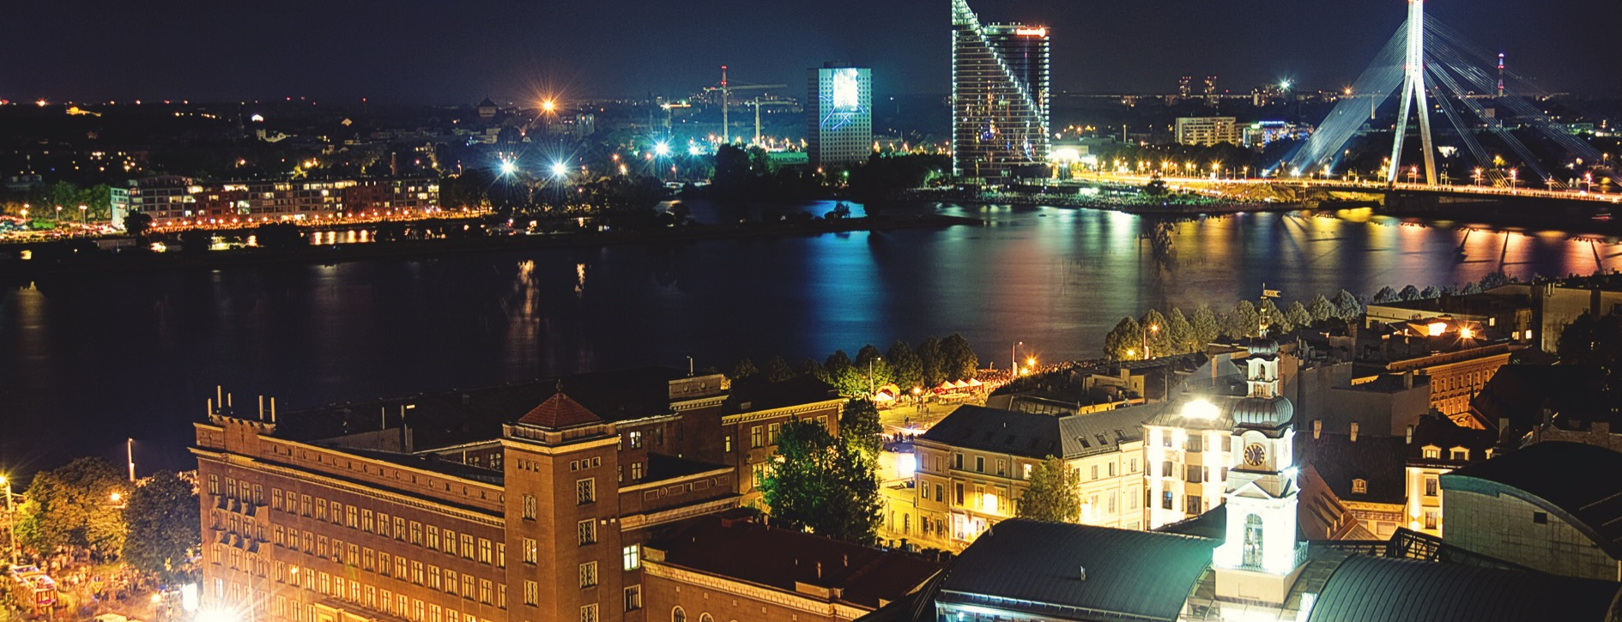

Riga Technical University
Latvian Centre of Engineering Science | Anno 1862

Slide 2
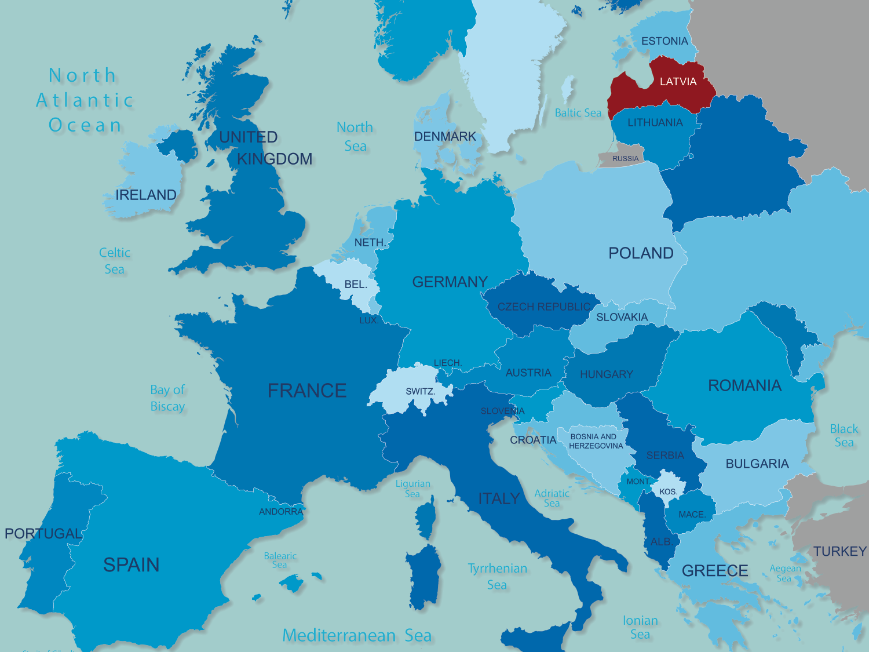
Area – 64 589 km²
Capital – Riga

Slide 3
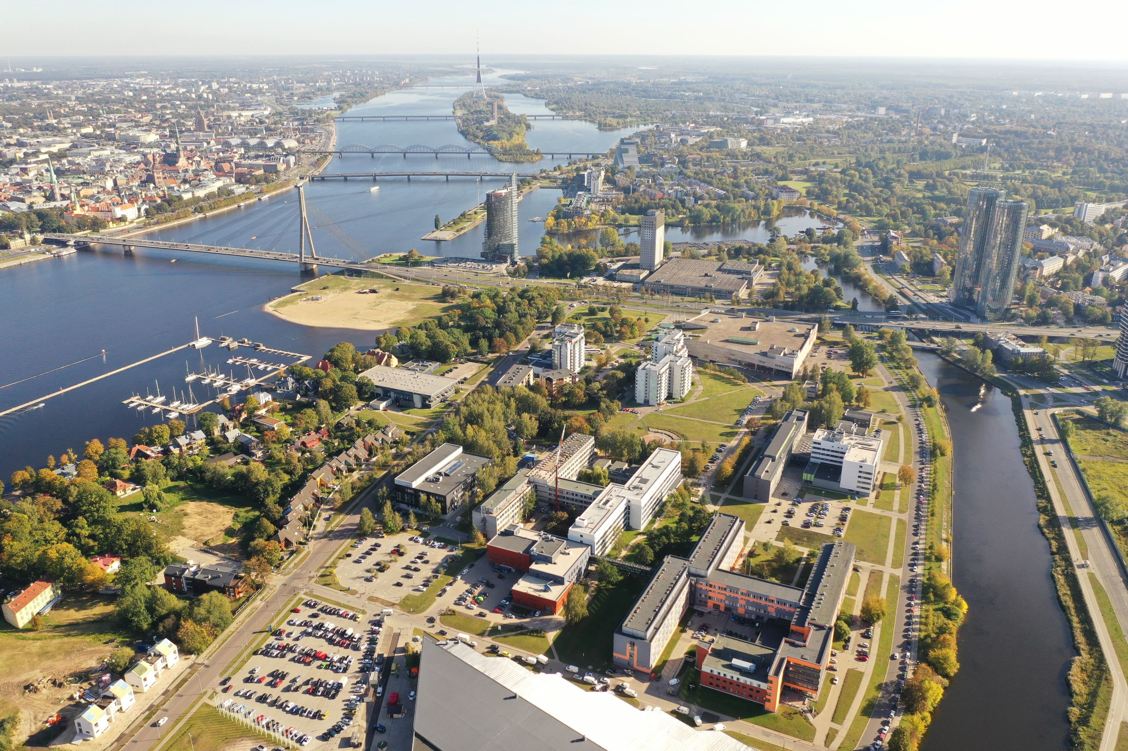
Location - Ķīpsala

Slide 4

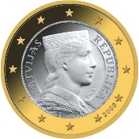
Latvia in Facts
One of the oldest flags in
the world – dates back to
the 13th century
Time zone
EET (UTC/ GME +2)
Winter 0... -7 C
Summer +17 C... +30 C
Currency
Euro
4 seasons
Climate humid continental
Member of European
Union and NATO
since 2004
Schengen Area - 2008
Lutheran (34%)
Catholic (24%)
Orthodox (18%)
One of TOP 4 countries
worldwide with the
fastest internet!

Slide 5
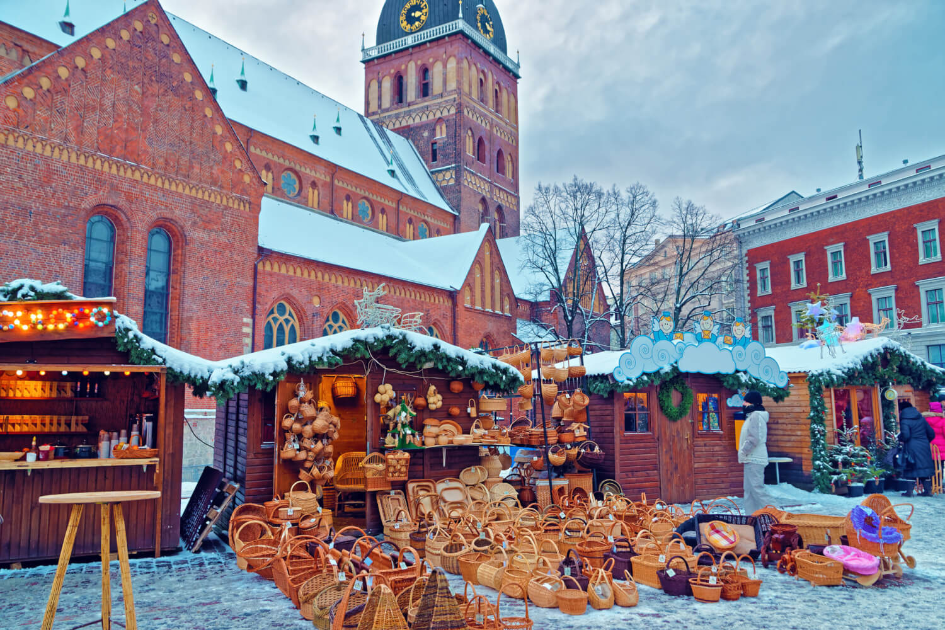
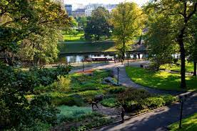
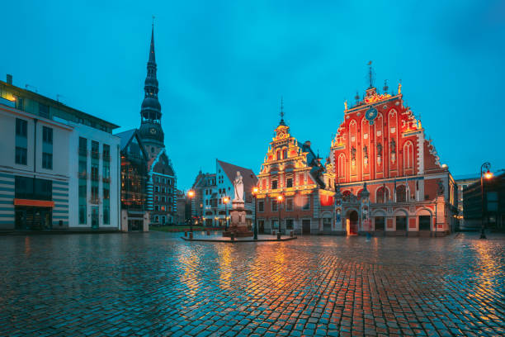
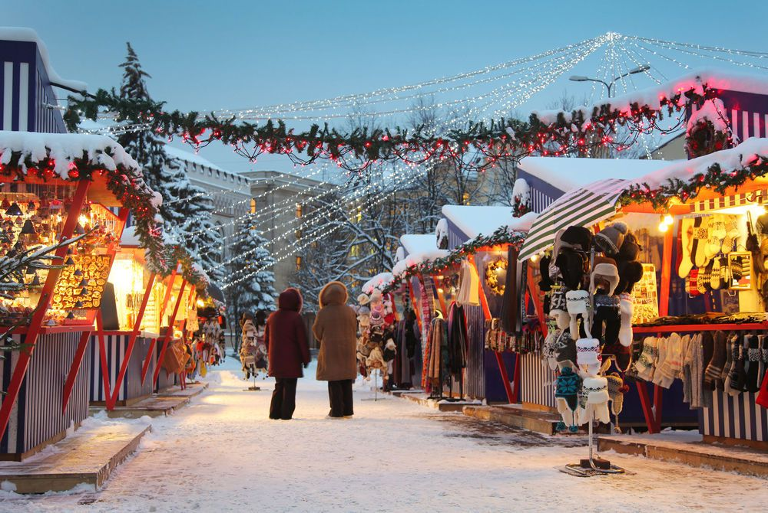
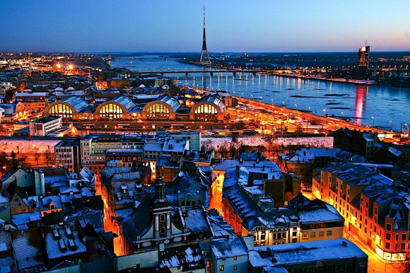
Things to do in Latvia

Slide 6
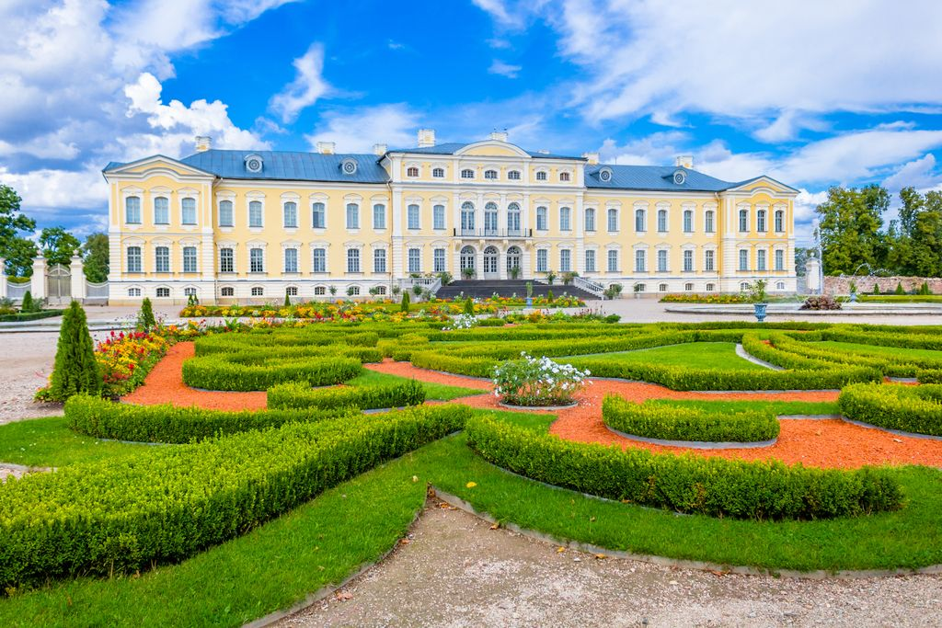


Things to do in Latvia
Riga – Jurmala takes about 30min by train and coast 1.15€
Nightlife is very active – bars and clubs are open until about 6:00
Lots of shopping and dining in the city (including lots of different cuisines)
Plenty of parks and natural trails for hiking
Great and cheap public transportation system in the city and suburbs

Slide 7

Crossroads
The largest European cities are just few hours flight away and the return flight costs starting from € 30
Riga
Amsterdam
Berlin
Helsinki
London
Moscow
Paris
Stockholm

Slide 8
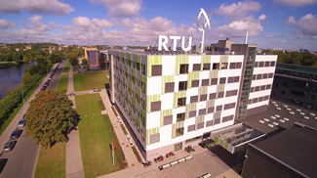
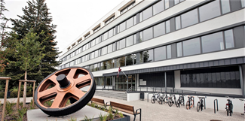
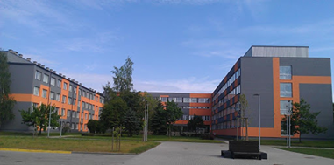
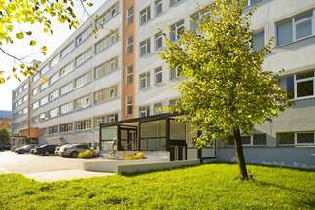
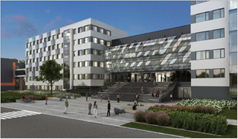
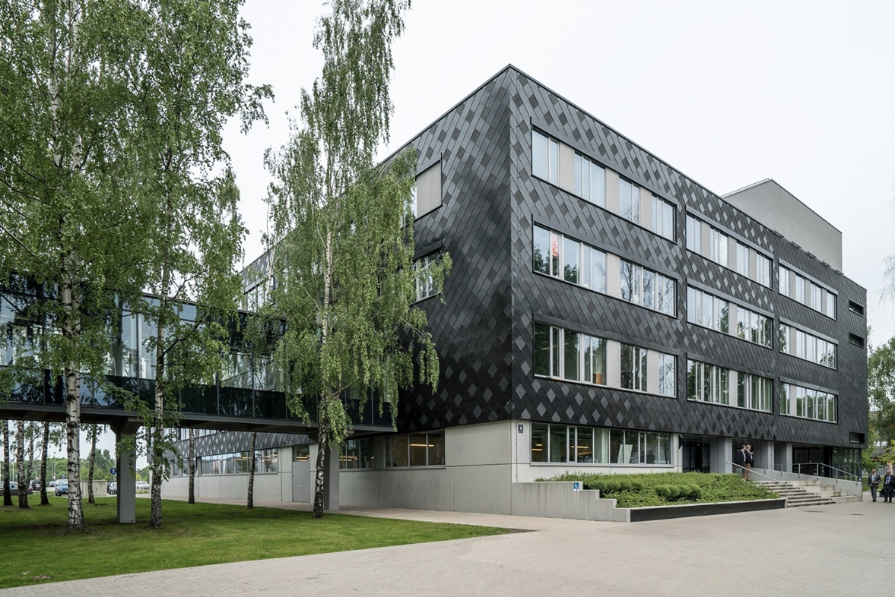
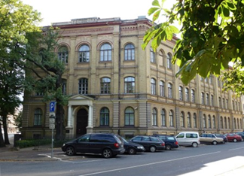
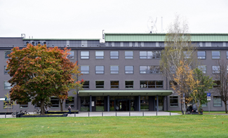
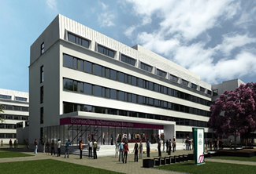
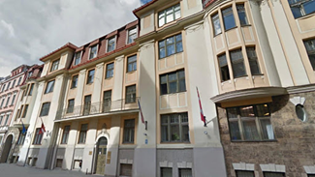
RTU Faculties
9 FACULTIES
11 STUDY DIRECTIONS
60 ENG STUDY PROGRAMS
Electrical and Environmental Engineering
Mechanical Engineering, Transport and Aeronautics
Materials Science and Applied Chemistry
Engineering Economics and Management
Computer Science and Information Technology
Architecture
E-Learning Technologies and Humanities
Electronics and Telecommunications
Civil Engineering
4 Regional Study and Science Centres
Riga Business School

Slide 9
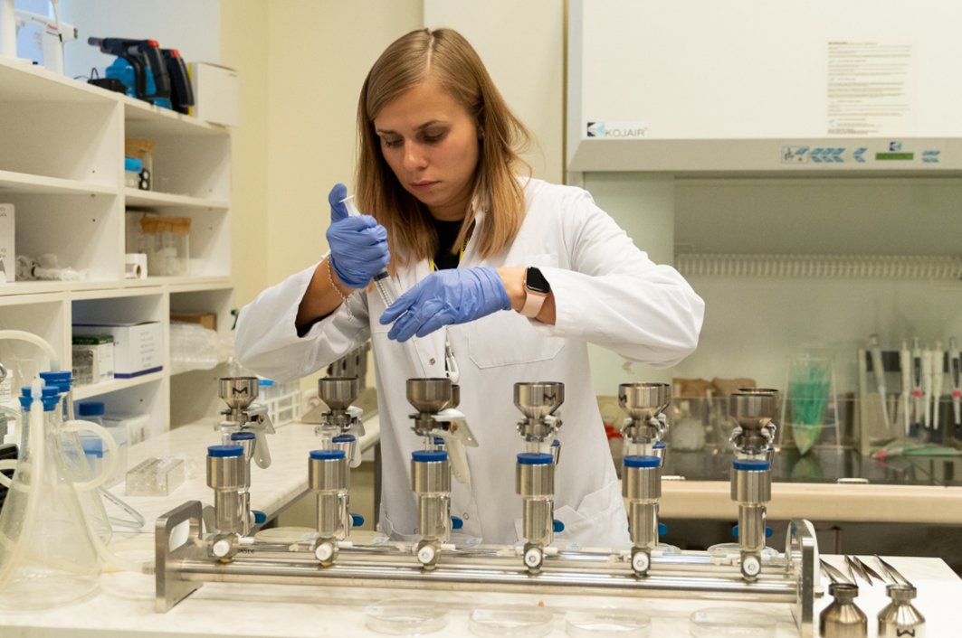
RTU Research Platforms
01
ENERGY & ENVIRONMENT
02
CITIES & DEVELOPMENT
03
MATERIALS & PROCESSES
04
SECURITY & DEFENSE
05
TRANSPORT
06
INFORMATION AND COMMUNICATION TECHNOLOGIES

Slide 10



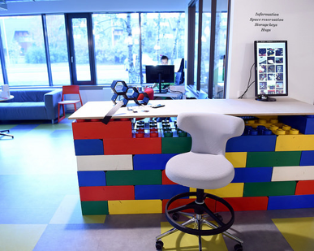
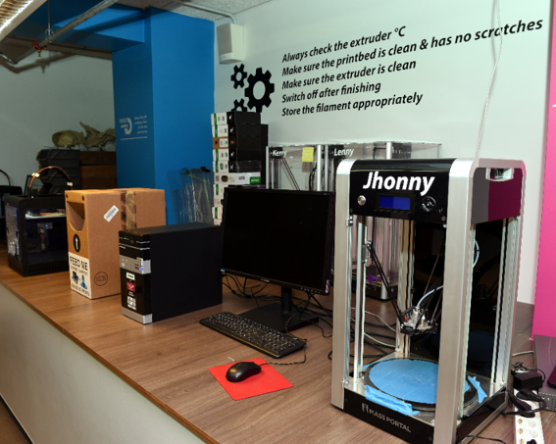
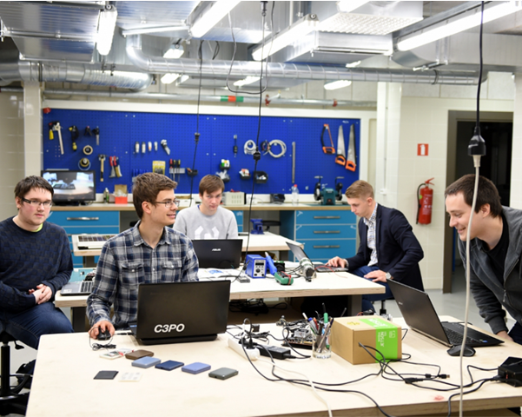
Innovation and business platform
The best equipped prototyping workshop in the Baltics
A team of highly qualified experts
Support for entrepreneurs, managers, students
To create innovative ideas, high value-added products and engineering solutions

Slide 11
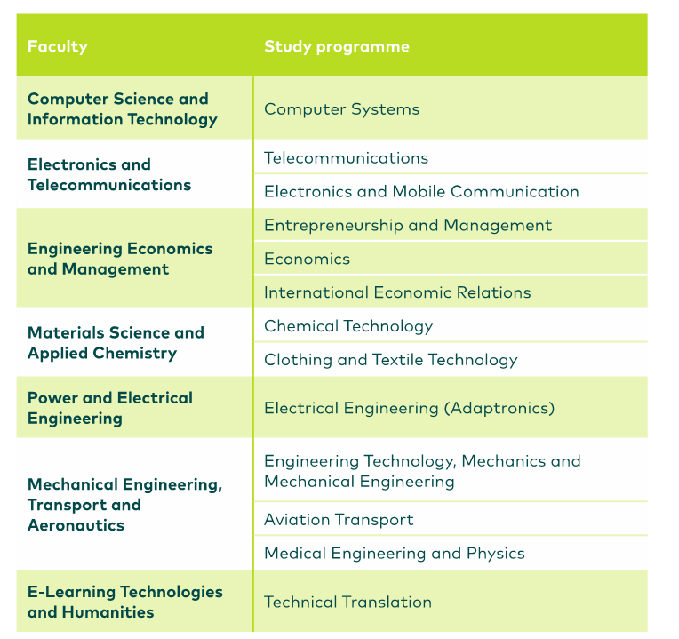
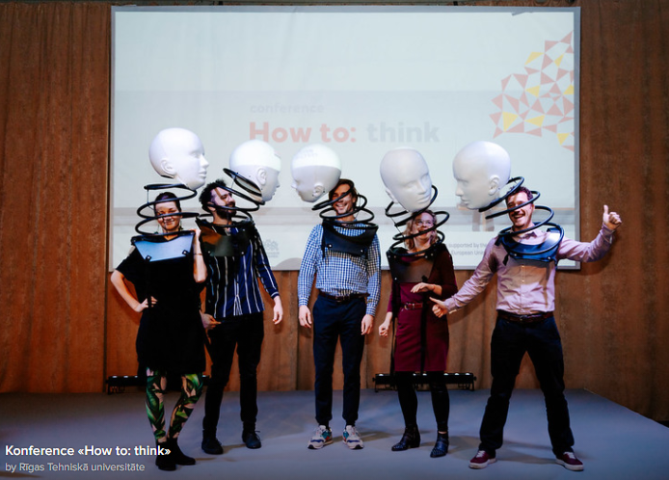
Bachelor study programmes

Slide 12
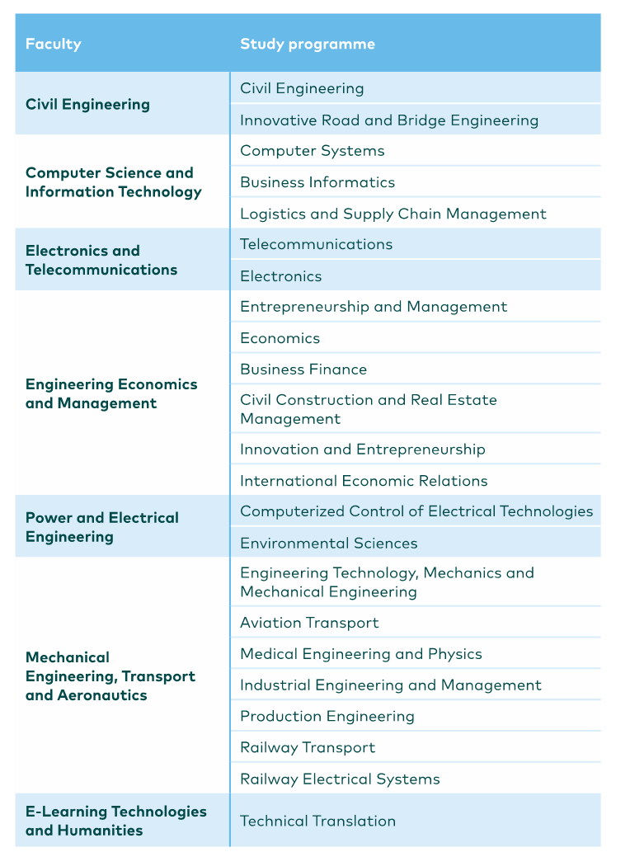
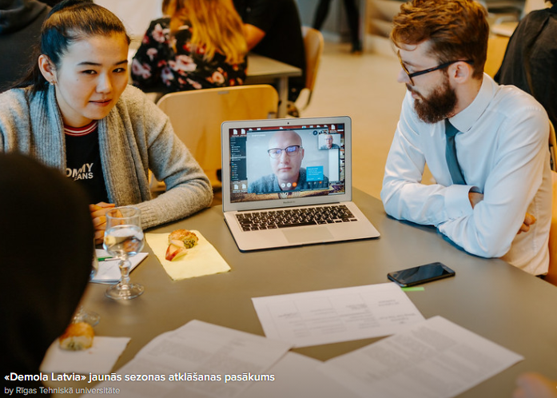
Master study programmes

Slide 13
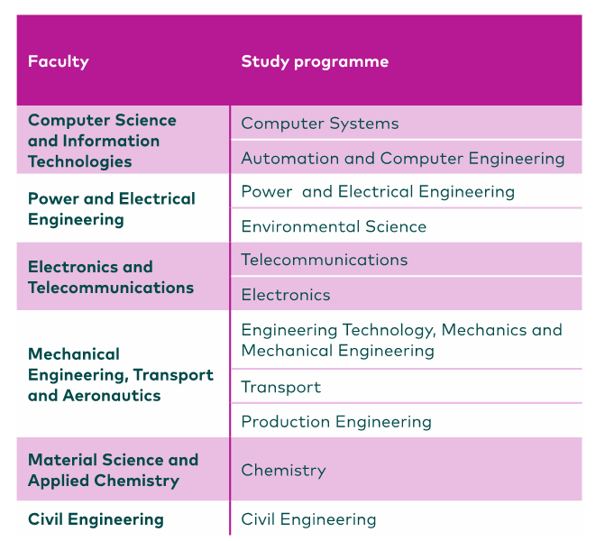
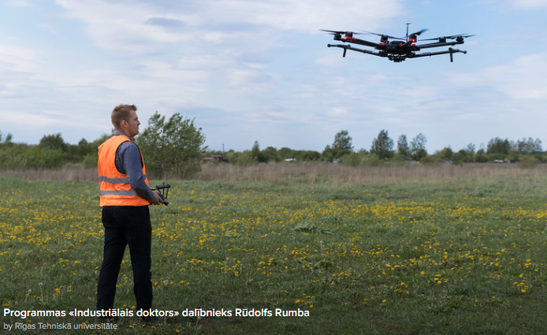
PHD study programmes

Slide 14
International students at RTU
Full time degree studies –
BSc, MSc, PhD.
2. Exchange studies – Erasmus+
(EU and non-EU countries KA107).
3. Study Abroad Semester
(MOU and Erasmus+ partners).
4. Summer Schools,
Foundation semester or courses.

Slide 15
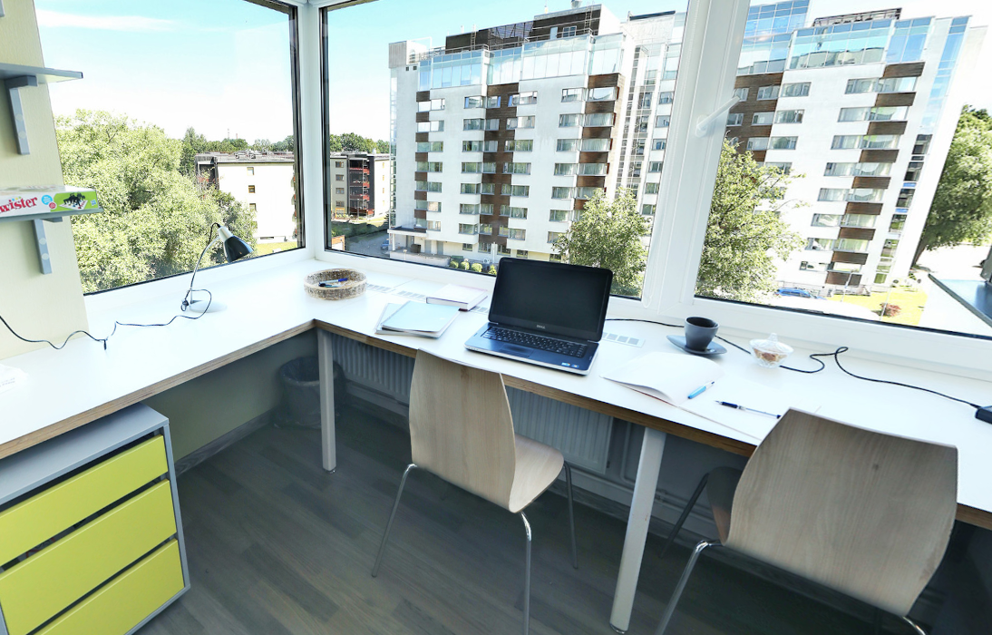
On campus accommodation in a fully equipped modern
dormitory building
The rooms are arranged into apartments. Each apartment has three double shared rooms, a kitchen, bathroom, toilet and corridor.
Right across from the campus, students have access to a large shopping mall, and the dormitory is within a walking distance from most RTU faculties.

Slide 16
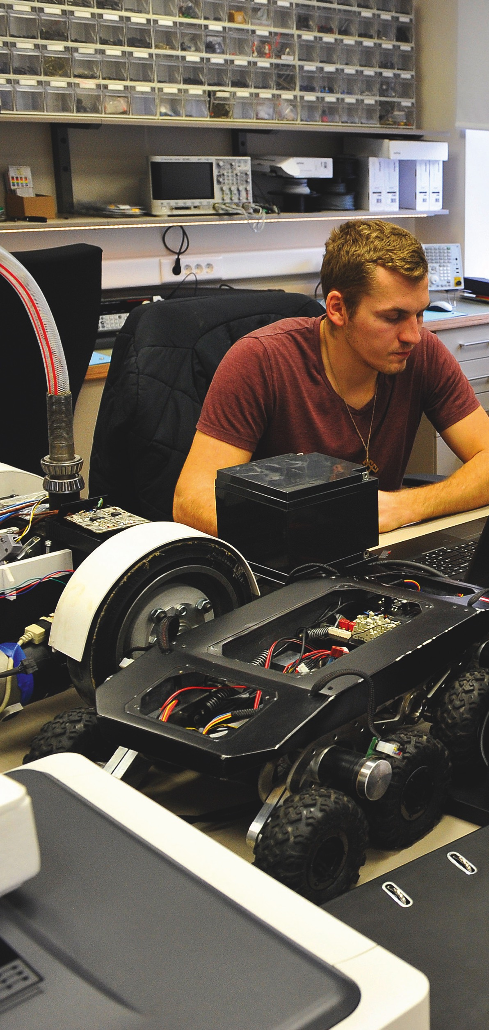
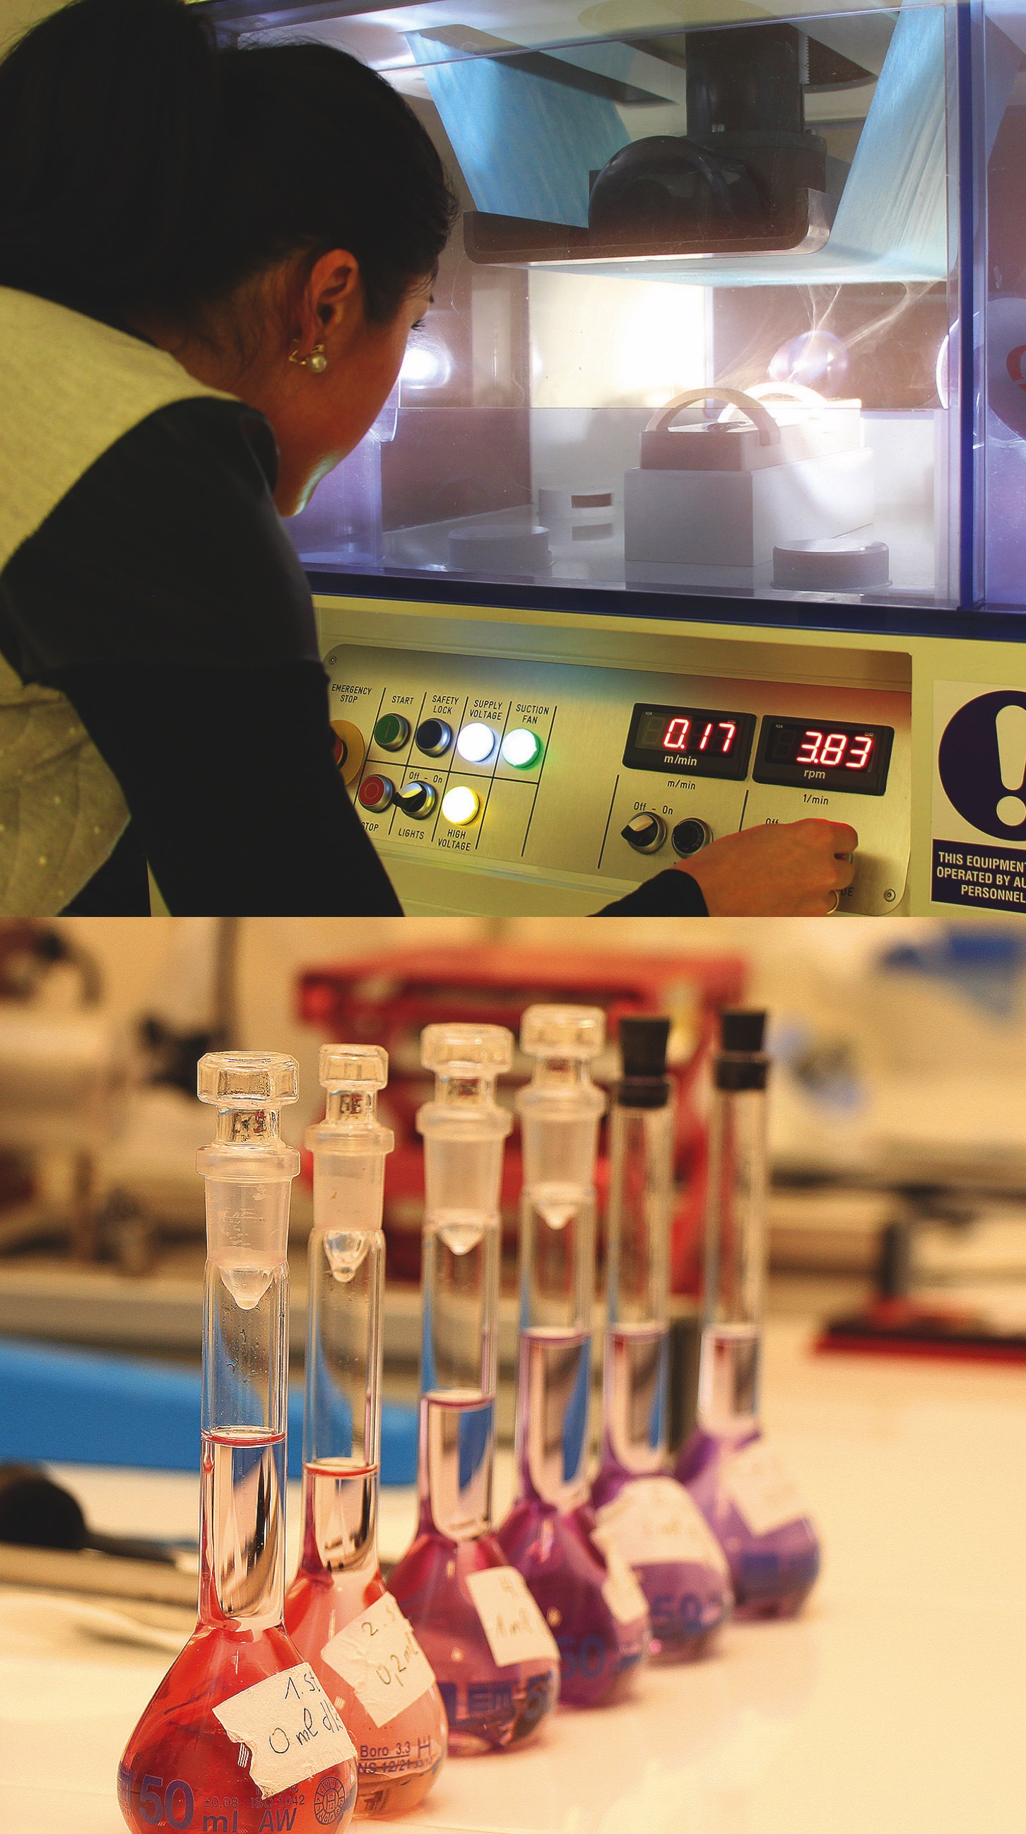
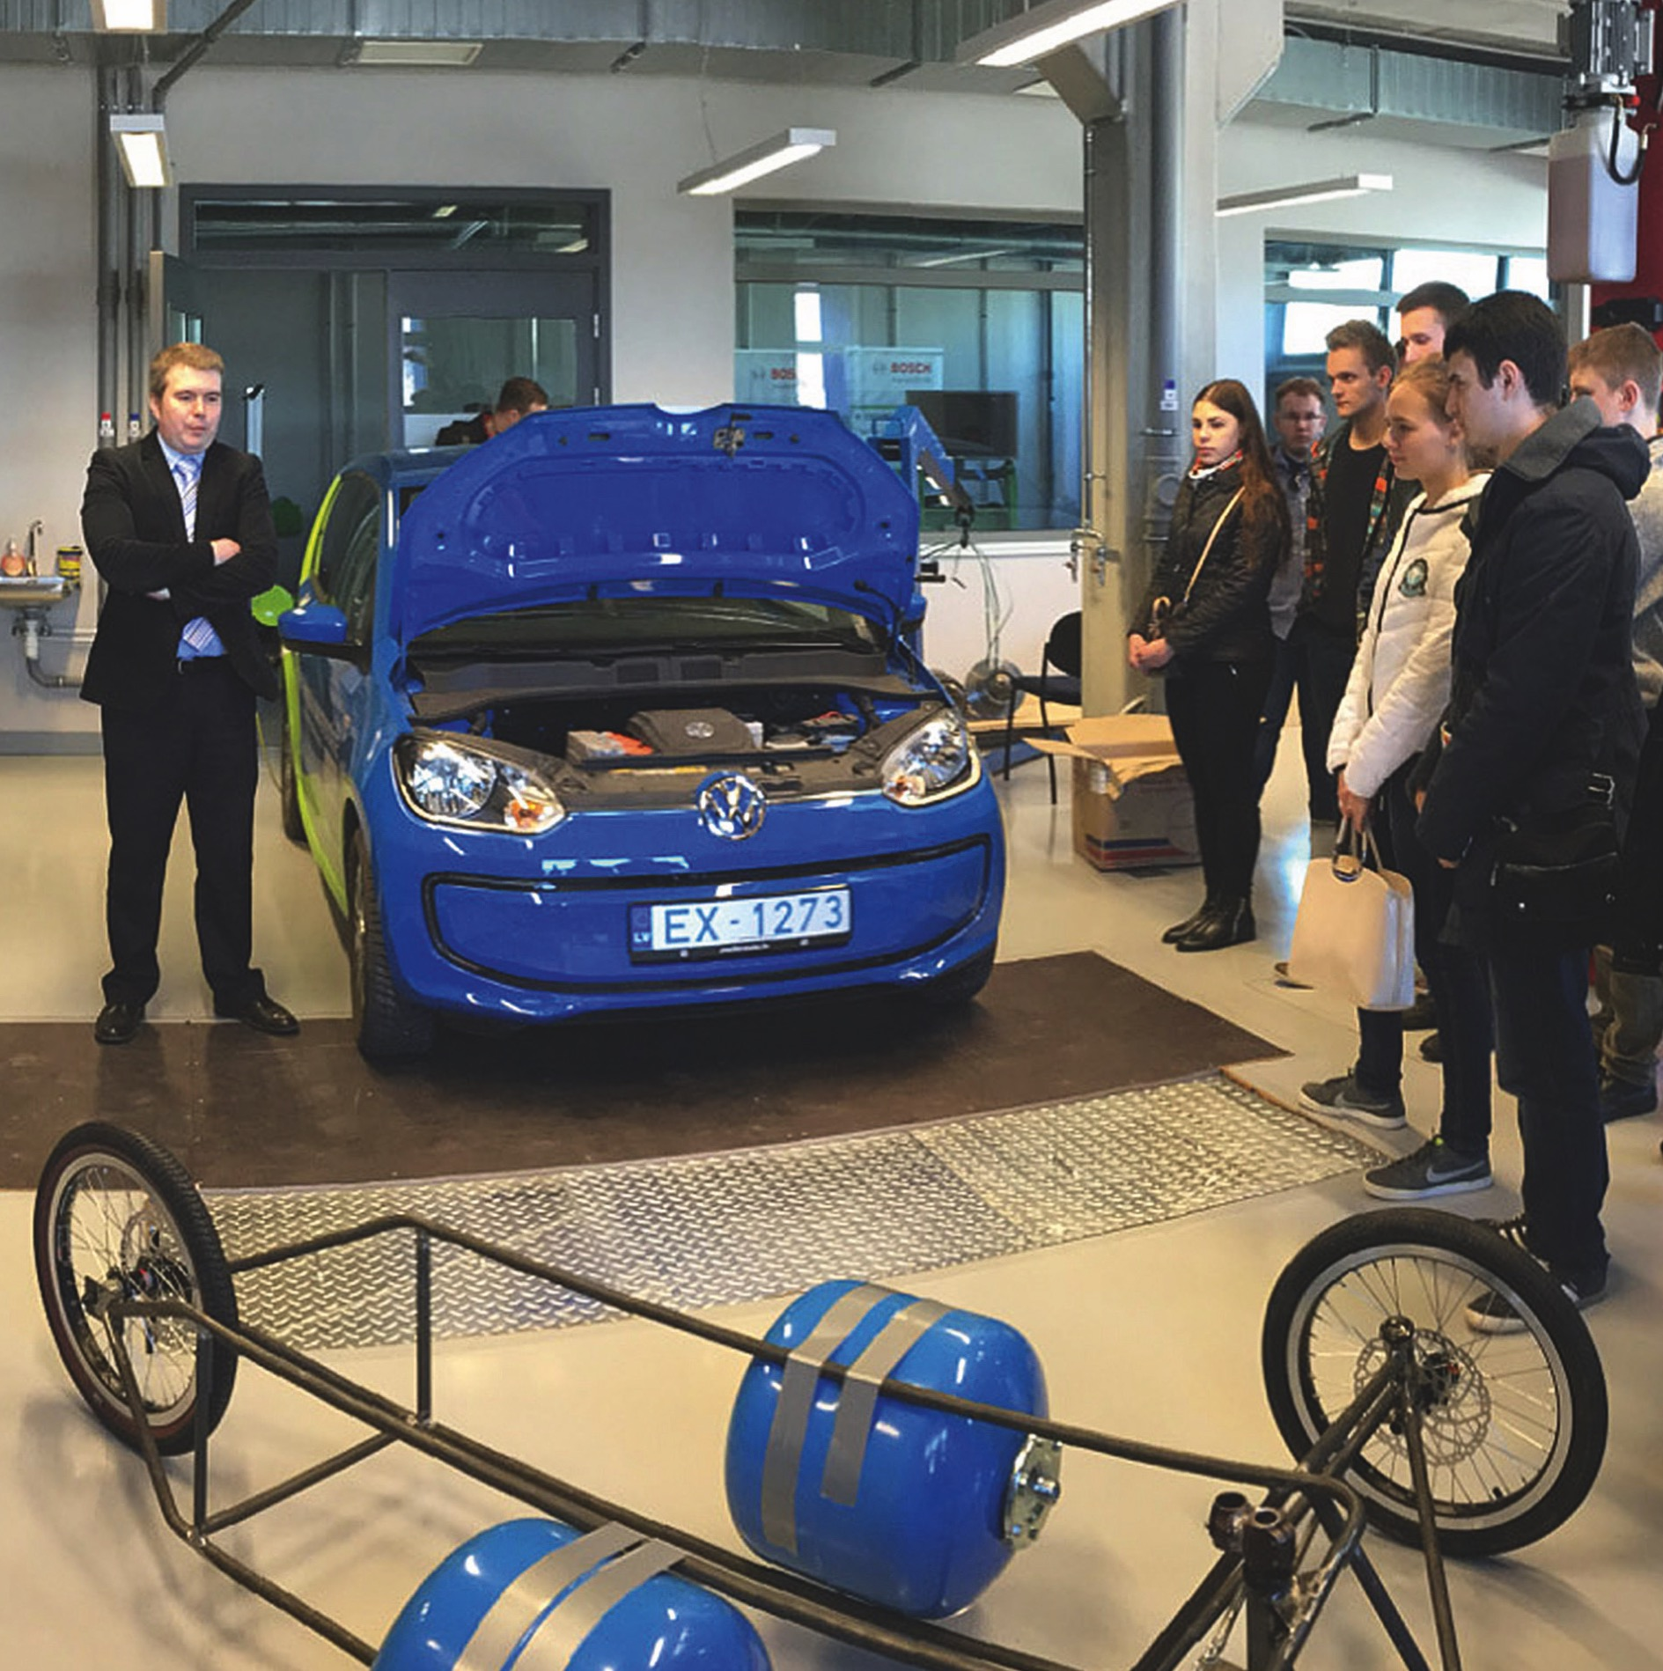
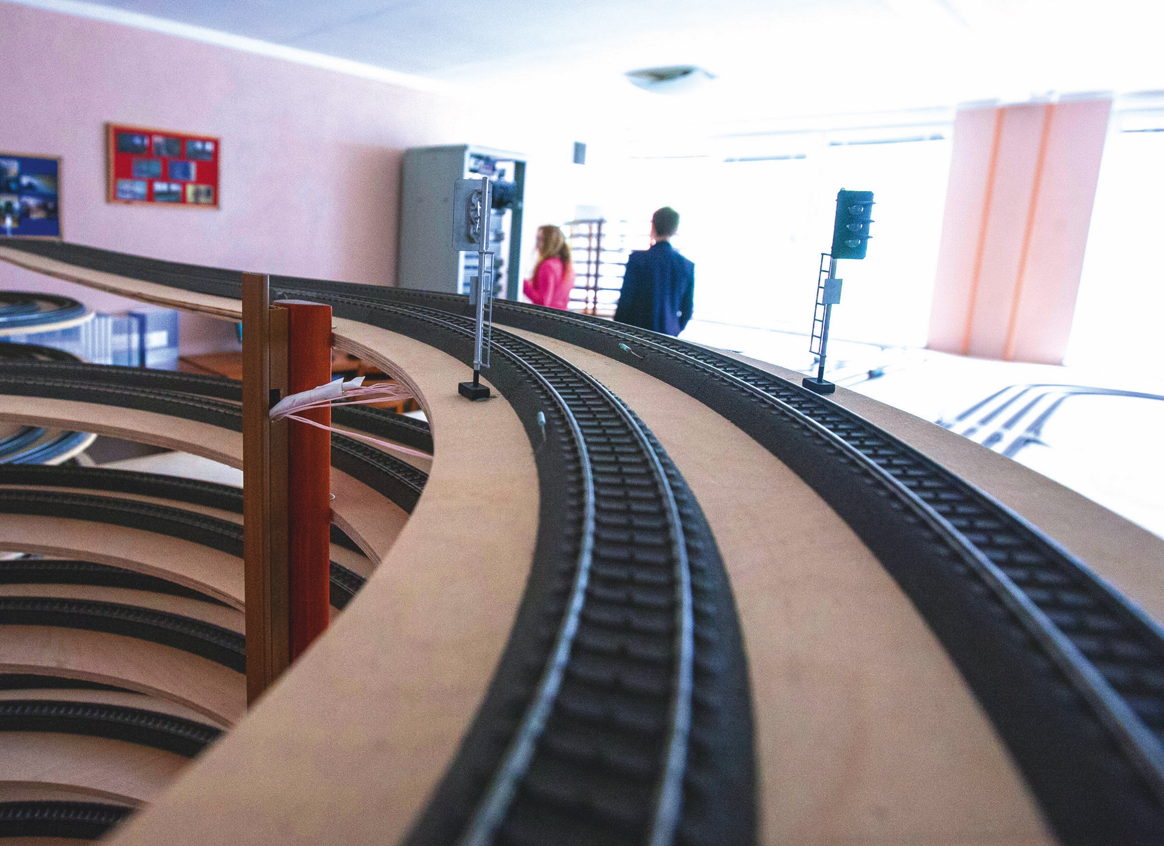
LABS

Slide 17
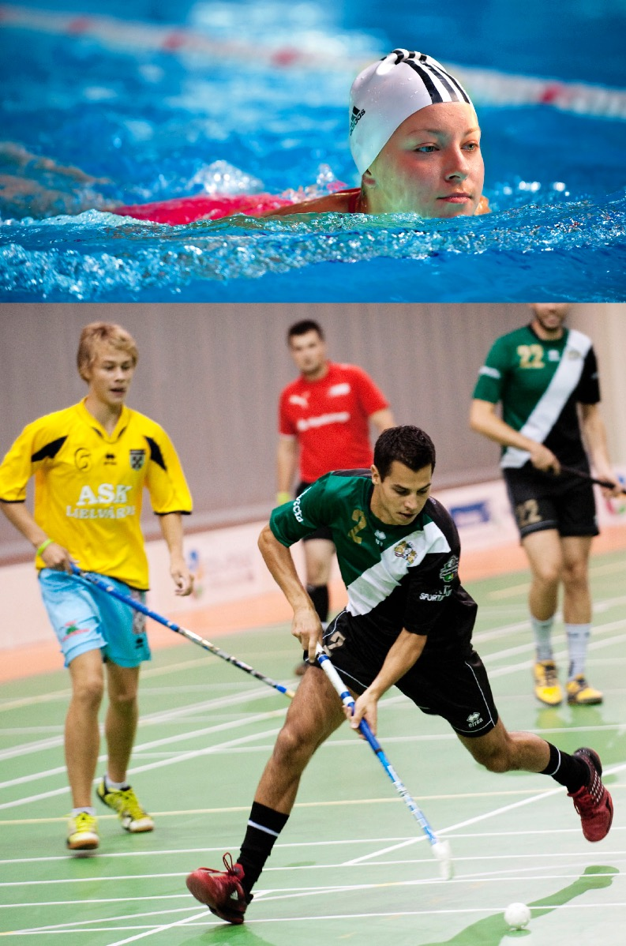
Sport Activities
Athletics
Badminton
Basketball
Boxing
Freestyle wrestling
Judo
Body building
Frisbee
Floor ball
Soccer
Table tennis
Swimming
Tennis
Volleyball

Slide 18
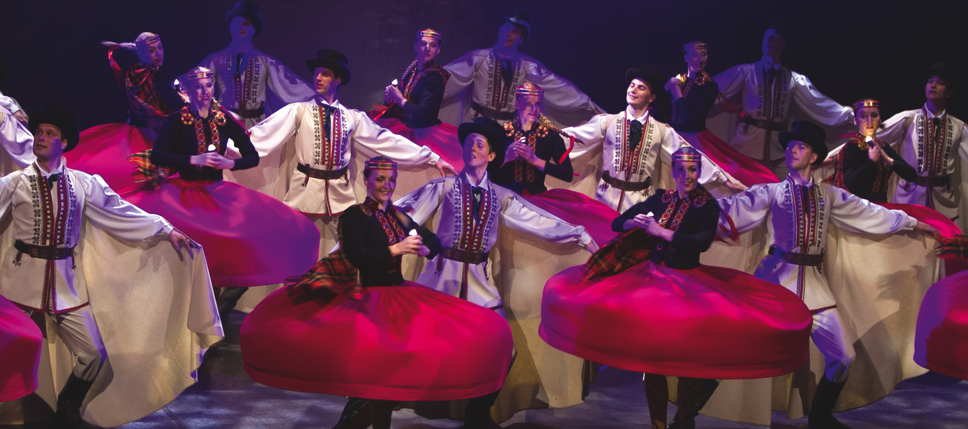
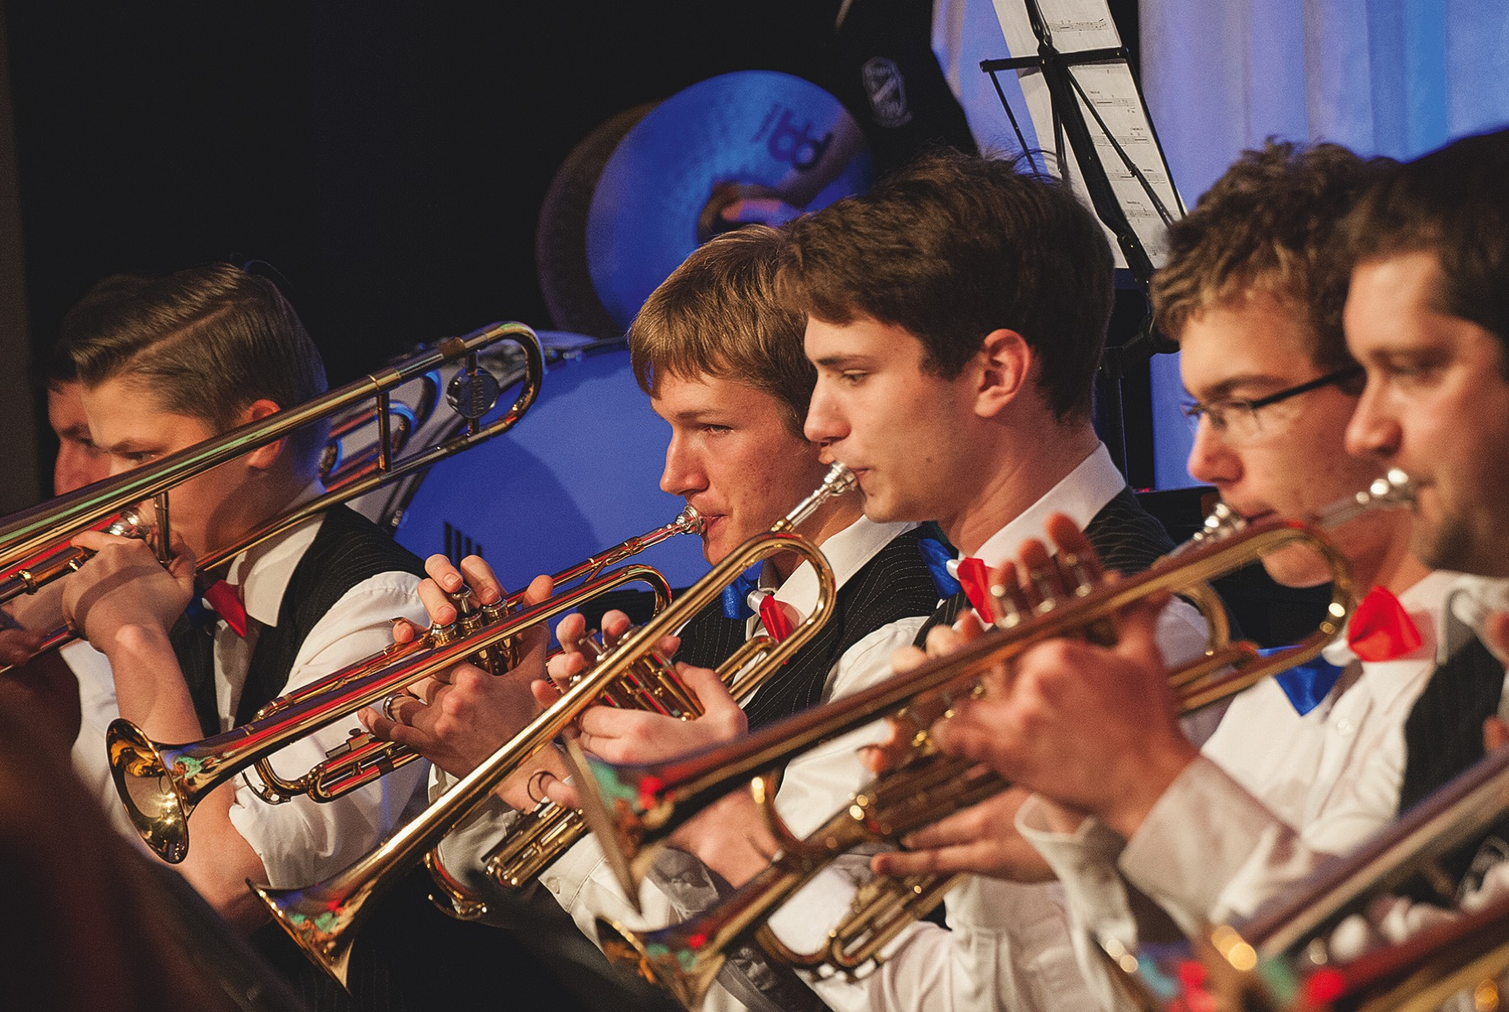

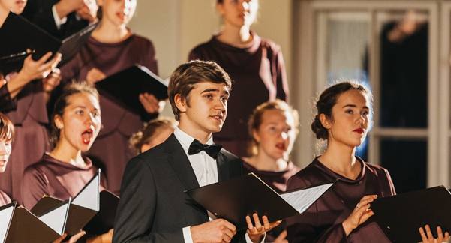
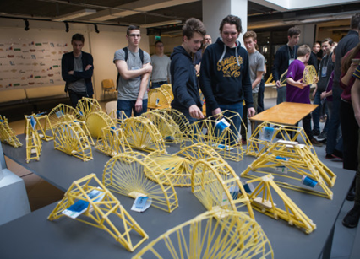
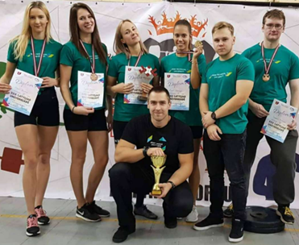
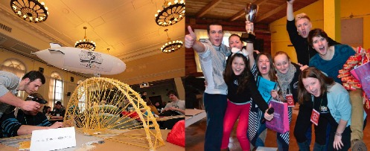
Student Life

Slide 19
International Projects Unit
  Established in 2013, IPU is an independent unit working under the International Cooperation and Foreign Students Department
  The main function of the IPU is to attract EU funding and support RTU's missions
  During the past years, RTU has been successful with Erasmus+ KA1 and KA2 project funding
  At the moment, RTU is a part of the following projects: Capacity building projects, Strategic partnership project, Erasmus+ mobility projects

Slide 20
ERASMUS+ WORLD KA171
  Erasmus+ is the EU's program to support education, training, youth and sports in Europe through International Credit Mobility (ICM)
  International Credit Mobility projects are funded by the European Commission
  ICM supports the mobility of individuals enrolled or employed at a higher education institution (HEI), from a Program Country to a Partner Country or vice versa
    Student mobilities for studies
    Student mobilities for traineeships
    Staff mobilities for teaching
    Staff mobilities for training

Slide 21
Mobilities
  Current Erasmus+ call (2022) and the upcoming project call:
    15 incoming student mobilities
    New 2023 project proposal has been submitted and we anticipate funding for a similar number of student mobilities to be granted to RTU as of September 2023
    We anticipate approx. 2-3 incoming/outgoing staff mobilities in September 2023
  Nomination deadline:
    For Fall semester by March 17th
    For Spring semester, usually by mid-October (contingent upon the announcement of project results)
  Deadline to implement mobilities:
    Erasmus+ 2022 project– until July 2025
    Erasmus+ 2023 project– until July 2026

Slide 22
Collaboration
  Subject areas included in the IIA (2021-2027) for the partnership (*for student mobilities):
    Business and administration
    Information and communication technology
    Engineering and engineering trades
    Languages
    Maritime Transport and related fields
  Staff mobilities can be implemented outside these 4 subject areas
    Administrative staff is also welcome to apply for and utilize staff mobilities
    Staff mobilities are available as teaching (academic staff) or training (academic and non-academic staff)

Slide 23
Student Mobilities
  Can be at any level: Bachelor's, Master's, Doctoral*
  Can't be less than 3 months; the scholarship is paid for the actual duration of the mobility
  Can't be more than 12 months at one study level
  Students must stay at RTU until the official end of the mobility
  The grant covers the scholarship – 800 EUR per month and travel costs based on the travel distance (EACEA)
  The grant is awarded upon selection of the best candidates
  *A top-up grant of 250 EUR per month is available in some specific cases for some students with fewer opportunities

Slide 24
Staff Mobilities
  Duration: 5 activity days
    For teaching: minimum 8 academic hours
  Individual support of 140 EUR per day & travel cost based on travel distance (EACEA)
  Funding is for 5 activity days + 2 travel days
  Incoming mobilities: the grant is awarded upon the signing of the Grant Agreement in person
  Selection of participants is based on the strength of the application + number of mobilities available

Slide 25

European University of Technology
A European University of Technology for Europe and European technology
EUt+ are: 8 members
8 countries, 8 campuses
100,000 students
1 single European university
Only 1 diploma (in construction)
EUt+ aims to become the leading partner for key players in education, research and transfer, economy, governance, and society to promote a new European model of education.
• An inclusive and diverse model, that helps every student to define one’s own role in society.
• A model that delivers a high-level scientific education & research, that allows everyone to achieve excellence through a long-term education.
• A model that raises technologically responsible citizens, and that gives its students the ability to act for a better world

Slide 26
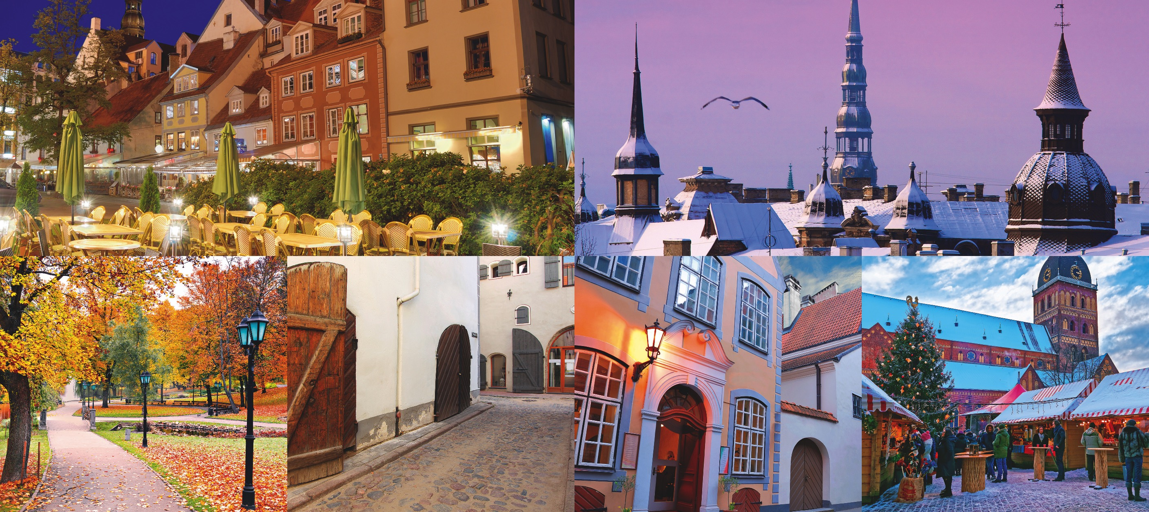
Thank you!
International Cooperation and Foreign Students Department | International Projects Unit https://international.rtu.lv/ globalerasmus@rtu.lv
Phone (+371 67089709)

