Slide 1
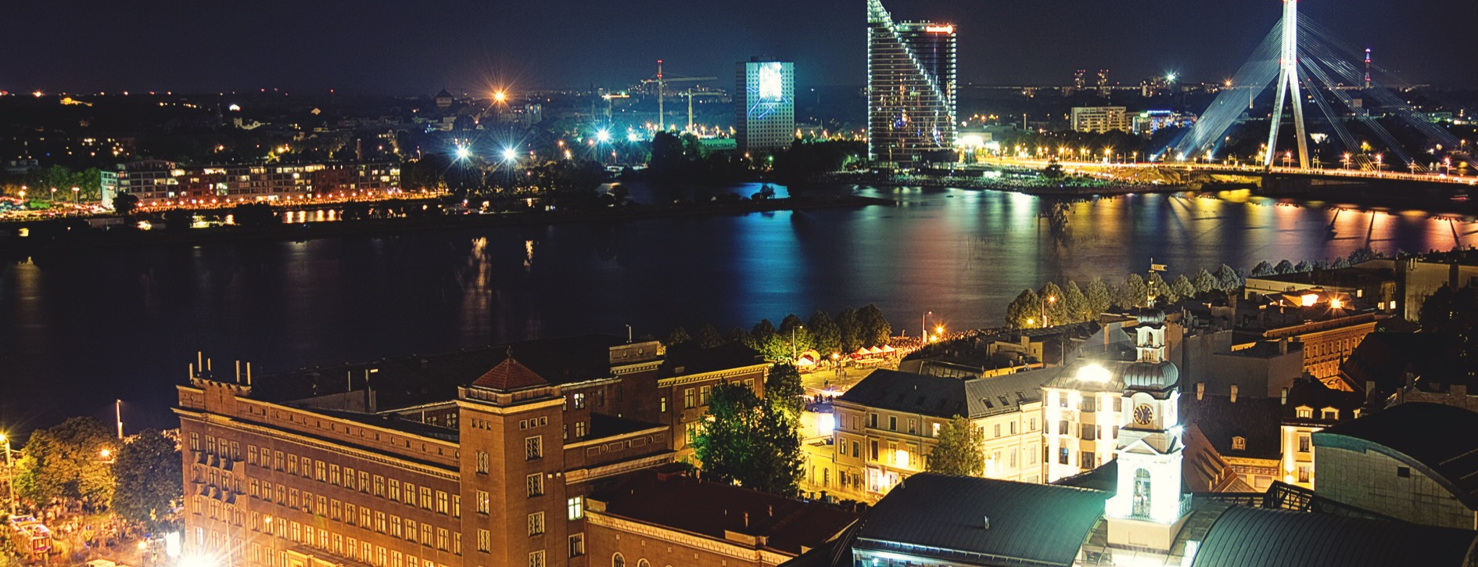

Riga Technical University
Latvian Centre of Engineering Science | Anno 1862

Slide 2
International students at RTU
Full time degree studies –
BSc, MSc, PhD.
2. Exchange studies – Erasmus+
(EU and non-EU countries KA107).
3. Study Abroad Semester
(MOU and Erasmus+ partners).
4. Summer Schools,
Foundation semester or courses.

Slide 3
International Projects Unit
  Established in 2013, IPU is an independent unit working under the International Cooperation and Foreign Students Department
  The main function of the IPU is to attract EU funding and support RTU's missions
  During the past years, RTU has been successful with Erasmus+ KA1 and KA2 project funding
  At the moment, RTU is a part of the following projects: Capacity building projects, Strategic partnership project, Erasmus+ mobility projects

Slide 4
ERASMUS+ WORLD KA171
  Erasmus+ is the EU's program to support education, training, youth and sports in Europe through International Credit Mobility (ICM)
  International Credit Mobility projects are funded by the European Commission
  ICM supports the mobility of individuals enrolled or employed at a higher education institution (HEI), from a Program Country to a Partner Country or vice versa
    Student mobilities for studies
    Student mobilities for traineeships
    Staff mobilities for teaching
    Staff mobilities for training

Slide 5
Mobilities
  Current Erasmus+ KA171 Project Partners (2020-2022):
    The Western Balkans, Neighborhood East, Asia, the South-Mediterranean, Sub-Saharan Africa, the Caribbean, and Latin America.
  Most popular outgoing staff mobility destinations:
    Western Balkans (Bosnia and Herzegovina, Kosovo, Albania)
  Most funding available (incoming students/staff, outgoing staff):
  Sub-Saharran Africa (Zambia, Zimbabwe, Kenya, Nigeria, Ghana)

Slide 6
Collaboration
  Subject areas included in the IIA (2021-2027) for partnerships (*for student mobilities):
    Business and administration
    Information and communication technology
    Engineering and engineering trades
    Languages
    Maritime Transport and related fields
  Staff mobilities can be implemented outside these 4 subject areas
    Administrative staff is also welcome to apply for and utilize staff mobilities
    Staff mobilities are available as teaching (academic staff) or training (academic and non-academic staff)

Slide 7
Student Mobilities
  Can be at any level: Bachelor's, Master's, Doctoral*
  Can't be less than 3 months; the scholarship is paid for the actual duration of the mobility
  Can't be more than 12 months at one study level
  Students must stay at RTU until the official end of the mobility
  The grant covers the scholarship – 800 EUR per month and travel costs based on the travel distance (EACEA)
  The grant is awarded upon selection of the best candidates
  *A top-up grant of 250 EUR per month is available in some specific cases for some students with fewer opportunities

Slide 8
Staff Mobilities
  Duration: 5 activity days
    For teaching: minimum 8 academic hours
  Funding is for 5 activity days + 2 travel days
  Outgoing staff: Individual support of 180 EUR per day & travel cost based on travel distance (EACEA)
  The grant is awarded within 30 days of signing the Grant Agreement (usually 1-2 weeks prior to the start of the mobility)
  Selection of participants is based on the strength of the application + number of mobilities available
  Incoming staff: Individual support of 140 EUR per day & travel cost based on travel distance (EACEA)
  The grant is awarded upon the signing of the Grant Agreement in person
  Selection of participants is based on the strength of the application + number of mobilities available

Slide 9
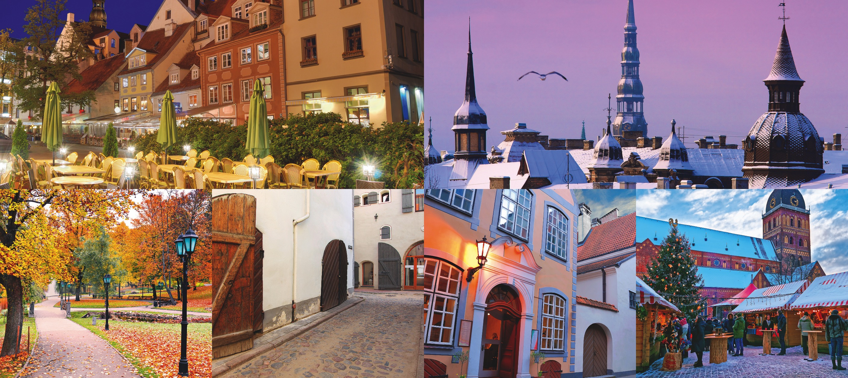
Thank you!
International Cooperation and Foreign Students Department | International Projects Unit https://international.rtu.lv/ globalerasmus@rtu.lv
Phone (+371 67089709)

