Slide 1
Development of practically-oriented student-centred education in the field of modelling of Cyber-Physical Systems – CybPhys 609557-EPP-1-2019-1-LV-EPPKA2-CBHE-JP – ERASMUS+ CBHE
MC and WS meeting
March 16-18th 2023
Anatolijs Zabashta,
Project coordinator
Riga Technical University

Slide 2
Agenda for Wednesday April 12th
Welcome by KU Leuven
Welcome by the project coordinator. Adoption of agenda. Project progress.
WP2: Development and modernizing of curricula Accreditation of new/modernized courses and programs Overview of all tasks: completed or not completed
WP3: Implementation of innovative ICT based teaching / learning environment Overview of all tasks: completed or not completed
WP4: Developing the Sharing Modelling and Simulation Environment platform (SMSE) Status of the work package Tutorial: practical implementation of the SMSE platform
WP6: Dissemination General status and final opportunities. Implementation of KPIs.
Other issues and conclusions of day 1
Campus Tour: KU Leuven Bruges Campus

Slide 3
Agenda for Thursday April 13th
WP5: Quality assurance Feedback on the risk assessment in Quality Assurance QA evaluation by external expert
WP6: Preparation of the final conference. Agenda. Invitation.
WP6: Bilateral agreements among all partners: status and opportunities for the (nearby) future
WP2: Progress on preparation to Double Diploma between RTU and KhNAHU
Questions and other issues

Slide 4
Agenda for Friday April 14th
WP7: Project extension: practical implications, purchase of laptops, etc.
WP7: Project financial aspects, preparation to the final reporting
All WPs: Continuing discussion about global progress of all work packages
Other issues, next steps and conclusions
End of the meeting: see each other at the final conference

Slide 5
Project progress
Purchase of laptops is on a way – evidences as soon as possible!
External expert on quality assurance issues. Confirmation of the Report is underway (is sent on 26.03.23):
CybPhys Quality assessment with track changes.
Table “Project deliverables” – updated version.
CybPhys Sustainability Plan - updated version.
A Workshop in Riga on March 27-29th
RTU has signed an agreement with a financial auditor

Slide 6
The project targets and deliverables

Slide 7
Courses and programs: new / updated
BSU: courses 11/2; Programs 1/1
GSU: courses 10/2
MSPU: courses 4/1
CNTU: Courses 5/2; Programs 1 (and 1 updated)
KhNTHU: Courses 2/4; programs 1
KNU: courses 3/4; programs 1
Total: courses Belarus 25/5 and Ukraine 10/10 = 35/15 = 50

Slide 8
What we promissed! Indicators 1
Expected number of new/updated courses to be DEVELOPED/ ACCREDITED/ IMPLEMENTED: 50
Volume (in ECTS) of new/updated courses: 240
Number of planned learners enrolled per course delivery: 15
Expected number of partner country "HEIs' students" to be trained: 420
Expected number of partner country "HEIs' academic staff" to be trained: 120.
Expected number of partner country "non-HEI individuals" to be trained (priv. sector, NGOs, civil servants, etc.): 4

Slide 9
Indicators 2
Number of direct beneficiaries in the Partner countries per year: academic staff from HEIs: 102
Number of direct beneficiaries in the PCs (/year): students: 140
Number of direct beneficiaries in the PCs (/year): non HEs individuals: 16
% of the new curriculum planned to be taught in foreign language of the total of new curriculum developed by the project: 20%

Slide 10
New teaching books - implementation
1. Bringing Innovations to the Market, ISBN 978-9934-22-673-1
2. Mathematical Modelling of Mechatronic Systems, ISBN 978-9934-22-716-5
3. Model-oriented control in Intelligent Manufacturing Systems, ISBN 978-9934-22-674-8
4. Modern Mathematical Physics: Fundamentals and Application – BSU – several chapters are available
5. High-Performance Scientific Computing and Data Analysis – BSU- not available!
6. Cyber-Physical Systems modelling and simulation , ISBN 978-9934-22-675-5
7. Cyber-Physical Systems for Clean Transportation, ISBN 978-9934-22-676-2
8. Control methods for critical infrastructure and Internet of Things (IoT) systems interdependencies analysis – RTU (ISBN will be beyond the project)
9. Computer modeling of physical processes (handbook for students and PhD students) – we have all chapters, however, without translation. Is published in the e-Library

Slide 11
Dissemination and Exploitation and Sustainability of results (WP6)

Slide 12
Final conference in April 27-29th
Day 1: Thursday, April 27th, Pre-Conference Workshop
Day 2: Friday, April 28th, Conference
Day 3: Saturday, April 29th, Post-Conference Workshop
See a preliminary agenda of the Conference

Slide 13
Project financial aspects. Partner’s agreements. Tenders for the equipment: WP7
Riga technical University

Slide 14
Final report

Slide 15
Documents for a Final report on CybPhys implementation
Final Technical report on progress of the project, period 15.11.19-14.05.23.
Detailed-budget Excel
Declaration of Honour (RTU only)
Financial statement PDF, signed, stamped
Table of achieved results
Dissemination/Exploitation Plan (consolidated)
Report about implementation of Dissemination/Exploitation Plan (consolidated)
Quality Assurance Plan
Table of developed courses
Training and mobilities table
Sustainability Plan
Audit certificate (the report of an external financial auditor, RTU only)
Report of an external QA auditor

Slide 16
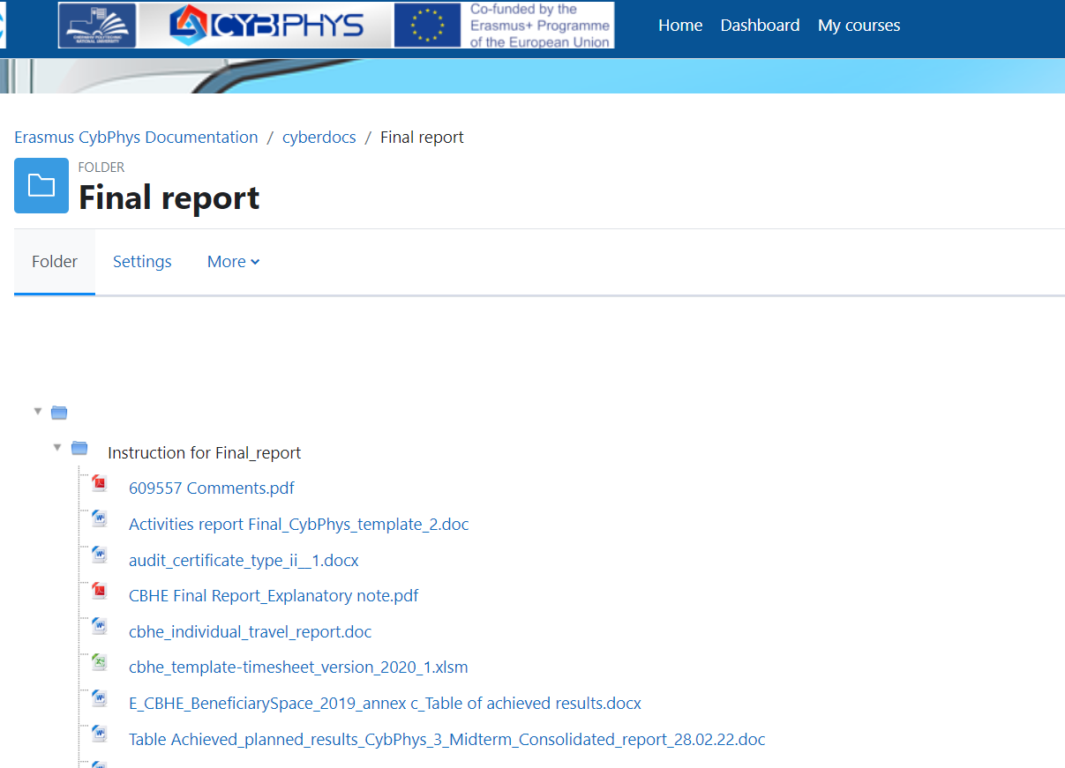
Please, check the EACEA letter on evaluation of the Midterm report!

Slide 17
Financial issues
Reminder: a financial report in October 2021 was prepared without supporting documents
Dead line: 30.05.2023.
Excel – Table of advance payments to the partners
Examples of budgets forecasts of CPNU and KhNAHU
Calculation of the exchange rate for preparation of the financial report (the case of purchase of laptops)

Slide 18
Further tasks and the next steps

Slide 19
Further tasks and the next steps
Preparation to the final reporting. Dead line: 30.05.2023.
Coordinator shares reporting forms and tables.
EACEA comments on the Midterm Report
Documents are available at Erasmus CybPhys Documentation /cyberdocs /Final report
https://eln.stu.cn.ua/mod/folder/view.php?id=198168
WP6 leader will prepare a new version of KPI: plans versus achievements
The partners send to KNU video, clips for publishing on YouTube.
To create folders for tasks 7.6 and 7.7 in the e-Library
Ukrainian partners will publish all documents, which proof accreditation of courses and study programs in the e-Library of CybPhys
Preparation to the Final conference in Riga in April 27-29th
UA partners will invite Ukrainian stakeholders: business, representative of the Ministry of Education, ERASMUS+ NCP, etc.

Slide 20
Acquisition of SMSE by the project partners. Demonstration of experience.

Slide 21
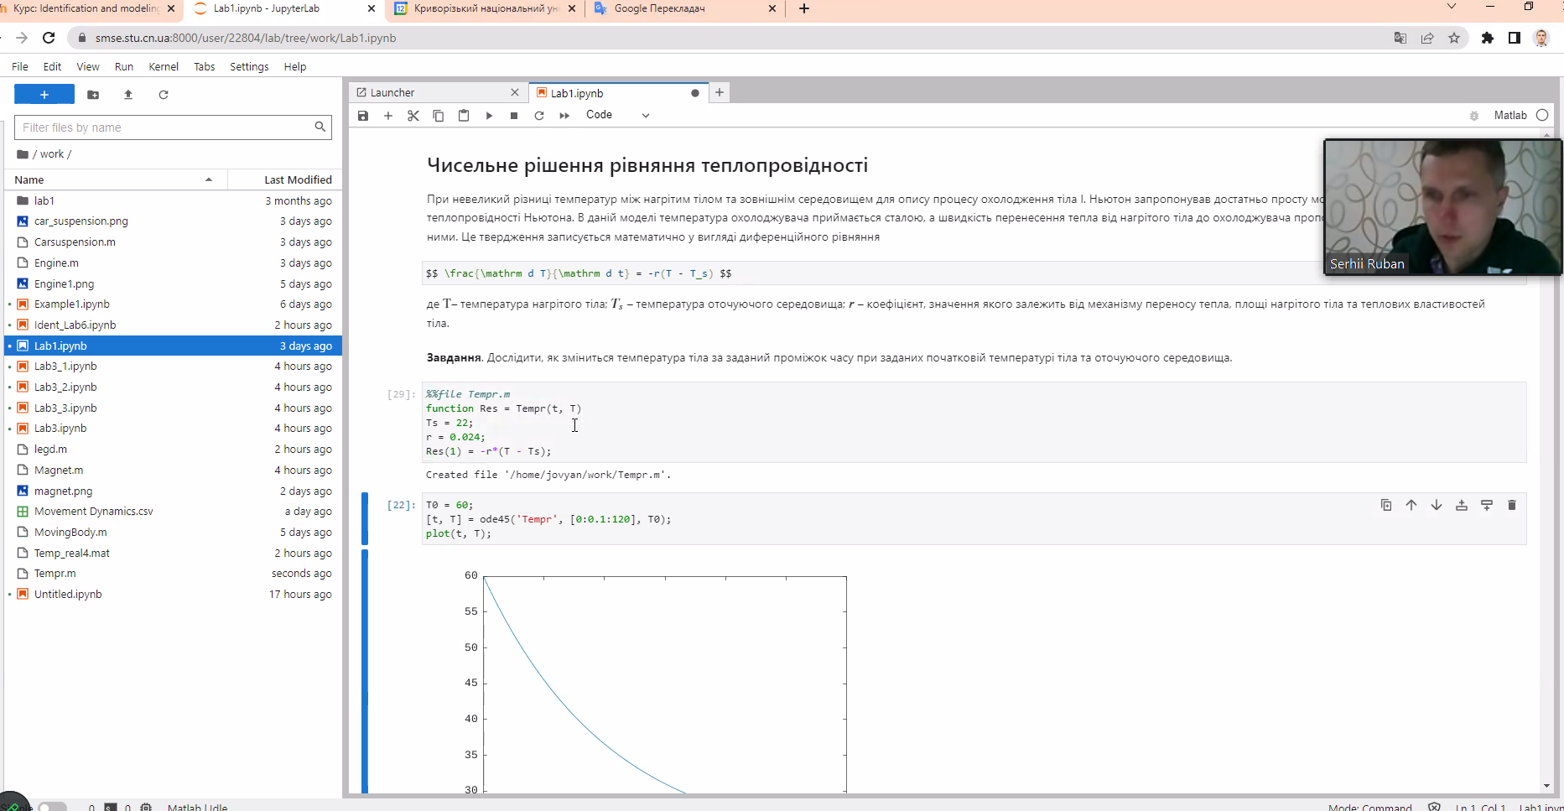

Slide 22
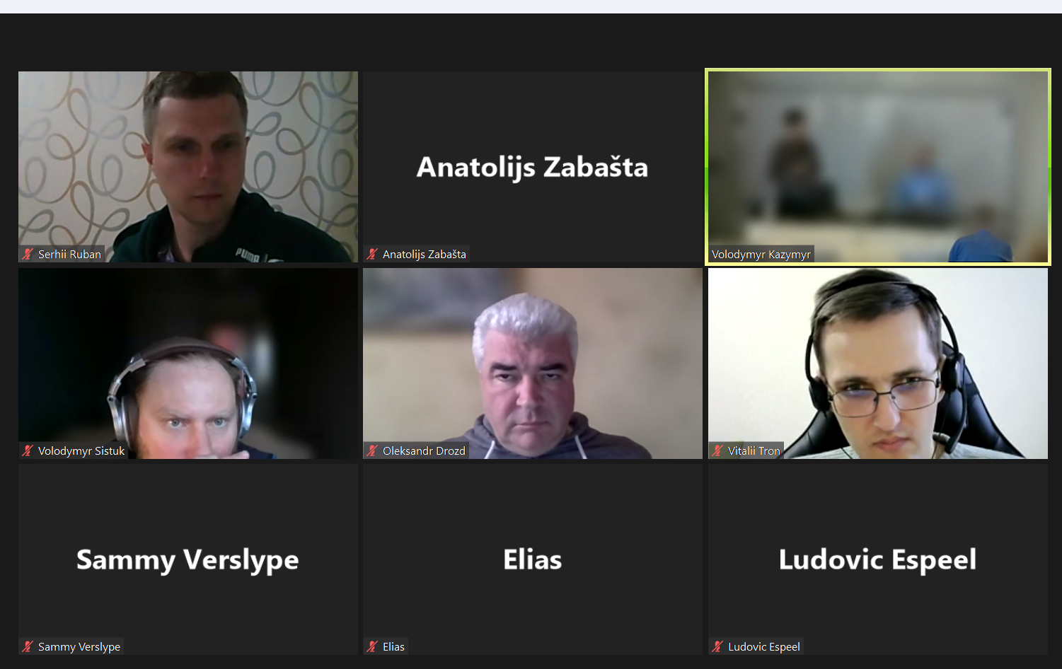

Slide 23
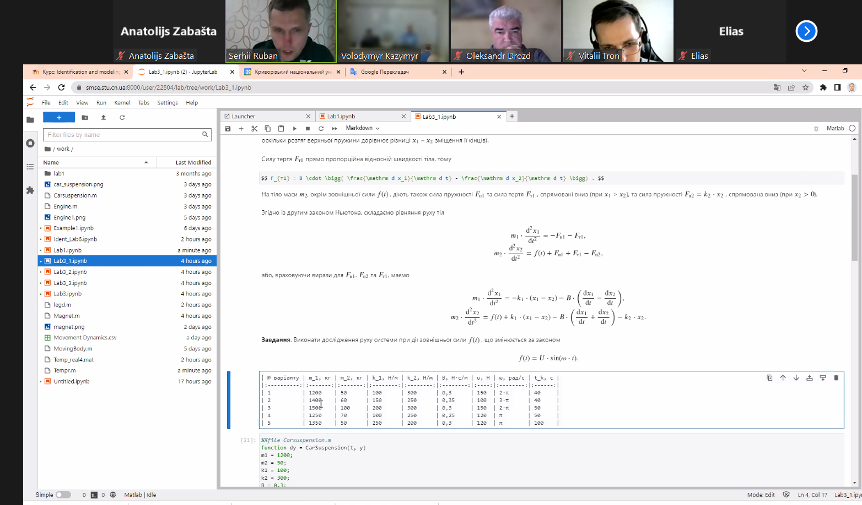

Slide 24
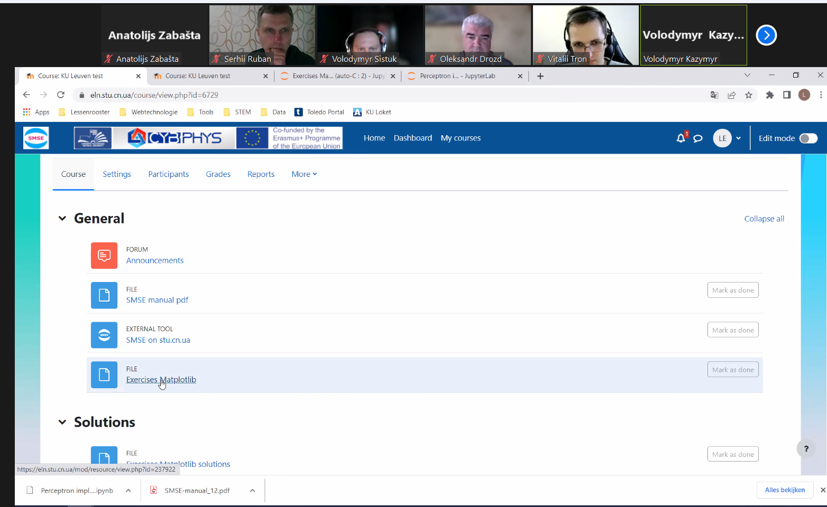

Slide 26
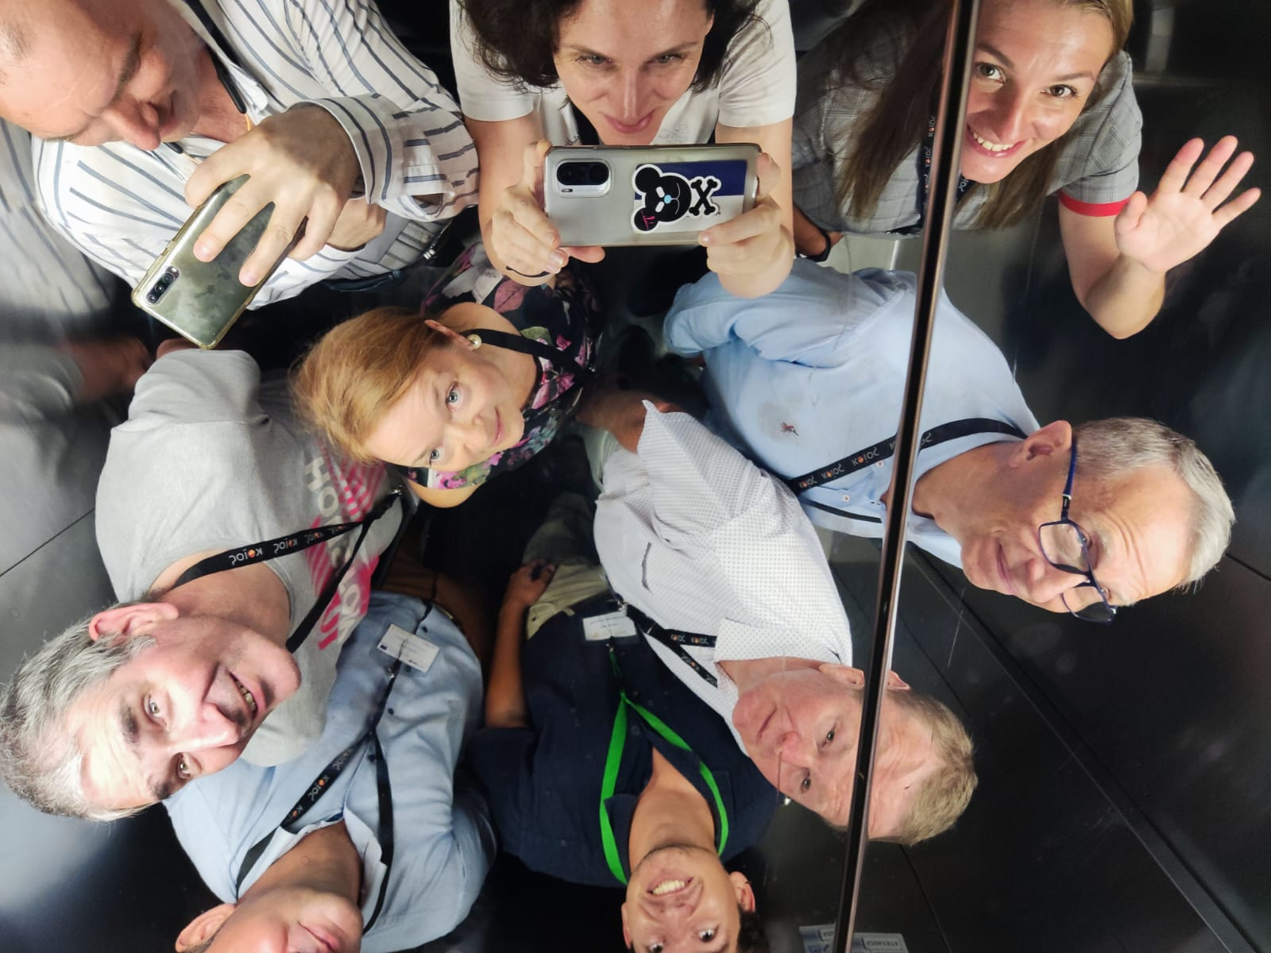
Thank you for the questions!

